Slide 1

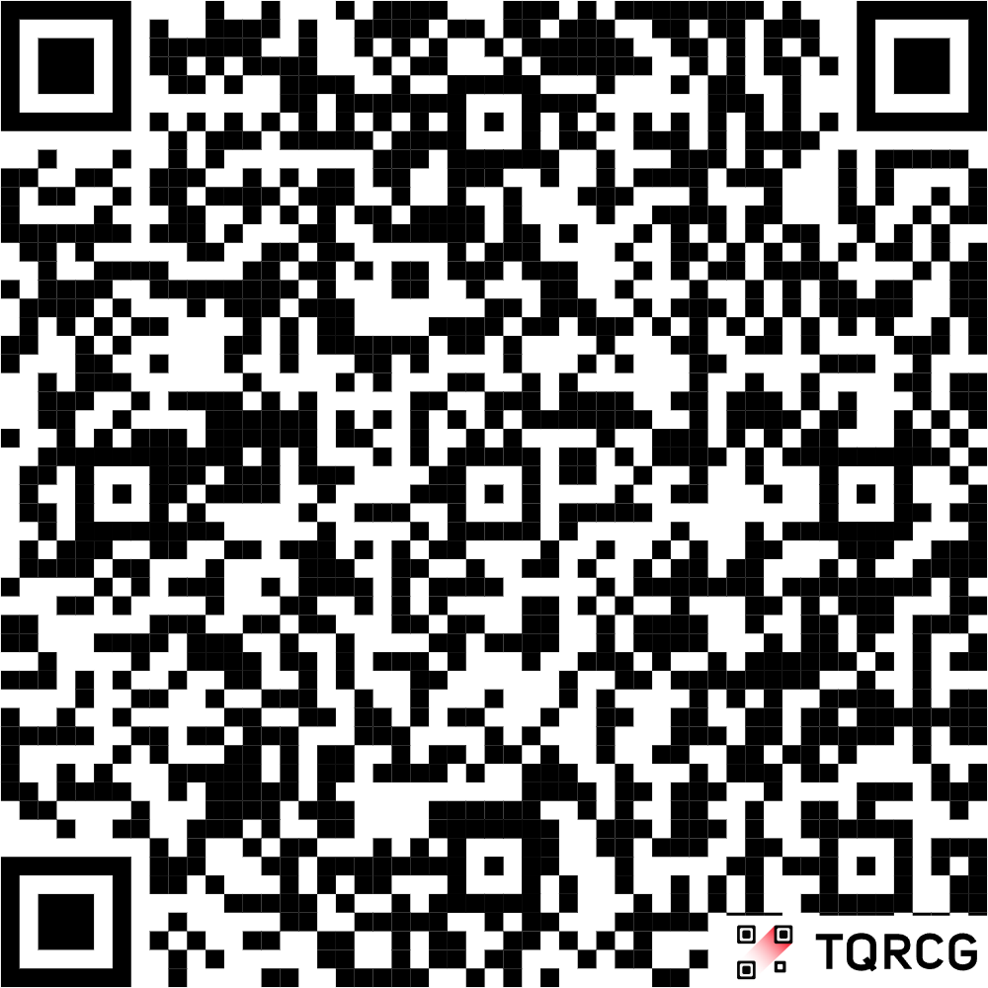

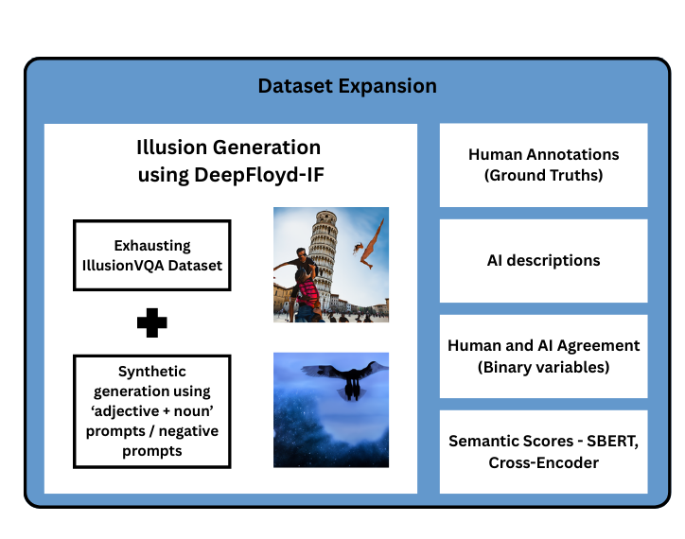
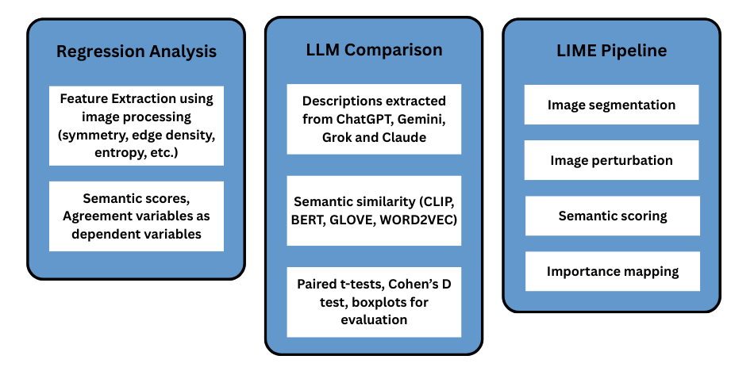
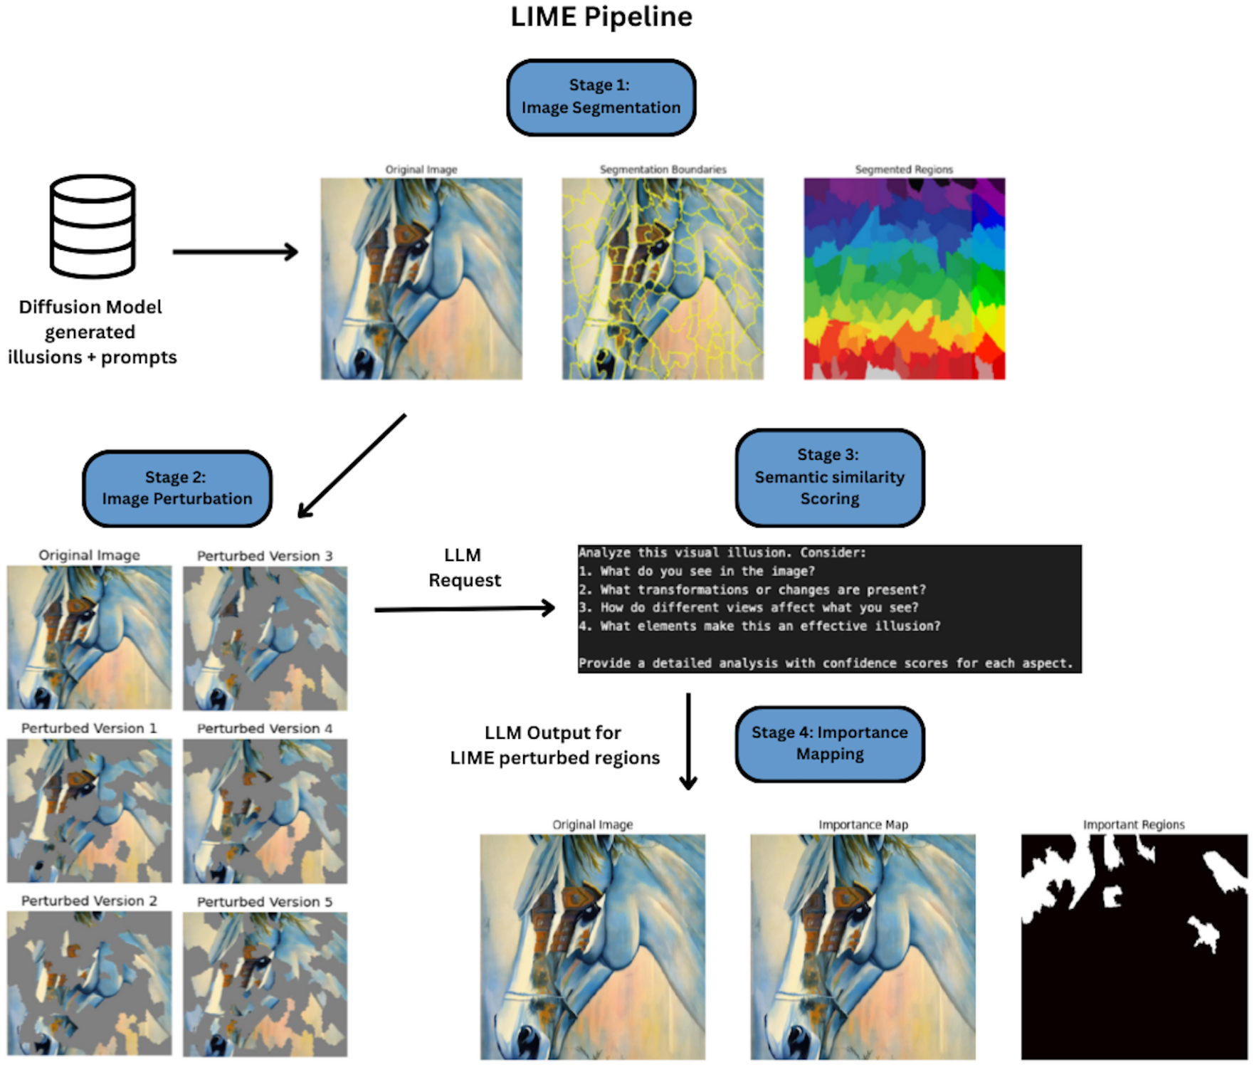
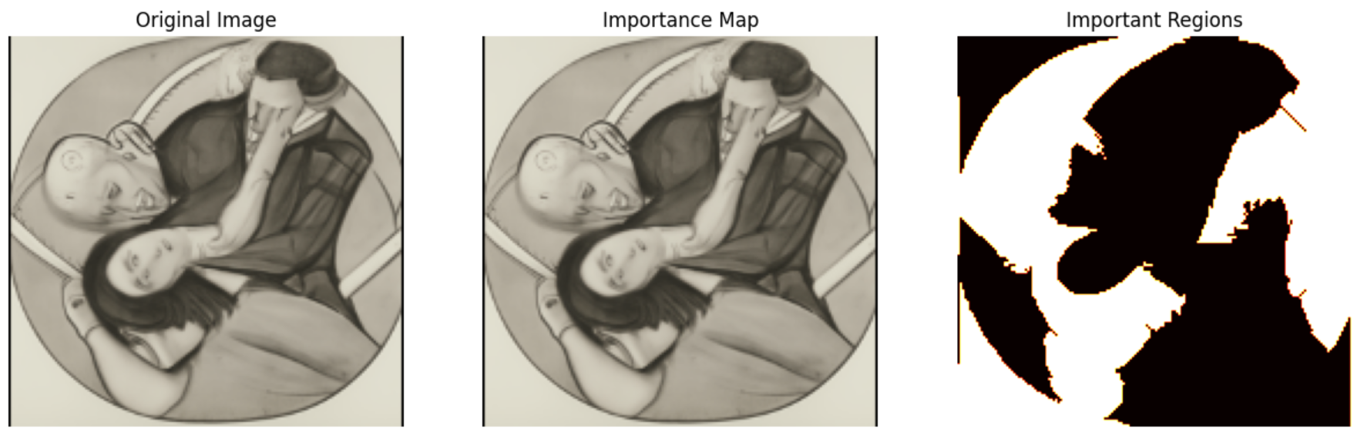
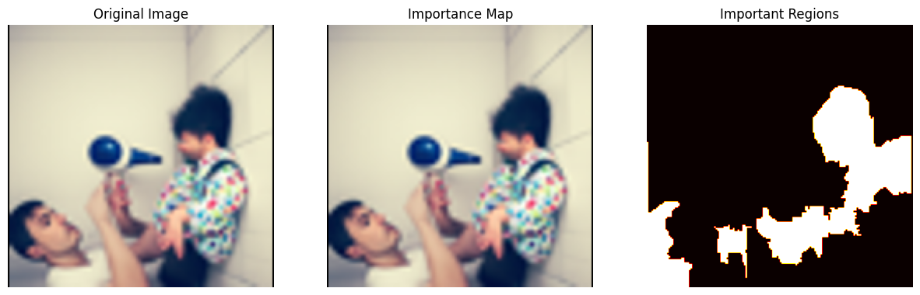
Failure Modes in Generative AI through Optical Illusion Interpretation
Laya Yashwant Rathod, Sandra Liz Sunny, Julio Garza Lopez, Nossaiba Kheiri
Supervised by: Dr. Ali Hirsa, Miao Wang and Gary Kazantsev (Bloomberg)
Report
Abstract
Optical illusions expose gaps between human perception and AI interpretation, making them powerful probes for semantic alignment. We studied how large language models (LLMs) interpret illusions, using similarity metrics, regression analysis, and explainability tools. Our findings reveal systematic failure modes that highlight fundamental blind spots in multimodal AI systems.
Methodology
Dataset Expansion: 130 → 806 illusions (IllusionVQA + diffusion-generated). Each paired with human and AI-written descriptions.
Cross-Model Validation: Evaluated ChatGPT, Claude, Gemini, Grok.
Similarity Metrics: CLIP, BERT, Word2Vec, GloVe.
Statistical Analysis: Paired t-tests, Levene’s tests, Cohen’s d.
Regression Analysis: Visual features (perspective, contrast, abstraction, motion, edge density, entropy, symmetry, color contrast, texture variance).
Explainability: LIME-based importance maps identified regions driving model interpretations.
Quantitative Interpretability Experiments
Challenges
Variability in diffusion-generated outputs.
Inherent ambiguity of illusions (multiple valid interpretations).
Manual annotation of 800+ images was time-intensive.
High computational demands of LIME prevented scaling to the full dataset.
Failed Interpretation
Successful Interpretation
Conclusion
Generative AI shows systematic interpretive blind spots. Failures stem from visual complexity, ambiguity, and bias, with no model consistently robust across metrics. Optical illusions thus serve as an effective testbed for revealing weaknesses in AI perception and interpretation.
Keywords: Generative AI, Semantic Similarity, Optical Illusions, LIME, ChatGPT, Diffusion Models

