Slide 1


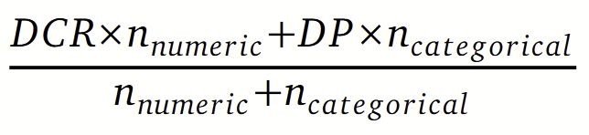
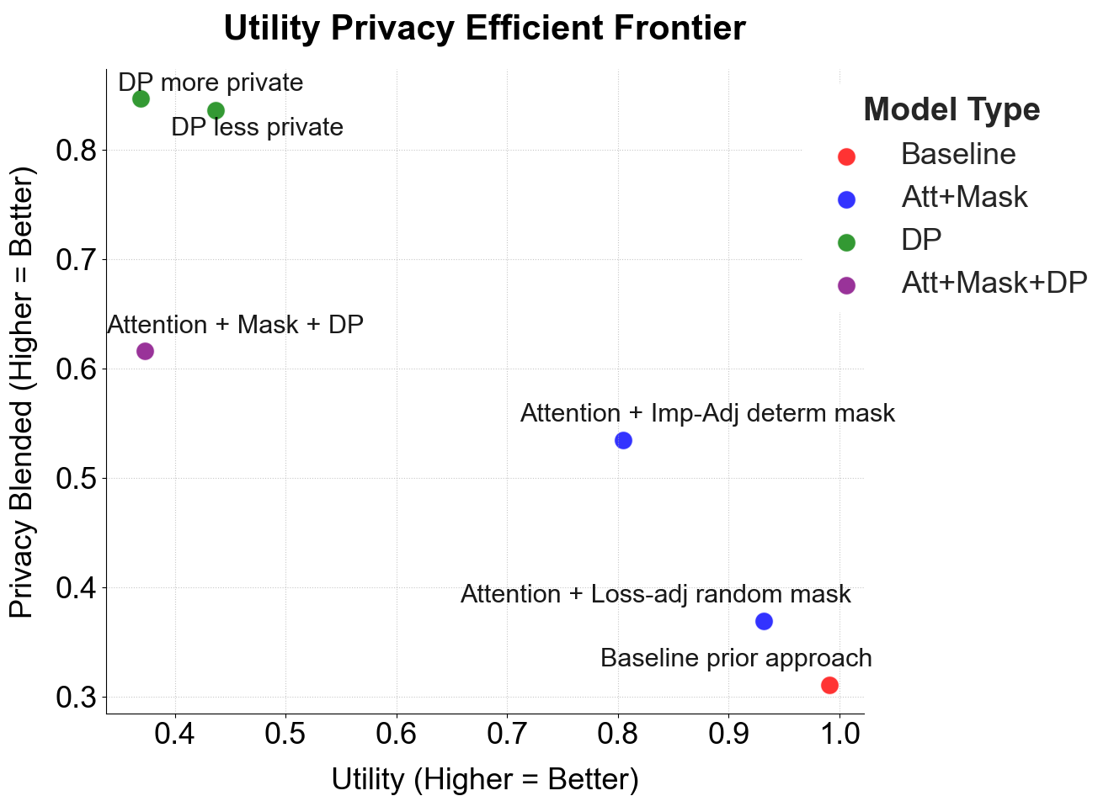
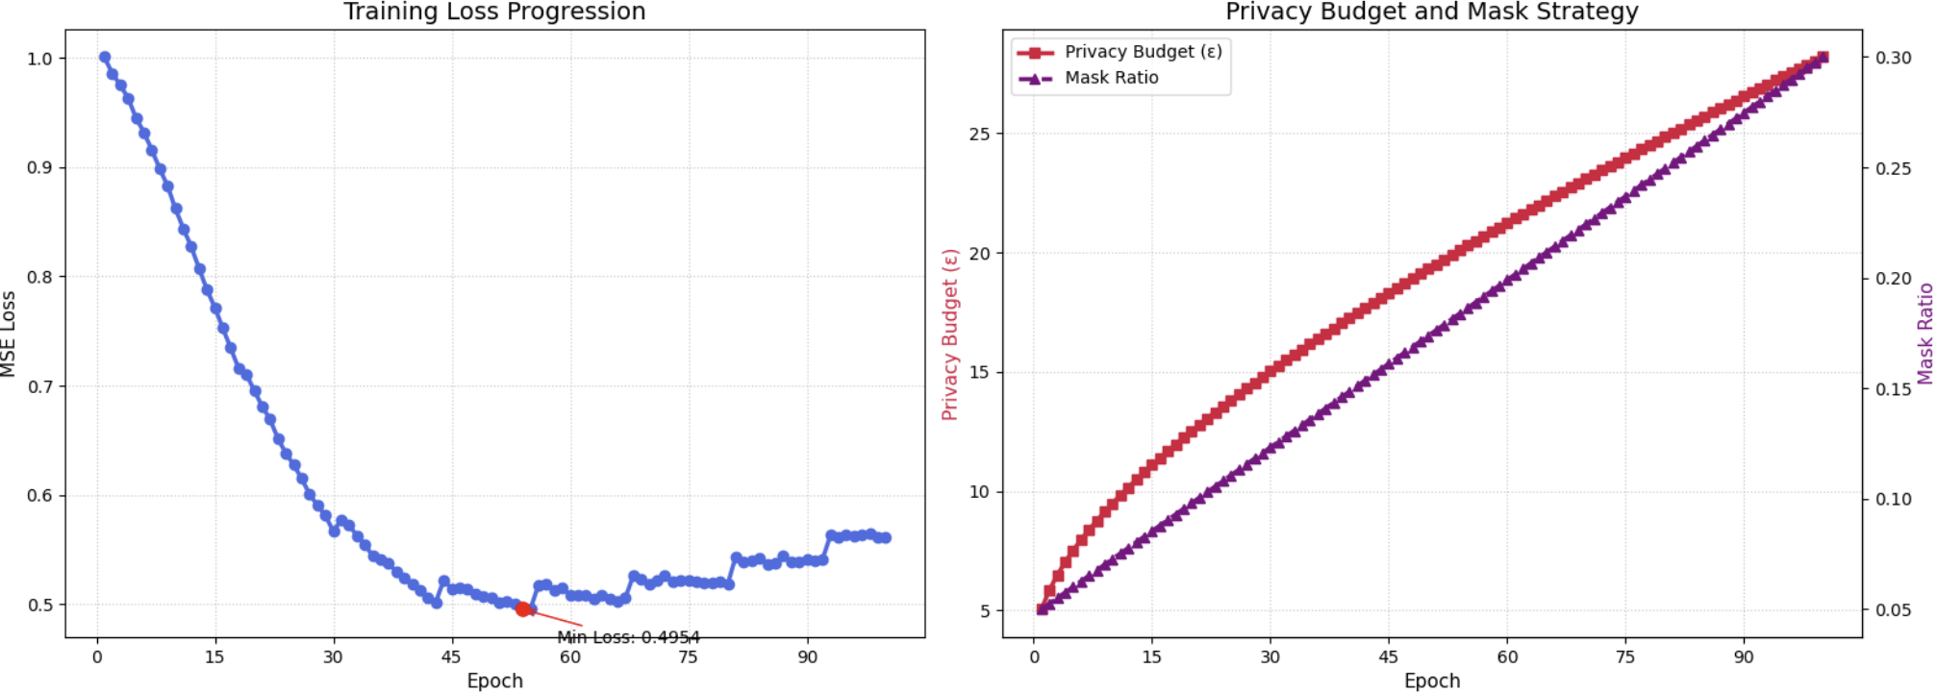
Enhancing Financial Diffusion of Tabular Data
Cristy Almeida, Sam Gilmer
Columbia University
ca3147@columbia.edu sg4406@columbia.edu
COLUMBIA UNIVERSITY
IN THE CITY OF NEW YORK
Introduction
Blended Privacy Metric
Privacy regulation compliant synthetic data generation is key to enabling research advancements and financial data-sharing. The FinDiff model [1] has demonstrated potential for addressing this need. FinDiff is a generative diffusion model which handles tabular data by embedding features, perturbing them with noise, and reconstructing them in a manner which preserves privacy and utility.
In this project, we focus on developing new enhancements in three areas to further boost the efficacy of FinDiff:
1. Training improvements such as the addition of an attention layer with masking, differential privacy, and a combination thereof, with the objective of achieving a more optimal balance of fidelity, utility, privacy and synthesis scores.
2. A new privacy metric that blends a Distance to Closest Record approach for numeric data with an approach that measures disclosure protection under a synthesized data breach for categorical data.
3. Pre-processing modifications to improve computational efficiency and learning of feature interactions.
Training Enhancements
Distance to Closest Record (DCR) privacy metrics are well-suited to numeric data, but translate poorly to categorical data. The traditional binary hamming distance used for categorical data implies linear ordinality and introduces sensitivity to cardinality. Disclosure Protection (DiscProt) metrics are strong for categorical data, but are sensitive to binning parameters for numerical data. We introduce a blended metric which performs well in mixed datasets by using a DiscProt metric for categorical and DCR for numeric data. The two metrics are then weighted according to:
We implement a number of improvements to the original FinDiff model in the interest of improving privacy and model performance.
1. Differential Privacy: Implementation of Differentially Private Stochastic Gradient Descent (DP-SGD) during training provides statistical guarantees of privacy in the face of data disclosure.
2. Cross-Attention Layer with Masking: Cross-attention layers and masking improve the model’s ability to learn complex interfeature relationships. We investigate two approaches, a loss-adjusted random mask and an importance-adjusted deterministic mask. On their own both approaches improve model performance at the cost of privacy, although the cost to privacy can be mitigated (e.g. with DP-SGD).
3. Regularization: DP-SGD and other design choices negatively impact model utility and the quality of generated data. Addition of a regularization term re-emphasizes data fidelity and utility within the loss metric. This proved promising but implementation alongside DP-SGD requires further investigation of gradient flow associated with categorical embeddings.
Table 1 illustrates the extent to which the privacy definition drives a different output, from using a statistical distance-based approach to the simulation of disclosure risk from synthetic data leaking patterns, and a blend thereof.
Dataset | Unique Values | DCR Privacy | Disclosure Protection | Blended Privacy
Credit Default | 133 | 0.043 | 0.762 | 0.342
City Payments (original) | 4323 | 0.437 | 0.990 | 0.597
City Payments (sectors) | 303 | 0.384 | 0.989 | 0.813
Table 1: Comparison of privacy metrics
Pre/post-processing Improvements
Datasets
Categorical Data Treatment: We evaluate a number of approaches for handling ordinal categorical data ( e.g. education, delayed payment), including no encoding (treating the columns as numeric); using a label encoder; encoding according to default rates; and encoding according to CVAE-learned weights. Table 2 presents the results, which confirm Sattarov’s approach (assigning indices via a label encoder).
We experiment on two publicly available financial datasets:
1. Default of Credit Card Clients, containing numerical and categorical features related to clients’ credit behavior.
2. Philadelphia City Payments, containing granular categorical data of government payment records.
Morph | Row Fidelity | Column Fidelity | Utility | DCR Privacy | Blended Privacy
Numeric (no encoding) | 0.947 | 0.898 | 0.991 | 0.117 | 0.311
Categorical (using label encoder) | 0.937 | 0.825 | 0.951 | 0.179 | 0.363
Linear default rates | 0.797 | 0.809 | 0.702 | 0.215 | 0.310
CVAE weights | 0.748 | 0.807 | 0.904 | 0.193 | 0.310
Metrics
·Column Fidelity: Measures how well each column in the synthetic data replicates the real distribution.
·Row Fidelity: Assesses similarity of feature relationships by comparing column pair correlations.
·Privacy Score: Evaluates privacy risk by comparing the measured Distance to the Closest Record (DCR) between synthetic and real data points with the DCR between random data and real data points
·Utility Score: Compares model performance trained on synthetic data versus real data using F1-score or R².
·Synthesis Score: Quantifies originality by checking for exact matches between synthetic and real rows.
Table 2: Processing morph results on Credit Default dataset
Similarity Search: The original FinDiff model makes use of torch.cdist() for similarity search. We confirm that implementation of Facebook AI Similarity Search (FAISS) does not affect the generated data while significantly improving computational and memory efficiency.
Morph - Credit Default Dataset | Row Fidelity | Column Fidelity | Utility | DCR Privacy | Blended Privacy
Baseline (prior approach) | 0.933 | 0.883 | 0.991 | 0.117 | 0.311
Differential Privacy (no masking) | 0.464 | 0.433 | 0.437 | 0.796 | 0.836
Cross-Attention Layer with Loss-Adjusted Mask | 0.929 | 0.894 | 0.932 | 0.162 | 0.369
Cross-Attention Layer with Importance-Adjusted Mask | 0.762 | 0.636 | 0.805 | 0.430 | 0.535
Cross-Attention Layer with Random Mask and DP-SGD | 0.540 | 0.488 | 0.373 | 0.583 | 0.616
Similarity Search Method | Row Fidelity | Column Fidelity | Utility | DCR Privacy | Blended Privacy
torch.cdist() | 0.872 | 0.713 | 0.151 | 0.443 | 0.759
faiss.IndexFlatL2() | 0.871 | 0.711 | 0.151 | 0.436 | 0.595
Table 3: Similarity search comparison on City Payments dataset
These training advances significantly enhance the FinDiff model's efficacy. The introduction of a masked attention layer elevates utility and fidelity, while differential privacy substantially strengthens privacy protection, as validated by both DCR and our novel blended metric. Together, these techniques provide a tunable balance, enabling users to more precisely target their desired position on the privacy-utility efficient frontier.
Future Direction
Future work streams could investigate improving computational efficiency, addressing class label imbalance, introducing attention layer conditioning based on unmasked features, adding an auxiliary loss term between reconstructed and original masked features, and custom DP implementation (combining multiple mechanisms such as gradient and output perturbation, dynamically adjusting noise levels).
References
[1] Timur Sattarov, Marco Schreyer, and Damian Borth. 2023. FinDiff: Diffusion Models for Financial Tabular Data Generation. Preprint, currently under review. ACM, NY, USA, 9 pages.
[2] LLM approach: Adwin R Lee, Rohit S Sadavarte, Zhijie Chen (Columbia University, 2024).

