Slide 1

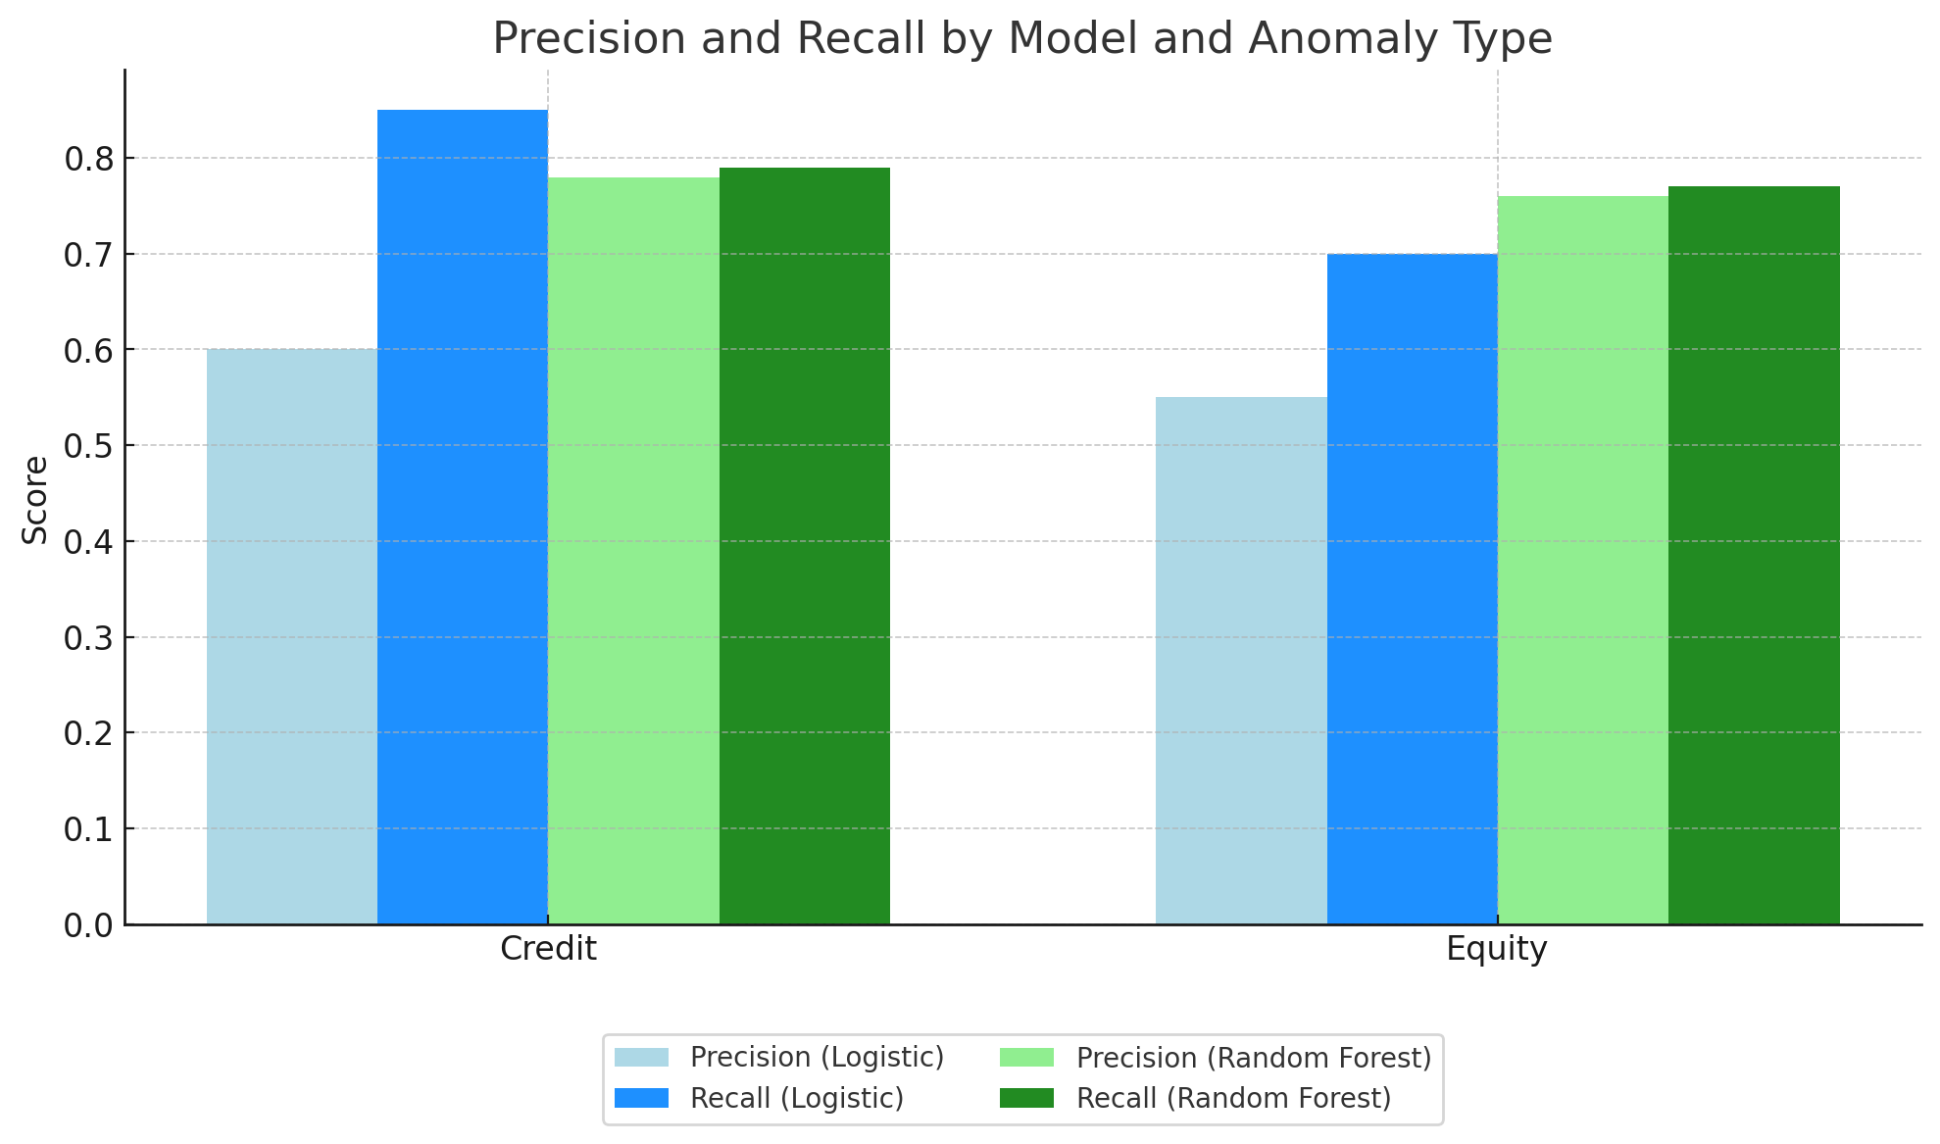
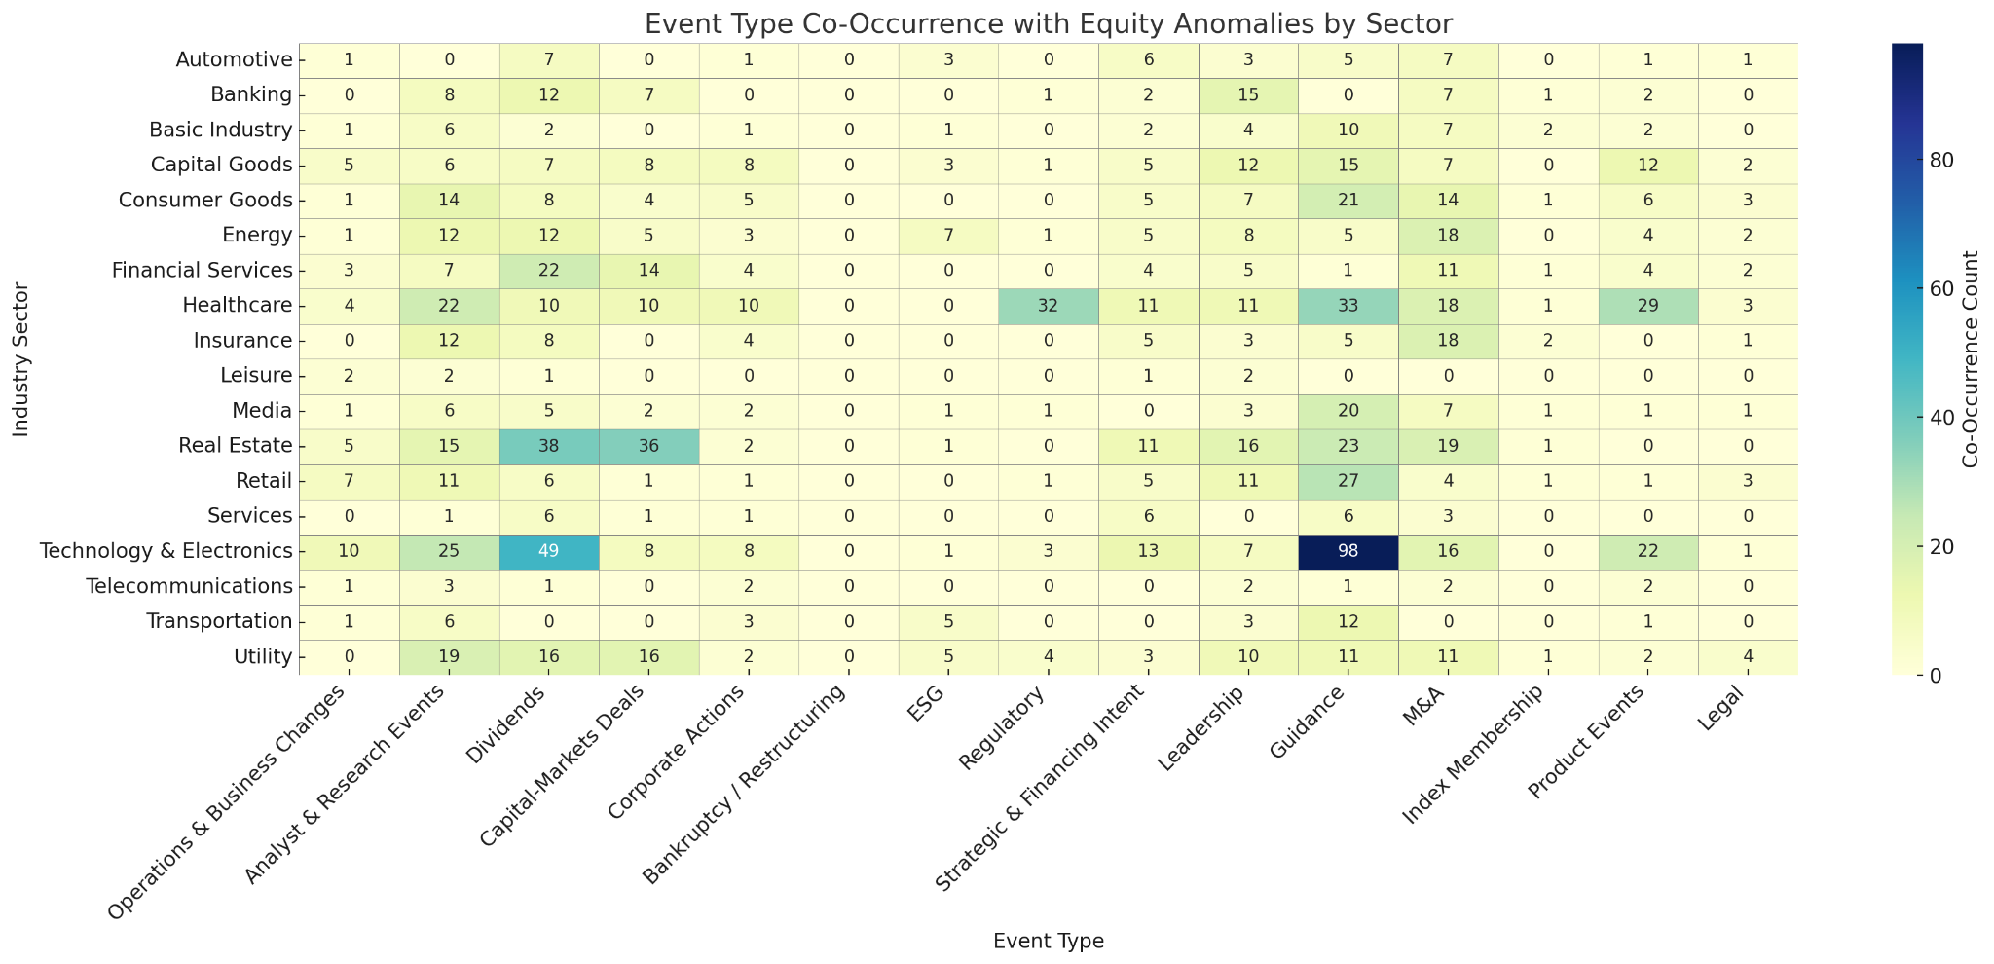
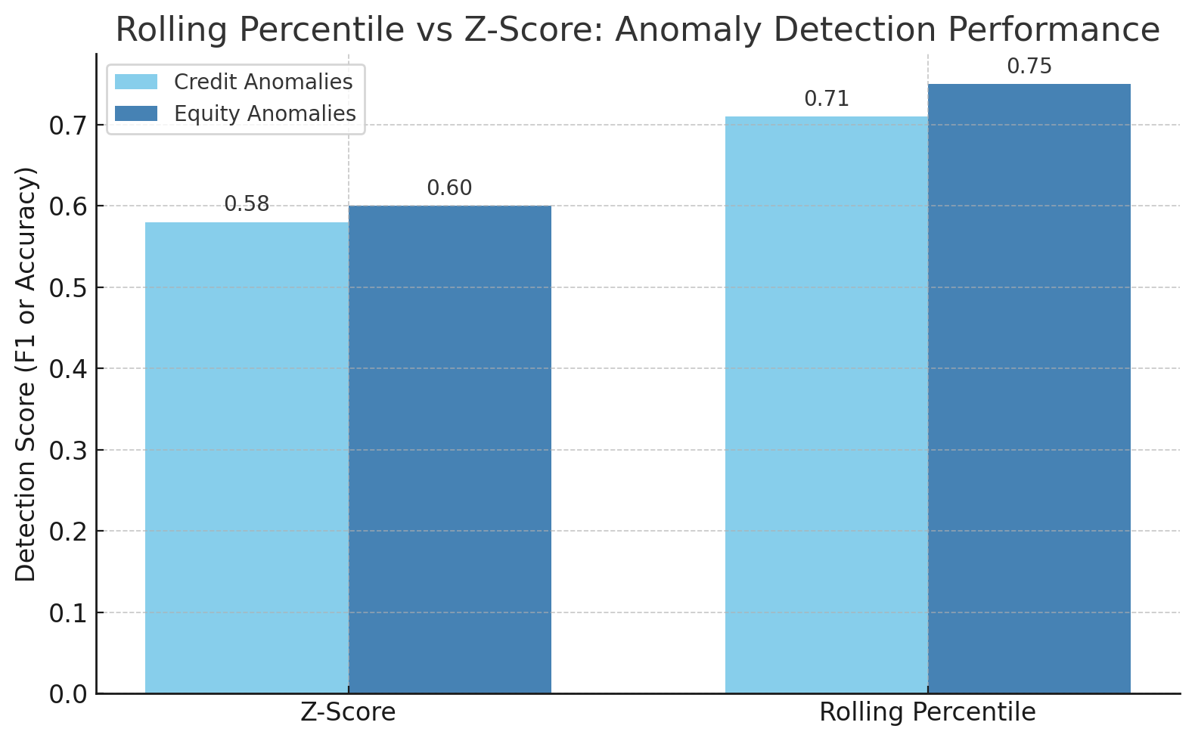
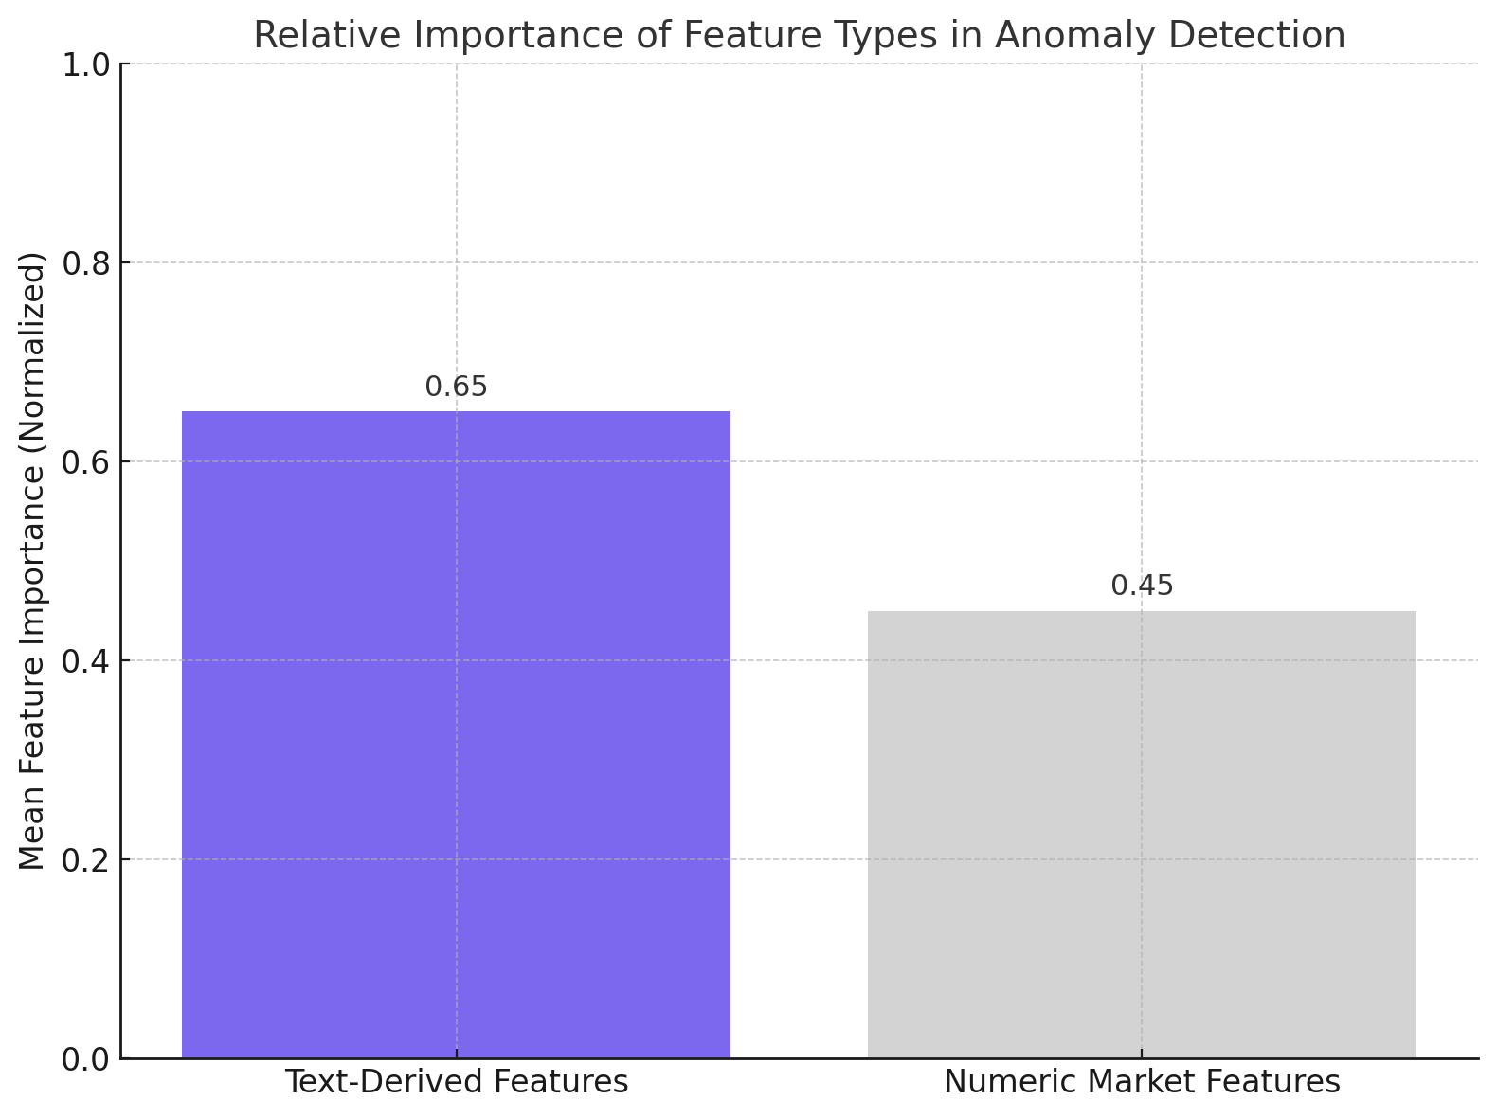
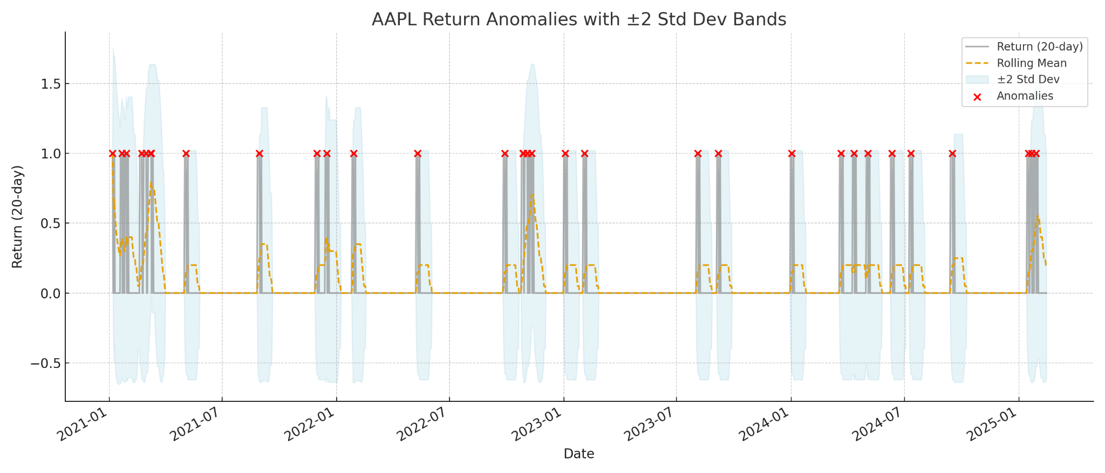
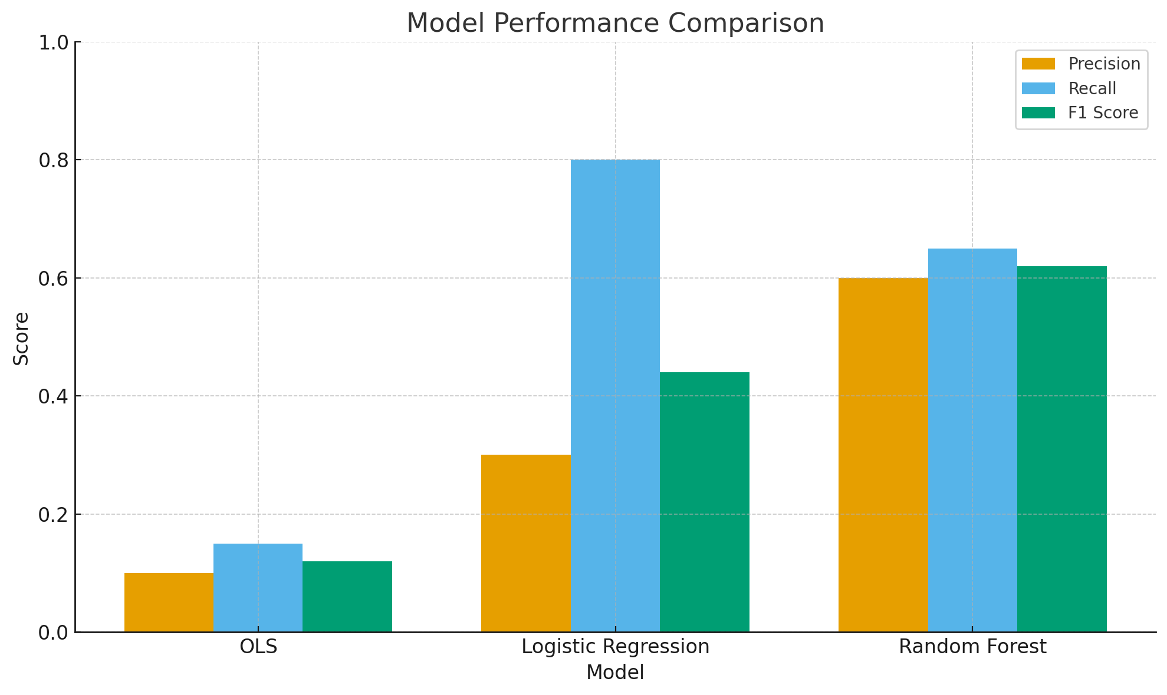
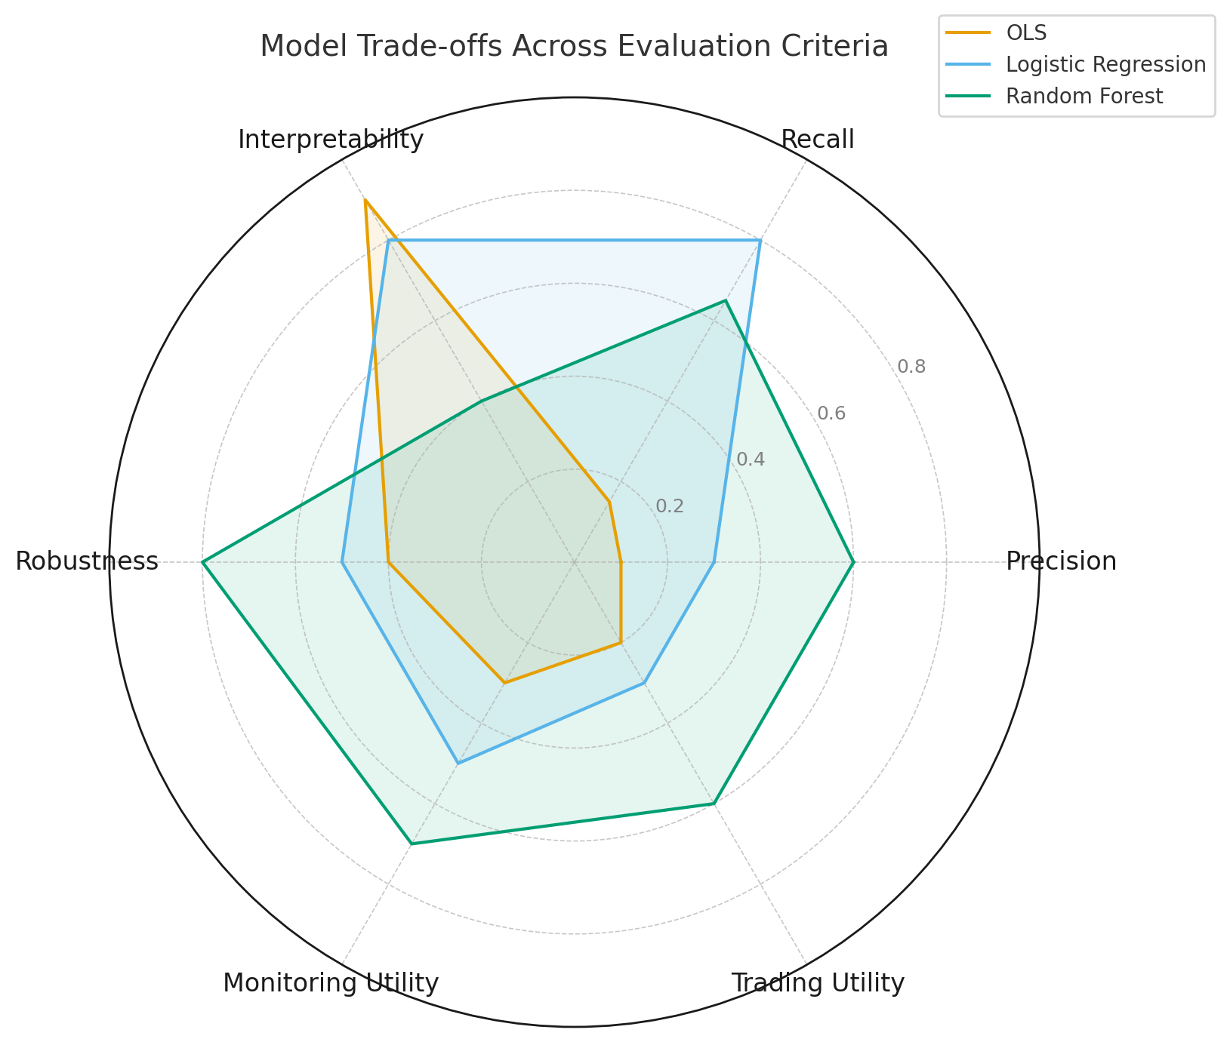
Explaining Anomalous Equity and Credit Market Movements via Textual Data
Research By: Zhaocheng Lyu, Pooja Satish, Jasur Abdurazzakov
Supervised By: Dr. Ali Hirsa, Miao Wang, Sponsored by Wellington Management Company
Abstract
We develop a robust framework for detecting and explaining anomalies in equity and credit markets by combining distribution-free statistical methods with structured textual data. Departing from fragile z-score baselines, we adopt rolling percentiles to capture extreme firm-specific movements. We then integrate LLM-extracted features from earnings calls, news, and corporate events to interpret anomalies. Random Forest and Logistic Regression models show that robust anomaly definitions, not model complexity, are the key to useful predictions. Sector-level insights reveal distinct drivers for equity (growth signals) and credit (risk factors), with implications for trading, risk monitoring, and regulation.
Textual Feature Engineering
We construct event-based predictors from firm-level textual data using the following approach:
Earnings Calls:
  Extract firm tone on EPS, EBITDA, Revenue, Debt
  Signals coded as +1 (positive), -1 (negative), 0 (neutral)
Structured Corporate Events:
  GPT-labeled into M&A, ESG, Dividends, Regulation, etc.
  Binary event dummies per firm-date
Financial News:
  Headlines rewritten and labeled via LLM
  Signals merged to issuer timeline with dummy encoding
Final dataset merges firm-level daily returns, anomaly flags, and all textual event indicators.
Results & Insights
Logistic Regression: Best recall on credit anomalies
Random Forest: Balanced precision and recall across both anomaly types
Rolling Percentile outperformed z-score in capturing meaningful shocks
Equity Anomalies: Driven by positive earnings signals and analyst tone
Credit Anomalies: Associated with ESG disclosures, regulatory tone, and risk sentiment
Datasets
We analyze over 400 U.S. corporate issuers using the following structured and unstructured datasets:
Equity Returns: Daily firm-level log returns adjusted for market movements
Credit Spreads: Daily 10-year issuer-level OAS changes, adjusted against benchmarks
Earnings Calls: Full-transcript text with GPT-extracted tone/signal for EPS, EBITDA, Revenue, and Debt
Corporate Events: Structured taxonomy of firm events (M&A, ESG, Governance, etc.)
News Data: Headlines curated and cleaned via LLMs, labeled by sentiment and event type
Anomaly Detection
We define anomalies as outliers in firm-specific return and spread data, and test multiple methodologies:
Z-Score (baseline): Flags if return or spread exceeds ±3 standard deviations (sensitive to volatility)
Isolation Forest: Non-parametric multivariate detection (low performance in univariate setting)
Final Method - Rolling Percentiles:
  20-day backward-looking window
  Flags top 1% (positive) or bottom 1% (negative) movement days
  Sector-adjusted to isolate idiosyncratic shocks
Anomaly Event Window: [-3, +2]
Labeling: Signed (±1) and Unsigned (0/1)
Conclusion
Modeling Approach
Our study demonstrates that careful anomaly definition is central to identifying meaningful firm-specific shocks. While logistic regression offers interpretability and strong recall in credit, random forest provides balanced performance across domains. The integration of LLM-derived text features unlocks interpretability, revealing different anomaly drivers across sectors. This framework opens doors for real-time monitoring and deeper insights in asset management.
We evaluate three modeling strategies for anomaly prediction:
OLS Regression: Poor fit for binary outcome; low explanatory power
Logistic Regression: High recall, especially for credit anomaly prediction
Random Forest: Best precision-recall balance and most stable feature importances
Finding: Model performance depends more on how anomalies are defined than on model complexity.
Limitations & Future Work
Limitations:
Our framework has a few limitations. The binary nature of anomaly labels may oversimplify the spectrum of market reactions. GPT-based classification of event types can introduce occasional noise or mislabeling. Additionally, macroeconomic context such as inflation surprises or policy shifts was not explicitly modeled.
Future Work:
Use continuous/multi-class anomaly scores
Add macroeconomic data (rates, VIX, CPI)
Evaluate economic value via trading simulations
Explore multivariate anomaly detection (autoencoders, isolation forests)
Columbia Engineering
Summer 2025

