Slide 1
Privacy Amplification by Structured Subsampling for Deep Differentially Private Time Series Forecasting
Jan Schuchardt¹†, Mina Dalirrooyfard²,
Jed Guzelkabaagac¹,
Anderson Schneider²,
Yuriy Nevmyvaka²,
Stephan Gunnemann¹
1 Technical University of Munich & Munich Data Science Institute
2 Machine Learning Research, Morgan Stanley
† Work done during an internship at Morgan Stanley
The opinions expressed are those of the authors. They do not purport to reflect the opinions or views of Morgan Stanley.

Slide 2

Overview
Differential privacy background
Why standard tools do not apply to sequences/time-series modeling
New bounds for sequences
Numerical exercises/experiments

Slide 3
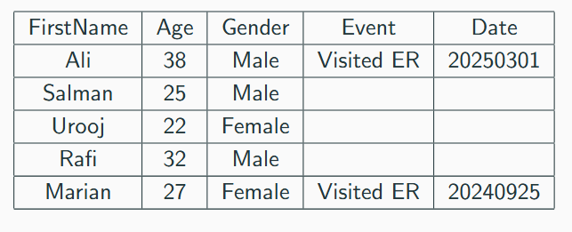
Why anonymization Fails
We have sensitive data
Naive approach: replace sensitive data with some ID or masking

Slide 4
Why anonymization Fails
Example taken from The Ethical Algorithm book
Netflix Competition 2006 $1 million prize
Dataset consisting of 100 million movie ratings. “Anonymized” numeric user ID, but with dates
Researchers could identify 99% of users who rated 6 or more movies by cross-referencing with IMDB, where people posted reviews publicly with their real names

Slide 5
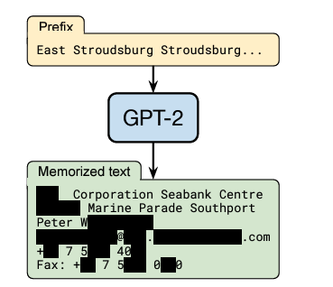
Why anonymization Fails
The cross-refence “database” can be an LLM…
[Extracting Training Data from Large Language Models, 2021]

Slide 6
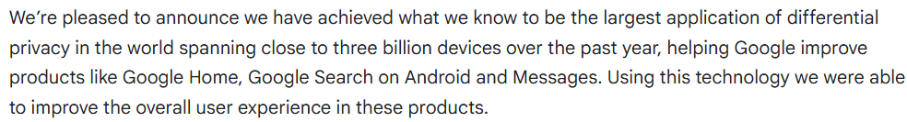
Differential Privacy
US Census since 2020
Apple and Google
  Private data on devices are used to train models, publish statistics, etc.
  IOS 10 and later include DP
[developers.googleblog.com/en/sharing-our-latest-differential-privacy-milestones-and-advancements/]

Slide 7
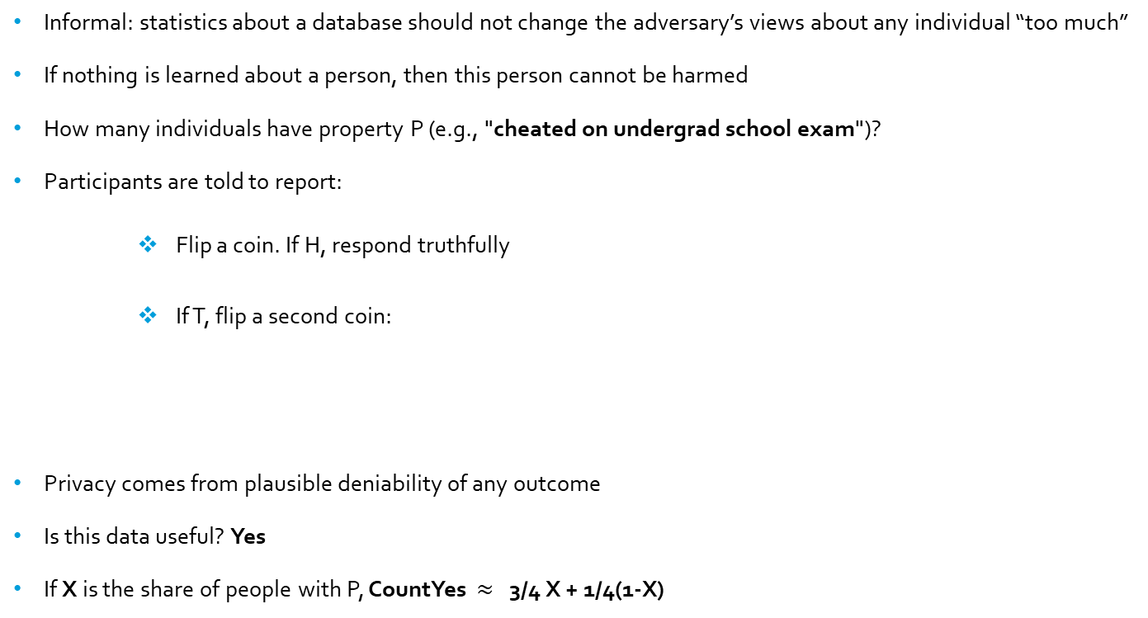
Differential Privacy Early Example: Randomized Response
Informal: statistics about a database should not change the adversary’s views about any individual “too much”
If nothing is learned about a person, then this person cannot be harmed
How many individuals have property P (e.g., "cheated on undergrad school exam")?
Participants are told to report:
        Flip a coin. If H, respond truthfully
        If T, flip a second coin:
Privacy comes from plausible deniability of any outcome
Is this data useful? Yes
If X is the share of people with P, CountYes $≈$ 3/4 X + 1/4(1-X)
"yes" if H
“no" if T

Slide 8
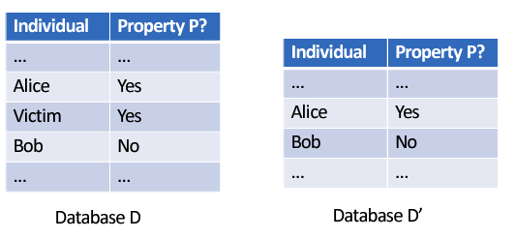
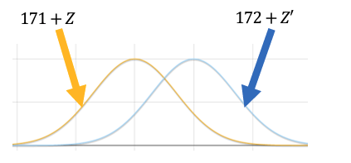
Differential Privacy
How many individuals in the database D have property P?
Neighboring dataset D’
Answering the query privately?
Outputs from D and D' should be similar
A solution: add noise to the answer

Slide 9
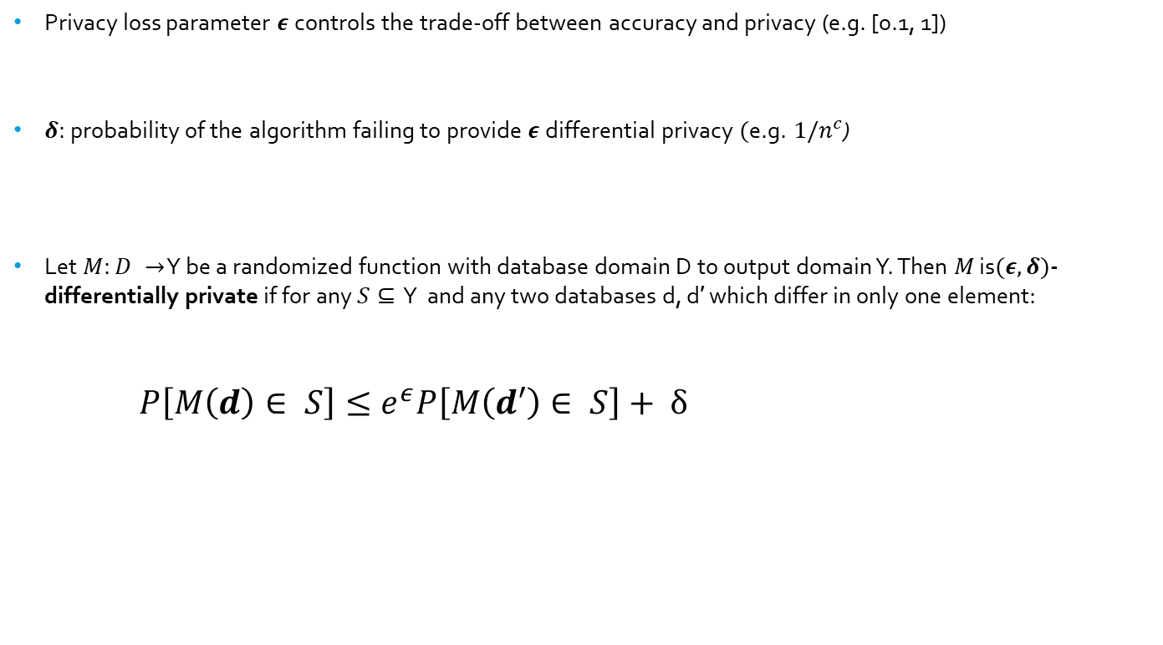
Differential Privacy Definition
Privacy loss parameter $ε$controls the trade-off between accuracy and privacy (e.g. [0.1, 1])
$δ:$probability of the algorithm failing to provide $ε$differential privacy $(\text{e}\text{.}\text{g}\text{.} 1/n^{c}$)
Let $M:D →$ Y be a randomized function with database domain D to output domain Y. Then $M$ is$(ε,δ)$- differentially private if for any $S⊆$ Y and any two databases d, d′ which differ in only one element:
  $P\left[M\left(d\right)∈ S\right]≤e^{ε}P\left[M\left(d′\right)∈ S\right]+ δ$
“Can’t tell if Mary’s data was ever used”

Slide 10
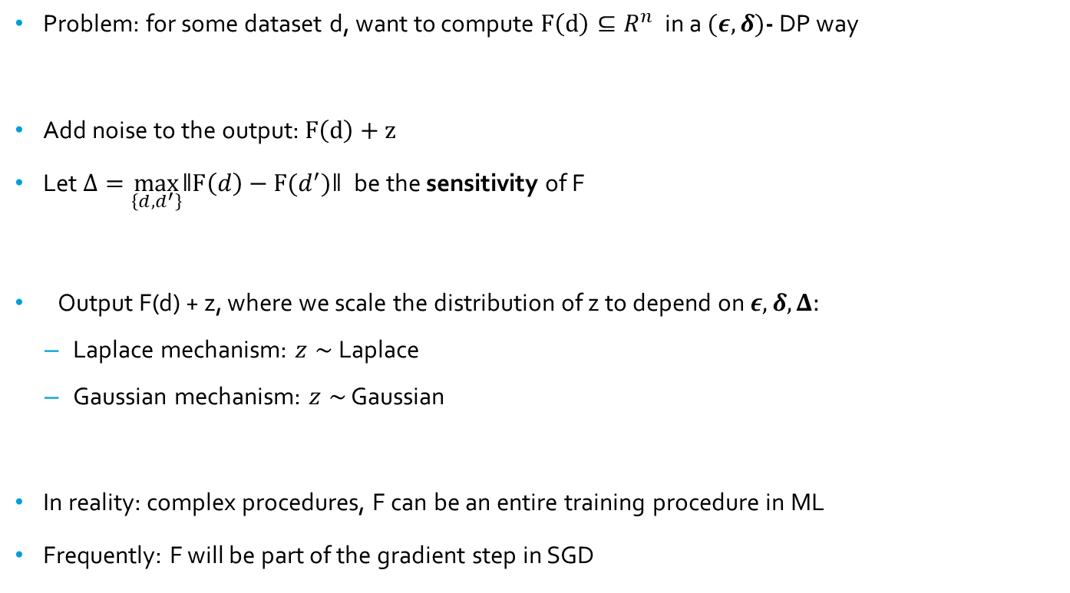
Differential Privacy: Basic Techniques
Problem: for some dataset d, want to compute $F\left(d\right)⊆R^{n}$ in a $(ε,δ)$- DP way
Add noise to the output: $F\left(d\right)+z$
Let $Δ=\max_{\left\{d,d^{′}\right\}}ǁF\left(d\right)−F(d^{′})ǁ$be the sensitivity of F
Output F(d) + z, where we scale the distribution of z to depend on $ε,δ,Δ:$
  Laplace mechanism: $z∼$ Laplace
  Gaussian mechanism: $z∼$ Gaussian
In reality: complex procedures, F can be an entire training procedure in ML
Frequently: F will be part of the gradient step in SGD

Slide 11

Differential Privacy: Basic Techniques
$(ε,δ)$- DP $: P\left[M\left(d\right)∈ S\right]≤e^{ε}P\left[M\left(d′\right)∈ S\right]+ δ$
Laplace mechanism with scale $\frac{Δ}{ε}$ is $(ε,0)$- DP
  $$\frac{f_{x^{′}}(y)}{f_{x}(y)}=e^{\frac{ε(ǁy−μ^{′}ǁ−ǁy−μǁ)}{Δ}}≤e^{\frac{εΔ}{Δ}}=e^{ε}$$
  Gaussian mechanism with scale $σ^{2}= \frac{2Δ_{2}^{2}log⁡(2/δ)}{ε^{2}}$ is $(ϵ,δ)$- DP
    If $P\left( \frac{P\left(M\left(x\right)=y\right)}{P(M\left(x^{′}\right)=y)}≥e^{ε}\right)≤δ$ then M is $(ϵ,δ)$- DP
    Work on ratio of densities and use concentration inequality applied to Gaussian
  A truncated Laplace mechanism is (ϵ, $δ$)-DP, where the truncation point is a function of $δ$

Slide 12
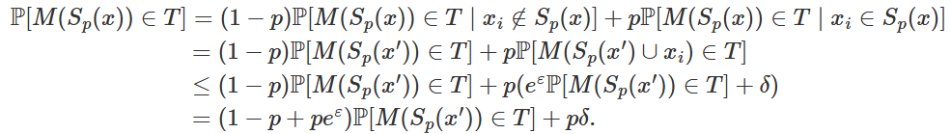

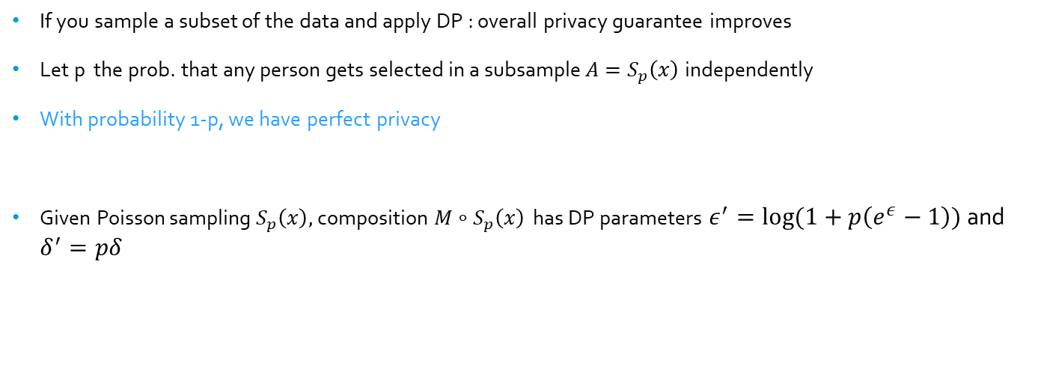
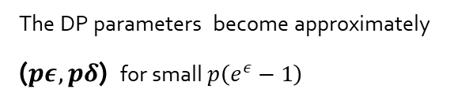
What is Privacy Amplification by Subsampling?
If you sample a subset of the data and apply DP : overall privacy guarantee improves
Let p the prob. that any person gets selected in a subsample $A=S_{p}\left(x\right)$independently
With probability 1-p, we have perfect privacy
Given Poisson sampling $S_{p}\left(x\right),$ composition $M∘S_{p}\left(x\right)$ has DP parameters $ε^{′}=log⁡(1+p\left(e^{ε}−1\right))$ and $δ^{′}=pδ$
[From: Thomas Steinke's notes differentialprivacy.org/subsampling]
The DP parameters become approximately ($pε, pδ$) for small $p\left(e^{ε}−1\right)$

Slide 13
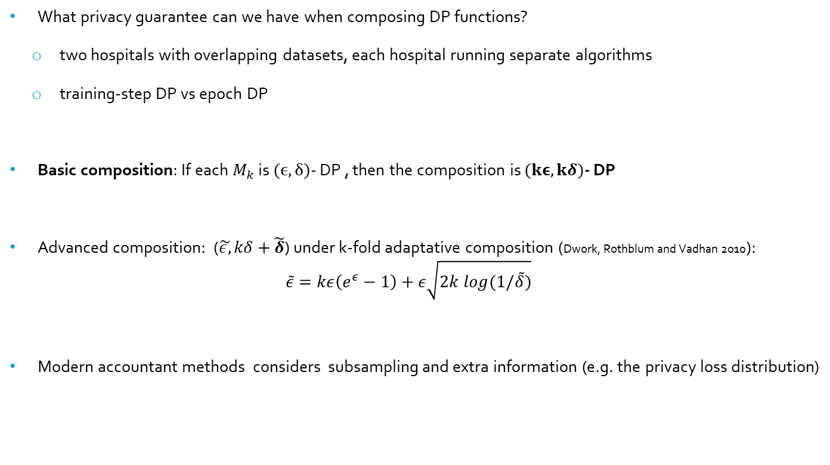
Differential Privacy: Composition
  What privacy guarantee can we have when composing DP functions?
    two hospitals with overlapping datasets, each hospital running separate algorithms
    training-step DP vs epoch DP
  Basic composition: If each $M_{k}$ is $(ϵ,δ)$- DP , then the composition is $(kε,kδ)$- DP
  Advanced composition: ($\tilde{ε,}kδ+\tilde{δ}$) under k-fold adaptative composition (Dwork, Rothblum and Vadhan 2010):
    $$\tilde{ε}=kε\left(e^{ε}−1\right)+ε\sqrt{2k log(1/\tilde{δ})}$$
  Modern accountant methods considers subsampling and extra information (e.g. the privacy loss distribution)

Slide 14

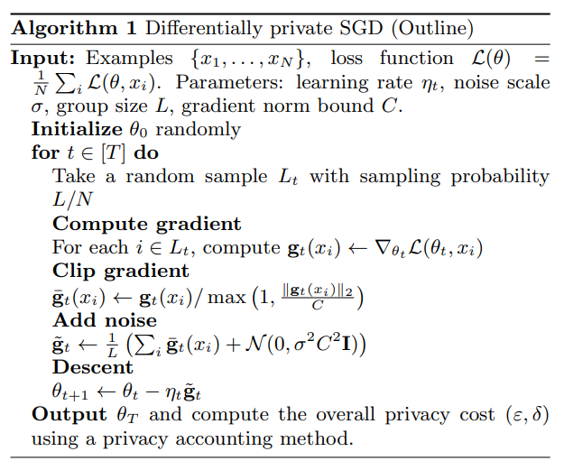
DP SGD
Whole training procedure will have DP parameters upper bound:
Combining subsampling amplification plus advanced composition (K=T training steps)
Clip per-example gradient
Add noise
[Deep Learning with Differential Privacy, 2021]

Slide 15
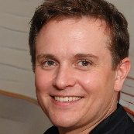
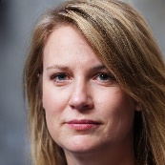
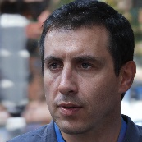
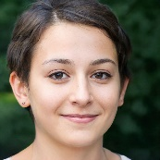







Putting all together so far...
Random
Training
DP
$$D$$
$$m_{D}\left(θ\right)$$
$$θ$$
$$≈$$
$$D′$$
Random
Training
DP
$$m_{D^{′}}\left(θ\right)$$
$$θ$$
Can we just apply existing tools/proofs to sequences? Clearly not ... they assume unstructured samples from an unstructured dataset
For unstructured datasets, usually “1 unit of PI = 1 row”
Sequences are structured: "neighboring relation in time", and private information is a subsequence of a sequence
Sampling for sequence modelling are also structured (next slide)
How private is DP-SGD when adapted to sequences, especially time-series forecasting?

Slide 16
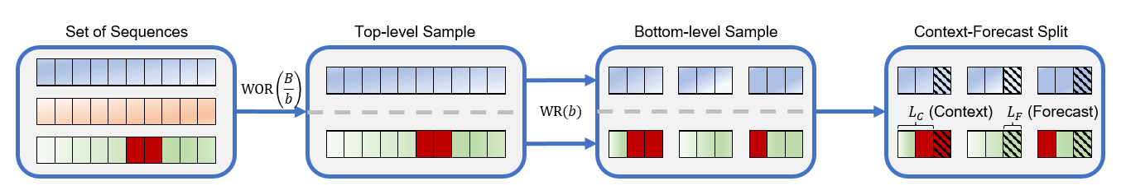
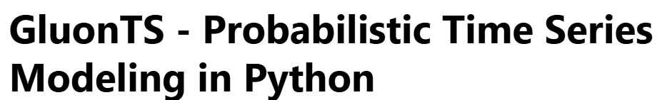

Structured Samples from a Structure Dataset
Toy-example of a common batch approach for time-series
  Top-level: select a batch of 2 individuals (time-series)
  Bottom-level: 3 contiguous subsequences sampled per sequence
  Context-forecast split on the 6 final sequences
Private information may contribute to a batch multiple times as context and/or ground-truth

Slide 17
Privacy Amplification: Main Contributions
Analysis of the non-trivial way in which components of the batching interact to amplify privacy of training steps:
    Derive event/user-level guarantees for bottom-level sampling of subsequences
    Analyze how the strength of these guarantees can be amplified by top-level sampling
Show how data augmentation can exploit the context–forecast split to further amplify privacy

Slide 18
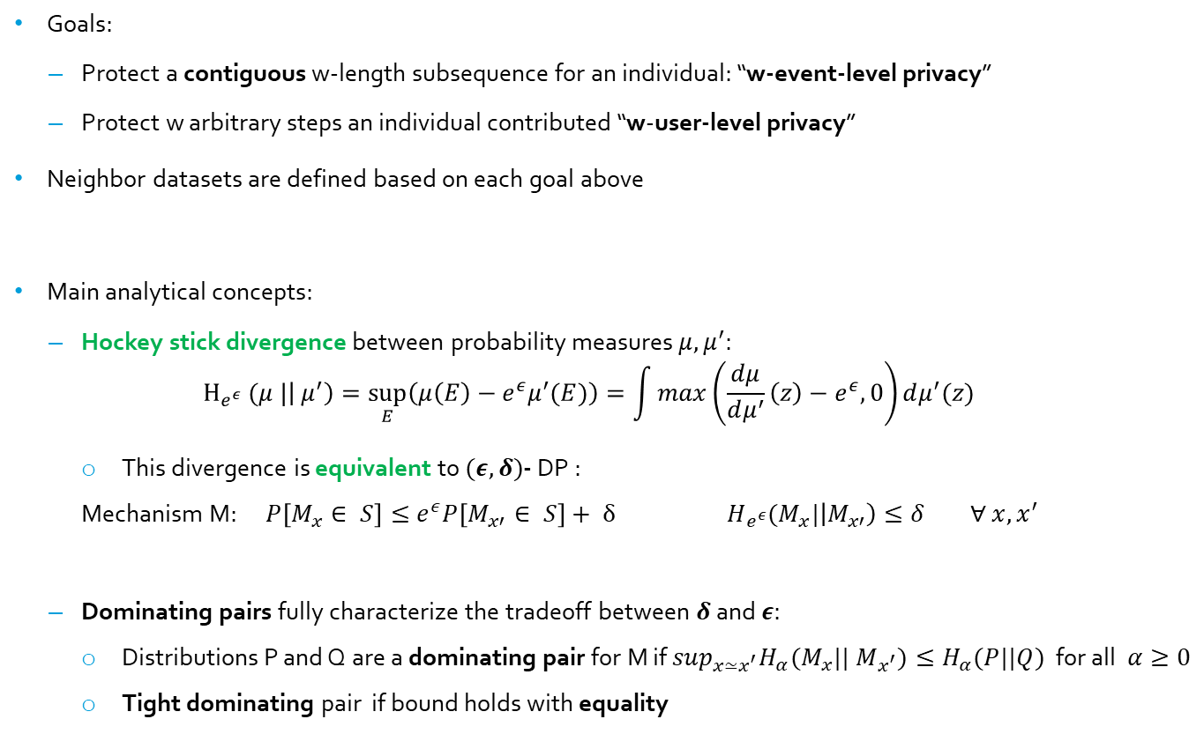
Differential Privacy for Time Series Forecasting
Goals:
  Protect a contiguous w-length subsequence for an individual: “w-event-level privacy”
  Protect w arbitrary steps an individual contributed “w-user-level privacy”
Neighbor datasets are defined based on each goal above
Main analytical concepts:
  Hockey stick divergence between probability measures $μ, μ^{′}:$
  $$H_{e^{ε}} (μ |\left|{ μ}^{′}\right)=\sup_{E}\left(μ\left(E\right)−e^{ε}μ^{′}(E)\right)=\int{max\left(\frac{dμ}{dμ^{′}}\left(z\right)−e^{ε}, 0\right)dμ^{′}(z)}$$
    This divergence is equivalent to $(ε,δ)$- DP :
    Mechanism M: $P\left[M_{x}∈ S\right]≤e^{ε}P\left[M_{x′}∈ S\right]+ δ$ $H_{e^{ε}}(M_{x}|\left|M_{x′}\right)≤δ$ $∀ x,x^{′}$
  Dominating pairs fully characterize the tradeoff between$δ$ and $ε:$
    Distributions P and Q are a dominating pair for M if $\sup_{x≃x^{′}}H_{α}(M_{x}|{| M}_{x^{′}})≤H_{α}(P||Q)$ for all $α≥0$
    Tight dominating pair if bound holds with equality
It’s a f-divergence, max is convex

Slide 19
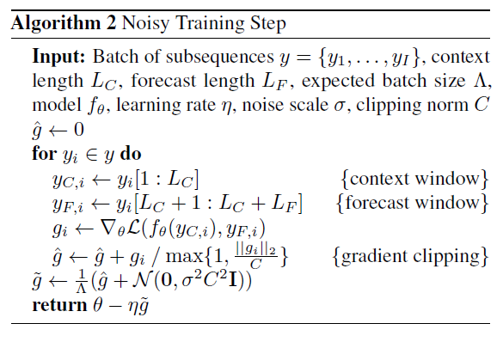
DP-SGD for Time Series Forecasting
DP-SGD training step for a given batch

Slide 20
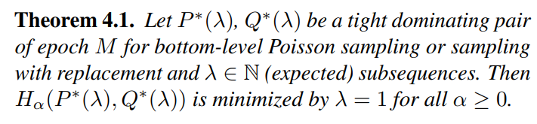

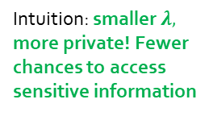

Amplification of Bottom-Level Subsampling: Effect of $λ$
$\text{Example}\text{:}λ$=3
Consider top level sampling deterministic
Bottom-level samples $λ$ subsequences per sequence selected by top level ($λ$=3 in example above)
Given a batch size:
  small $λ$: output has few subsequences from many original sequences
  Large $λ$: output has many subsequences from few original sequences
Paper shows this intuition is correct:
Intuition: smaller $λ,$ more private! Fewer chances to access sensitive information

Slide 21
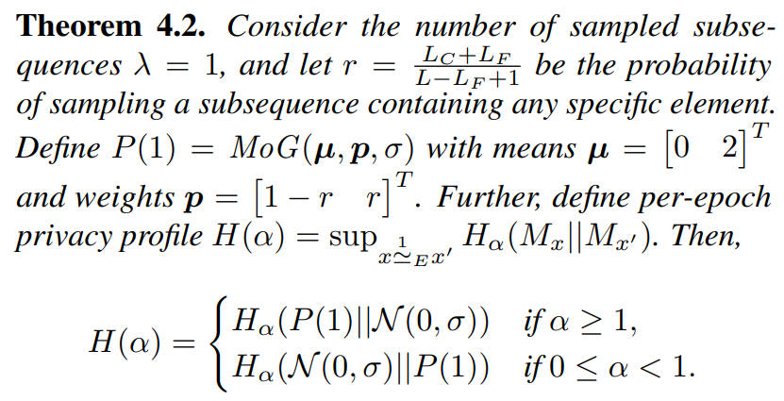
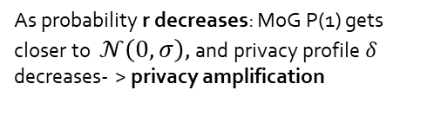

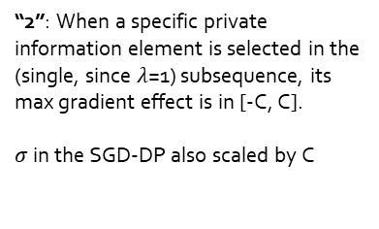
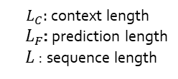
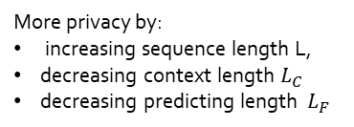
Amplification of Bottom-Level: Tight bounds when $λ$=1
When $λ$=1 we have smallest privacy leakage per epoch
${ L}_{C}:$context length
${ L}_{F}$: prediction length
$L$: sequence length
“2”: When a specific private information element is selected in the (single, since $λ$=1) subsequence, its max gradient effect is in [-C, C].
$σ$ in the SGD-DP also scaled by C
Mixture of Gaussians
As probability r decreases: MoG P(1) gets closer to $\text{𝒩}\left(0, σ\right)$, and privacy profile $δ$ decreases- > privacy amplification
More privacy by:
increasing sequence length L,
decreasing context length $L_{C}$
decreasing predicting length ${ L}_{F}$

Slide 22
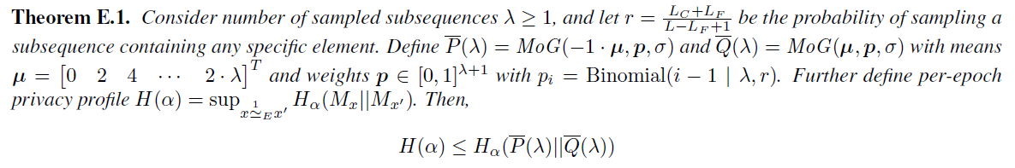

Amplification of Bottom-Level: $λ$ > 1
$\text{Example}\text{:}λ$=3
When $λ$>1, characterization in terms of all possible (events) number of subsequences with information for a given individual in a batch. We prove an upper bound:

Slide 23
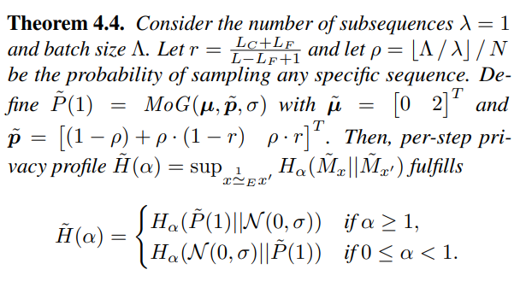

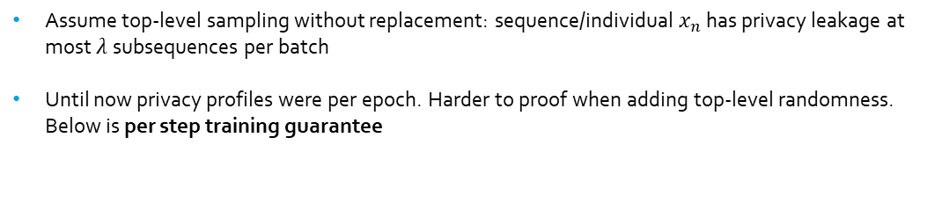
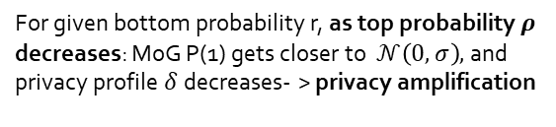
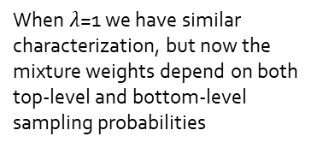
Amplification of Top-Level Subsampling
Assume top-level sampling without replacement: sequence/individual $x_{n}$ has privacy leakage at most $λ$subsequences per batch
Until now privacy profiles were per epoch. Harder to proof when adding top-level randomness. Below is per step training guarantee
Numerically we show later that per-epoch guarantees are better than per-epoch with deterministic top-level
Is optimal $λ$=1? Yes, we show numerically later
When $λ$=1 we have similar characterization, but now the mixture weights depend on both top-level and bottom-level sampling probabilities
For given bottom probability r, as top probability $ρ$ decreases: MoG P(1) gets closer to $\text{𝒩}\left(0, σ\right)$, and privacy profile $δ$ decreases- > privacy amplification

Slide 24


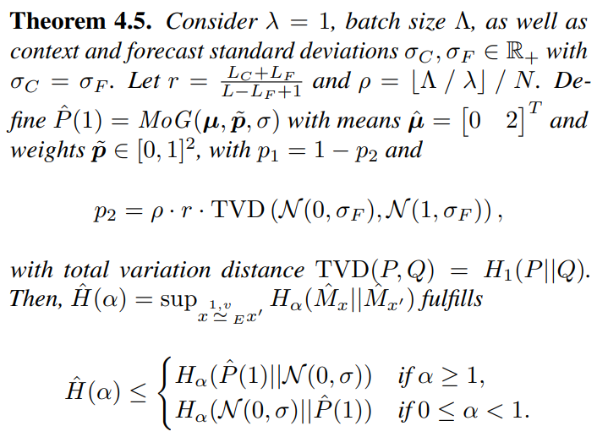

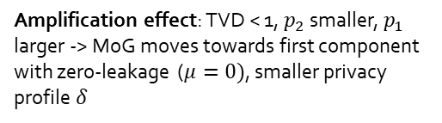
Counterbalancing Context & Forecast Length Effect
Recall that increasing either context and/or forecast length reduces privacy
Any other way to counterbalance reduction of privacy in these cases?
  Yes, if we assume everyone can change each step of the series by at most v
Data augmentation: add noise to both context and forecast scaled by v, so each individual gradient becomes:
It follows for :
Not a good assumption if data is about wire-transfers, and Elon Musk is in it
Amplification effect: TVD < 1, $p_{2}$ smaller, $p_{1}$ larger -> MoG moves towards first component with zero-leakage ($μ=0)$, smaller privacy profile $δ$
Top and bottom-level sampling are interconnected through $λ$
Data augmentation: $σ_{C}$and $σ_{F}$ can be independent

Slide 25
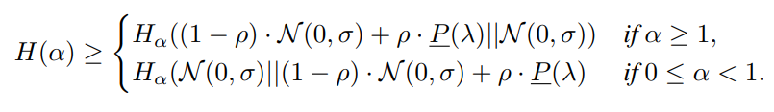
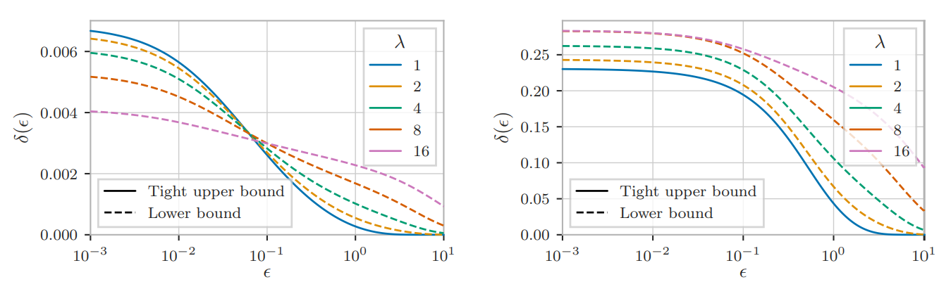
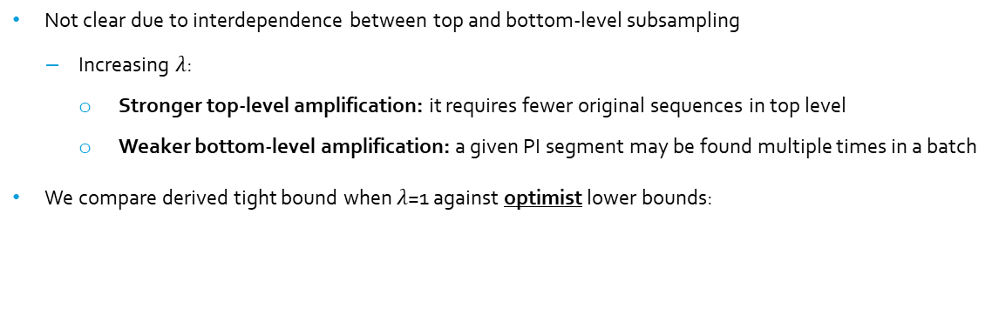
Numerical tradeoffs: Optimal 𝝀?
Not clear due to interdependence between top and bottom-level subsampling
  Increasing $λ$:
    Stronger top-level amplification: it requires fewer original sequences in top level
    Weaker bottom-level amplification: a given PI segment may be found multiple times in a batch
We compare derived tight bound when $λ$=1 against optimist lower bounds:
Training Step 1
Training Step 100

Slide 26
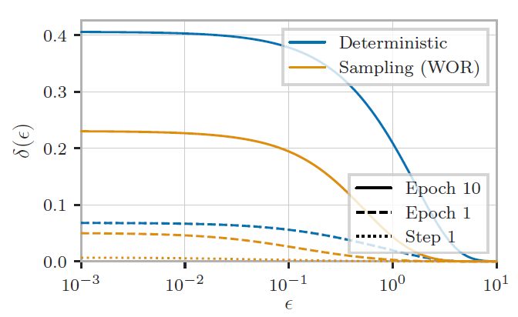
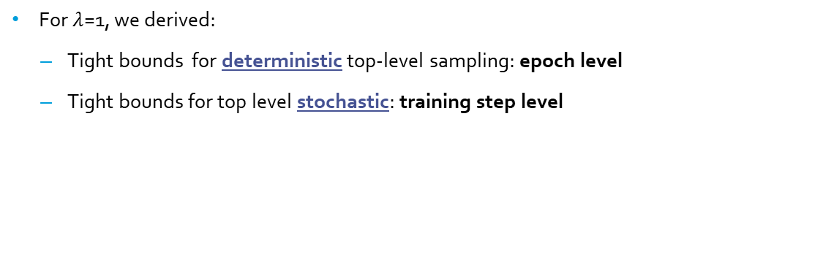
Numerical tradeoffs: Top level deterministic vs stochastic
For $λ$=1, we derived:
  Tight bounds for deterministic top-level sampling: epoch level
  Tight bounds for top level stochastic: training step level
Not a big surprise, subsampling reigns supreme in DP

Slide 27
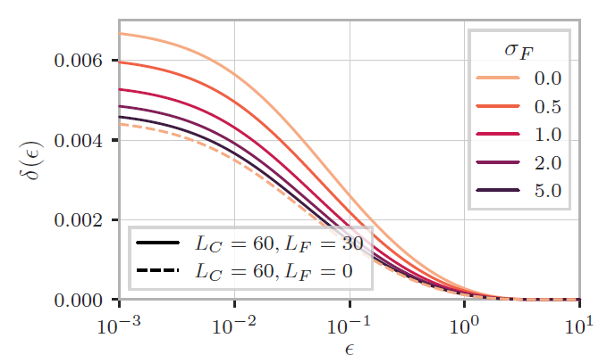
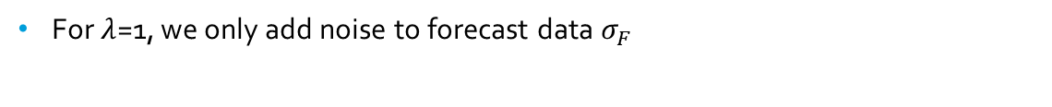
Numerical tradeoffs: Label Perturbation
For $λ$=1, we only add noise to forecast data $σ_{F}$
Increasing label noise has the same effect of making forecast window going to zero: eliminates privacy leakage from forecast window

Slide 28
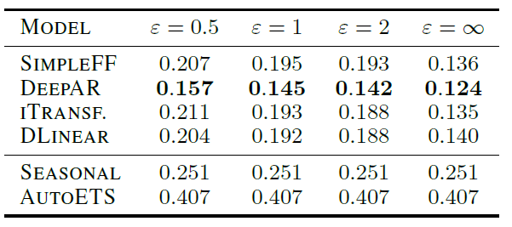

Privacy-utility trade-off
  Basic test: can differentially private models fit some non-trivial time-series?
  Traffic dataset: hourly, 862 sensors, L=17K, $L_{F}$=24, we set $δ={10}^{−7}$
  We use the tight bounds of Theorem 4.4 for $λ$=1
  Privacy–utility trade-off seems acceptable

Slide 29
Conclusion
Derived privacy guarantees when sensitive information is located inside subsequences
Considered both top and bottom-level sampling amplification
Sampling only one subsequence per sequence in a batch is preferrable in terms of privacy
Data augmentation of context/forecast enhances privacy amplification
Confirmed empirically that differentially private forecasting models can retain meaningful utility
Natural extension to LLMs

