Slide 1

Applying Fairness in
Multi-Label ML for
Financial Transaction Modelling
A case study from Mastercard & The Alan Turing Institute
Presented by: Deniz Sezin Ayvaz
Notes:
Narrative:
“Welcome everyone, thank you for joining. Today, I’ll present our work with the Alan Turing Institute and Mastercard on fairness in financial transaction models. To quickly introduce myself, I’m Sezin, and I was one of the participants in this collaborative case study. I currently work as a data science manager at PwC London.

Slide 2
Agenda
01 | Introduction & challenge overview
02 | Fairness & bias overview
03 | Data analysis and bias findings
04 | Fairness measurement framework
05 | Bias mitigation: adversarial debiasing
06 | Conclusion and future work
Notes:
We’ll cover the challenge, briefly go over fairness and bias in ML, what we found in the data, our fairness measurement framework, and how adversarial debiasing can be applied to mitigate bias.
Transition:
“Let’s start with the summary of our study.”

Slide 3

Introduction & challenge overview
1

Slide 4


Summary of the collaborative study
Title: Measuring fairness in financial transaction machine learning models
Alan Turing Institute Data Study Group - May 2024
Challenge partner: Mastercard
Duration: 5 days
Participants: Industry professionals and PhD students, and a challenge owner
Focus: Fairness in multi-label ML
Key innovation: Applying adversarial debiasing for multi-label scenario
Data Study Group Team. (2024). Data Study Group Final Report: Mastercard – Measuring Fairness in Financial Transaction Machine Learning Models (Version 1). The Alan Turing Institute. https://doi.org/10.5281/zenodo.14528864

Slide 5
Challenge & objective
How do we define, measure, and mitigate bias when fairness must be achieved across multiple demographic dimensions and multiple prediction tasks simultaneously?
Business context |  | Fairness challenge |  | Objective
Mastercard deploys ML models to predict likelihood of industry-specific spending by cardholders. These predictions support campaign design, offer personalisation, and attrition reduction. |  | Sensitive attributes (age, gender, ethnicity) are excluded from training inputs. (fairness-through-unawareness*) However, correlated variables can act as proxies, introducing bias despite good intentions.* |  | Define fairness for this setting. Measure disparities across model outputs. Apply a bias mitigation strategy.
*: Hardt, M., Price, E., & Srebro, N. (2016). Equality of opportunity in supervised learning. Advances in neural information processing systems, 29.
Notes:
Narrative:
“The key question was: how can we define, measure, and mitigate bias when fairness must be achieved across multiple demographic dimensions and multiple prediction tasks at the same time? Mastercard’s predictive models handle multiple outputs, will a customer spend in a given industry, and multiple groups, age, gender, ethnicity. Ensuring fairness across this complexity is non-trivial.”
Transition:
“To understand this better, we need to review the data we worked with.”

Slide 6
Data & sensitive attributes overview
1 million synthetic customer records, 12-month transaction history
Sensitive attributes*
9 binary output labels for the likelihood of spending (adoption) in the next 3 months per industry
Gender: Male, Female
20 features derived from transactional behaviour
Age: <40, ≥40
Ethnicity: 6 categories
*: This demographic data comes from a third-party data source, as Mastercard does not collect demographic data on cardholders
Notes:
Narrative:
“We worked with 1 million synthetic customer records covering 12 months of transaction history. Each record had 20 features, 9 binary output labels, and 3 sensitive attributes: gender, age, and ethnicity.
The challenge owner told us that the disadvantageous groups in each sensitive attribute are female, <40, and non-white ethnicity categories. Importantly, this is synthetic data, no real customer data were used, but it mimics key patterns. This synthetic nature both helps with privacy and introduces challenges for fairness assessment.”
Transition:
“With the challenge and dataset in mind, let’s turn to fairness and bias more broadly.”

Slide 7

Fairness & bias overview
2

Slide 8
What is fairness in machine learning?
Fairness in ML ensures that individuals are treated equitably, promoting just outcomes in AI systems.
Decisions should not systematically advantage or disadvantage any particular group unless justified by the task or context.​
It aims to ensure equitable treatment across sensitive (protected) attributes like ​gender​, race​, age​, socioeconomic status.
Fairness definitions in ML are context-dependent.
Notes:
Narrative:
“In machine learning, fairness means ensuring that predictions do not systematically disadvantage one group or individual over another, unless differences are truly justified. Importantly, fairness definitions are context-dependent, there is no universal definition. What fairness means in hiring differs from what it means in financial transactions.”
Transition:
“So why is fairness especially critical in our use case?”

Slide 9
Why fairness matters in this use case
Benefits
Risks
Unlock, attract new customer segments
Increase loyalty and engagement: users feel equally valued by the business
Hedge regulatory risk: anticipate and aligns with changing regulations
Improve sustainable performance and brand value
Some demographic groups may be excluded from receiving offers or campaigns
The model may perform worse for specific groups (e.g. lower recall or precision) which undermines customer trust and brand value
Notes:
Narrative:
“For Mastercard, fairness is both a business and an ethical imperative. Fair models can unlock new customer segments, strengthen loyalty, and hedge against regulatory risks. Unfair models, on the other hand, may exclude some groups from receiving offers or simply deliver poorer predictions for them. That undermines customer trust and brand value.”
Transition:
“This meant we had to be explicit about which fairness definitions we would use.”

Slide 10
How is fairness conceptually defined in ML?
Allocation/access
Quality of service
Equality of service provided and customer satisfaction
We don’t want some customers to consistently receive lower-quality predictions
Fair distribution of resources (e.g. card offers)
No group should systematically receive fewer opportunities
Notes:
Narrative:
“The most common definitions of fairness in ML are in two concrete ways.
First, allocation or access fairness: are offers distributed fairly across groups? For example, no group should systematically receive fewer opportunities.
Second, quality-of-service fairness: are model predictions equally accurate across groups? In other words, we don’t want some customers to consistently receive lower-quality predictions.
These two definitions framed the fairness objectives in our study.”
Transition:
“With these definitions in place, let’s look at the methodological challenges that make fairness assessment complicated in our case.”

Slide 11
Methodological challenges in assessing fairness
Spending ~ ability to spend + willingness to spend
Hard to separate individuality vs. identity when dealing with fairness
Individual fairness
Group fairness
Statistical parity across demographic groups
  Challenge: Which groups? Which statistics? Which trade-offs?
Similar individuals receiving similar outcomes
  Challenge: How do we define "similarity” in high-dimensional transaction space?
Experiment focus
Notes:
Narrative:
“One of the core challenges in assessing fairness in our case is that spending reflects both ability and willingness to spend. That makes it hard to separate what belongs to someone’s individual circumstances from what might reflect broader group-level patterns.
This tension shows up clearly when we think about fairness definitions.
• For individual fairness, the principle is that similar individuals should receive similar outcomes. But in a high-dimensional space like financial transactions, it’s very hard to define what ‘similar’ actually means.
• For group fairness, the principle is statistical parity across demographic groups. The challenge here is deciding which groups to compare, which statistics to focus on, and which trade-offs are acceptable.
For this study, given the data and business context, we ultimately chose to focus on group fairness as our main framework. And we’ll revisit the specific challenges tied to group fairness later, when we discuss the fairness metrics and how they were applied in our analysis.”
Transition:
“These methodological issues are fundamental, and they sit alongside structural challenges, which I’ll cover next.”

Slide 12
Structural challenges in assessing fairness
Context
Explanation
Proxy distribution
Non-sensitive features can leak demographic information and introduce bias.
Multi-label
complexity
Multiple predictions per user require fairness checks across each label.
Intersectionality
Bias can compound for people with overlapping identities (e.g. age <40 + Hispanic).
Synthetic data
May not fully reflect real-world distributions, introducing noise in fairness assessment.
Notes:
Narrative:
“Our structural challenges when assessing fairness are as follows:
• Proxy distribution – non-sensitive features can still leak demographic information.
• Multi-label complexity – fairness had to be checked across nine industry labels and multiple subgroups.
• Intersectionality – overlapping identities, like young + Hispanic, can compound bias.
Synthetic data - may not fully reflect real-world distributions, introducing noise in fairness evaluation.
Transition:
“Now, let’s look at the types of bias that can creep into ML systems in our case.”

Slide 13
Potential types of bias in our data
Bias refers to systematic errors in model outcomes, which can lead to unequal advantages or disadvantages for different groups.
Historical bias
Representation bias
Measurement bias
Societal inequalities embedded in data patterns
Demographic groups underrepresented in training data
Inconsistent feature measurement across groups
Algorithmic bias
Evaluation bias
Simpson’s paradox
Model architecture introduces unfair outcomes
Inappropriate benchmarks for different groups
Subgroup trends differ from aggregates
Notes:
Narrative:
“Bias refers to systematic errors in model outcomes, which can lead to unequal advantages or disadvantages for different groups.
Bias can arise in many forms, and here we listed the ones which are more likely to appear in our dataset: historical bias reflecting systemic inequalities, representation bias from unbalanced datasets; measurement bias from noisy features; algorithmic bias due to model design; evaluation bias from inappropriate benchmarks; and paradoxes like Simpson’s paradox where subgroup trends differ from aggregates.”
Transition:
“Given these risks, detecting bias in our models was a crucial step.”

Slide 14
Detecting bias in our data and model outputs
Understand the context
Analyse the data
Use bias detection tools
What are the sensitive attributes (e.g., race, gender)?
What is the desired definition of fairness?
Look for imbalances, missing and unexpected values.
Check for proxy discrimination.
Check if outcomes differ significantly for subgroups.
AI Fairness 360
Fairlearn
Aequitas
Notes:
Narrative:
“Here we set out the methodology we used to detect bias.
After setting out the context and definitions, we conducted data analysis to see the imbalances and outliers in data, testing whether sensitive attributes could be inferred indirectly from non-sensitive features, and on comparing baseline model outputs across demographic groups. We made use of open-source packages as well.”
Transition:
“The specific findings will be presented later in the data analysis section which we’ll cover next.”

Slide 15

Data analysis & bias findings
3

Slide 16
Dataset characteristics and challenges
Challenge
Explanation
Sensitive attributes
Imbalanced sensitive and non-sensitive group sizes
Labels
Strong skew across the 9 industry labels
Some labels are correlated with each other
Features
Many features were bimodal, clustering at extremes with little density in the middle
Correlations between engineered features (e.g. spending statistics) can create redundancy and instability in modelling
Notes:
Narrative:
“Our exploratory analysis highlighted several important challenges in the dataset.
First, the representation of sensitive and non-sensitive groups for each sensitive variable are unbalanced, which can lead to representation bias.
Second, the labels were highly imbalanced across industries. For example, Label 6 showed the highest spending volume but was the least adopted, while Labels 2 and 8 had both high adoption and high spending. We also observed correlations between some labels, which suggests they should be handled jointly rather than by training an independent model for each label.
Third, the features themselves showed limitations. Many clustered at the extremes, with very little signal in the middle range. On top of that, we found strong correlations among certain features, creating redundancy and limiting the diversity of information available to the model.
Taken together, these issues complicated not only the accuracy of the models but also the assessment of fairness across different groups and outputs.”
Transition:
“Next, let’s look at the proxy discrimination evidence from data.”

Slide 17
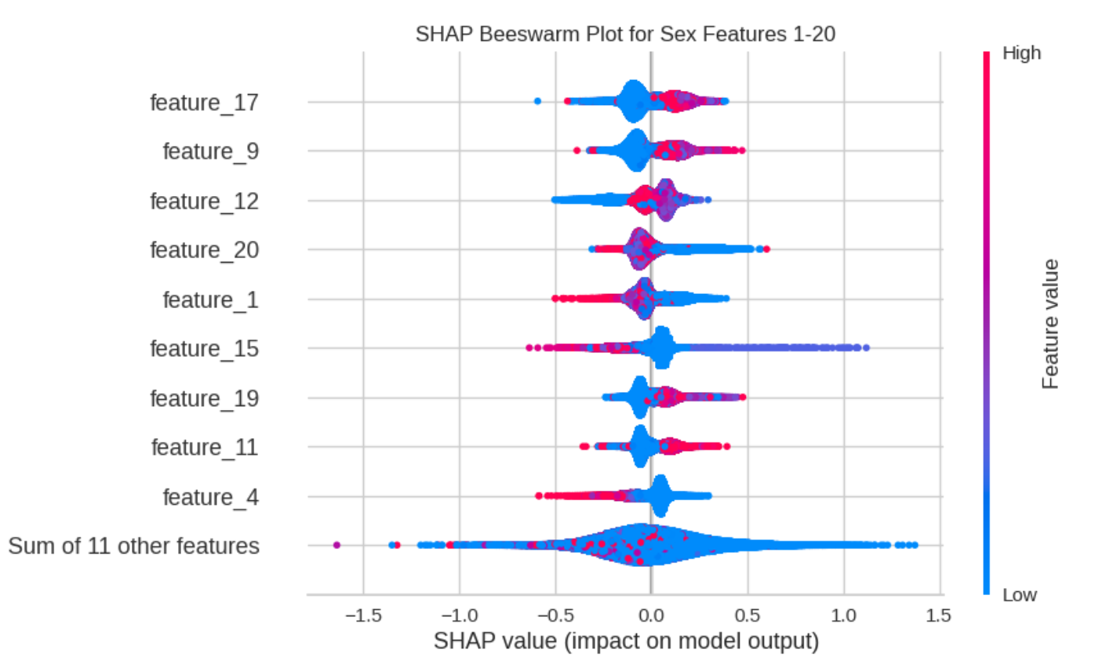
Proxy discrimination evidence
  We used ML classifiers to measure dependencies between features and sensitive attributes.
  Age could be predicted with ~72% accuracy and gender with ~60% accuracy using only transactional features, proving leakage of sensitive attributes.
  SHAP analysis showed which features contributed most to this leakage.
Notes:
Narrative:
“To test for proxy discrimination, we applied machine learning classifiers as a type of two-sample test. This approach is more robust than traditional methods when dealing with high-dimensional features, because it can flexibly capture hidden dependencies. The results showed that sensitive attributes were indeed leaking: age could be predicted with around 72% accuracy, and gender with about 60%. SHAP analysis further confirmed which features were most responsible for this leakage.”
Transition:
“This confirmed that fairness-through-unawareness was not enough. Active mitigation was required.”

Slide 18
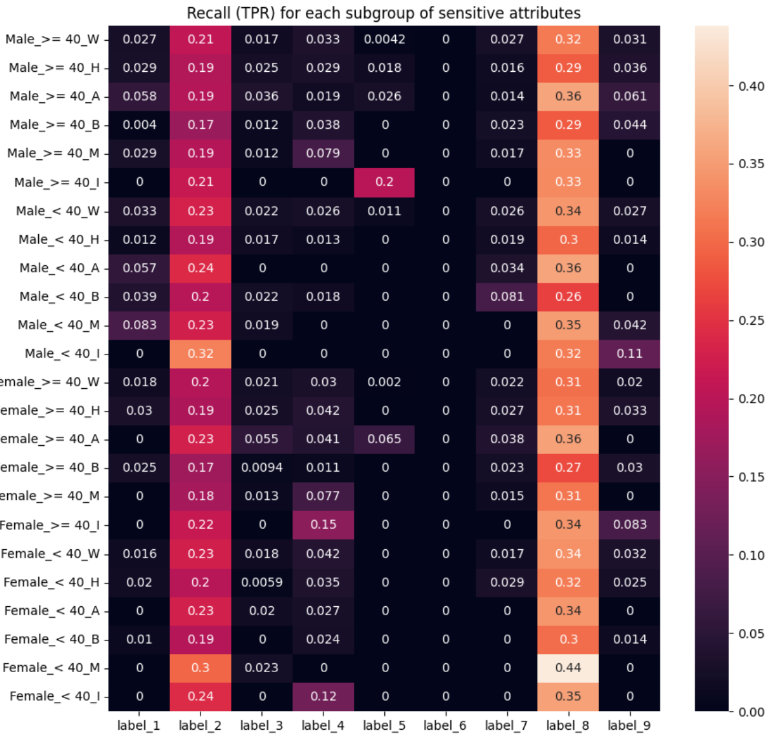
Baseline model fairness findings
  Logistic regression models: consistent across groups but performed only marginally better than random.
  XGBoost models: stronger recall, but disparities emerged when results were disaggregated by subgroup (gender, age, ethnicity).
  Subgroup heatmaps revealed
    subgroup disparities within a label.
    subgroup disparities across labels.
Notes:
Narrative:
“Logistic regression was fairer across groups but weak overall. XGBoost achieved higher recall but amplified disparities. Subgroup-level analysis showed consistent disadvantage for certain intersections, like female + minority groups.”
Transition:
“This implies that more complex models offer better accuracy but can bring greater fairness risks.”

Slide 19
Key insights
Multi-label + intersectional setting adds unique difficulty: fairness varies not just across groups but across industry labels and group combinations.
Labels are not independent. They should be considered jointly in predictive modelling to avoid missing important patterns.
Complex models (e.g. XGBoost) deliver better predictive performance but also amplify fairness risks.
  Evidence of bias in baseline models confirmed the need for active mitigation beyond fairness-through-unawareness.
Notes:
Narrative:
“From our exploratory analysis, a few key insights stand out.
First, the multi-label and intersectional setting creates unique challenges. Fairness doesn’t just vary across demographic groups, it also varies across industry labels, and even more so when you look at combinations of labels and groups. This means fairness can’t be assessed in isolation, it has to be considered across multiple dimensions.
Second, we found that complex models, like XGBoost, deliver stronger predictive performance but also amplify fairness risks. The higher accuracy came at the cost of larger disparities between groups, showing the trade-off between performance and fairness.
Third, the labels are not independent. We saw correlations that suggest they should be considered jointly, since there’s underlying information in their joint distribution. Treating them completely separately risks missing important patterns.
Finally, our baseline models already showed clear evidence of bias. This confirmed that fairness-through-unawareness, simply leaving sensitive attributes out of the training data, is not enough. Active mitigation strategies are required if we want to reduce bias in these models.
Altogether, these insights shaped the motivation for moving beyond exploratory analysis and applying advanced bias mitigation methods.”
Transition:
““So, we’ve seen evidence of bias in the dataset and baseline models: imbalanced labels and disparities across groups.
But this raises an important question: how do we formally measure fairness in machine learning? To answer that, let’s now look at the different fairness metrics, and why choosing among them involves trade-offs.”

Slide 20
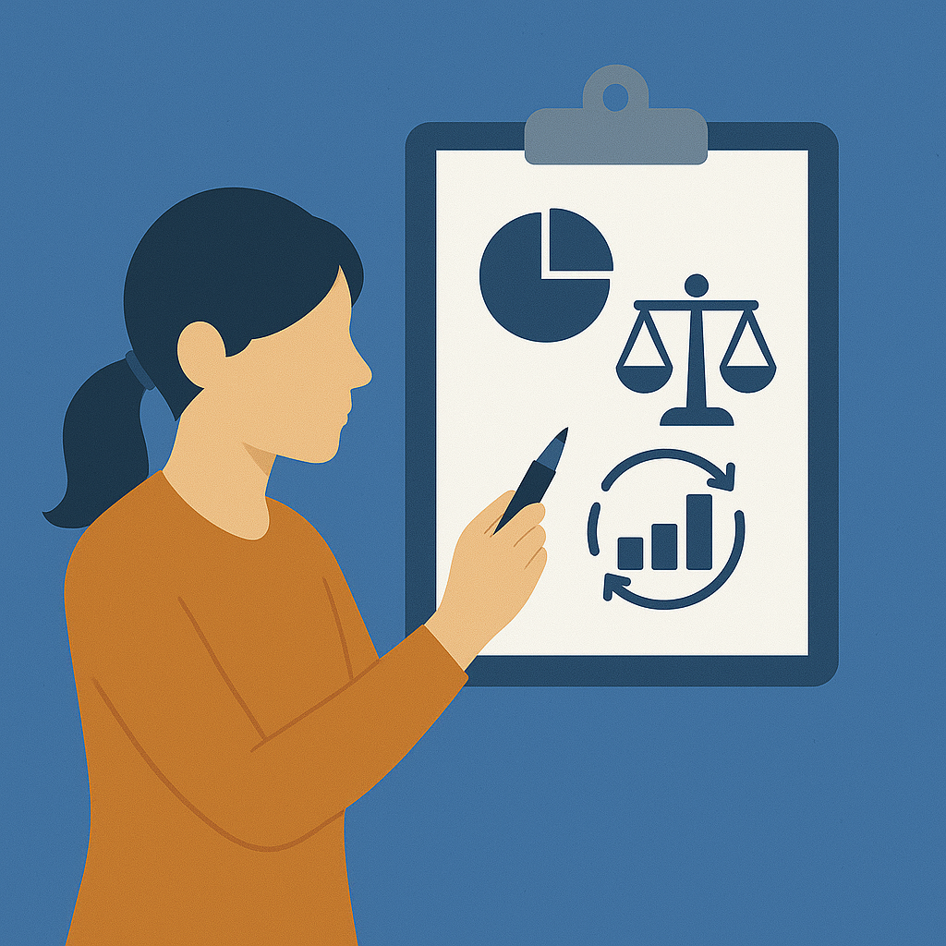
Fairness measurement framework
4

Slide 21
Measuring fairness in ML
As fairness is not a single concept, it’s a set of trade-offs between definitions.
To assess how fair a model is, we use different metrics depending on what aspect of fairness we care about.
Fairness metric categories
“There is no single metric that guarantees fairness across the board.”
The impossibility of “fairness” means that even theoretically sound fairness criteria can contradict one another.*
Group-level parity: Compare outcomes across groups (e.g. Demographic Parity, Disparate Impact).
Error balance: Ensure misclassification rates (false positives/negatives) are similar across groups.
Access to benefit: Check that qualified individuals get equal access to positive outcomes (Equality of Opportunity).
*: Miconi, T. (2017). The impossibility of" fairness": a generalized impossibility result for decisions. arXiv preprint arXiv:1707.01195.
Notes:
Narrative:
“When it comes to measuring fairness, there isn’t just one definition, we think about it across several categories.
First, group-level parity: here we ask if outcomes are distributed evenly across demographic groups. Metrics like demographic parity or disparate impact fall into this bucket.
Second, error balance: we want to know if misclassification errors, false positives and false negatives, are happening at the same rate for different groups.
Third, access to benefit: this is about ensuring qualified individuals have equal access to positive outcomes. Equality of Opportunity is the key metric here.
Because of the way we defined fairness for this study, focusing on allocation and quality of service, we concentrated primarily on the group-level parity and access to benefit categories.”
“Worth to mention that, even within these categories, fairness metrics can sometimes conflict, which brings us to the idea of the impossibility of fairness.”
“Miconi’s 2017 paper, The impossibility of fairness, it is shown that fairness metrics can contradict each other. Improving one can worsen another. That’s why fairness is about trade-offs, you can’t optimize for everything at once.”
Transition:
“Let’s see some specific examples of fairness metrics.”

Slide 22
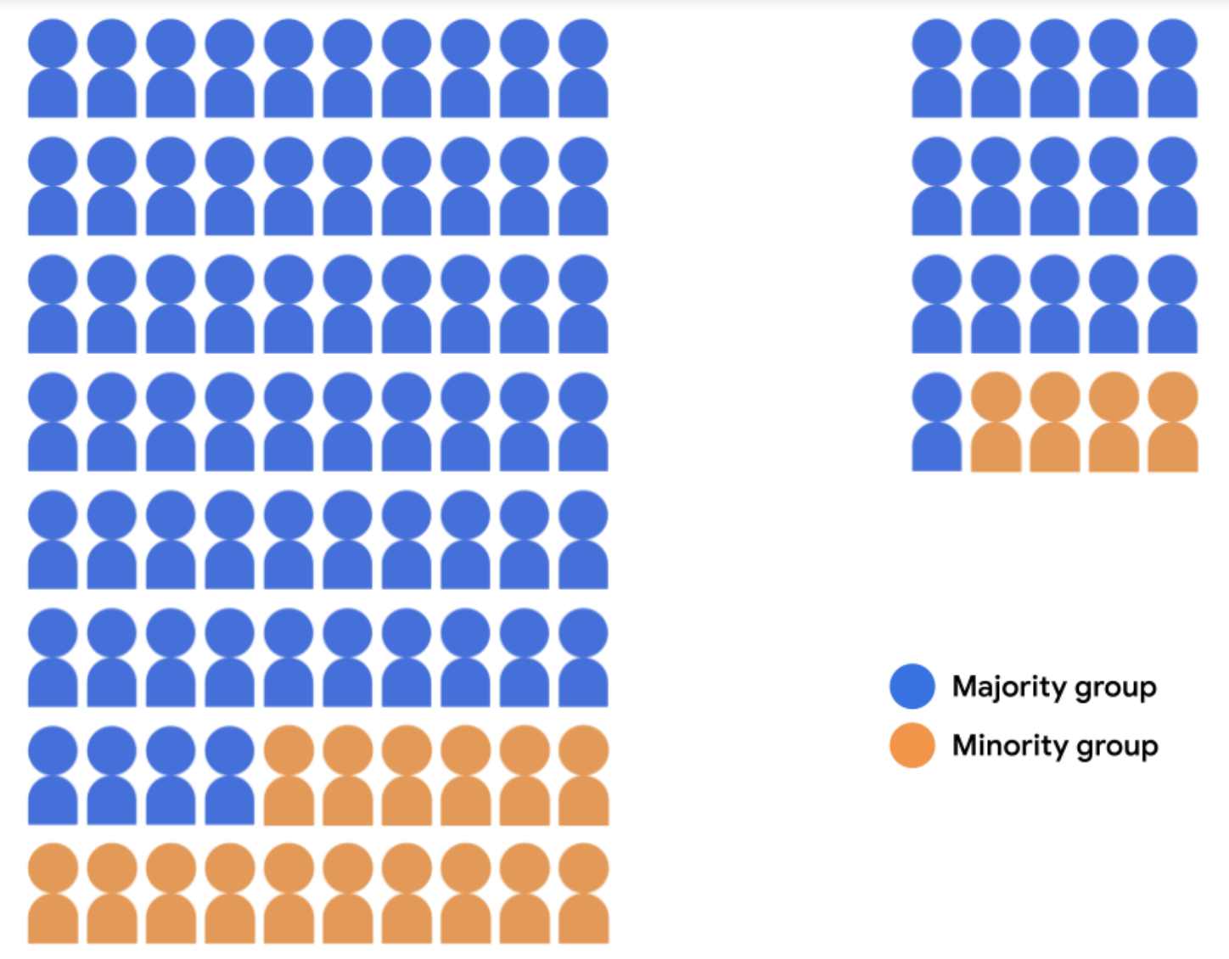
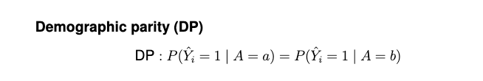
Fairness metrics – demographic parity
  A classifier is DP fair if ensures that there is equality in the likelihood of positive predictions between the demographic groups.
  Candidate pool split into two groups: Rejected Candidates and Accepted Candidates. Both the majority (blue) and minority (orange) groups have an acceptance rate of 20%.
  Drawback: ???
Google. Fairness: Demographic parity. Google Developers – Machine Learning Crash Course. CC-BY 4.0. https://developers.google.com/machine-learning/crash-course/fairness/demographic-parity
Notes:
Narrative:
“Demographic parity requires equal positive prediction rates across groups. For example, if 20% of candidates are accepted, both majority and minority groups must have 20% acceptance.”
There is a drawback about this metric.
Interactive question:
Would anyone like to comment on what it could be?

Slide 23
Fairness metrics – demographic parity
  A classifier is DP fair if ensures that there is equality in the likelihood of positive predictions between the demographic groups.
  Candidate pool split into two groups: Rejected Candidates and Accepted Candidates. Both the majority (blue) and minority (orange) groups have an acceptance rate of 20%.
  Drawback: It does not take the distribution of predictions for each demographic group (the number of students classified as "qualified" vs. "unqualified") into account when evaluating how the 20 admissions slots should be allocated.
Google. Fairness: Demographic parity. Google Developers – Machine Learning Crash Course. CC-BY 4.0. https://developers.google.com/machine-learning/crash-course/fairness/demographic-parity
Notes:
However, this metric ignores whether accepted candidates were truly qualified.”
Transition:
“To address this, we look at equality of opportunity.”

Slide 24
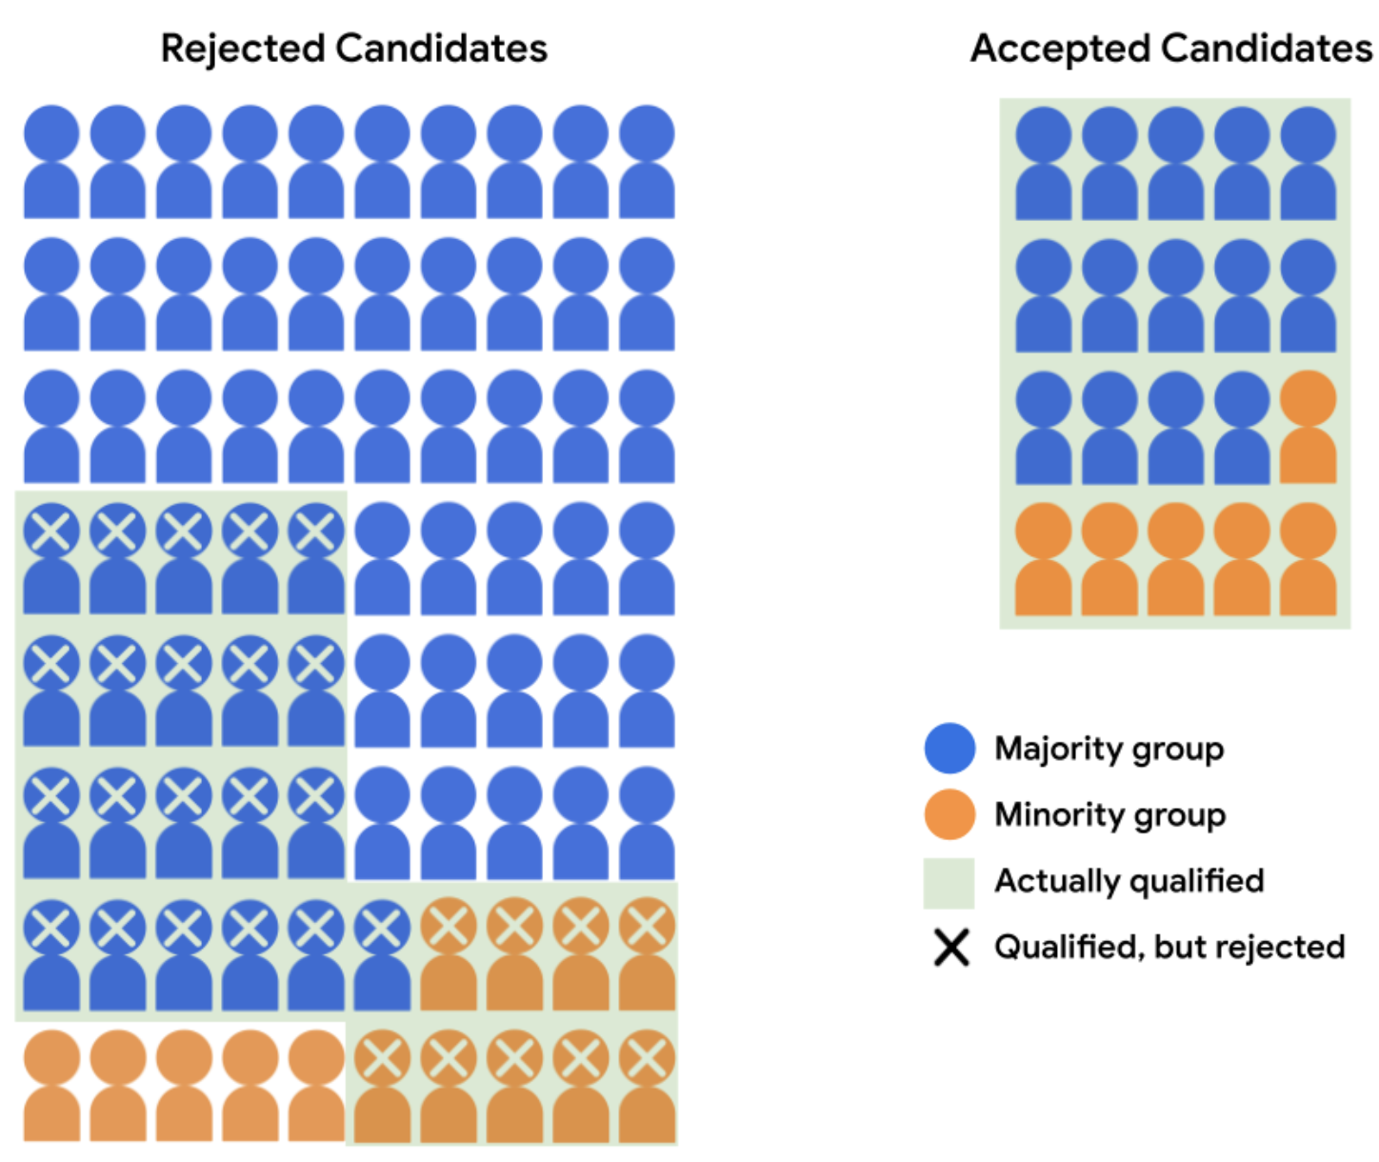
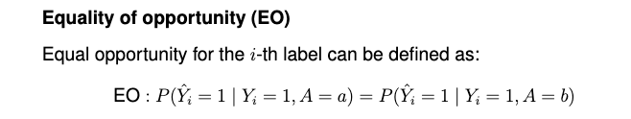
Fairness metrics – equality of opportunity
  It ensures that the true positive rate between the demographic groups are equal.
  Breakdown of Rejected and Accepted candidates, with all qualified students in both the majority and minority groups shaded in green.
  Of the 35 qualified majority-group students, 14 were accepted.
  Of the 15 qualified minority-group students, 6 were accepted.
  Both groups thus have an acceptance rate of 40% for qualified students.
Google. Fairness: Equality of opportunity. Google Developers – Machine Learning Crash Course. CC-BY 4.0. https://developers.google.com/machine-learning/crash-course/fairness/equality-of-opportunity
Notes:
Narrative:
“Equality of opportunity ensures equal true positive rates across groups, that is, equally qualified individuals should have equal chances of being accepted. This is often more aligned with fairness goals in financial transactions like offer allocation.”
Transition:
“So, how did these metrics play out in our data?”

Slide 25
Measurement framework
Metric
Description
Use case
Equality of
Opportunity (EO)
Equal true positive rates (TPR) across groups
Ensuring equal access to
opportunities (e.g. campaign
eligibility)
Disparate
Impact (DI)
Ratio of positive outcomes in sensitive group to non-sensitive group
Measuring overall systemic bias in output distribution
Demographic
Parity (DP)
Equal prediction rates across groups, regardless of labels
Diagnostic use; strict, rarely realistic
Recommendation
Use EO as the target
Monitor DI to catch systemic effects
Use DP as a diagnostic signal, not a target
Notes:
Narrative:
“We used equality of opportunity as our primary fairness target, monitored disparate impact to check for systemic effects, and used demographic parity as a diagnostic signal. This framework balanced realism with rigor.”
Transition:
“Now let’s turn to what the data actually showed us.”

Slide 26

Bias mitigation: adversarial debiasing
5

Slide 27
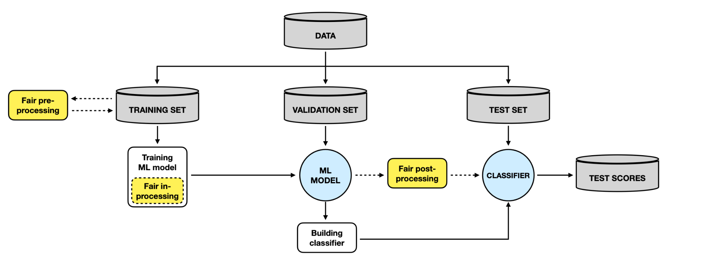
Mitigation pipeline
Notes:
Narrative:
“Let’s first start with the bias mitigation pipeline in ML. Bias in machine learning models can be mitigated at three different points in the pipeline.
• Pre-processing: here, the data itself is modified before training, for example, reweighting, resampling, or transforming features to reduce bias in the inputs.
• In-processing: this is where fairness constraints are built into the training process itself. The model learns not just to optimize for accuracy, but also for fairness.
• Post-processing: after the model is trained, you can adjust the outputs: for example, by changing thresholds across groups to equalize outcomes.

Slide 28
Choosing the right method
What we needed
Methods we explored
Why we chose adversarial debiasing
Handle intersectional and multi-label fairness simultaneously
Flexible enough to optimize for the selected fairness metrics
Show improvement in fairness with acceptable model accuracy
Exponentiated Gradient Reduction (EGR): in-processing method using fairness constraints
Post-processing adjustments: recalibrating model outputs after training
Meets our criteria: multi-label capable, metric-flexible
Showed consistent fairness improvements across sensitive attributes and labels
Balanced fairness gains with acceptable performance trade-offs
Notes:
For our challenge, we were looking for a method that could handle multiple fairness challenges simultaneously, work in a multi-label setting across industries, and be flexible enough to optimize for different fairness metrics. We also needed something that could achieve fairness with acceptable model accuracy.
During this study, we experimented with several methods. For example, exponentiated gradient reduction with fairness constraints, and recalibrating model outputs as post-processing. Each approach had its strengths, but none addressed the problem as comprehensively as we needed.
That’s why we chose adversarial debiasing which is an in-processing method. It met the criteria of being metric-flexible, capable of handling multi-label predictions, and it showed promising results in improving fairness while maintaining acceptable performance.
So, in the rest of this section, I’ll focus specifically on the adversarial debiasing method: how it works, how we implemented it, and the results we observed.”

Slide 29
Adversarial debiasing – framework overview
Two-network framework:
Main model: Predicts multi-label adoption outcomes.
Adversary model: Tries to predict sensitive attributes from the main model’s output.
Objective:
Train main model to be accurate while being undetectable by adversary.
If adversary fails, the main model outputs don’t encode sensitive info, and the model is fairer.
The goal is to maximize the adversary’s error, ensuring that the label predictions carry as little information as possible about the sensitive attributes.
Zhang, B. H., Lemoine, B., & Mitchell, M. (2018, December). Mitigating unwanted biases with adversarial learning. In Proceedings of the 2018 AAAI/ACM Conference on AI, Ethics, and Society (pp. 335-340).
Notes:
Narrative:
“We implemented an adversarial debiasing framework: a main model predicts adoption outcomes, while an adversary tries to predict sensitive attributes from those predictions. If the adversary fails, it means sensitive information is not encoded, and the model is fairer.”
Transition:
“Let’s see how the architecture was set up.”

Slide 30
Adversarial debiasing – technical implementation
Main model
Adversary model
Input: predicted labels from the main model
Output: predicted sensitive attributes
Also trained with cross-entropy loss
Model details:
  Deep neural network classifier with one dense layer
  The adversary model doesn’t need to be as complex as the main model*
  Input: customer features X
  Output: predicted industry adoption labels
  Trained with a standard cross-entropy loss
  Model details:
    Deep neural network with two dense layers
    ReLU activation functions
    Dropout for regularization
* Zhang, B. H., Lemoine, B., & Mitchell, M. (2018, December). Mitigating unwanted biases with adversarial learning. In Proceedings of the 2018 AAAI/ACM Conference on AI, Ethics, and Society (pp. 335-340).
Notes:
Narrative:
“The fairlearn package has an implementation as AdversarialClassifier, as well as IBM AI 360. However, we decided to build a custom version to have better flexibility.
Main model
Input: customer features X
Output: predicted industry adoption labels
Trained with a standard cross-entropy loss
The main model was a deep neural net with two dense layers and dropout, and ReLu activation functions.
Adversary model
Input: predicted labels from the main model
Output: sensitive attributes (e.g. gender, age, ethnicity)
Also trained with cross-entropy loss
The adversary was a shallow classifier. As suggested by the paper, the adversary model doesn’t need to be as complex as the main model”
Transition:
“We’ll now take a look at the model architecture and the loss structure.”

Slide 31
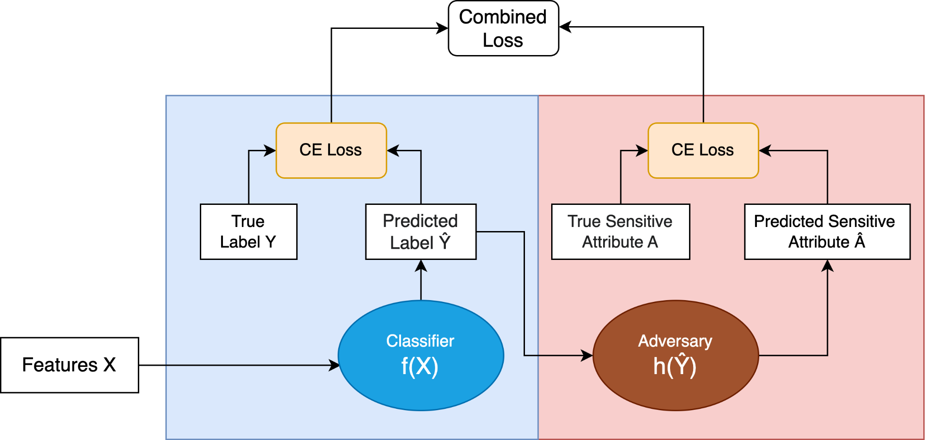
  Combined loss = Main model loss + (-1) x λ × Adversarial model loss
  λ balances predictive performance and fairness strength.
Main
model loss
Adversarial
model loss
Notes:
Narrative:
Main model
Input: customer features X
Output: predicted industry adoption labels
Trained with a standard cross-entropy loss
Adversary model
Input: predicted labels from the main model
Output: sensitive attributes (e.g. gender, age, ethnicity)
Also trained with cross-entropy loss
Training procedure
Models trained simultaneously
Combined loss function: Total Loss=Main Loss+λ×(−1)×Adversarial Loss
The −1 term maximizes the adversary’s error, discouraging the main model from encoding sensitive information in its predictions
λ controls the trade-off between accuracy and fairness
The gradient of adversary model will be incorporated into the weight update rule of main model so as to reduce the amount of information about A transmitted through Y^hat
Transition:
“There were two fairness modes depending on inputs to the adversary. Let’s see how the architecture is modified.”

Slide 32
Input to adversary
Training objective
Adversarial debiasing method: two fairness modes
Demographic parity
Equality of opportunity
Predicted labels (Ŷ)
(Y=1 only)
Predicted labels (Ŷ)
Remove dependence
between outputs & sensitive attributes
Equal True Positive Rate (TPR)
across groups with positive labels
Experiment focus
Beutel, A., Chen, J., Zhao, Z., & Chi, E. H. (2017). Data decisions and theoretical implications when adversarially learning fair representations.
arXiv preprint arXiv:1707.00075.
Method
Input to adversary
Training objective
Equality of
Opportunity (EO)
ŷ + true labels (Y) (Y=1 only)
Equal TPR across groups with
positive labels
Demographic
Parity (DP)
Predicted labels (ŷ)
Remove dependence between outputs & sensitive attributes
Notes:
Narrative:
We tested two setups: demographic parity, where the adversary sees predicted labels, and equality of opportunity, where it was trained only on
examples where the true label was the target class, limiting any information about A which Y^hat contains beyond the information already contained in Y.
The goal was to make outputs invariant to sensitive features under the chosen definition, by taking into account the willingness and ability to spend, therefore we decided to conduct the experiments with the equality of opportunity mode.”
Transition:
“So, what results did we achieve?”

Slide 33
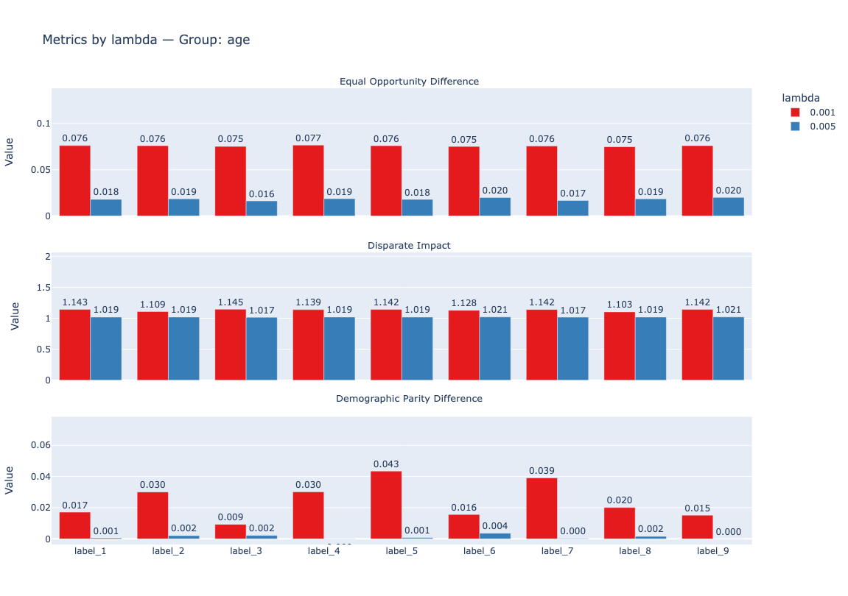
Results: Impact on fairness metrics per label
Sensitive attribute: age
Equal opportunity difference
Equality of opportunity and demographic parity differences and the disparate impact between sensitive and non-sensitive groups improve as the λ value is increased, for all 9 industry labels.
This demonstrates the adversarial debiasing with higher λ makes the expected impact on all three selected fairness metrics.
Disparate impact
Demographic parity difference
Notes:
Narrative:
On this slide, we see how three fairness metrics change across industry labels when we increase the mitigation coefficient, lambda, and train two separate models.
The metrics shown here are for the sensitive attribute age.
• Equal opportunity difference and demographic parity difference measure disparities between sensitive and non-sensitive groups: here, smaller values are better.
• Disparate impact compares group outcomes as a ratio: the closer it is to 1, the better.
As expected, when we increased lambda, adversarial debiasing improved all three metrics, reducing disparities and moving the model toward fairer predictions across all industry labels.
Transition:
“Let’s examine the average impact for all 9 labels.”

Slide 34
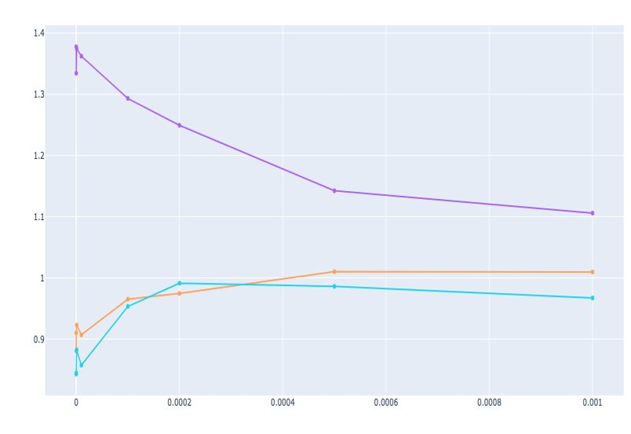
Results: Average impact on fairness metrics
Disparate impact
Graph: Average change observed in disparate impact as λ increases
The average changes in the Equality of Opportunity and Demographic Parity weren’t always in the same direction and magnitude across varying λ values and sensitive groups.
Likely reasons:
  Skewness in sensitive attributes and labels*
  Metrics respond differently to growing adversarial impact
Age
Ethnicity
Gender
λ
Takeaway
Adversarial training reduced proxy discrimination and improved overall fairness.
* Beutel, A., Chen, J., Zhao, Z., & Chi, E. H. (2017). Data decisions and theoretical implications when adversarially learning fair representations.
arXiv preprint arXiv:1707.00075.
Notes:
Narrative:
“Averaging across industry labels, disparate impact moves toward 1 as λ increases, evidence that adversarial debiasing improves overall fairness.
By contrast, equality of opportunity difference and demographic parity difference show less consistent average shifts (both in direction and magnitude). That’s likely due to skewed data and the fact that metrics respond differently to adversarial pressure. The effect of skewed data on labels and sensitive attributes are experimented separately by Beutel et al. and it is found that they can affect the parity and equality metrics separately.
A notable nuance in this plot is age: at baseline, disparate impact > 1. Recall that DI is the ratio of positive outcomes in sensitive group to non-sensitive group, so the sensitive group value is in the nominator.
Because we initially defined <40 as the sensitive group based on the information from the challenge owner, <40 group is in nominator. But DI>1 means on average <40 has a higher positive outcome rate than ≥40. This suggests the actually disadvantaged group may be ≥40, contrary to the initial assumption from domain input that <40 is more vulnerable. (There’s variation by label, but the average points that way.)
Taken together, this underscores how multi-label, multi-attribute fairness assessment is tricky: averaging can mask label-specific effects, and group definitions matter, specially when there are no importances assigned as weights, and averaging the impact can hide the individual impacts on labels, metrics and sensitive groups.”
Transition:
“Let’s examine the trade-offs with model accuracy.”

Slide 35
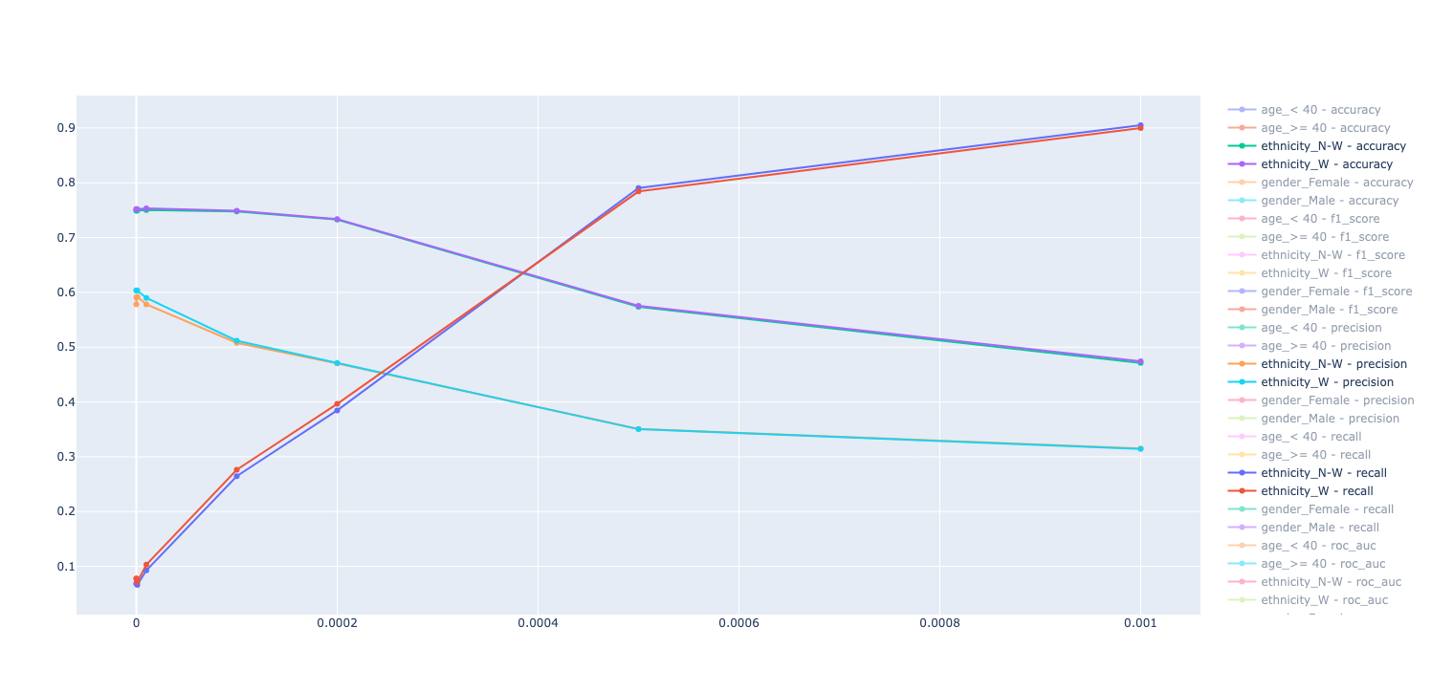
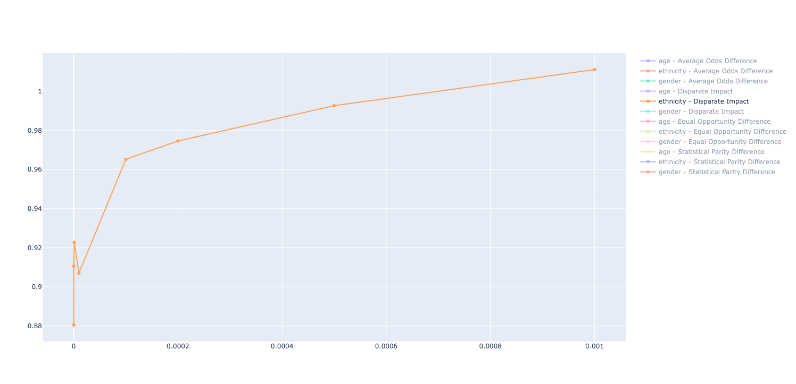
Fairness-accuracy trade-off analysis
Ethnicity: white/non-white groups
Bias mitigation results - Ethnicity:
  λ = 0.0001: Slight fairness improvement, minimal accuracy loss
  λ = 0.0002: Good balance point - significant fairness gains, acceptable accuracy loss
  λ = 0.001: Major fairness improvement, substantial accuracy degradation
Recall
Metric value
Accuracy
Precision
λ
Disparate impact
Notes:
Narrative:
“We tested different λ values. At λ=0.0001, there was slight fairness improvement with minimal accuracy loss. At λ=0.0002, we found the optimal balance, significant fairness gains with acceptable accuracy loss. At λ=0.001, fairness improved further but accuracy dropped substantially. Similar patterns held across gender, age, and ethnicity.”
Transition:
“This shows the practical balancing act in fairness optimization.”

Slide 36
Key observations
  Recall improvement: Higher λ increases recall (more inclusive predictions)
  Precision trade-off: Higher λ decreases precision (more false positives)
  Sweet spot: The λ value which balances fairness and performance effectively should be found via experiments
  Consistent patterns across different sensitive attributes validate approach generalizability
Notes:
Narrative:
“This slide summarizes the trade-offs we observed when adjusting the λ parameter in adversarial debiasing.
First, we saw recall improvement: as λ increased, the model became more inclusive, correctly identifying more positive cases across groups.
But there was a precision trade-off: the same higher λ values led to more false positives. In other words, fairness gains came with some performance cost.
The key is finding a sweet spot: a λ value that balances fairness with predictive performance. In our experiments, this balance was achievable at moderate λ settings.
Importantly, these patterns weren’t limited to one attribute. We saw consistent results across gender, age, and ethnicity, which gives confidence in the generalizability of this approach.”
Transition:
“So, while adversarial debiasing doesn’t remove trade-offs, it gives us a tunable way to manage them. With the mitigation explored, let’s move into the conclusions and future work.”

Slide 37

Conclusion
& future work
6

Slide 38
Key findings
Intersectional multi-label fairness presents unique challenges
Sensitive attribute exclusion is insufficient (fairness-through-unawareness)
Adversarial methods show promising results for bias mitigation in financial transaction modelling
Notes:
Narrative:
“Let me summarize the main findings from this study.
First, intersectional multi-label fairness presents unique challenges. We saw that fairness is not just about single attributes like gender or age, but also about their combinations, and across multiple prediction labels. This complexity makes both measurement and mitigation harder. The analysis revealed significant disparities in how different demographic groups fare across various
industries. Some groups may dominate in one industry in terms of transaction amount while being less active in others.
Second, excluding sensitive attributes is insufficient. Even when demographic data isn’t used, non-sensitive features leak enough information to reproduce bias. So fairness-through-unawareness doesn’t solve the problem.
And third, adversarial methods show promise for bias mitigation in financial transaction modelling. We saw meaningful fairness gains without completely sacrificing accuracy. This shows adversarial approaches can be a viable tool in practice.”
Transition:
“With those findings in mind, let’s look at our recommendations for how to move forward.”

Slide 39
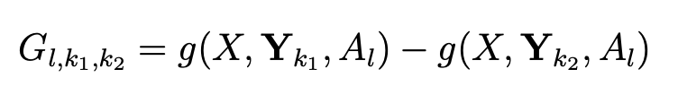
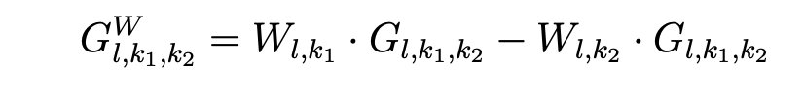
Recommendations
If we define any fairness metric g that receives as input a distribution X,
labels Y_{K}, and a sensitive attribute A_{l}, we obtain a tensor G ∈ R^{L×K×K} where:
By incorporating a weight matrix W, where W ∈ R^{L×K}, each element W_{l,k} represents the weight for the sensitive attribute l and the label class k, signifying its importance in the fairness analysis.
First identify which fairness concept is most appropriate for a given financial case study.
Select fairness metrics aligned to business and ethical goals. Decide on weighting for each dimension: sensitive attributes and industry labels.
Decide on the acceptable fairness-accuracy trade-off. Iterate and refine λ + model structure to reach trade-off goals.
Notes:
Narrative:
“Based on what we’ve seen, our first recommendation is to identify which fairness concept is most relevant for the specific financial case. Fairness has many definitions, and the right one depends on the context.
Second, once the fairness concept is chosen, we recommend selecting metrics that align with both business objectives and ethical goals, and making deliberate choices about how to balance them. This means working with stakeholders to decide on the relative importance of sensitive attributes, industry labels, and fairness metrics. Mathematically, this can be thought of as assigning weights across these dimensions, but practically, it’s about making decisions that reflect business priorities.
Third, organizations need to decide how much performance degradation is acceptable in order to optimize fairness. Fairness improvements often come at some cost to accuracy, so setting these thresholds up front is important. We recommend iterating on λ and architecture to find the sweet spot that balances fairness with performance.”
Transition:
“Finally, let’s look at future work.”

Slide 40
Future work
1
Real-world validation
2
Expanded sensitive attribute analysis
3
Advanced methods for stable bias mitigation in multi-label setting
4
Industry-specific fairness standards development
Notes:
Narrative:
“Looking ahead, we see four main priorities for future work.
First, real-world validation, our findings need to be tested on actual customer data, since synthetic data, while useful, can only take us so far.
Second, expanded sensitive attribute analysis beyond gender, age, and ethnicity, fairness may need to consider additional dimensions such as socioeconomic status or geography, depending on context and regulation.
Third, there is need for further experiments for finding methods to mitigate bias in a stable way for multi-label intersectional ML setting. Although adversarial debiasing shows promising results, its success depends on finding the correct hyperparameter.
And finally, industry-specific fairness standards development, setting clear guidelines for what fairness means for different industries will help practitioners and regulators align, and ensure fairness is applied consistently across the sector.”
Transition / Close:
“Together, these steps move us from validating in practice, to expanding scope, to innovating technically, and finally to shaping industry standards, making fairness both feasible and scalable. That concludes the presentation, and I’m happy to take your questions.”

