Slide 1

Stories that (are) Move(d by) Markets: A Causal Exploration of Market Shocks and Semantic Shifts across Different Partisan Groups
Felix Drinkall*, Stefan Zohren*, Michael McMahon†, Janet B. Pierrehumbert*‡
* Department of Engineering Science, University of Oxford
† Department of Economics, University of Oxford
‡ Faculty of Linguistics, University of Oxford
felix.drinkall@eng.ox.ac.uk
Notes:
Core idea: news narratives and markets co-move and sometimes drive each other. We test this bidirectionally.
Novelty: link semantic shifts (LLM embeddings) to market shocks with Granger-style tests.
Takeaway: measurable, two-way interaction between outlets and shocks.

Slide 2
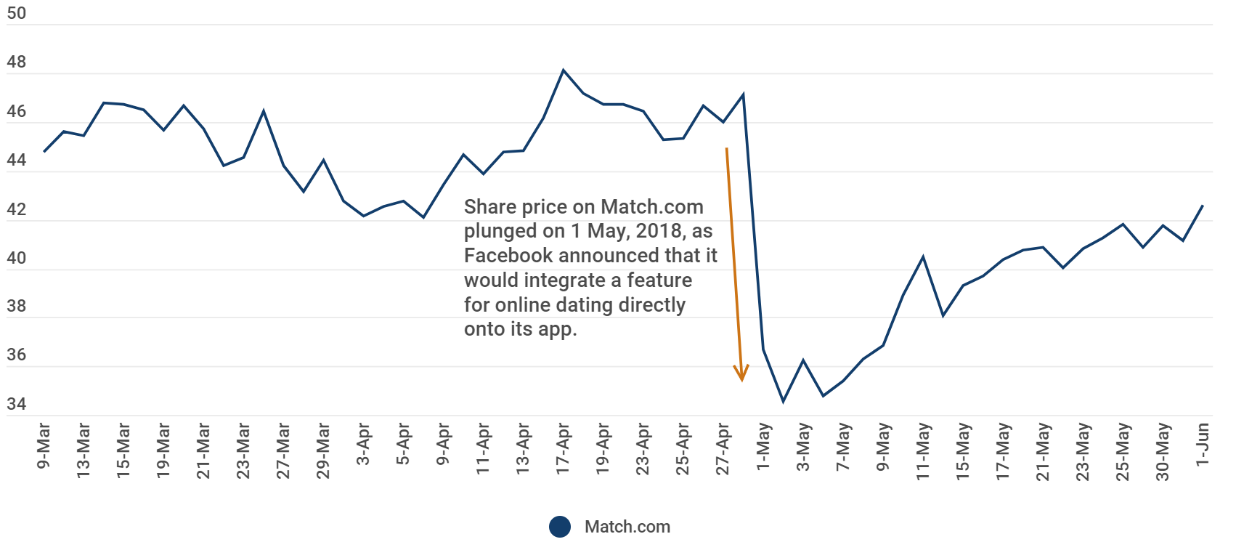

What information can text provide?
“We want Facebook to be somewhere where you can start meaningful relationships” – Mark Zuckerberg 1st May 2018
Notes:
Text has an impact on future price movements
Why?
Text can precede numerical indicators
Text ≈ proxy for beliefs: changes in how outlets write can signal shifting expectations.
Text can capture changes that are not possible with numerical data
Behavioural changes
Strategic changes
Use distributional (embedding) representations rather than keywords/sentiment to capture richer signals.

Slide 3
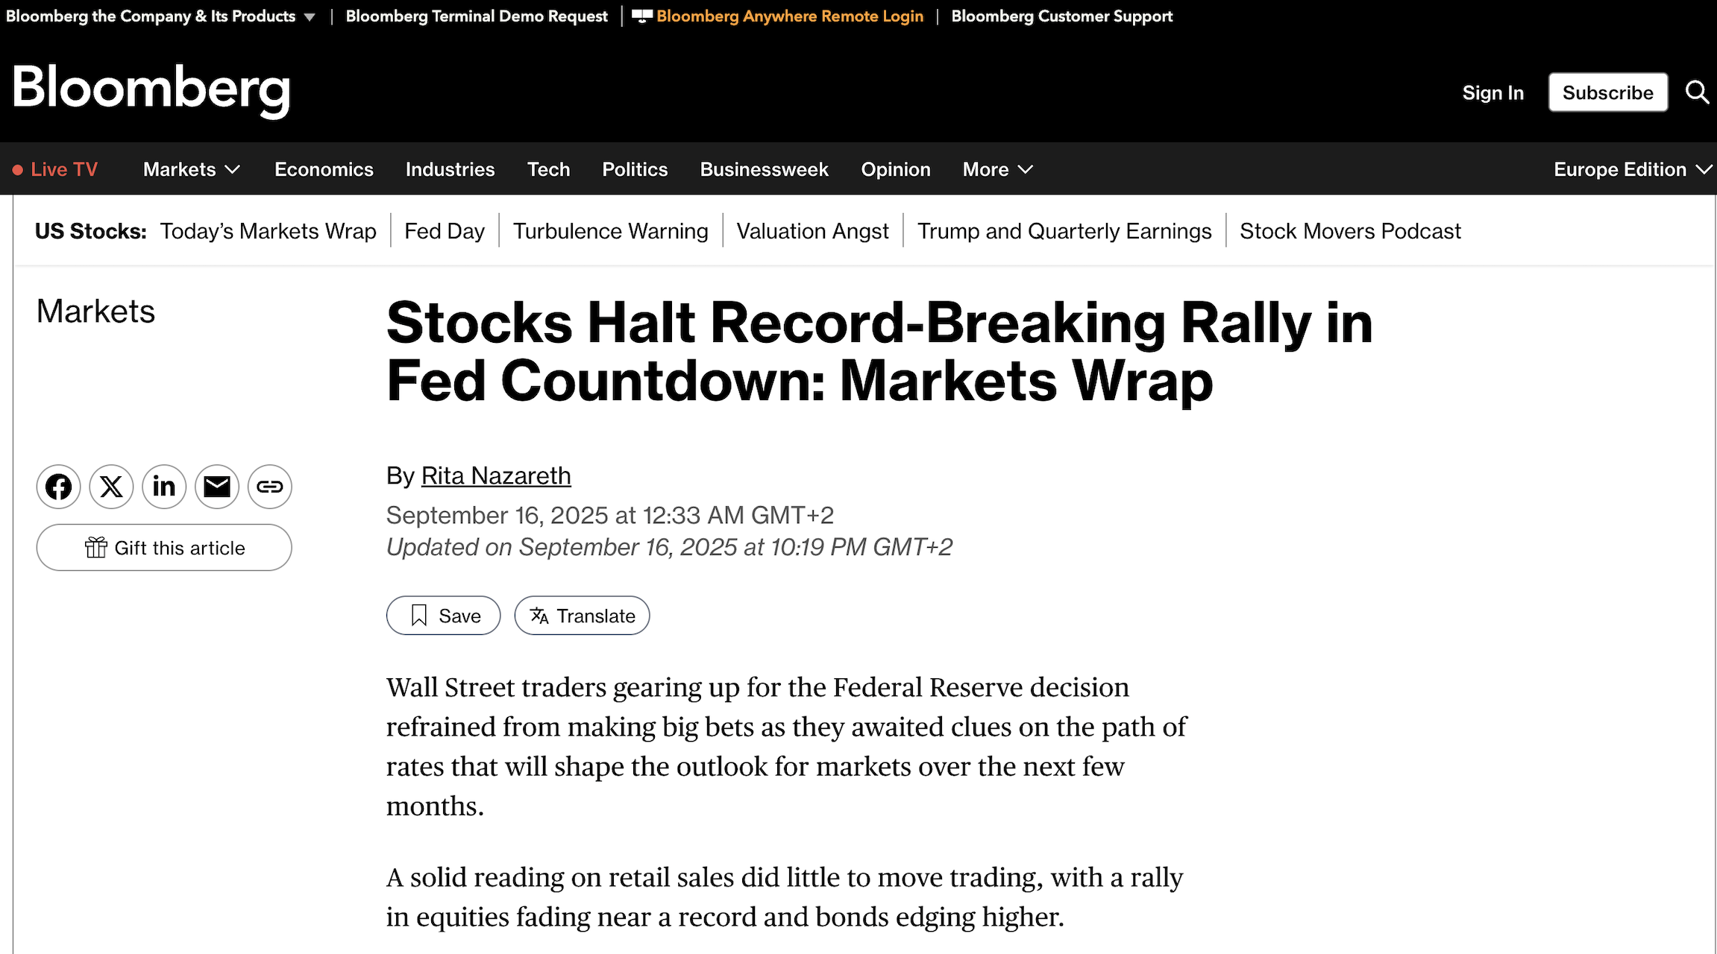
News Responds to Markets
Theory:
News information can both precede and follow market movements.
Goal of Paper:
To investigate the bidirectional causal relationship between news and market shocks.
Notes:
Our very own Bloomberg is reactive as well as predictive
Theory – news information can both precede and follow price moves; we explicitly model both directions.
Goal – to investigate the relationship
Bidirectional nature of the relationship has not been properly studied
quantify predictive value of markets→news and news→markets, not philosophical causality.

Slide 4
Research Questions
Which types of market shocks principally affect news outlets?
Are market shocks ever preceded by information within text? (hopefully!)
Does partisanship affect the response of news outlets?
Do feedback loops exist?
When is news information an important covariate?
Notes:
Which market shocks move outlets most?
Do outlets ever lead shocks?
How does partisanship shape reactions and predictability?
Are there feedback loops?
When does text matter most?

Slide 5
Which Economic Feature to Pick?
Challenges with most economic data
  Limited reporting frequency (CPI, GDP, unemployment etc.)
                Which limits sample number and temporal granularity
                Very difficult to determine any causal link between covariates and economic indices – too many possible confounders
Market information
  Solves these problems -> Daily data
  Market data is complex and heterogenous (where to look!)
Solution – structural VAR to identify market shocks
  Cieslak and Pang, Journal of Financial Economics 2021
  Deviation from expected market behaviour
  US Treasury Yields (2, 5 and 10-year maturities)
  Log stock returns (S&P 500)
  Asset co-movement can inform us of the type of shock
Notes:
1) Challenges
Most data is monthly or quarterly
Means that data is limited
Large gaps means that too many causal confounders could
2) Market information
3) Solution
Structural VAR
Not going to explain every detail
Fundamentally – a model is fitted on market information and then market shocks represent structural and logically defined deviations from the error component of that model

Slide 6

Different Market Shocks
Growth ($ω_{g}$)
Stock prices go up and bond yields increase at short to medium maturities
Monetary (tightening) ($ω_{m}$)
Stock prices go down and bond yields increase at short to medium maturities
Common premium ($ω_{cp}$)
Discount rate risk premium (linked to inflation) increases bond prices and thus lowers long-term bond yields whilst also lowering stock prices
Hedging premium ($ω_{hp}$)
Elevated future cash-flow risk depresses stock prices and increases long-term bond yields (safe-haven effect)
All four market shocks are orthogonal to one another
Notes:
Growth (ωg): stocks ↑, short/mid yields ↑.
Monetary tightening (ωm): stocks ↓, short/mid yields ↑.
Common premium (ωcp): discount-rate risk ↑ → long yields ↓, stocks ↓.
Hedging premium (ωhp): cash-flow risk ↑ → stocks ↓, long yields ↑.
Orthogonal series.
Good. Don’t double count shock’s effect
Shocks are separable and independent at a given time
Means that statistical tests are less likely to be correlated
Means that significant results can be attributed to a specific shock
Your tests ask “does past X help predict Y?” If shocks weren’t orthogonal, a text feature that really predicts monetary news could look like it predicts growth too—simply because those two shocks co-move contemporaneously.

Slide 7
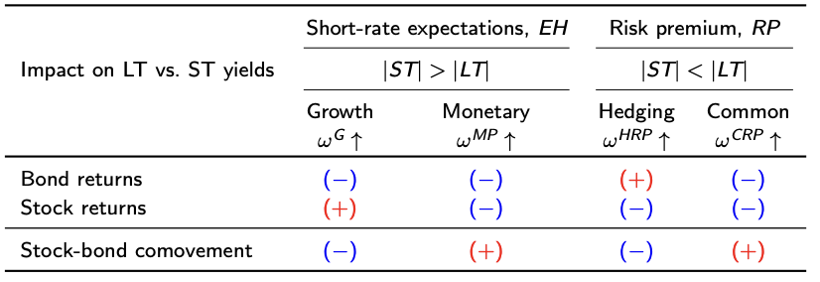
Deriving Market Shocks
Notes:
Visual aid to better understand the structural market shocks

Slide 8
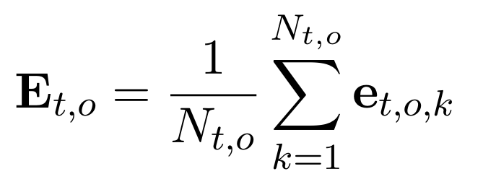
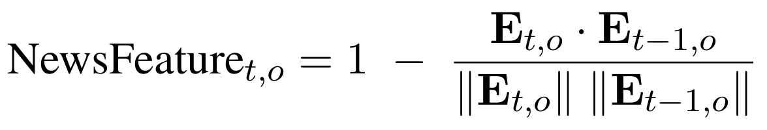
How to Identify Text Features?
Language models produce high dimensional outputs
  Problematic to prove change along dimensions
  Also… each dimension does not really mean anything
  Solution: Diachronic semantic change is a well-understood problem
Text feature
  Average embeddings across each day creates a daily outlet embedding
  Cosine distance from previous day’s embedding
  Represents the semantic deviation on a given day
Notes:
N_t,o is the number of articles per outlet on a given day
e_t,o,k is the embedding of each article
Create daily outlet embeddings by averaging article embeddings (all-mpnet-base-v2).
Measure day-to-day cosine distance = semantic shift ≈ a “textual shock.”

Slide 9
How to Identify Text Features?
Partisan dataset
  Spliethover et al. EMNLP 2022
  Each article tagged according to political partisanship of outlet
  Political tags taken from AllSides.com
Filter articles into sentences that talk about the economic concepts
  Five economic keywords/phrases - expanded list using 50 embedding-based synonyms
    “prices”, “inflation”, “labor”/“labour”, “real estate”, “growth”
    Synonyms rejected if that word is polysemic
  Store sentence if any of the economic synonyms appear in the sentence
Notes:
Use a partisan-tagged news dataset (AllSides labels).
Filter
Econ topics
prices, inflation, labor/labour, real estate, growth
carefully screened synonyms; require term as subject/object to stay on-topic.
Didn’t use embeddings to filter for economic/market news as we were measuring the embedding movements as part of the stat. tests

Slide 10
News Outlets Considered
Centre:
['Heavy', 'CNBC', 'Business Insider', 'Reuters', 'Wall Street Journal', 'USA TODAY', 'BBC News', 'Forbes', 'FiveThirtyEight']
Left:
['The New Yorker', 'Newsweek', 'CNN', 'The New York Times', 'CBS News', 'Vox', 'Rolling Stone', 'The Washington Post', 'The Guardian', 'Slate', ‘The Daily Beast', 'Vice', 'Politico', 'HuffPost', 'MSNBC', 'ABC News']
Right:
['The Gateway Pundit', 'PJ Media', 'The Western Journal', 'Breitbart News', ‘The Washington Times', 'ZeroHedge', 'New York Post', 'Reason', 'Fox News', 'Newsmax', 'RedState', 'The Epoch Times', 'Townhall', 'Orange County Register', 'The Daily Caller', 'National Review', ‘BizPac Review', 'TheBlaze']

Slide 11
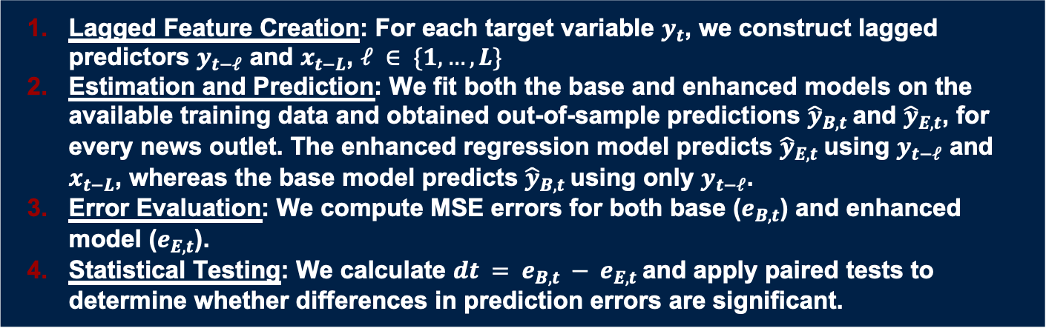
Methodology
Lagged Feature Creation: For each target variable $y_{t}$, we construct lagged predictors $y_{t−ℓ}$ and $x_{t−L}$, $ℓ ∈ \{1,…,L\}$
Estimation and Prediction: We fit both the base and enhanced models on the available training data and obtained out-of-sample predictions ${\hat{y}}_{B,t}$and ${\hat{y}}_{E,t}$, for every news outlet. The enhanced regression model predicts ${\hat{y}}_{E,t}$using $y_{t−ℓ}$ and $x_{t−L}$, whereas the base model predicts ${\hat{y}}_{B,t}$using only $y_{t−ℓ}$.
Error Evaluation: We compute MSE errors for both base ($e_{B,t}$) and enhanced model ($e_{E,t}$).
Statistical Testing: We calculate $dt = e_{B,t} − e_{E,t}$and apply paired tests to determine whether differences in prediction errors are significant.
Notes:
Describe slide simply and clearly
Train → predict OOS → compare MSEs. Significant MSE drop ⇒ predictive value.

Slide 12
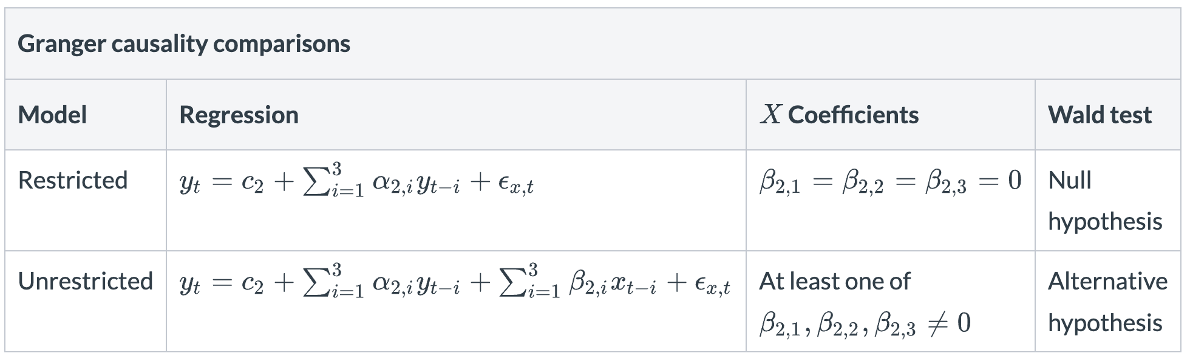

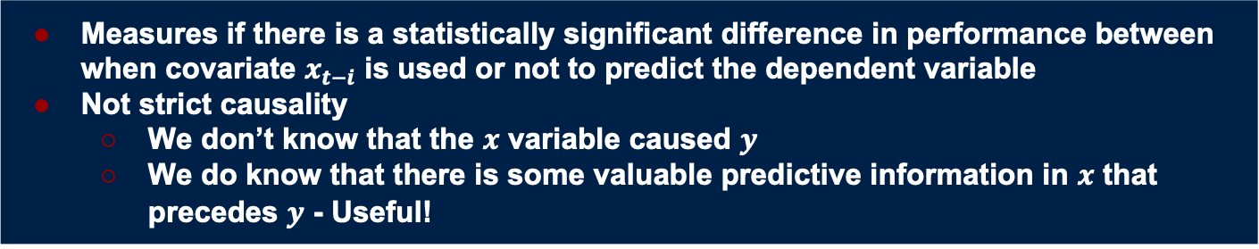
Granger Causality Test
Measures if there is a statistically significant difference in performance between when covariate $x_{t−i}$ is used or not to predict the dependent variable
Not strict causality
  We don’t know that the $x$ variable caused $y$
  We do know that there is some valuable predictive information in $x$ that precedes $y$ - Useful!
Notes:
We test temporal predictability

Slide 13
Regressors
Important to understand the nature of the relationship between news outlets and market shocks
  Independent and dependent variables can have linear and non-linear relationships
To test the type of relationship exists between the covariate information and the dependent variable we can vary the type of regressor
            Linear regression - OLS
            Non-linear - RBF Kernel Ridge regression
  RBF Kernel projects inputs into high dimensional and non-linear space
Notes:
Non-linear captures non-linear relations between text and shocks; we’ll see it matters. Duh!

Slide 14
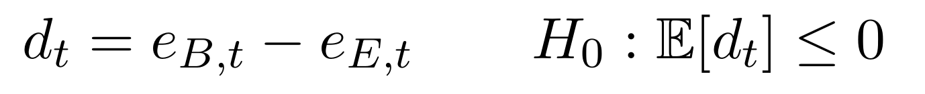
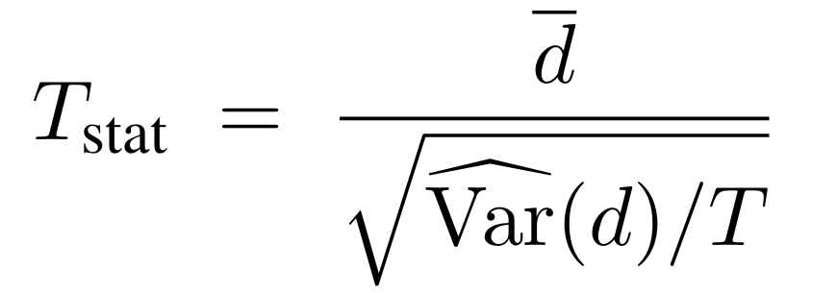
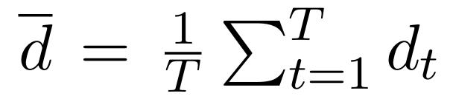
Statistical Test
Null hypothesis – no improvement when using the covariate information
Statistical test – one-sided paired T-test
Notes:
1 sided paired t-test for individual pairs!

Slide 15
P-Hacking!
Very large problem in science
Example:
  A researcher performs 20 experiments
                1 experiment is significant (5%)
                The researcher writes a paper on that 1 experiment
                Accepted into NeurIPS 🥳
Significant challenge in our study
  We perform a lot of statistical tests
  5% of random observations will be significant – outperforming that threshold is important
Solutions
  Introduce a strict statistical correction - Bonferroni Correction
  Measure significance at a group level
Notes:
Go through example of test

Slide 16

Statistical Significance
Group Level Significance
  Only recognise significance is the proportion of significant results exceeds the expected 5% by a significant amount
  Perform one sided binomial test with null hypothesis that $\hat{ρ}=0.05$
Individual Pairing Significance
  To prove that an individual news/market shock pair is significant we need an adjustment or the p-value threshold
  Bonferroni correction – adjusted threshold $p_{i} <\frac{α}{M}$, where $M$ is the total number of tests
  A strict adjustment that penalises correlated
  Represents a very high bar where we can be sure that significance exists if reached
Notes:
Group level: require the share of significant pairs to beat chance by binomial test.
Individual level: Bonferroni-adjusted p-threshold (conservative → high confidence).

Slide 17
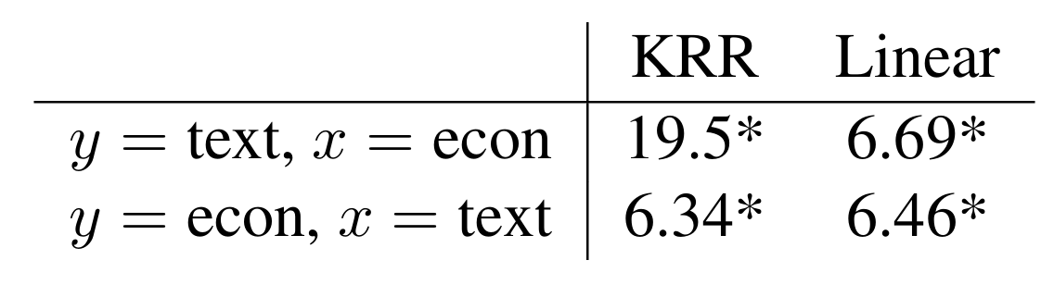
Overall Results
Markets causally inform semantic changes in news outlets
Weak but existent causal response of markets to changes in text
Relationship between market shocks to text is non-linear
All results are statistically significant
Notes:
Markets → News: strong, short-lived causal impact on outlet semantics.
News → Markets: weaker but real—text sometimes leads shocks.
The relationship is non-linear; KRR finds more signal than OLS. (E.g., 19.5% vs 6.69% sig. for markets→text across specs.)

Slide 18
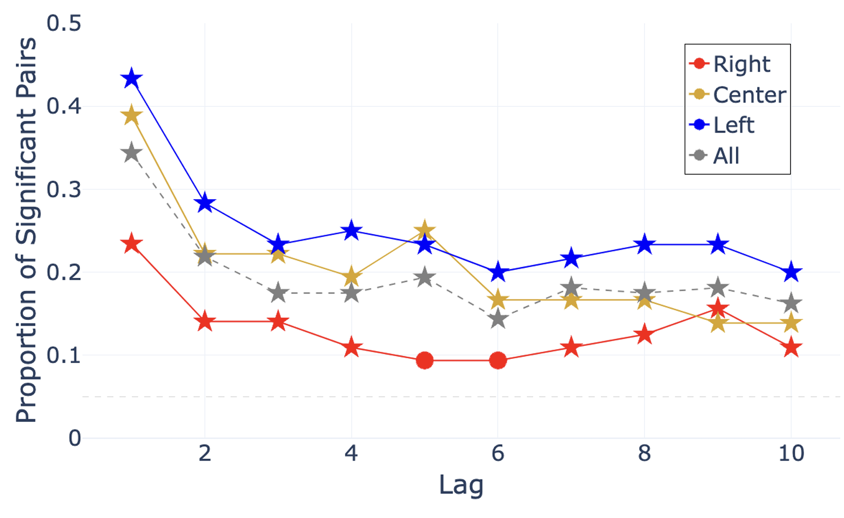
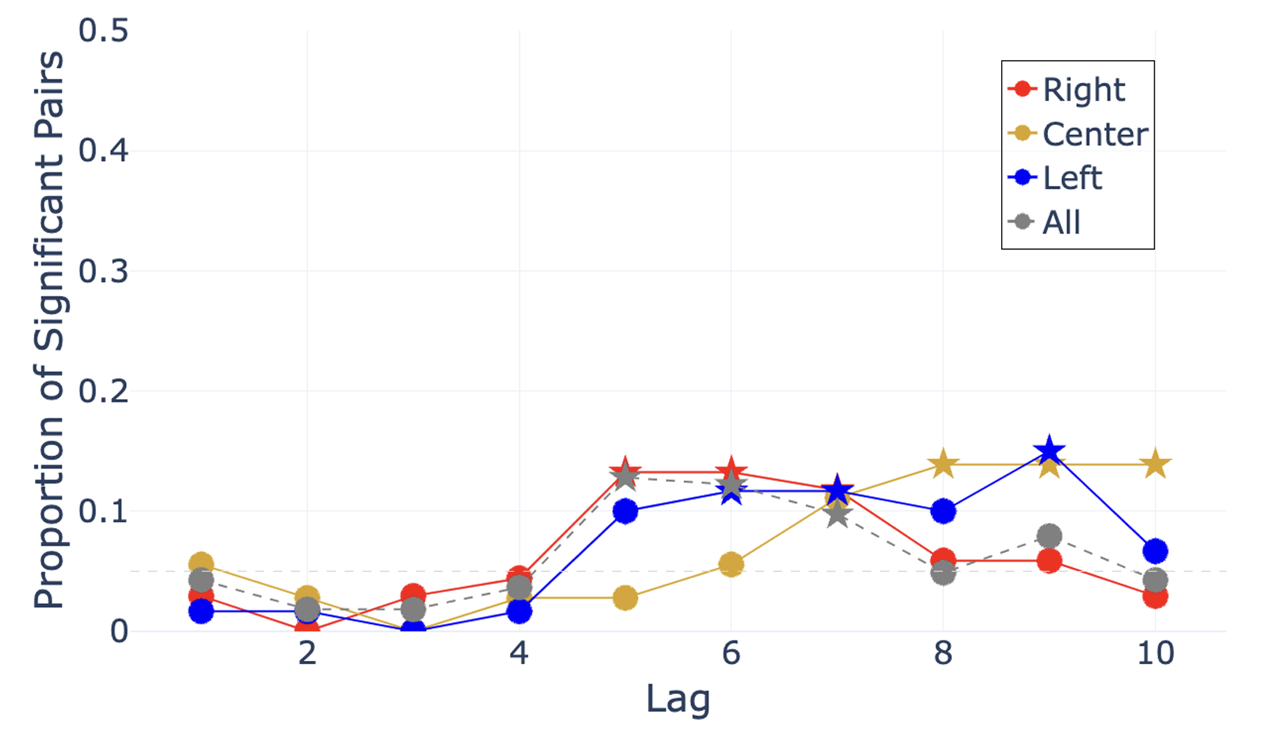


By Partisan Group
$$Y=Text X=Market Shocks$$
$$Y=Market Shocks X=Text$$
Causal impact is short term and diminishes after a few days
Right-wing outlets are less reactive
Significant results after a week
Possibly missing out on shorter effects with daily granularity
Notes:
Reactivity (markets→text): Left & Center react more/faster than Right; effects decay in a few days.
Predictiveness (text→markets): signals emerge at ~5–10 day lags; Right shows effects mainly at lags 5–7.

Slide 19
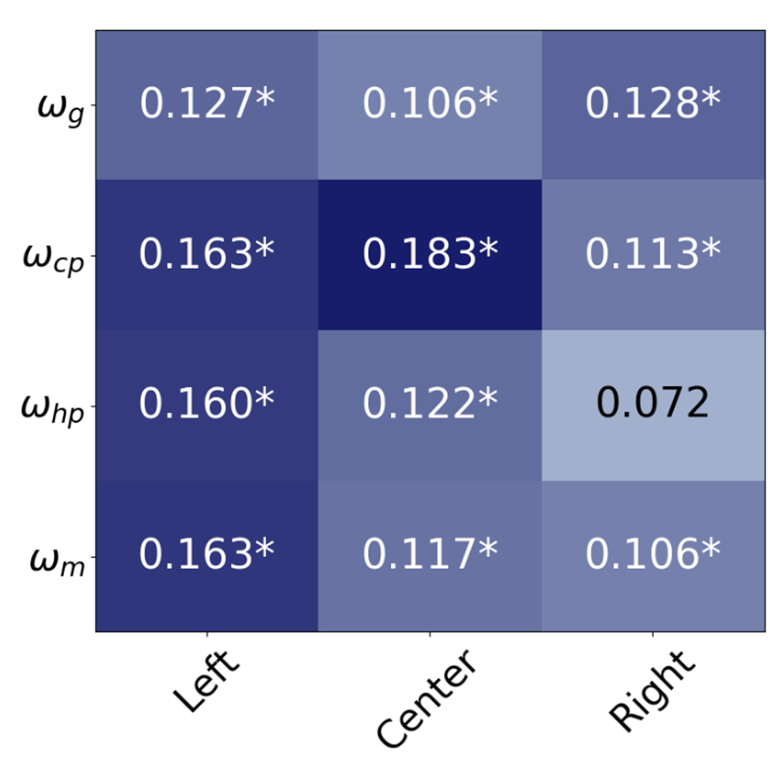
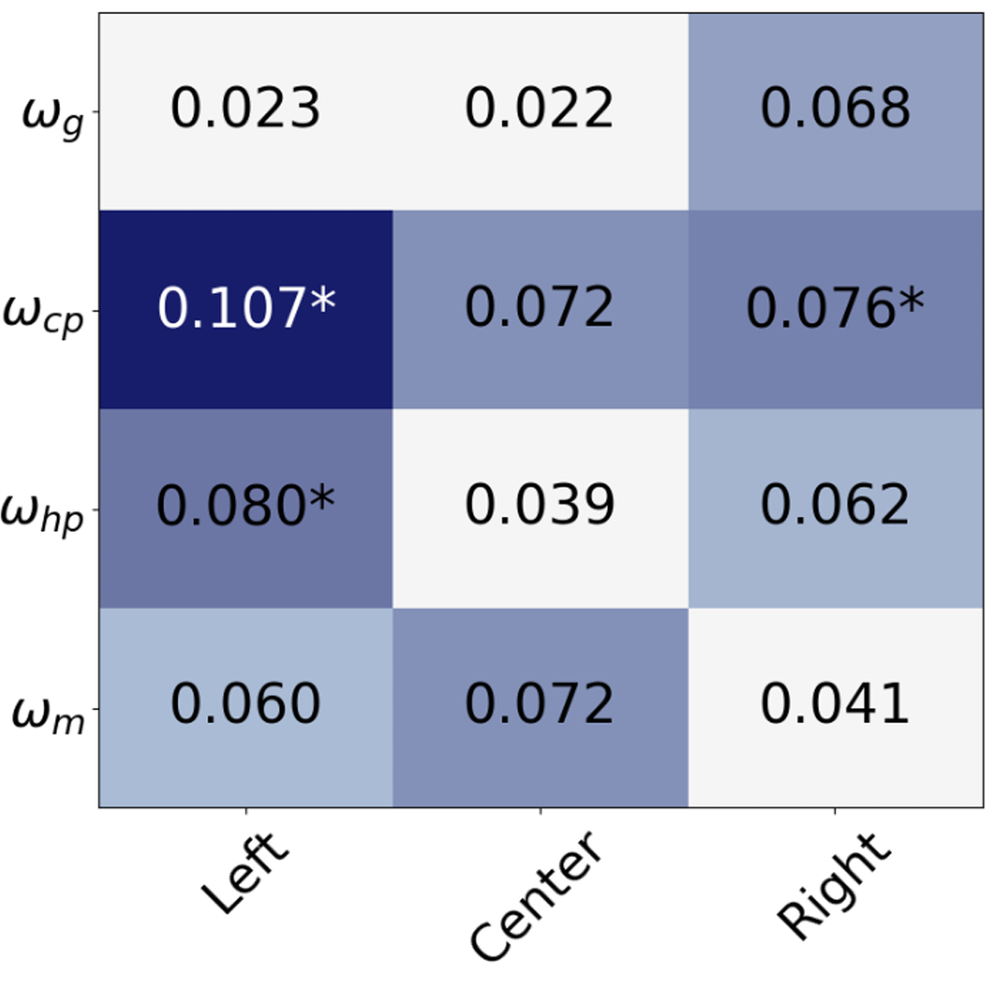




Which Shocks do News Outlets Respond to?
$$Y=Text X=Market Shocks$$
$$Y=Market Shocks X=Text$$
Central outlets are very responsive to $ω_{cp}$ shocks (inflation linked)
Right-wing outlets are most responsive to $ω_{g}$ (growth) shocks
Left-wing outlets are not reactive to $ω_{g}$ shocks
Left-wing news outlets causally precede $ω_{cp}$ shocks
Growth shocks hardest to predict – most likely to be priced in?
Notes:
Center most responsive to ωcp (inflation-linked risk premium).
Right most responsive to ωg (growth); Left not very reactive to ωg.
Left text tends to precede ωcp; ωg is hardest to predict overall. (Left’s ωcp predictiveness ≈10.7% sig. rate.)

Slide 20

Feedback Loops
Circular causality was identified by using the Bonferroni adjusted p-values to infer a significant degree of predictive causality, if both variables in the pair were deemed to cause one another, irrespective of lag, then circular causality was flagged
Proportion of individually significant pairs that have circular causality
  $ω_{cp} = 4.22\%{; ω}_{m} = 1.56\%; ω_{hp} = 0.2\%; ω_{g} = 0\%$
  Firstly, feedback loops are rare
  Why might inflation-linked shocks ($ω_{cp}$) form feedback loops?
  Inflation-linked shocks often ignite widespread media coverage, amplifying investors’ sensitivity to any hint of price instability
  Frequent shock-inducing events linked to inflation – such as commodity prices, central bank signals, or wage growth
  Repeated episodes of speculation can magnify market moves, drawing additional coverage and further intensifying the original inflation narrative.
Notes:
Define loop: each side Granger-causes the other (any lag) under Bonferroni.
Loops are rare, concentrated in ωcp (4.22% of pairs), modest in ωm (1.56%), tiny in ωhp (0.2%), none in ωg.
Why ωcp? Inflation stories attract broad coverage, frequent triggers (commodities, wages, central bank signals), creating self-reinforcing attention.

Slide 21
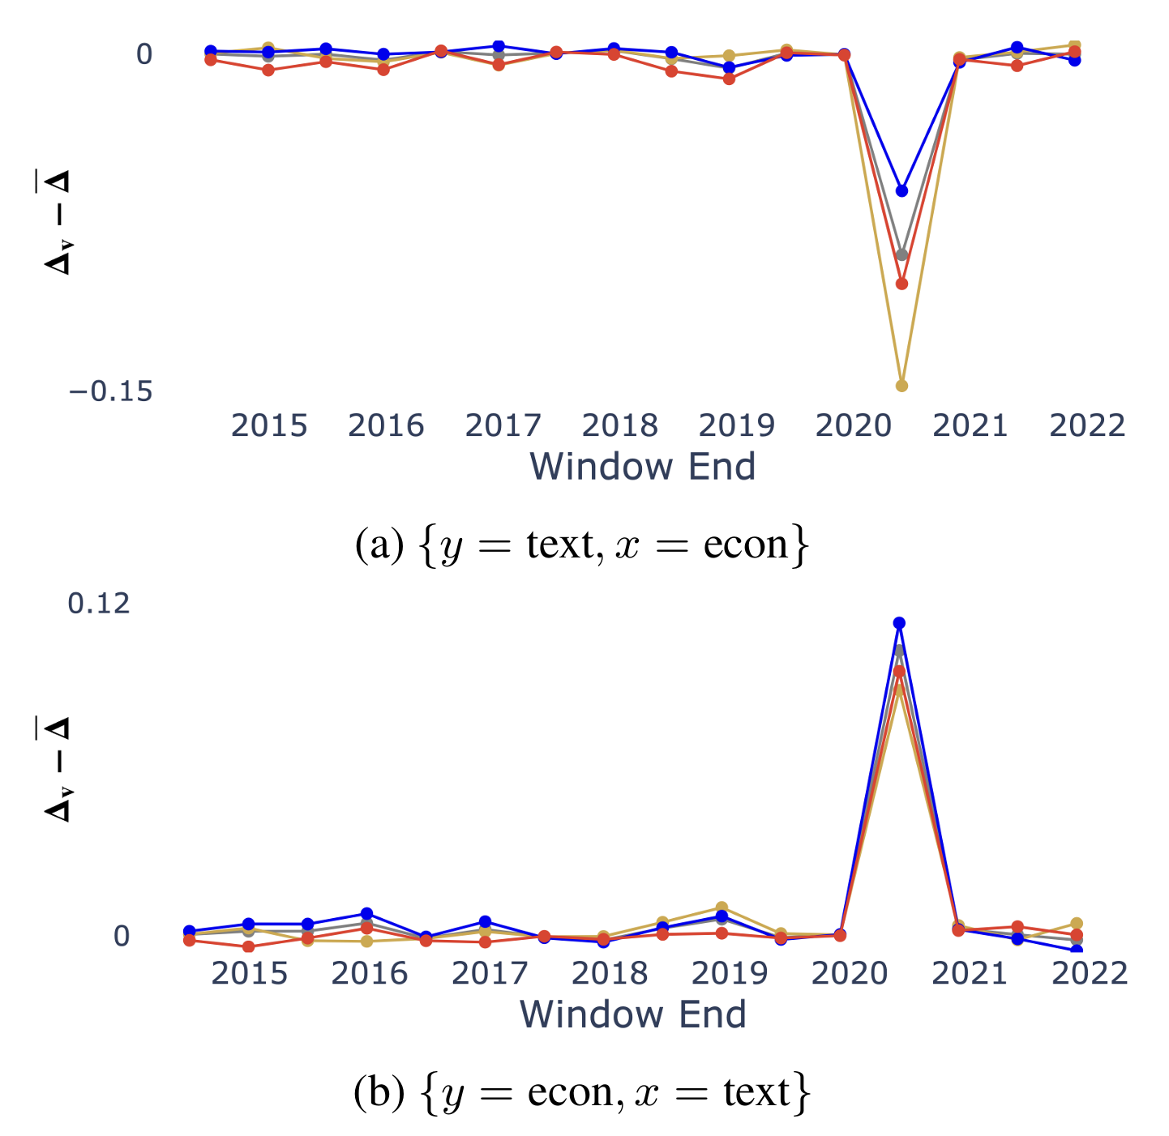
Temporal Analysis
We use a 365-day rolling window with a 90-day test set, advancing every 180 days
News is very useful at predicting markets during COVID
Markets worse at predicting news
Possible reasons
  Market movements less endogenously explained, leading to more structural shocks and weaker internal market predictive performance
  Markets were very reactive to news outlets
Notes:
Rolling windows show COVID (Mar–May 2020) was an outlier:
Text→Markets mattered more (markets highly reactive to news).
Markets→Text mattered less (news driven by pandemic, not shocks).
This is not the eval process for the rest of the paper

Slide 22

What have we learned?
News outlets are significantly reactive to markets
There is some useful predictive information in news data
Partisanship can affect the causal relationship between news and markets
Growth shocks are hard to predict
Feedback loops only really exist in common premium ($ω_{cp}$) shocks
News outlets are particularly useful during unstable market conditions
Notes:
News is significantly reactive to markets; some predictive power in text.
Partisanship shapes both reactivity and predictiveness.
Growth shocks are toughest to predict; feedback loops mainly in ωcp.
Text is especially useful in unstable regimes (e.g., COVID).

Slide 23
Limitations and Future Work
Data granularity means that we may have missed causal effects with shorter event horizons (e.g. seconds and minutes)
No directional analysis conducted
One dimensional linguistic representation (change)
Simple regression models
Notes:
Granularity: daily cadence may miss sub-day effects.
No directional content analysis; simple text feature (1-D change) and simple models.
Extend to multilingual settings; richer/domain-adapted embeddings; sub-day lags; broader confounder graphs; real-time evaluation.

Slide 24
Thank you!
Notes:
Closing thought: semantic change is a measurable signal that can both reflect and foreshadow macro shocks—useful for researchers and practitioners.

