Slide 1
Introduction
Data
Methodology
Results
Conclusion
Market Microstructure in the Big-data Era: Improving High-frequency Price Prediction via Machine Learning
Agostino Capponi¹, Shihao Yu¹
¹ Columbia University, IEOR
May 19, 2023
Bloomberg-Columbia Machine Learning in Finance Workshop 2023

Slide 2
Introduction
Data
Methodology
Results
Conclusion
Outline
Introduction
Data Methodology Results Conclusion

Slide 3
Introduction
Data
Methodology
Results
Conclusion
Outline
Introduction
Data Methodology Results Conclusion

Slide 4
Introduction
Data
Methodology
Results
Conclusion
Microstructure in the machine age
▶ Big data in the US equities market
▶ Extremely fast: algorithmic and high-frequency trading; 20% of trades arrive in < 1ms clusters (Menkveld, 2018)
▶ A highly fragmented market: 16 public exchanges, internalization, dark pools
▶ Voluminous trading data: level-3 order book messages
▶ The information set of market participants has greatly expanded
▶ Market data is crucial, for market makers, arbitrageurs & buy-side

Slide 5
Introduction
Data
Methodology
Results
Conclusion
Market data policy debate
▶ Two-tiered market data for U.S. equities:
▶ Consolidated (SIP) feeds: slow, top-of-book quotes, SEC-mandated, relatively cheap, used by unsophisticated traders
▶ Direct feeds: fast, depth-of-book quotes, sold by exchanges, expensive, used by sophisticated traders such as high-frequency traders
▶ Fair? Policy debates
▶ U.S.: NMS 1.0 (top-of-book in the SIP) ⇒ NMS 2.0 (five-level depth in the SIP)
▶ Europe: Consolidated feed in the making: What to include? Top-of-book? Depth-of-book?
▶ Economic questions:
▶ Which exchange contributes the most to price discovery?
▶ Which part of the data feed contributes the most to price discovery? (Top? Within the five best levels? Full depth?)

Slide 6
Introduction
Data
Methodology
Results
Conclusion
Contributions
▶ Empirical microstructure literature ¹
▶ Limited set of variables/features
▶ Ex-ante specification of price impact function
▶ In-sample, ex-post attribution of information shares
▶ Quantitative finance literature ²
▶ State-of-the-art machine learning models
▶ Economics is not clear
▶ The goal of our paper: bridge the above two strands of literature
¹Hasbrouck (1995) and Brogaard, Hendershott, and Riordan (2019)
²Kercheval and Zhang (2015), Tsantekidis et al. (2017), Ntakaris et al. (2019), Sirignano (2019), Zhang, Zohren, and Roberts (2019), and Wu et al. (2022)
6/27

Slide 7
Introduction
Data
Methodology
Results
Conclusion
Outline
Introduction
Data
Methodology
Results Conclusion

Slide 8
Introduction
Data
Methodology
Results
Conclusion
Data
▶ “Direct feeds” from public exchanges
▶ Level 3 order-book messages: all add (new limit orders), cancel/modification of existing orders, and trade messages
▶ Timestamped to microsecond precision
▶ 30 constituent stocks of the Dow Jones Index (DJI). 54 trading days spanning from the year of 2017 to 2021.
▶ For each exchange, we build the entire order book based on the direct feed messages

Slide 9
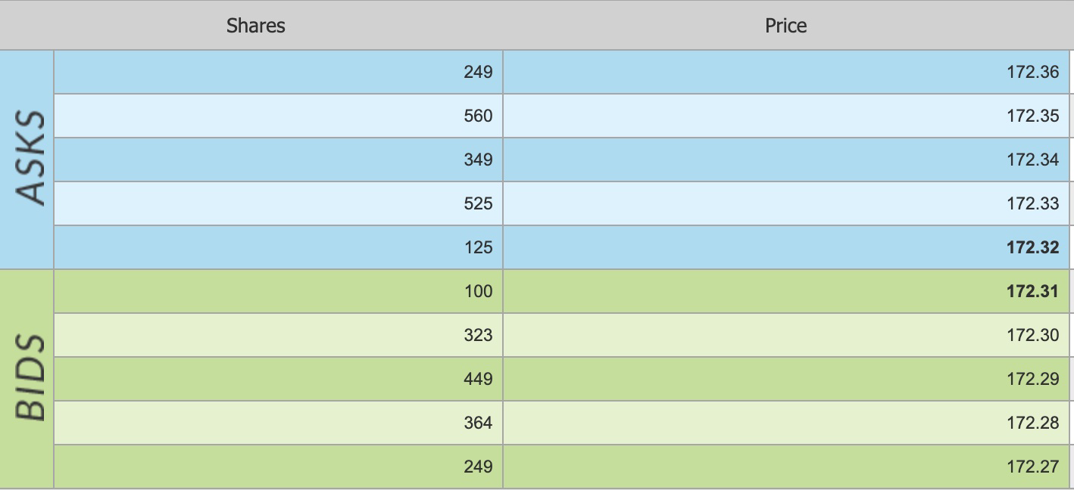
Introduction
Data
Methodology
Results
Conclusion
Limit order book (LOB) market
▶ Most liquid markets use limit order books (LOBs) for trading
▶ A limit order book is essentially a collection of unexecuted quotes
▶ Each quote specifies the price and quantity the trader is willing to trade
▶ New quotes can be continuously added and existing quotes can be canceled, modified, or executed against incoming marketable orders

Slide 10
Introduction Data Methodology Results
LOB data types
▶ Level-I: the best bid/ask prices and volumes,
▶ Level-II: price and aggregated volume across a certain number of price levels
▶ Level-III: non-aggregated orders placed by market participants
Figure 1: LOB data types. Source: Wu et al. (2022)
Conclusion

Slide 11
Introduction Data
Direct feeds
▶ “Direct feeds” examples
(a) Add message
Methodology
Results
Conclusion
(b) Cancel/modification message
(c) Trade message
Figure 2: Direct feeds

Slide 12
Introduction
Data
Methodology
Results
Conclusion
Outline
Introduction
Data
Methodology
Results
Conclusion

Slide 13
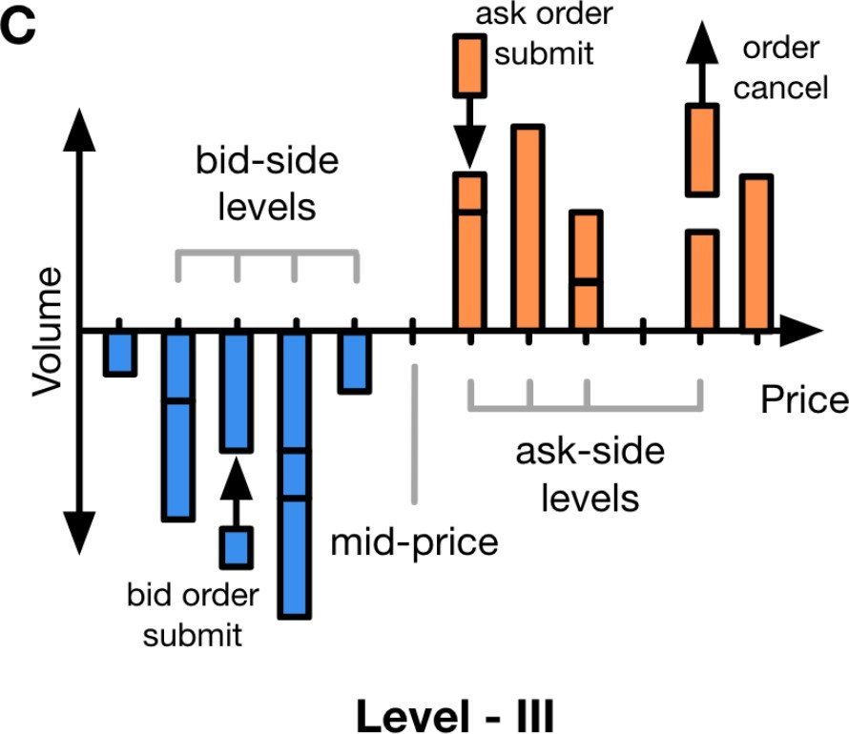
Introduction Data Methodology Results
LOB actions
▶ LOB is constantly changing due to add, modifications, and executions
▶ New quotes can be continuously added, and existing quotes can be canceled, modified, or executed against incoming marketable orders
▶ At different price levels
Figure 3: LOB actions. Source: Wu et al. (2022)
Conclusion

Slide 14
Introduction
Data
Methodology
Results
Conclusion
Feature engineering
▶ LOB actions and their lagged values, from each exchange
▶ Trade-BBO-Changing: Executions moving BBO
▶ Trade-NonBBO-Changing: Execution not moving BBO
▶ Add-BBO-Improving: Add orders improving BBO
▶ Cancel-BBO-Worsening: Cancel orders worsening BBO
▶ Add-at-BBO: Add orders adding depth at the current BBO
▶ Cancel-at-BBO: Cancel orders removing depth at the current BBO
▶ Add-<=5lvlBBO: Add orders adding depth <= 5 levels from BBO
▶ Cancel-<=5lvlBBO: Cancel orders removing depth <= 5 levels from BBO
▶ Add->5lvl-BBO: Add orders adding depth > 5 levels from BBO
▶ Cancel->5lvl-BBO: Cancel orders removing depth > 5 levels from BBO
▶ Midquote changes, and their lagged values, from each exchange

Slide 15
Introduction
Data
Methodology
Results
Conclusion
Target and performance evaluation
▶ Target
▶ Short-term NBBO change (e.g. in the next 5 events)
▶ Clock runs in event time
▶ Performance evaluation
▶ Mean squared error (MSE)
_{▶ R}2

Slide 16
Introduction
Data
Methodology
Results
Conclusion
Machine learning models
▶ Simple linear model (OLS)
▶ Linear models with penalties
▶ Elastic net penalties
▶ Tree-based models
▶ Random forests (RF)
▶ Boosted regression trees (BRT)

Slide 17
Introduction
Data
Methodology
Results
Conclusion
Linear model with penalties
▶ Too many features might lead to overfitting
▶ One solution is to add penalties to the loss function
▶ Elastic net penalties: penalize + shrink
(1)
▶ Solves overfitting but is still linear.

Slide 18
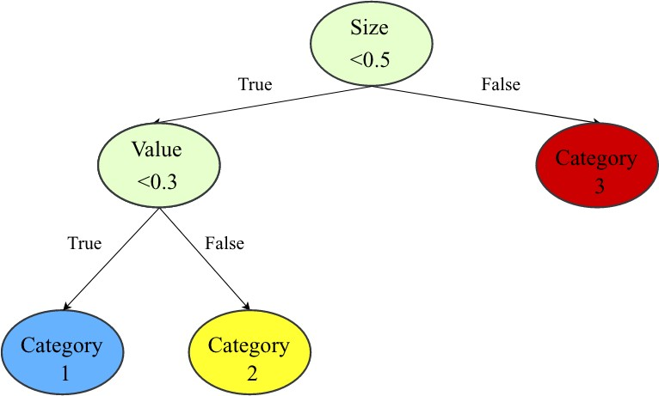
Introduction
Data
Methodology
Results
Conclusion
Random forests and boosted regression trees
▶ Regression tree
Figure 4: Tree example. Source: Gu, Kelly, and Xiu (2020)
▶ Tree splitting captures non-linearities and flexible interactions
▶ Both random forests and boosted regression trees are ensemble methods

Slide 19
Introduction
Data
Methodology
Results
Conclusion
Tranining, validation, and testing sample split
▶ We split each trading day into 13 half-an-hour intervals
▶ Training (system parameters fitting), validation (hyper/tuning parameters fitting), and testing based on inter-day rolling windows. For example,
▶ 09:30 - 10:00 today as training
▶ 09:30 - 10:00 tomorrow as validation
▶ 09:30 - 10:00 the day after as testing
▶ We follow the hyperparameters in Gu, Kelly, and Xiu (2020)
▶ Elastic-net: ρ = 0.5; α = (0.1, 0.01, 0.001, 0.0001)
▶ RF: Depth = (2, 4, 6); #Trees = 300; #Features in each split = (3, 5, 10)
▶ BRT: Depth = (1, 2); #Trees = (100, 1000); Learning rate = (0.01, 0.1)

Slide 20
Introduction
Data
Methodology
Results
Conclusion
Outline
Introduction
Data Methodology
Results
Conclusion

Slide 21
Introduction
Data
Methodology
Results
Conclusion
Prediction (MSE)
▶ Consider the five stocks: American Express (AXP), Boeing (BA), Caterpillar (CAT), Disney (DIS), and Goldman Sachs (GS).³
▶ BRT consistently outperforms linear models in terms of MSE
Table 1: MSE of different models. The bold font shows the smallest for each column/stock.
ticker model | AXP | BA | CAT | DIS | GS
OLS | 0.0149 | 0.1267 | 0.0407 | 0.0213 | 0.3925
Elastic-net | 0.0149 | 0.1206 | 0.0368 | 0.0213 | 0.3808
RF | 0.0151 | 0.1214 | 0.0363 | 0.0218 | 0.3727
BRT | 0.0145 | 0.1158 | 0.0343 | 0.0204 | 0.3593
³In our paper, we include results for all 30 DJI tickers.
21/27

Slide 22
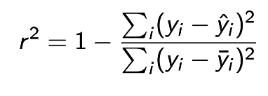
Introduction
Data
Methodology
Results
Conclusion
Prediction (R-squared)
▶ BRT consistently outperforms linear models in terms of r ²
(2)
Table 2: MSE of different models. The bold font indicates the smallest for each column/stock.
ticker model | AXP | BA | CAT | DIS | GS
OLS | 0.0309 | -0.0479 | -0.1429 | 0.0448 | -0.0526
Elastic-net | 0.0325 | 0.0229 | 0.0186 | 0.0465 | -0.0113
RF | 0.0202 | 0.0179 | 0.0230 | 0.0251 | 0.0148
BRT | 0.0509 | 0.0520 | 0.0296 | 0.0737 | 0.0497

Slide 23
Introduction
Data
Methodology
Results
Conclusion
Permutation importance
▶ To assess the importance of a feature or several features, permutate (randomly shuffle the ordering) them in the testing set
▶ Then compare the change in MSE or r ² from the testing set
▶ Different from in-sample feature importance
▶ Agnostic to model choice

Slide 24
Introduction Data Methodology Results
Permutation importance (exchange)
▶ Which exchange contributes the most to price discovery?
▶ Look at the r ² drops when an exchange’s data feed is permutated
▶ Larger exchanges are more important. But the drop in r ² is mild.
Conclusion
Table 3: r ² of permutated testing samples. The first line shows the r ² of the original sample. The second lines and so on report the r ² changes when an exchange’s data feed is permutated. The bold font indicates the largest drop for each column/stock.
ticker | AXP | BA | CAT | DIS | GS
exchange
All exchanges | 0.0588 | 0.0649 | 0.0915 | 0.0909 | 0.0484
NYSE | -0.0025 | -0.0029 | -0.0074 | -0.0044 | -0.0035
ARCA | -0.0014 | -0.0008 | -0.0014 | -0.0008 | -0.0008
NASDAQ | -0.0051 | -0.0021 | -0.0113 | -0.0194 | -0.0025
BATS | -0.0039 | -0.0011 | -0.0019 | -0.0022 | -0.0007
EDGX | -0.0016 | -0.0008 | -0.0008 | -0.0001 | -0.0004

Slide 25
Introduction
Data
Methodology
Results
Conclusion
Permutation importance (data feeds)
▶ Which part of the data feed (e.g., beyond the best five levels, or within the best five levels) contributes the most to price discovery?
▶ Look at the r ² drop when a different part of the data feeds is permutated
▶ Data feeds beyond the five best levels have limited information; within five levels much more important
Table 4: r ² of permutated testing samples. The first line shows the r ² of the original sample. The second lines and so on report the r ² changes when part of the data feed is permutated.
ticker lvl | AXP | BA | CAT | DIS | GS
All lvls | 0.0588 | 0.0649 | 0.0915 | 0.0909 | 0.0484
beyond_5lvl (shuffled) | -0.0019 | -0.0028 | -0.0021 | -0.0019 | -0.0012
beyond_top (shuffled) | -0.0052 | -0.0046 | -0.0062 | -0.0084 | -0.0024

Slide 26
Introduction
Data
Methodology
Results
Conclusion
Outline
Introduction
Data Methodology Results
Conclusion

Slide 27
Introduction
Data
Methodology
Results
Conclusion
Conclusion
▶ Machine learning models have consistently better prediction performance for LOB midquote changes than linear models
▶ From an economic perspective:
▶ Larger exchanges are more important. But the drop in r ² is mild.
▶ Data feeds beyond the five best levels have limited information
▶ Future extensions:
▶ LOB events have time-series dynamics, e.g, autoregressive structure
▶ Suitable for time-aware machine learning models:
▶ Long short-term memory (LSTM),
▶ Transformers

