Slide 1
VQ-TR: Vector Quantized Attention for Time Series Forecasting
Kashif Rasul, Umang Gupta, Hena Ghonia,
Anderson Schneider, Yuriy Nevmyvaka

Slide 2
Overview
Motivation
Background: VQ-VAE
Model
Results
Future Work

Slide 3
Motivation
Probabilistic Neural Forecasting methods involve two main components:
A model that learns representation of time series histories
Some probabilistic-flavored emission model:
Could be as simple as some distribution with analytical likelihood
Mixture of densities, denoising diffusion etc.
Here we focus on 1). For learning representations, we can use:
RNNs: compress history to a single latent vector for each time
CNNs: have a limited "temporal" view for a given number of parameters
Transformers: can reason over the entire context history for each time point
Transformers scale quadratically with sequence length in terms of memory / computation

Slide 4
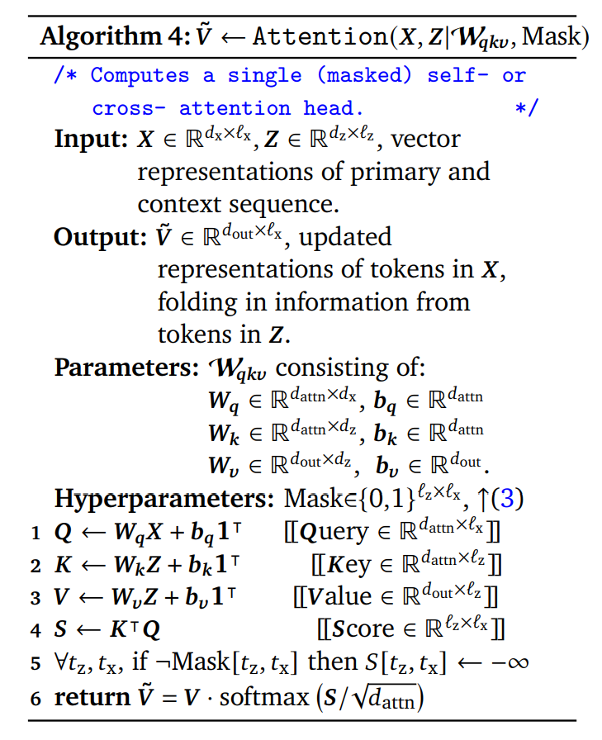
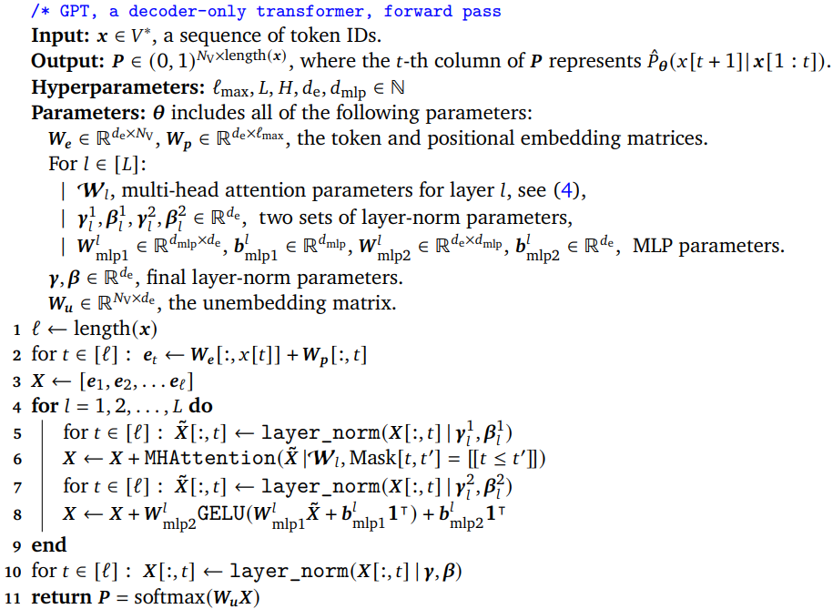
The Quadratic Cost per attention layer
When Z=X: self-attention
Context length given by $l_{x}$
Calculating V takes O($l_{x}^{2})$ time and space
Example how attention is used in LLM’s:
From Phuong & Hutter “Formal Algorithms for Transformers”

Slide 5
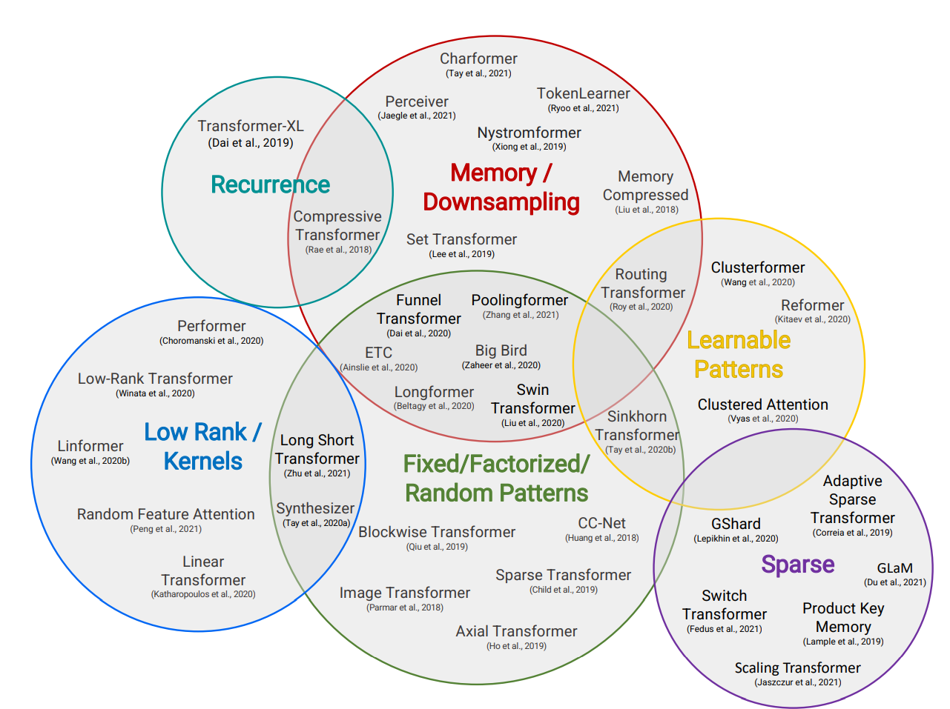
Mitigating the quadratic cost
Quadratic cost bites you very frequently:
Long-range dependencies in time-series
Max history in ChatGPT
Document summarization
Efficient Transformer Eco-system:
Approximation of the Attention mechanism
Design architecture to do less computation, occupy less memory
Novel methods of computing the Attention:
To not be quadratic
Or when $d_{x}$ x $l_{x}$ is too large (X is high resolution image, or multi-modal)
This work falls in the category of "doing less computation“
From Tay et al. “Efficient Transformers: A Survey”

Slide 6
Time Series Transformers
Time series Transformer or Vanilla Time Series Transformer can essentially use the default architecture of Transformers
An encoder can be given a vector of a time series from some context length temporal window
A masked (or causal) decoder can be given the next steps to predict
We can then fit the distribution parameters of the next time point for all the prediction length decoder inputs
At inference time we can pass the very last context window to the encoder and the decoder can be used to sample the next time point and the result passed back to the decoder for our desired prediction horizon (greedy decoding)
We can add known covariates (e.g. isItHoliday, HourOfDay etc.)
This is not much different to the “Next Token" task in NLP

Slide 7
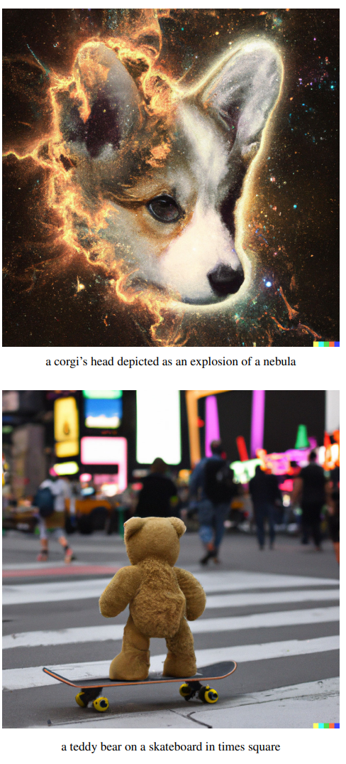
Observations
The inputs to the different layers of the Transformer are latent vectors of some size
Time series data of a particular dataset typically has some set of patterns
Can we perhaps design a method to learn only some fixed set of patterns or latent patterns?
Community does this a lot in the image and audio domain so why not here?
In Dalle-E model: first train a model that learns a discrete set of latents over images/text (Contrastive Language-Image)
Then use only these discrete latents for down-stream task like text-to-image generation

Slide 8
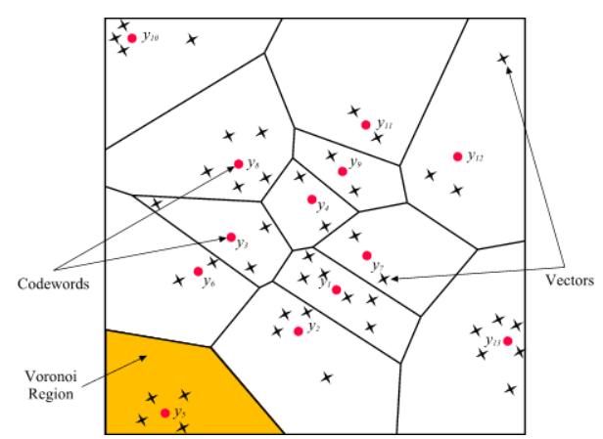
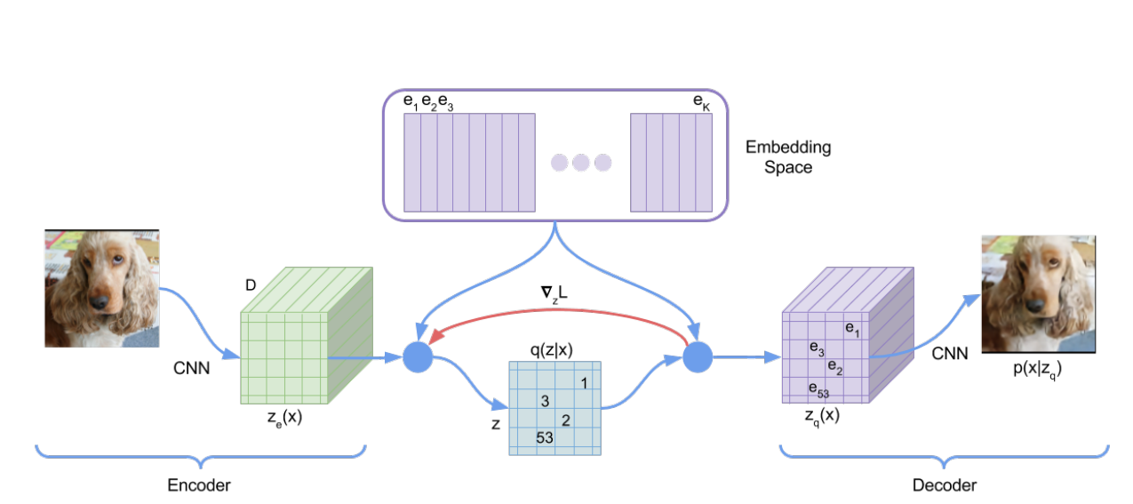
VQ-VAE
“Neural Discrete Representation Learning” NeurIPS 2017
“Generating Diverse High-Fidelity Images with VQ-VAE-2” ” NeurIPS 2019
Introduces Vector Quantization: Compression of latent space
Decoder outputs a discrete categorical distribution.

Slide 9
VQ-VAE
No real gradient for equation 2: can't brackprop over argmin
Can use straight-through estimator: “copy gradients downstream”
Due to the above, discrete embeddings receive no gradient from standard VAE reconstruction loss
Overall loss:
VAE: Evidence Lower Bound loss
VQ loss: $l_{2}$ error to guide codebook towards encoder output
Commitment loss: adjust encoder to prevent diverging from codebook
Can we apply similar idea for time series latents?

Slide 10
VQ-TR
In our model we map the incoming inputs to our Transformer's Encoder into a VQ layer
Since we only have a fixed set of latents we only need to do attention over this fixed size (independent of the sequence size)
This makes the resulting attention mechanism linear (instead of quadratic)
We can stack many layers of this to learn hierarchical latent representations
The Decoder is the vanilla Causal (masked) transformer decoder

Slide 11
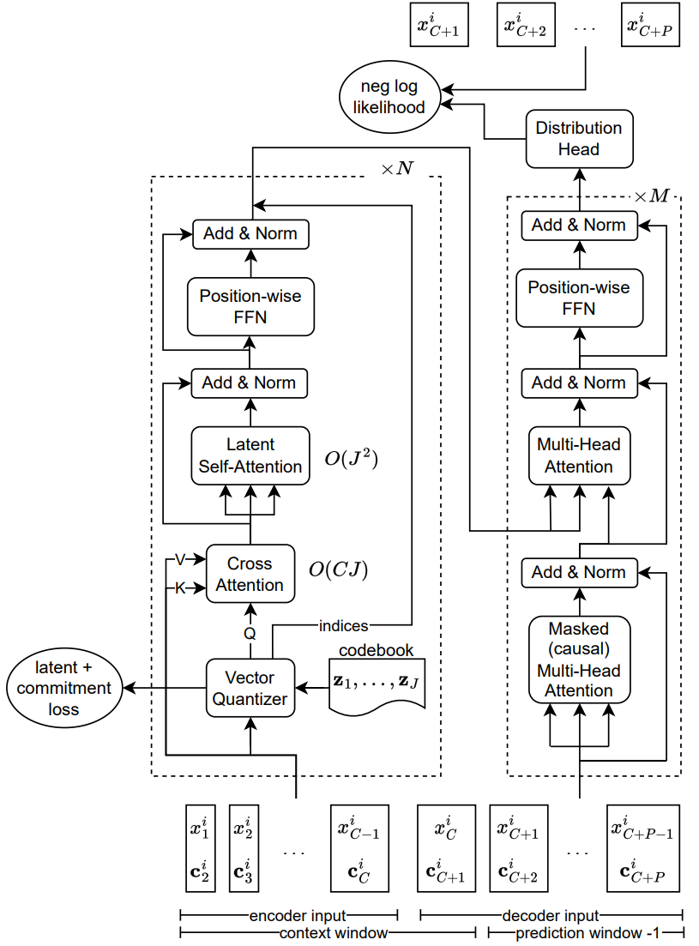
VQ-TR
Encoder part of the architecture:
Input
Vector quantizer layer: returns
Note
And with
Then self-attention:
N encoder layers: each having complexity O($CJ)$ + O($J^{2}$)
Encoder has linear complexity in context length C when

Slide 12
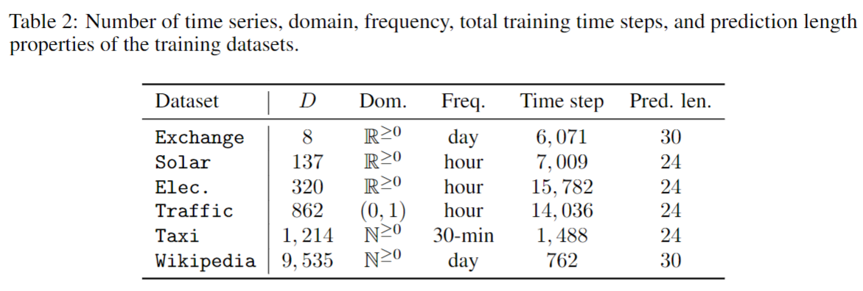
Evaluation
Univariate forecasting
Input scaling is important to train a shared model over different time-series within a dataset
3 emission heads for model and all baselines: Student-T, Negative Binomial and Implicit Quantile Networks*
Metrics:
Mean Scale Interval Score for 95% prediction interval
Continuous Ranked Probability Score (CRPS)
Quantile Losses
For point forecast: different (normalized) versions of Mean Absolute Error
* Probabilistic Time Series Forecasting with Implicit Quantile Networks

Slide 13
Results vs Non-Transformer-based Models
DeepAR: RNN-based, learns parameters of chosen distribution
MQCNN: CNN-quantile regression
SQF-RNN: RNN + non-parametric quantiles via splines
IQN-RNN: RNN + Implicit Quantile Network
VQ-AR: RNN + VQ
D-Linear: (“hot”) linear model decomposes trend + residual
Classical ETS: exp smoothing + Gaussian additive errors + Trend + Seasonality

Slide 14
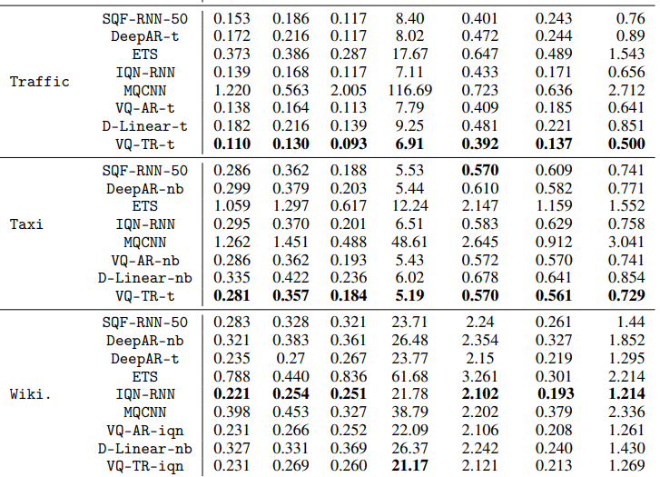
Results vs Non-Transformer-based Models

Slide 15
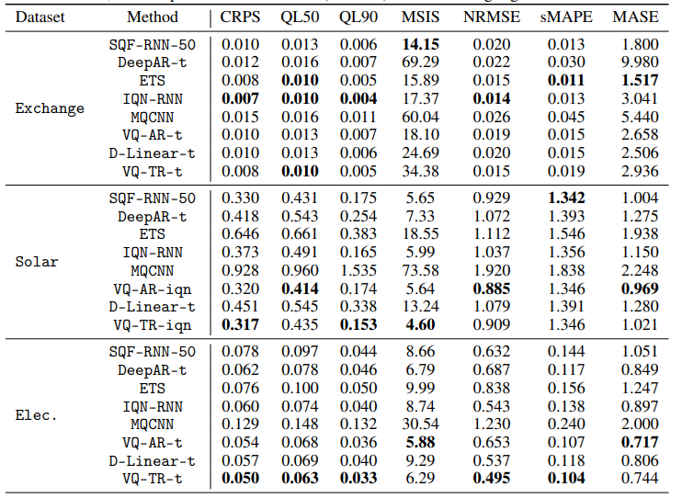
Results vs Non-Transformer-based Models

Slide 16
Results vs Transformer-based Models
TFT: attention based Seq-to-Seq model with variable selection network for selecting relevant inputs
Informer: an efficient transformer and full horizon predictor model
Autoformer: decomposes trend and seasonal during forecasting together with a series-wise auto-Correlation mechanism
ETSformer: adds exponential smoothing and frequency attention in the attention mechanism
Hopfield: Hopfield network with continuous state which generalizes attention
Longformer: local attention model with sliding window attention
Reformer: replaces dot-product attention by locality-sensitive hashing
Linformer: fixed projection matrix to reduce the length of the keys and value
Nystromformer: Nyström method to approximate standard self-attention to make its complexity linear
Performer: estimates regular full-rank attention by using linear space/compute complexity
PatchTST: transformer encoder that takes as input segments of time series as fixed sized vectors

Slide 17
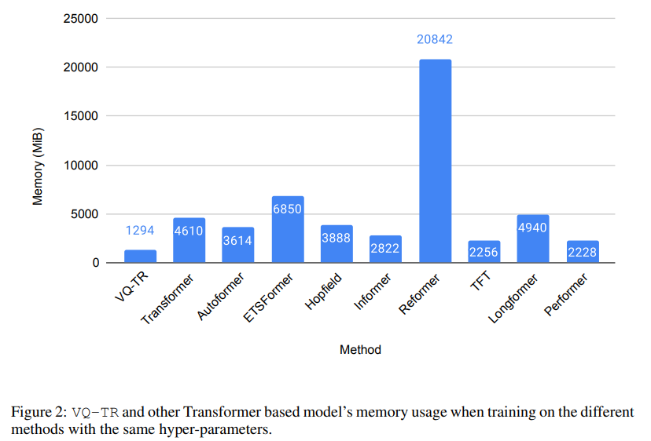
Results vs Transformer-based Models: Memory Usage

Slide 18
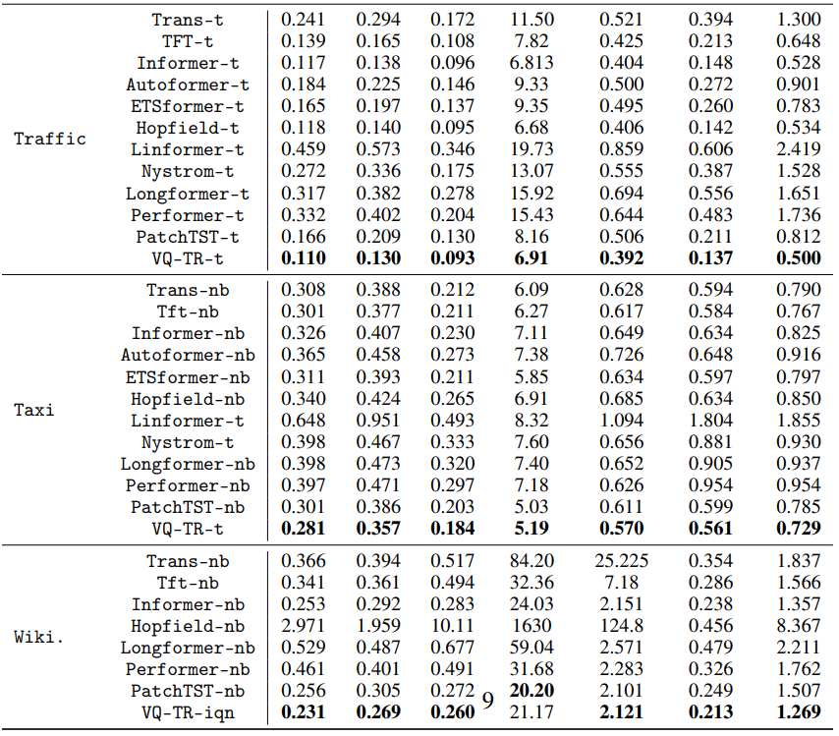
Results vs Transformer-based Models

Slide 19
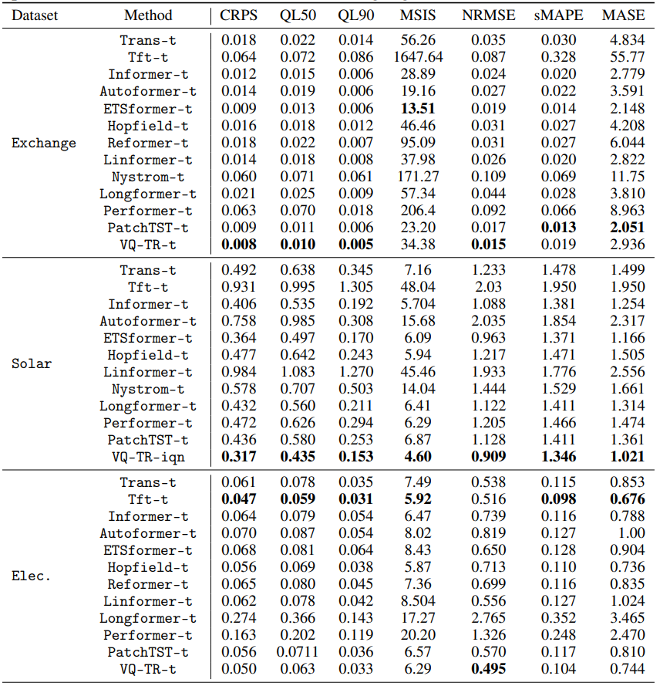
Results vs Transformer-based Models

Slide 20
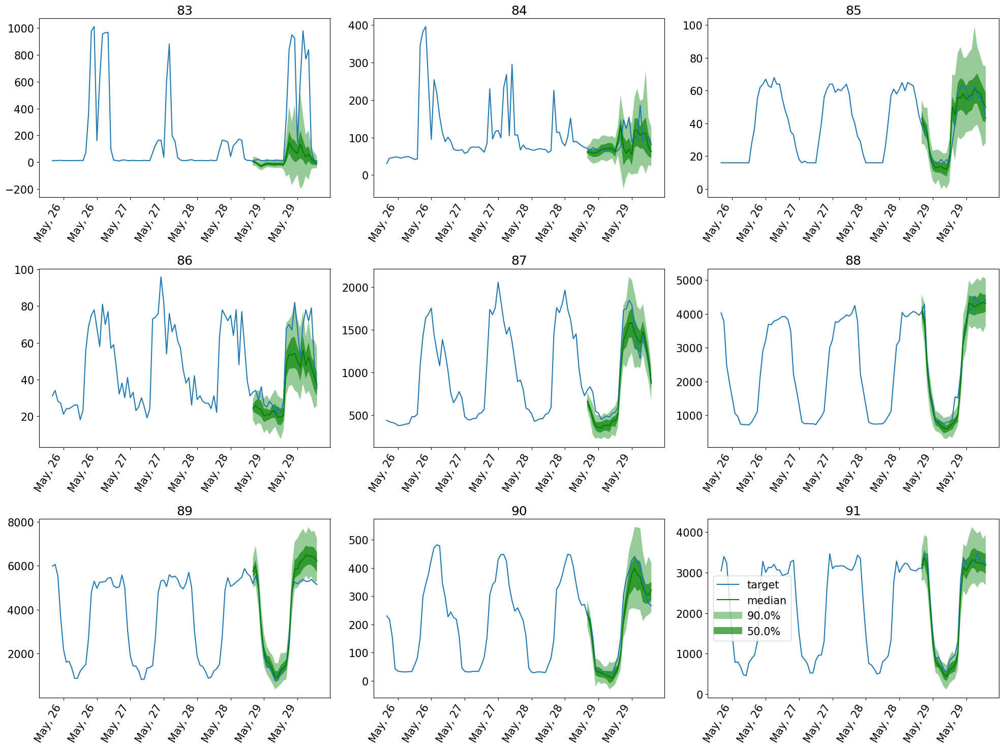
Sample Forecasts (Student-T head)
Oops!

Slide 21
Future Work
Can also be used for NLP, Audio or Vision based tasks
Can be used in RL setting to discretize state representations for example
VQ can be replaced with modern variants like Residual-VQ
Code: github.com/kashif/vq-tr

