Slide 1
Optimal Transport Based Distributionally Robust Optimization
Jose H. Blanchet
Stanford University
Support from Air Force Office of Scientific Research under award FA9550-20-1-0397 and from NSF is gratefully acknowledged.

Slide 2
General Goal
Distributionally robust optimization via optimal transport: an effective tool to quantify and mitigate
model errors
Model error is essential in finance and insurance:
Portfolio choice ←→ Past and future environments differ / non-stationarities.
ML in general ←→ Out-of-sample performance / generalization.

Slide 3
Question: Is Your Portfolio Selection Policy Efficient?
Theoretical Efficient Frontier
In-efficient (Out-of-Sample) Frontier
What drives inefficiencies?
How to address inefficiencies?
Return
Return
Risk
Risk

Slide 4
Motivating Example – Portfolio Selection 101
Efficient Frontier
Population version:
r (return)
where Population distribution.
As you change risk aversion
coefficient you move along
efficient frontier
σ (stdv)

Slide 5
Data Driven – Portfolio Selection 101
Data-Driven Version：
where is empirical measure.
You can do fancier utilities… the story doesn’t change.
We did the following experiment.

Slide 6
Monthly data for 10 years on 20 randomly selected S&P 500 stocks from 01/90-01/2000.
We compute a standard mean-variance portfolio selection.
We apply the strategy in future months – 2000-2017.
Compute mean return and standard deviation empirically out-of-sample.
We repeat the experiment 100 times – keeping the same time window (randomizing over the choice of 20 stocks).

Slide 7
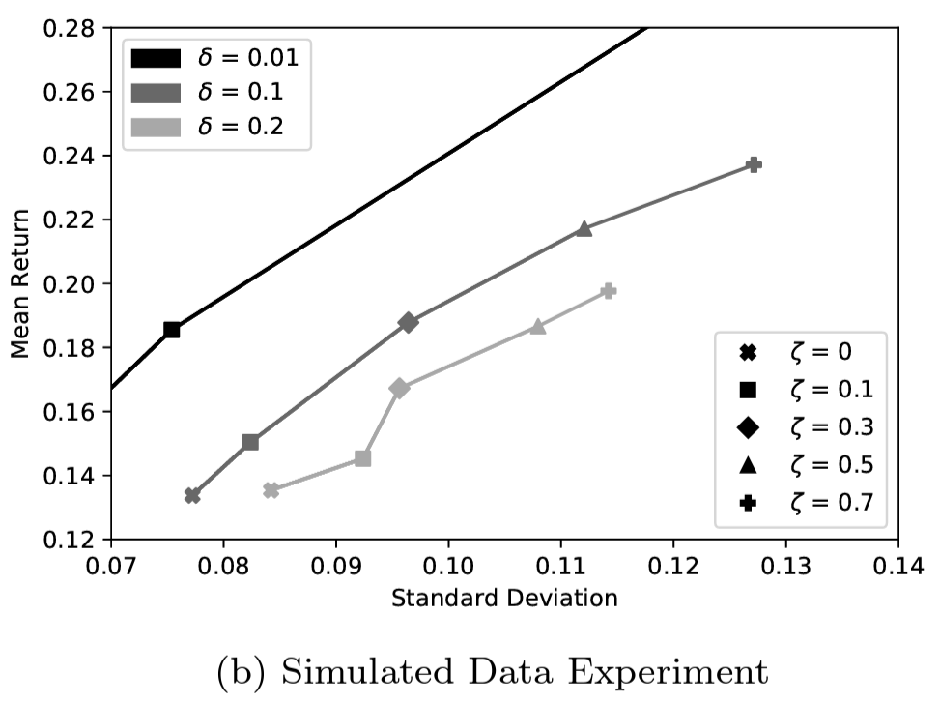
What Theory Predicts…
Theoretical Efficient Frontier
In-Sample Performance
r (return)
σ (stdv)

Slide 8
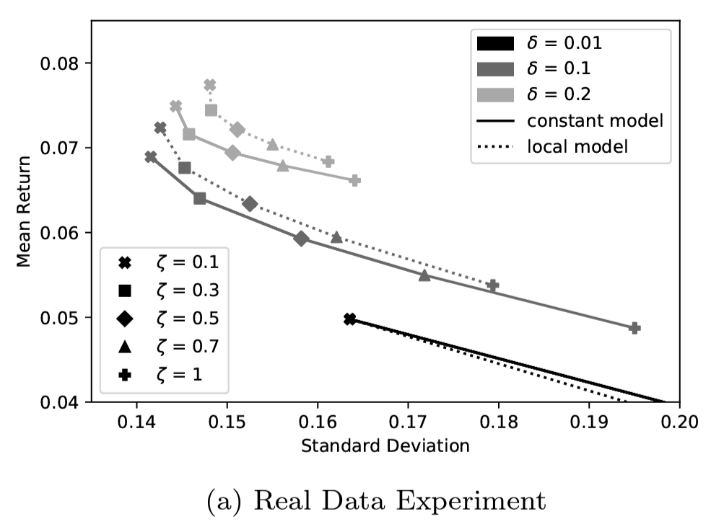
What Really Happens Out-of-Sample…
Out-of-Sample Performance
$δ=0$means vanilla mean variance portfolio selection.
$δ>0$measures discrepancy between past and future.
$ζ=$risk aversion coefficient.
Conclusion: Significant non-stationarity & out-of-sample effects.

Slide 9
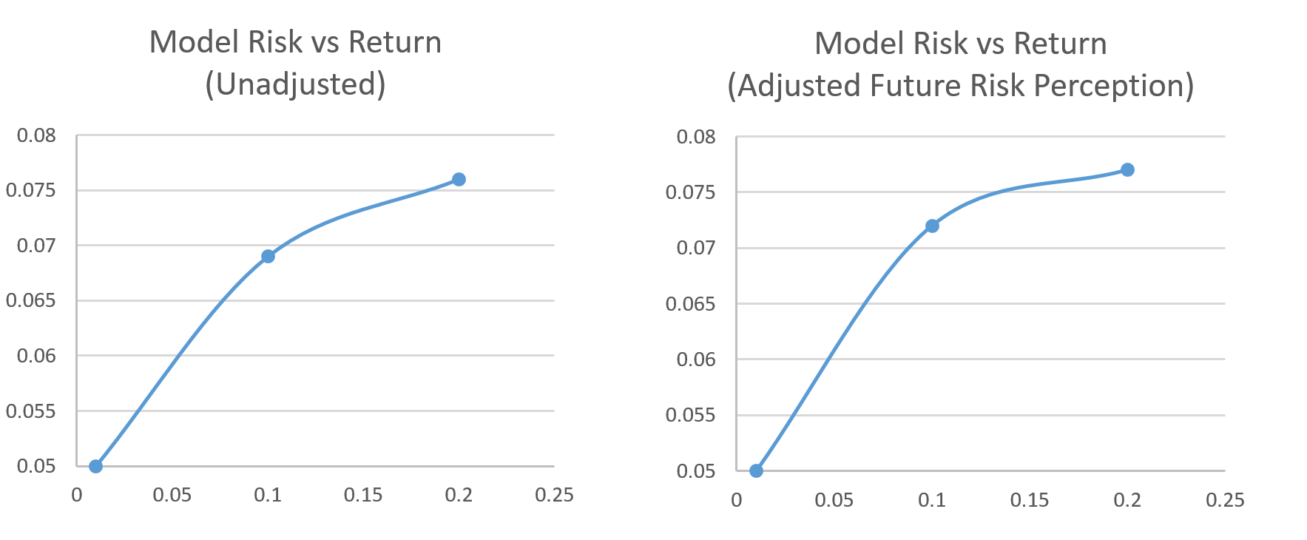
Model Risk vs Mean Return
$Model risk measured in adversarial distance to empirical$

Slide 10
Example suggests that model error can “flip” desirable economic stylized features
Rest of the talk is about how we model misspecification + how we use these models to produce these plots

Slide 11
Approach: Distributionally Robust Decision Making
Population version:
Data-driven version:
DRO (Distributionally Robust Optimization) version ← this is what we do:

Slide 12
Natural Questions / Agenda
Why optimal transport / intuition?
The choice of δ?
Statistical guarantees?
How to choose the transportation cost?
Are these problems tractable?
Is there a value of the game (i.e. min-max = max-min)?
Beyond? (Non-parametric prediction?)

Slide 13
Natural Questions / Agenda
Why optimal transport / intuition?
The choice of δ?
Statistical guarantees?
How to choose the transportation cost?
Are these problems tractable?
Is there a value of the game (i.e. min-max = max-min)?
Beyond? (Non-parametric prediction?)
Keep portfolio optimization in mind to simplify discussion, but most of what we discuss applies to:

Slide 14
Why optimal transport?
Two natural ways to model changes in distributions →
A) The likelihood or observing X is corrupted / perturbed.
B) Contamination of outcomes (i.e. X is corrupted / perturbed to → X+∆).
Traditionally A) and B) are seen as different mechanisms.

Slide 15
Why optimal transport?
Two natural ways to model changes in distributions →
A) The likelihood or observing X is corrupted / perturbed.
B) Contamination of outcomes (i.e. X is corrupted / perturbed to → X+∆).
Traditionally A) and B) are seen as different mechanisms.
Approach A) – Divergence: Dupuis, James & Peterson '00; Hansen & Sargent '01, '08; Nilim & El Ghaoui '02, '03; Iyengar '05; A. Ben-Tal, L. El Ghaoui, & A. Nemirovski '09; Bertsimas & Sim '04; Bertsimas, Brown, Caramanis '13; Lim & Shanthikumar '04; Lam '13, '17; Csiszár & Breuer '13; Jiang & Guan '12; Hu & Hong '13; Wang, Glynn & Ye '14; Bayrakskan & Love '15; Duchi, Glynn & Namkoong '16; Bertsimas, Gupta & Kallus '13…
Approach B) – Wasserstein: Scarf '58; Hampel '73; Huber '81; Pflug & Wozabal '07; Mehrotra & Zhang '14; Esfahani & Kuhn '15; Blanchet & Murthy '16; Gao & Kleywegt '16; Duchi & Namkoong '17.

Slide 16
Why optimal transport?
Two natural ways to model changes in distributions →
A) The likelihood or observing X is corrupted / perturbed.
B) Contamination of outcomes (i.e. X is corrupted / perturbed to → X+∆).
Traditionally A) and B) are seen as different mechanisms.
But both can be seen as a particular case of optimal transport.
Approach A) – Divergence: Dupuis, James & Peterson '00; Hansen & Sargent '01, '08; Nilim & El Ghaoui '02, '03; Iyengar '05; A. Ben-Tal, L. El Ghaoui, & A. Nemirovski '09; Bertsimas & Sim '04; Bertsimas, Brown, Caramanis '13; Lim & Shanthikumar '04; Lam '13, '17; Csiszár & Breuer '13; Jiang & Guan '12; Hu & Hong '13; Wang, Glynn & Ye '14; Bayrakskan & Love '15; Duchi, Glynn & Namkoong '16; Bertsimas, Gupta & Kallus '13…
Approach B) – Wasserstein: Scarf '58; Hampel '73; Huber '81; Pflug & Wozabal '07; Mehrotra & Zhang '14; Esfahani & Kuhn '15; Blanchet & Murthy '16; Gao & Kleywegt '16; Duchi & Namkoong '17.

Slide 17
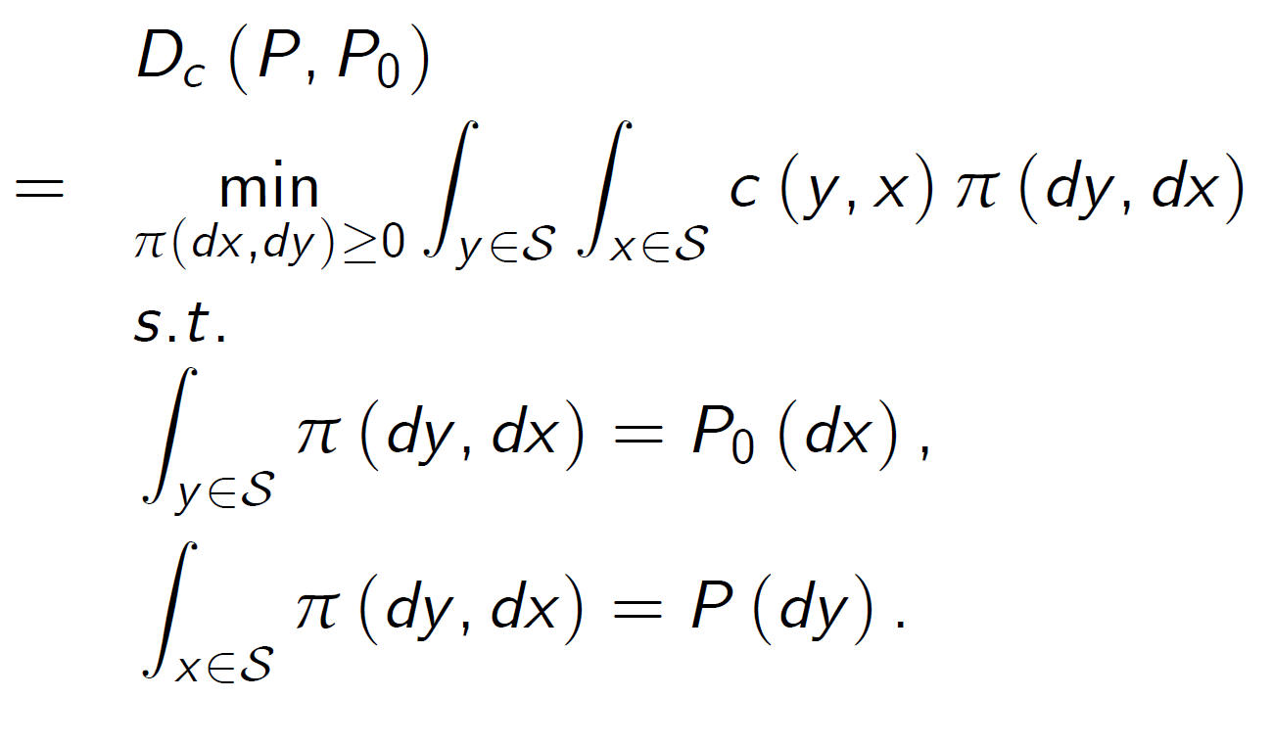
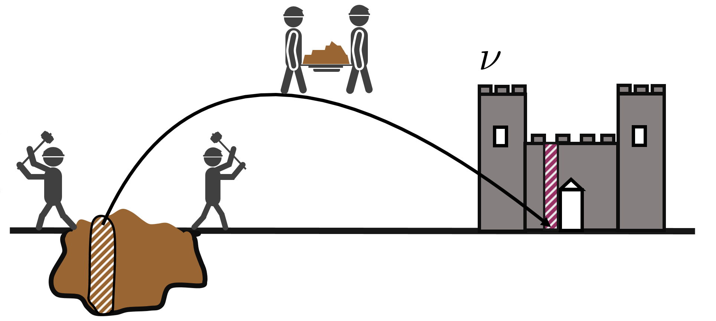
Optimal Transport
c(y,x ) = transportation cost function
- Linear programming problem (Monge-Kantorovich)
Strong duality holds in great generality (lower semi-continuous non-negative c(.) in Polish spaces)
See e.g. Villani (2003).

Slide 18
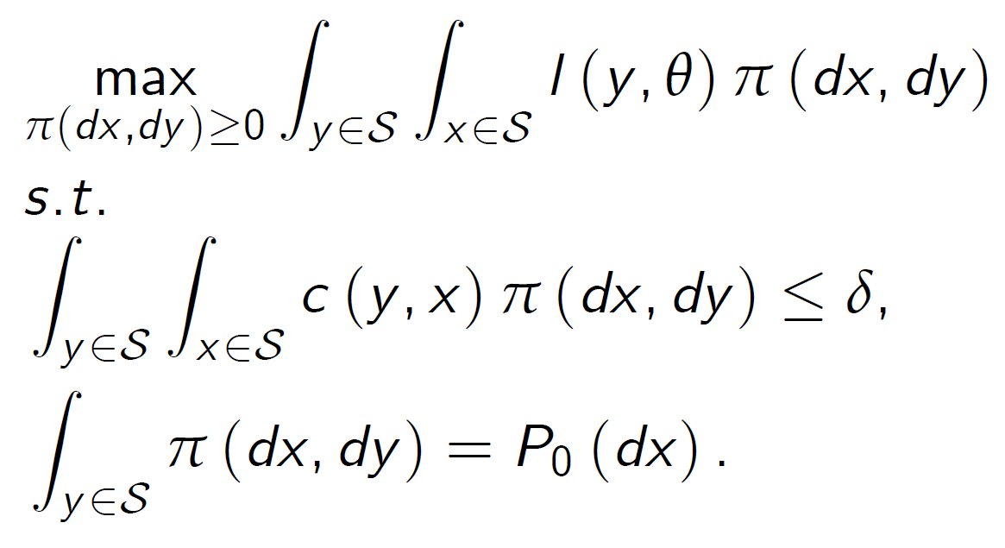
Optimal Transport DRO Duality
Primal Optimal Transport DRO:
Dual Optimal Transport DRO:
Another linear programming problem
Strong duality holds at the same level of generality – B. & Murthy ’19 MOR https://pubsonline.informs.org/doi/10.1287/moor.2018.0936
c(.) non-negative, lower semicontinuous (possibility infinity) – l(.) integrable under P0

Slide 19
Optimal Transport DRO Formulations
Primal Optimal Transport DRO:
Dual Optimal Transport DRO:
Recover Wasserstein DRO if:
Another linear programming problem
Strong duality holds at the same level of generality – B. & Murthy ’19 MOR https://pubsonline.informs.org/doi/10.1287/moor.2018.0936
c(.) non-negative, lower semicontinuous (possibility infinity) – l(.) integrable under P0

Slide 20
Optimal Transport DRO Formulations
Primal Optimal Transport DRO:
Dual Optimal Transport DRO:
Recover Wasserstein DRO if:
Recover φ-divergence DRO if:
Strong duality holds at the same level of generality as OT.
c(.) non-negative, lower semicontinuous (possibility infinity) – l(.) integrable under P0
see B. & Murthy ’19 MOR https://pubsonline.informs.org/doi/10.1287/moor.2018.0936

Slide 21
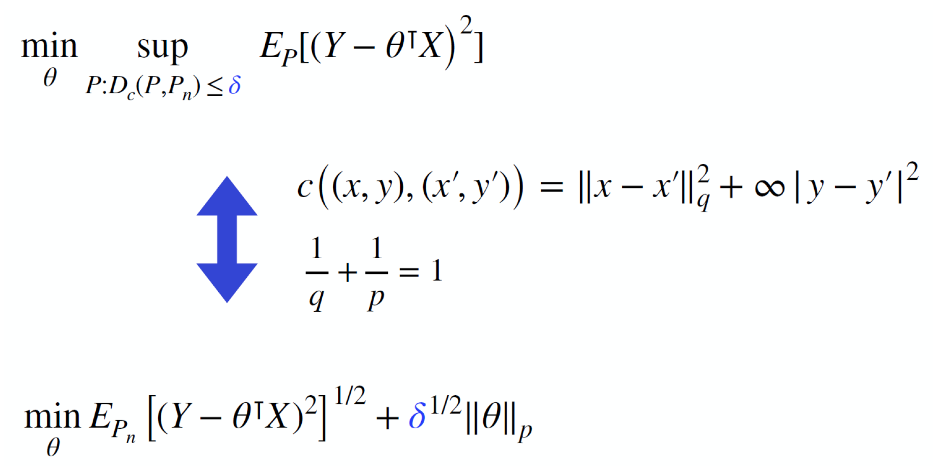
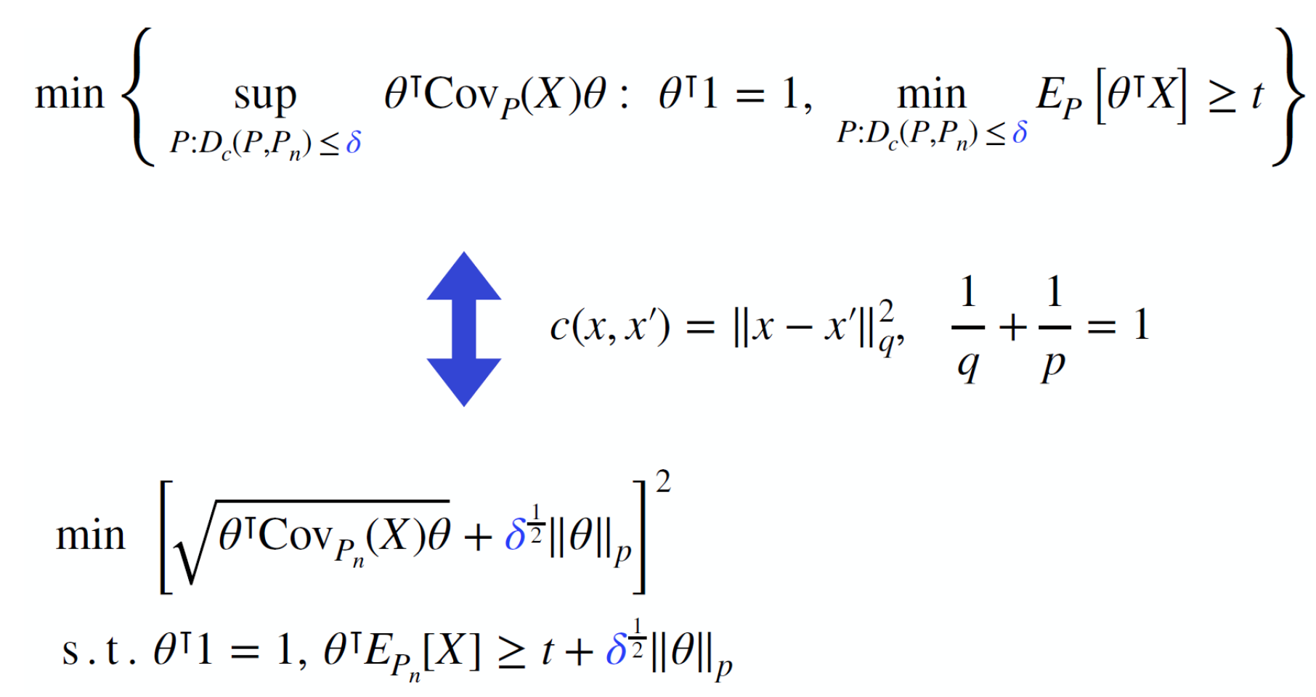
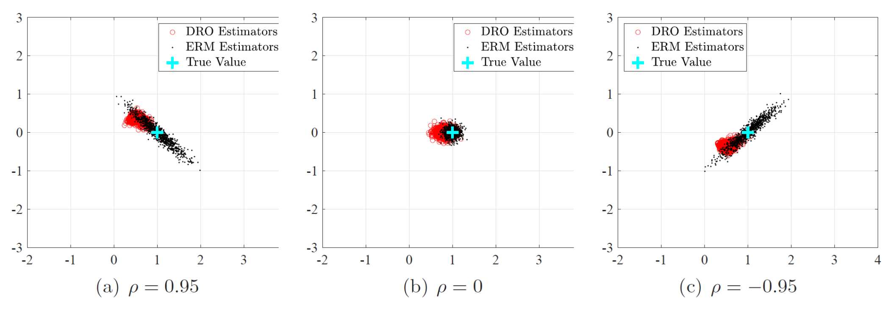
Lasso, Regularization (Variance and Norm)
B., Kang, Murthy (2019): https://doi.org/10.1017/jpr.2019.49
B., Li, Zhou (2021) https://pubsonline.informs.org/doi/abs/10.1287/mnsc.2021.4155

Slide 22
The Choice of Uncertainty Size
Consider space of optimal portfolio choices generated by distributional uncertainty
Space of decisions believed to be plausible
Minimize uncertainty in plausible decisions s.t. coverage
Best possible decision (i.e. population known)
B., Kang, Murthy (2019): https://doi.org/10.1017/jpr.2019.49
B., Si, Murthy (2021): https://academic.oup.com/biomet/article/109/2/295/6239705
Si, B., Gosh, Squillante (2021): https://proceedings.neurips.cc/paper/2020/hash/f3507289cfdc8c9ae93f4098111a13f9-Abstract.html

Slide 23
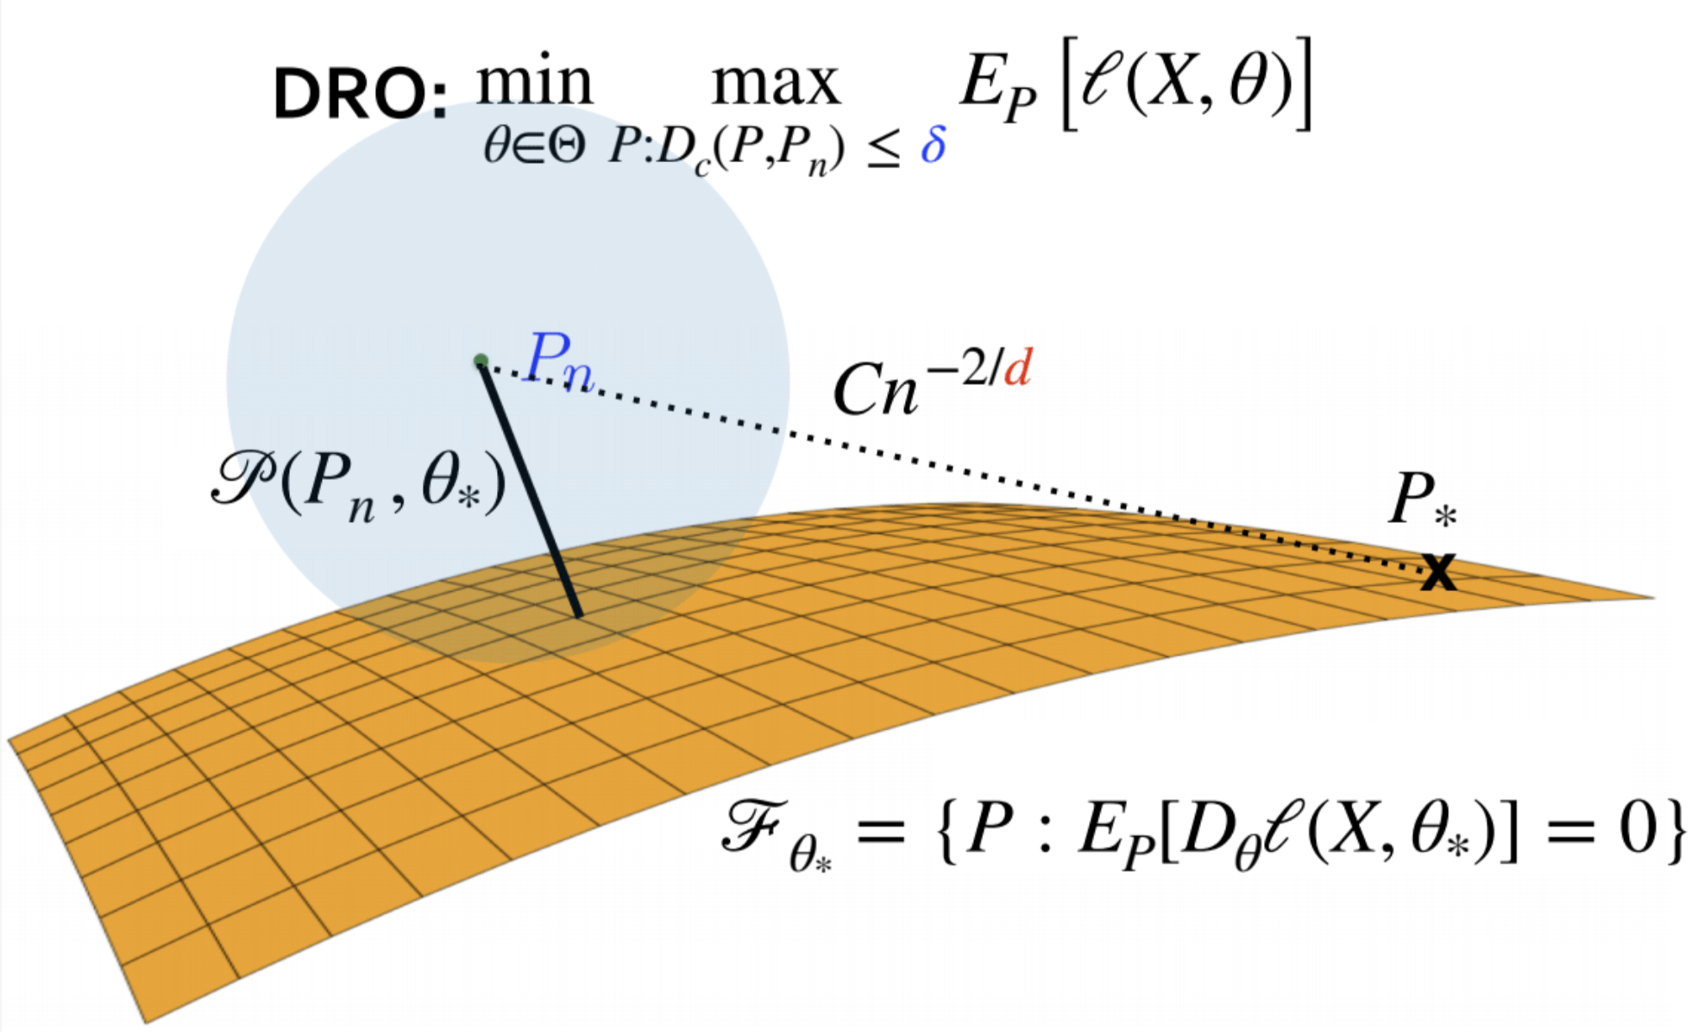
Optimal Choice of Uncertainty: Projection Problem
B., Kang, Murthy (2019): https://doi.org/10.1017/jpr.2019.49
B., Si, Murthy (2021): https://academic.oup.com/biomet/article/109/2/295/6239705
Si, B., Gosh, Squillante (2021): https://proceedings.neurips.cc/paper/2020/hash/f3507289cfdc8c9ae93f4098111a13f9-Abstract.html

Slide 24
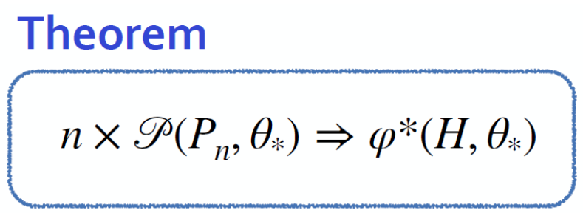
Optimal Choice of Uncertainty: Projection Problem
Consequence:
Optimal δ = 95% quantile of $φ^{∗}(H, θ_{∗})/n$
If c(.) is quadratic $φ^{∗}(H, θ_{∗})$ is chi-squared.
-- Recovers high dimensional statistics choice for sqrt Lasso O(log(d)/n)
B., Kang, Murthy (2019): https://doi.org/10.1017/jpr.2019.49
B., Si, Murthy (2021): https://academic.oup.com/biomet/article/109/2/295/6239705
B., Murthy, Nguyen (2021): https://pubsonline.informs.org/doi/pdf/10.1287/educ.2021.0233 <-- Tutorial!

Slide 25
Optimal Choice of Uncertainty: Projection Problem
Monthly data for 10 years on 100 randomly selected S&P 500 stocks from 01/90-01/2000.
We compute a standard mean-variance portfolio selection.
We apply the strategy in future months – 2000-2017.
We target 10% annualized return & choose δ as indicated 10 yrs. of data.
We repeat the experiment 100 times – keeping the same time window (randomizing over the choice of 100 stocks).

Slide 26
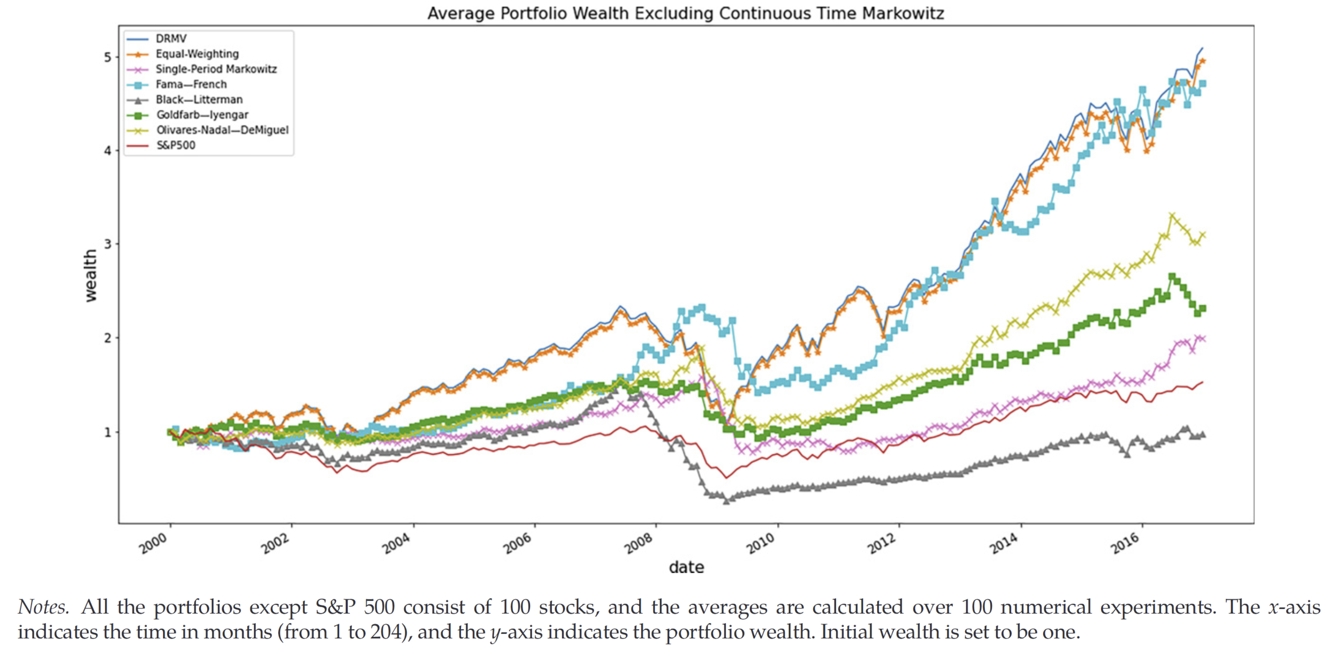
Average Rolling Horizon over 100 samples of 100 stocks S&P500

Slide 27
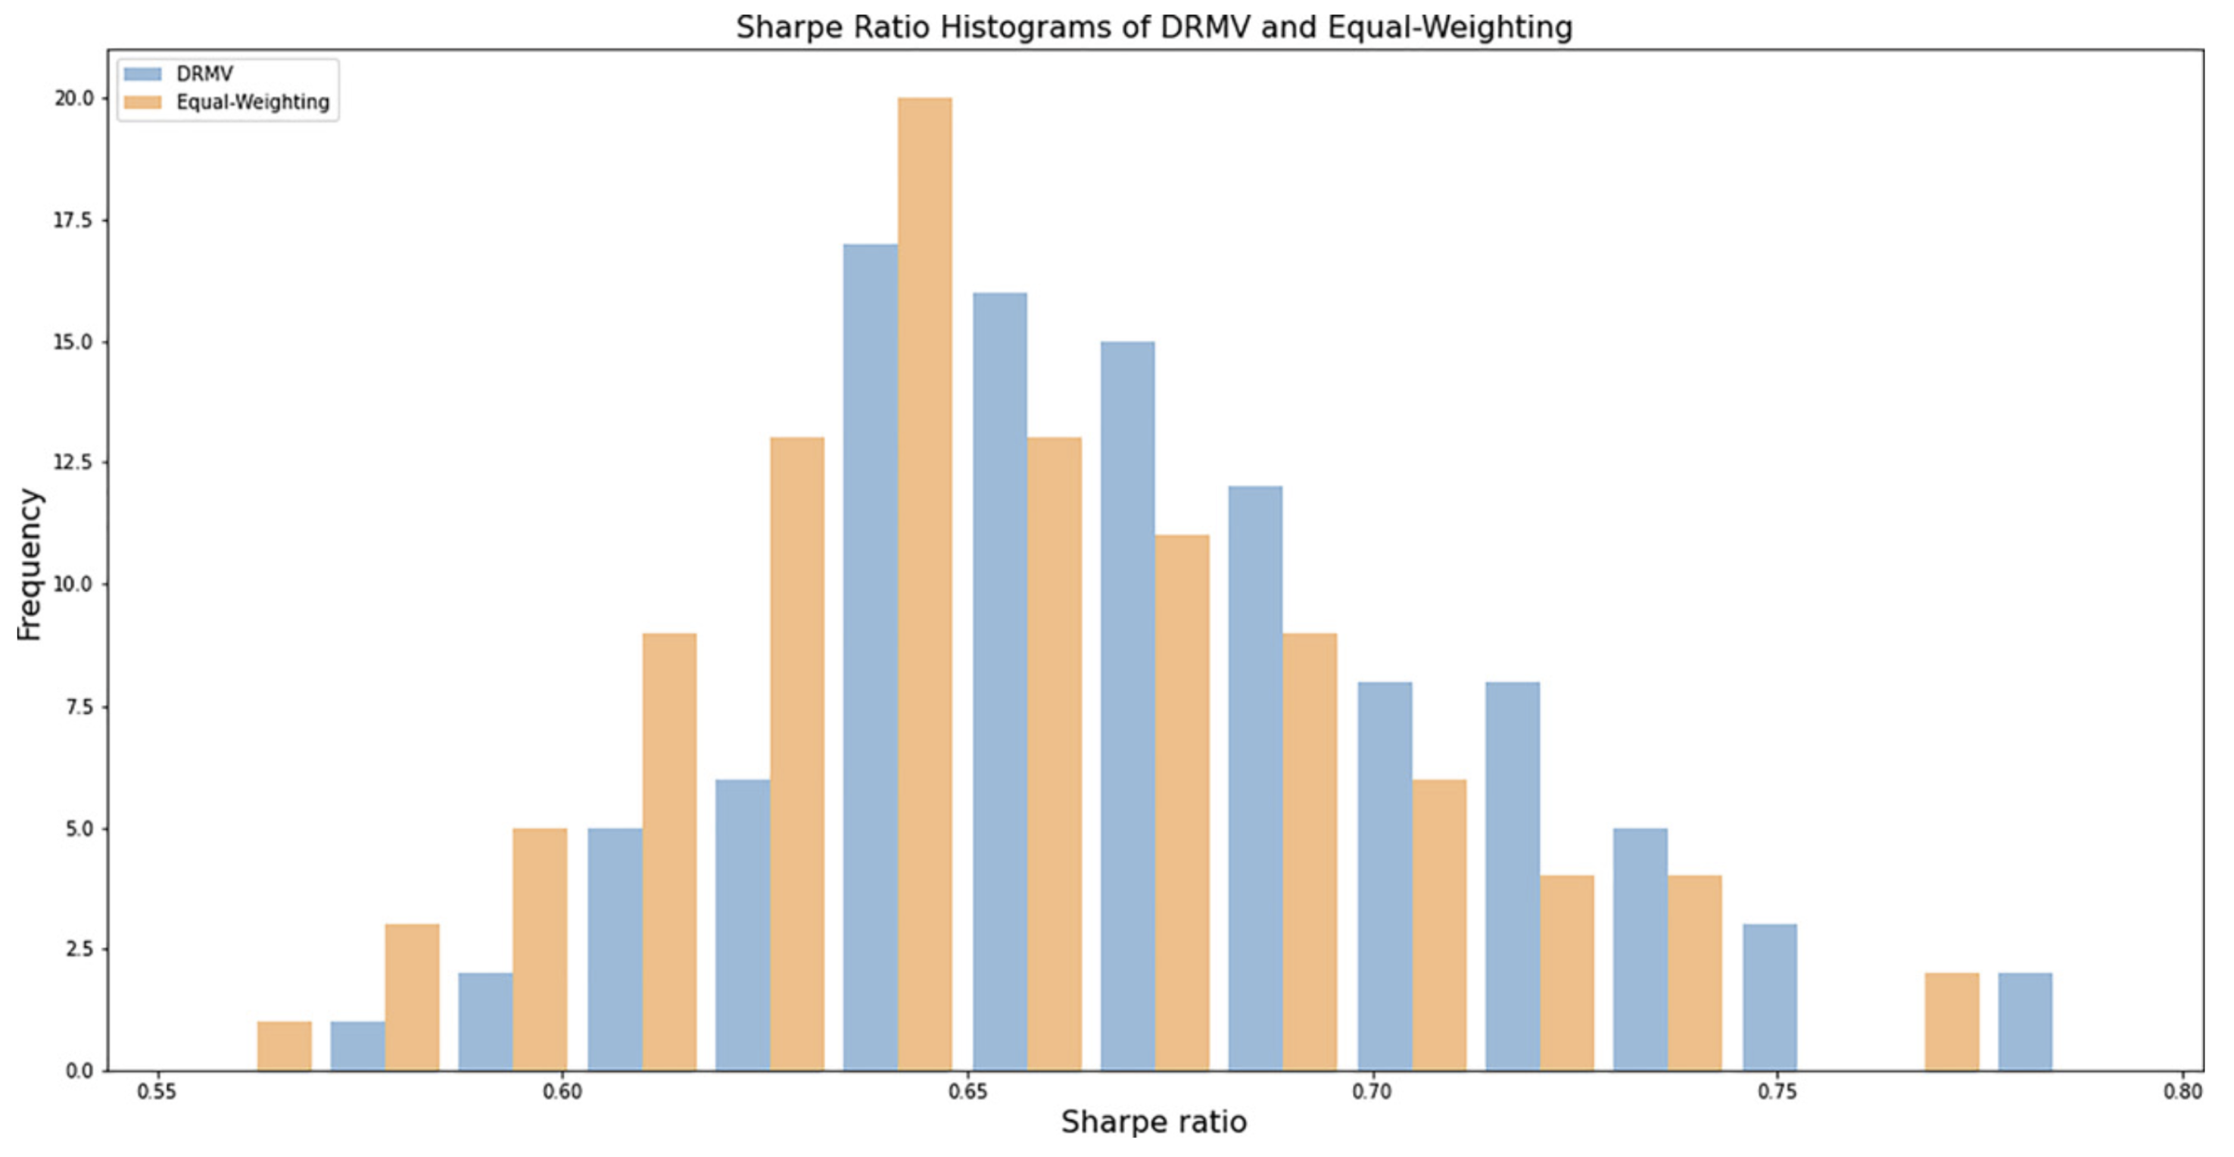
Histograms Sharpe Ratio DRMV vs Equal-Weighting

Slide 28
Inform Transportation Cost using Current Market Information?
Cost function can be used to encode information -> Recall picture motivating the talk!
Example: Use an implied volatility index (e.g. VIX), say “V” and consider
Here X’ is the adversarial choice and we can pick Ai = 1/Vi
Intuition: Market perceives high volatility → low transportation cost → higher adversarial attacks
Challenge → Computational tractability?
B., Murthy, Zhang (2021) https://pubsonline.informs.org/doi/10.1287/moor.2021.1178

Slide 29
Model Risk vs Mean Return
$Model risk measured in adversarial distance to empirical$

Slide 30
Tractability
B., Murthy, Zhang (2021) https://pubsonline.informs.org/doi/10.1287/moor.2021.1178
Tractable for affine decision rules

Slide 31
Tractability
B., Murthy, Zhang (2021) https://pubsonline.informs.org/doi/10.1287/moor.2021.1178
Tractable for affine decision rules

Slide 32
Tractability
B., Murthy, Zhang (2021) https://pubsonline.informs.org/doi/10.1287/moor.2021.1178
Tractable for affine decision rules
Inner optimization is one dimensional optimization problem BUT difference of two convex functions.

Slide 33
Tractability
B., Murthy, Zhang (2021) https://pubsonline.informs.org/doi/10.1287/moor.2021.1178
Tractable for affine decision rules
Thm:
Assuming quadratic growth and local strong convexity of l(.), uniformly bdd cond. Number of A(x), 4th moment of |X|, then
Local strong convexity for δ< δ₀
SGD with rate O(log(1/ε)/ε²) – (essentially optimal).
Stable structure of worst case adversary.
Inner optimization is one dimensional optimization problem BUT difference of two convex functions.

Slide 34
Tractability
Tractable for l(.) being the maximum of affine functions and Wasserstein distance
-- Formulation with O(n) dual variables, see
Kuhn et al. https://doi.org/10.1287/educ.2019.0198 and references therein.
-- Important goal in the DRO literature –> tractable reformulations that can be implemented in packages.

Slide 35
min-max = max-min?
Unique Nash Equilibrium?
Least Favorable Distributions?
Adversary chooses first & then we select portfolio

Slide 36
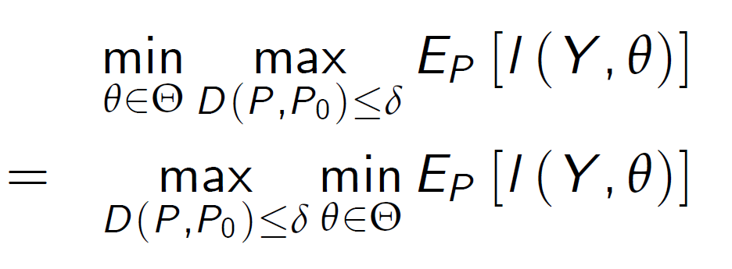
On the Value of the Game
Adversary knows portfolio selection in advance = Portfolio manager knows adversarial choice in advance?
Hard part is upper semi-continuity of the map P → E_{P}(…) in cases of interest (e.g. l(.) quadratic and quadratic cost function (Sion’s theorem doesn’t apply).

Slide 37
On the Value of the Game
Adversary knows portfolio selection in advance = Portfolio manager knows adversarial choice in advance?
Hard part is upper semi-continuity of the map P → E_{P}(…) in cases of interest (e.g. l(.) quadratic and quadratic cost function (Sion’s theorem doesn’t apply).
B., Si, Murthy (2021): https://academic.oup.com/biomet/article/109/2/295/6239705
Thm:
l(.) is non-negative and continuous,
l(x,.) is convex, and unique solution for δ=0.
c(x,y)=|x-y|^{r}, then
min-sup = sup-min

Slide 38
On the Value of the Game
Adversary knows portfolio selection in advance = Portfolio manager knows adversarial choice in advance?
Hard part is upper semi-continuity of the map P → E_{P}(…) in cases of interest (e.g. l(.) quadratic and quadratic cost function (Sion’s theorem doesn’t apply).
B., Si, Murthy (2021): https://academic.oup.com/biomet/article/109/2/295/6239705
Thm:
l(.) is non-negative and continuous,
l(x,.) is convex, and unique solution for δ=0.
c(x,y)=|x-y|², for then
min-sup = sup-min
If δ is small l(.) is M-smooth and gradient’s don’t vanish with positive probability then Nash equilibrium is unique.

Slide 39
Conclusions
Optimal transport DRO is versatile and powerful for portfolio selection tasks.
Explains regularization & gives improved out-of-sample performance.
Model misspecification can be informed by current market information.
Often tractable game formulation (with optimal complexity).
Nash-equilibrium -> least favorable distribution.
Thank you.

Slide 40
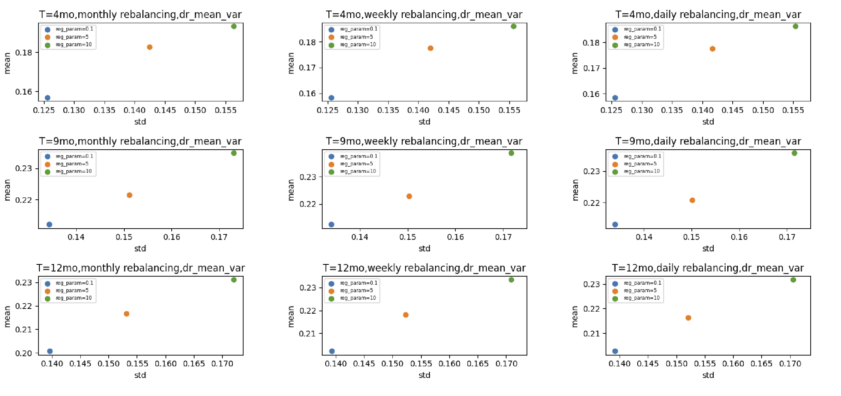
Additional Plots Controlling for Environment and Frequency

Slide 41
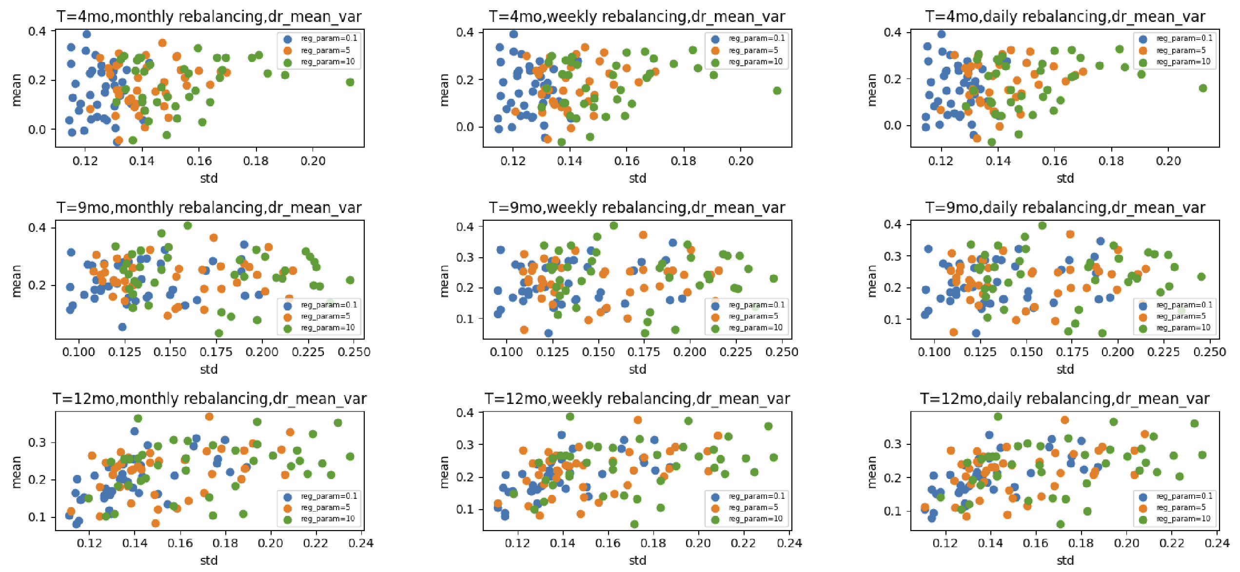
Additional Plots Scatter

