Slide 1
Learning Not to Spoof
Normative Guidance for
Autonomous Trading Agents
David Byrd
Columbia-Bloomberg ML in Finance 2024
Research Support: National Science Foundation (Grant No. 1741026) and a J.P. Morgan AI Fellowship.

Slide 2
Responsible AI
Responsible
Sustainable
Human
Centered
Transparent
Robust
Accountable
Fairness
Quality, Allocation
Accountability
Decision Making
Control
Testing, Monitoring
Social Good
Improve Life
Behavior unacceptable from humans should be unacceptable from AI.
https://oecd.ai/en/ai-principles

Slide 3
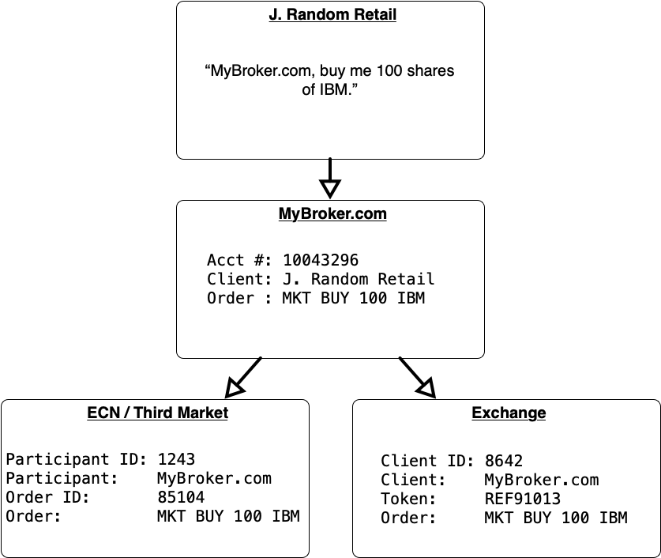
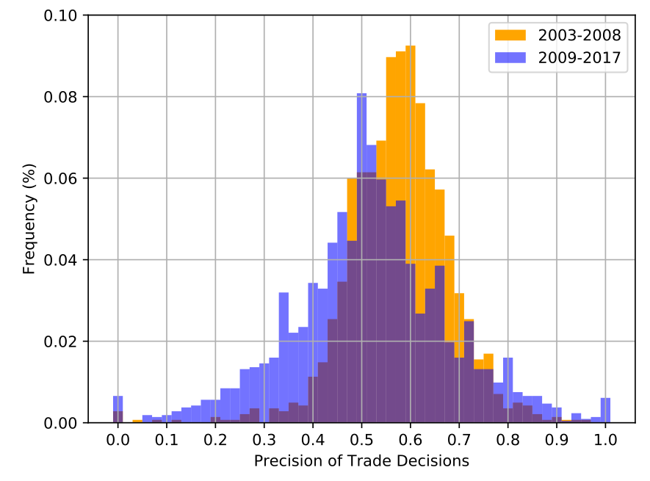
Why simulation?
Generalization
Counterfactuals, interactivity
Explanation
Visibility of latent variables
Lack of Data
Quantity, relevance
Safety
Unintended behavior
Cost
Encourage responsible ML
Notes:
Correlating HFT : efficiency
Neural prediction efficiency
What happened in late 2008? (N = 1)

Slide 4
Spoofing in Electronic Financial Markets
Disruptive Practices
Bidding/Offering with intent to cancel before execution (“Spoofing”)
CFTC Guidance, Enforcement
Federal Register/Vol. 78, No. 102
2020: 16 cases, > $1B settlements
Could AI inadvertently spoof?
Buy/Hold target stock
Limit buys below market
Adjust to avoid execution
Sell holdings
Cancel limit orders
Spoofing Life Cycle
Wang, Xintong, and Michael P. Wellman. (IJCAI’20)
"Market manipulation: An adversarial learning framework for detection and evasion."

Slide 5
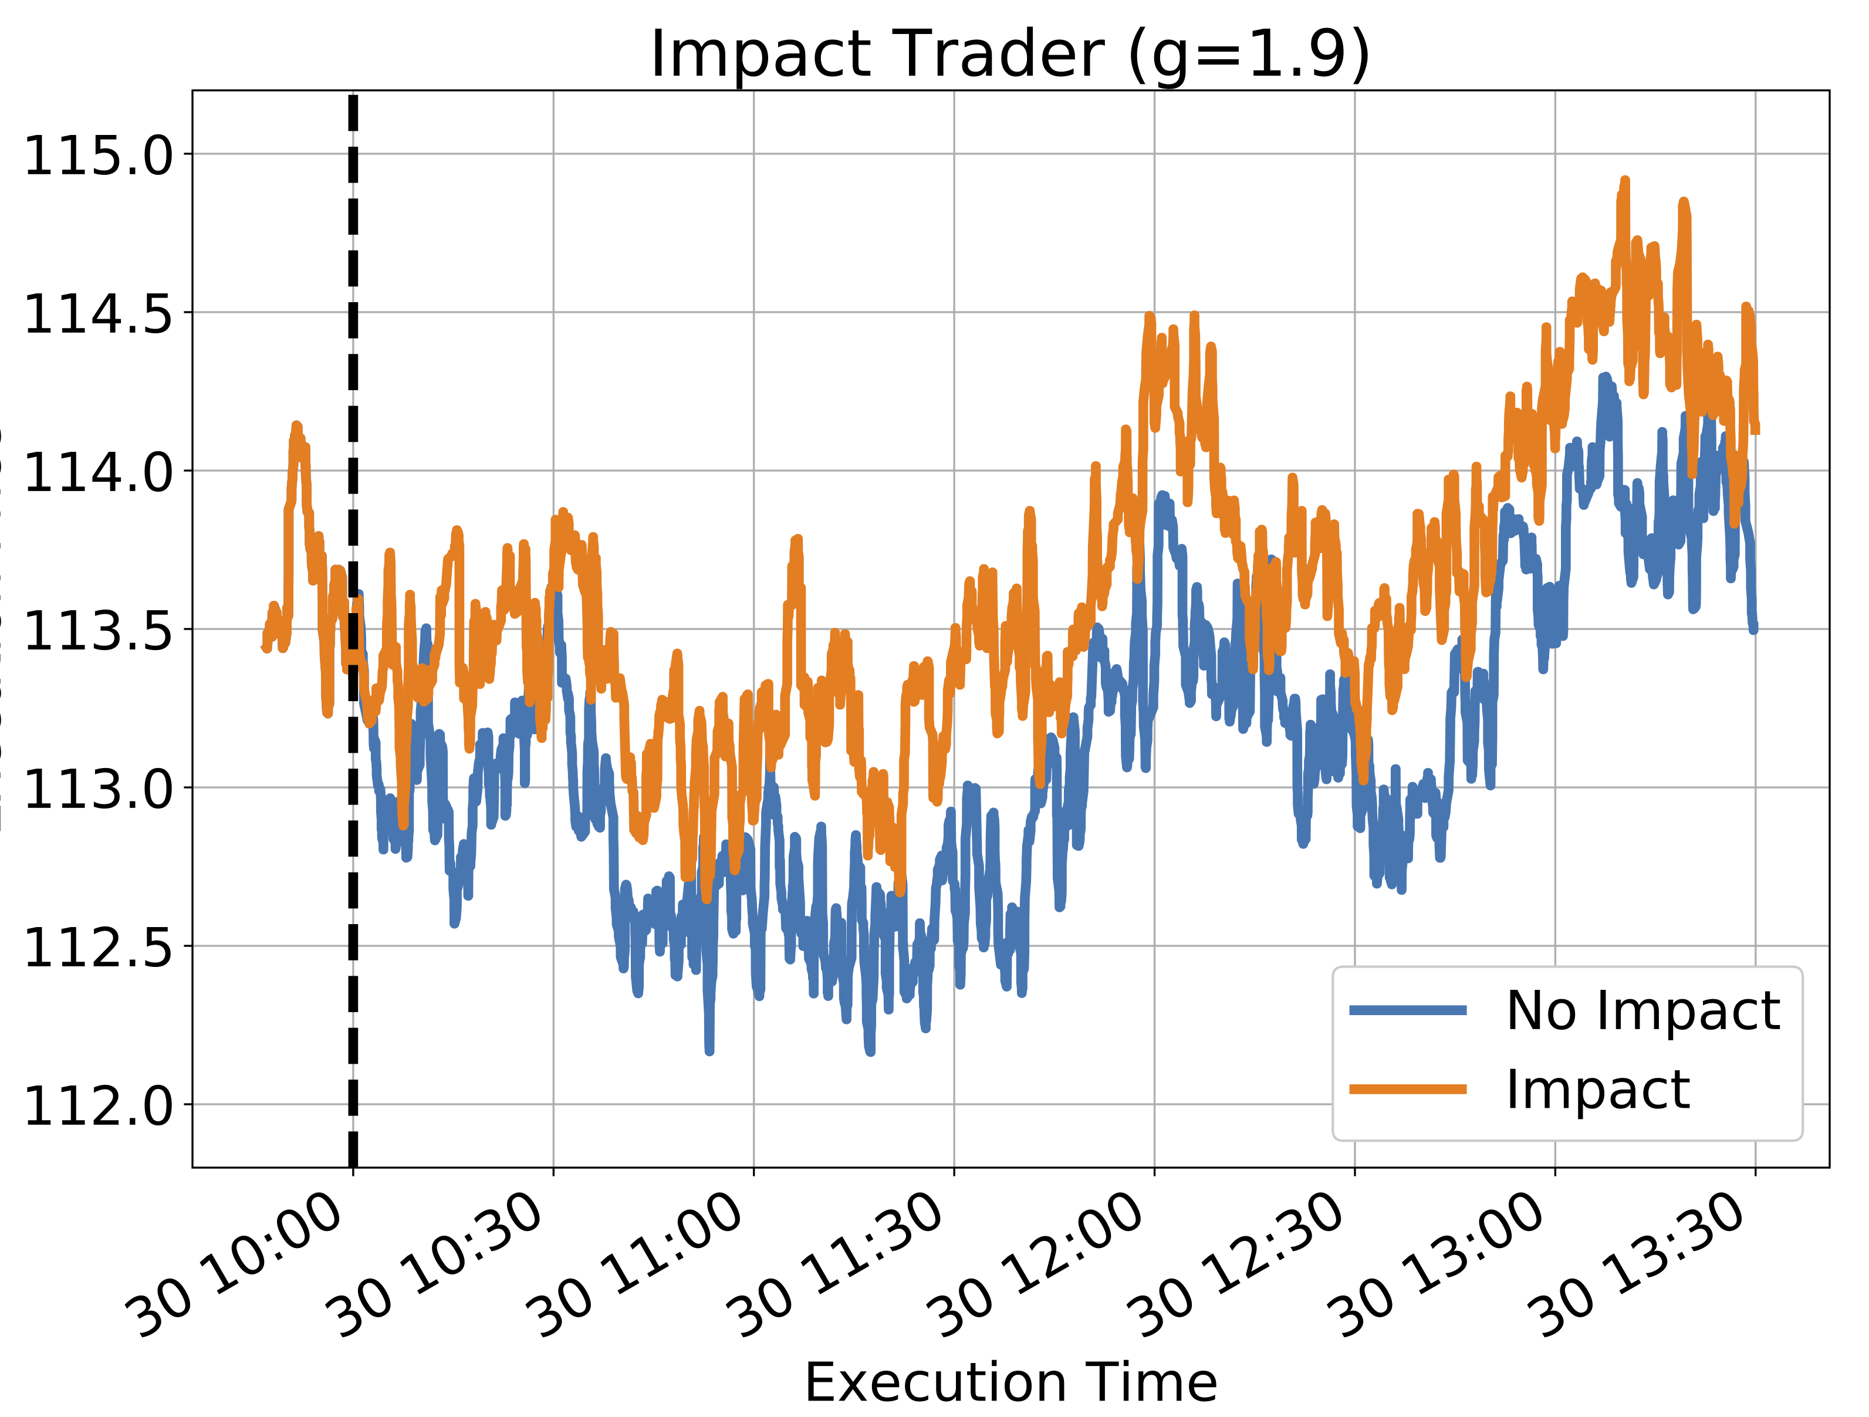
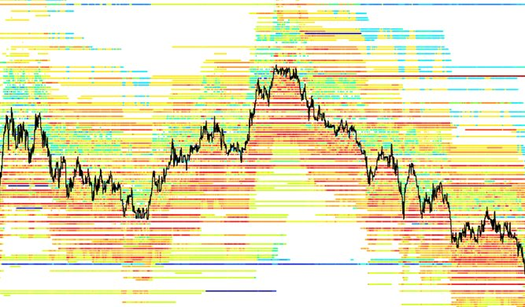
ABIDES
Discrete event simulation
Multiple time scales
Python
Arbitrary strategies
Off the shelf AI
Includes
Literature agents
OU-based fundamental
A / B testing
Specialized visualizations

Slide 6
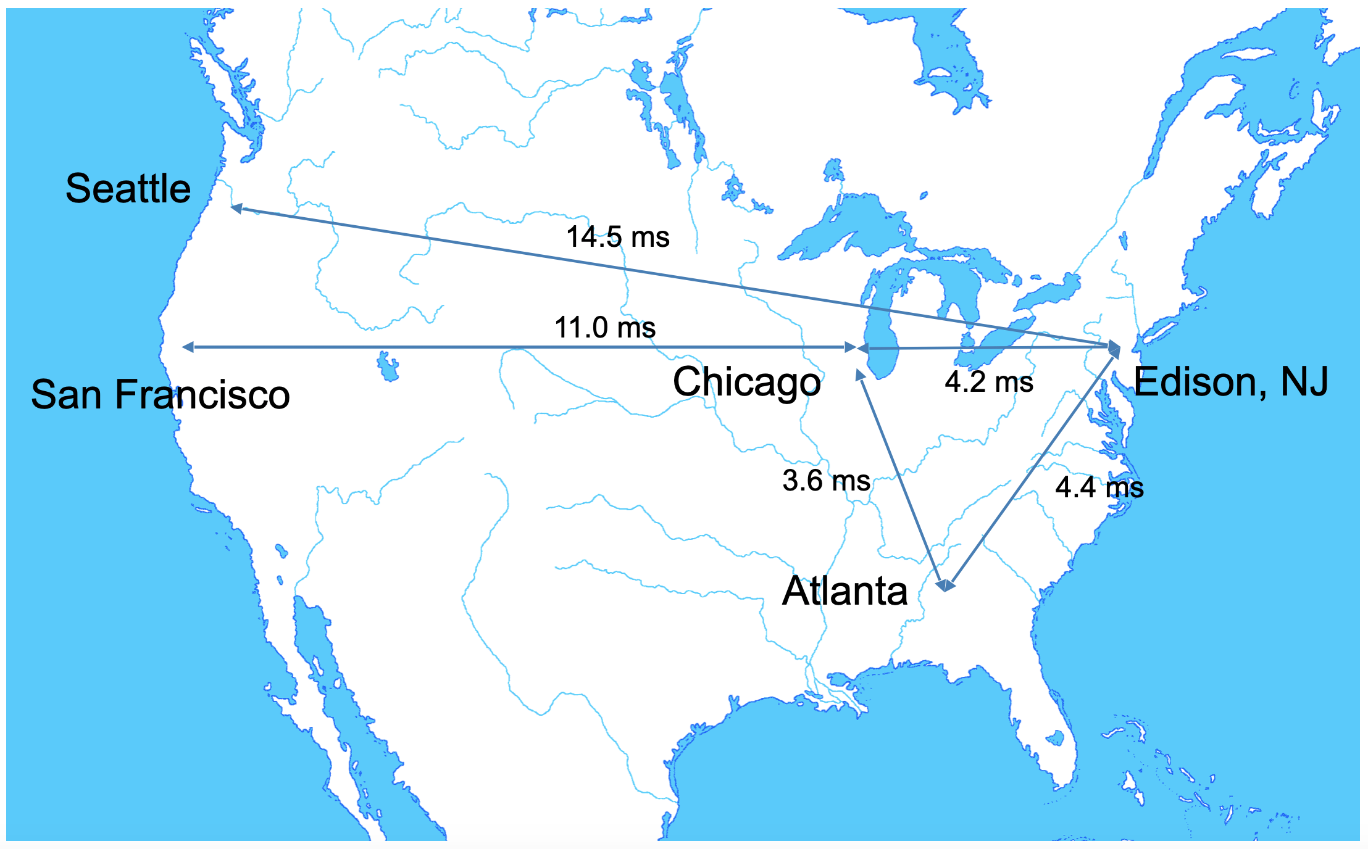
Key Features
ns resolution
Controlled messaging
Computation delays
Network graph
Notes:
Date simulation
Message flexible but constrained
Sampled or set computation delays
“Realistic” cubic network jitter (+ min pairwise latency)

Slide 7
Market Domain Features
Exchange Agent
Trading Agent
Fundamentals
Operating Hours
Exchange Aware
Extrinsic Price Series
Limit Order Book
Portfolio Tracking
Ease of Use
Quotes in Depth
Open Order Tracking
Order Flow
Data Caching
Simulation Life Cyle
Matching Engine
Mark to Market
Pure Python 3

Slide 8
Simulation Life Cycle
Configuration
Initializing
Starting
Kernel
Until GVT > End Time
Simulate
Wake up
Receive Message
Log Activity
Stopping
Save State
Terminating

Slide 9
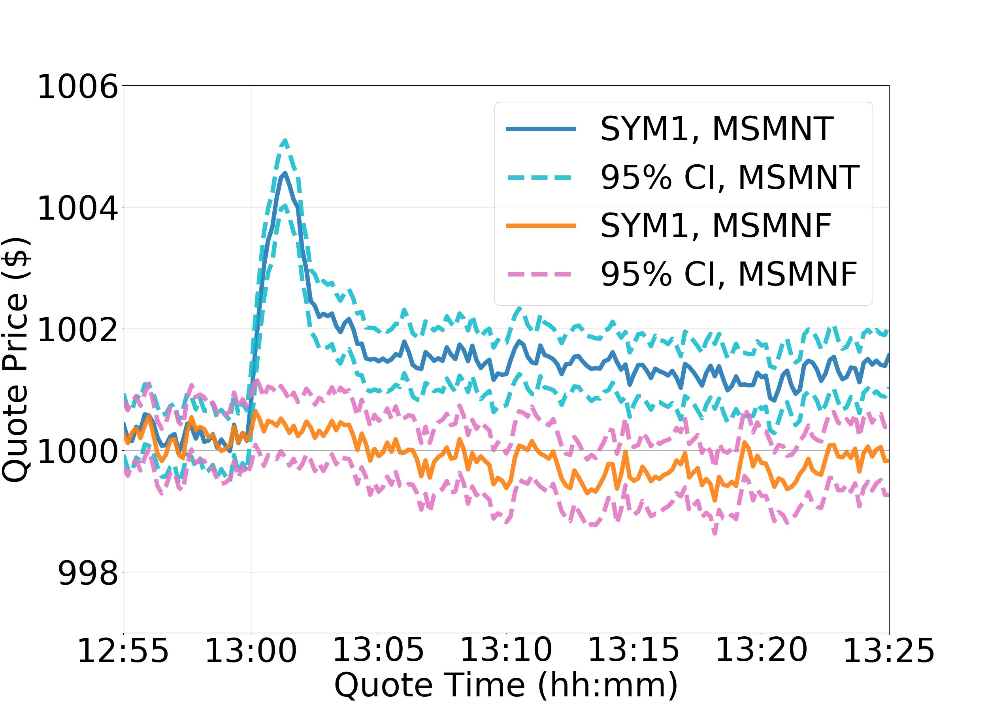
Case Study: ETF volatility contagion
Will an exchange-traded fund spread volatility from one constituent to another?
Yes, but perhaps not in the
direction you expect!
Shearer, M., Byrd, D., Balch, T. H., & Wellman, M. P. (ICAIF’21)
“Stability effects of arbitrage in exchange traded funds: an agent-based model”

Slide 10
Case Study: Privacy-preserving FedML
Evaluate protection and efficiency of protocol
Collaborative calculation from geolocated devices
Information recovery from insider attack
Byrd, D., & Polychroniadou, A. (ICAIF’20).
Differentially private secure multi-party computation for federated learning in financial applications.

Slide 11
Preventing Inadvertent Spoofing
Reinforcement Learning
Typical R(s,a) = $$
Ethical, Risk-aware Practitioner
Wants to leverage AI
Wants normative behavior
How? Markov Decision Process
Value Learning Problem
“An intelligent agent must be designed to learn and act according to the preferences of its operators.”
Nate Soares, 2014

Slide 12
Normative Reinforcement Learning
Best worst case
Penalize variance
Constraints
Demonstrations
Trading Policies
Naïve Rewards
Shaping
*
Reward Shaping
Policy Shaping
Action Reranking
Non-normative
Ng et al. "Policy Invariance Under Reward Transformations”, ICML ’99.
Al Nahian et al. “Training Value-Aligned Reinforcement Learning Agents Using a Normative Prior”, arXiv:2104.09469, 2021.

Slide 13
Spoofing Data Synthesis
Recognize spoofing
Challenge: training data
ABIDES Simulation
500 noise, 500 value agents
10 order book imbalance
Hand-designed spoofer
Variable Parameters
Order timing / cooldown
Spoofing depth / quantity
Profit / loss targets
Fair price?
12ms
Spoofer
Exchange Agent
8ms
Retail
Agents
< 21µs
333 ns
10.5ms
HFT Agents

Slide 14
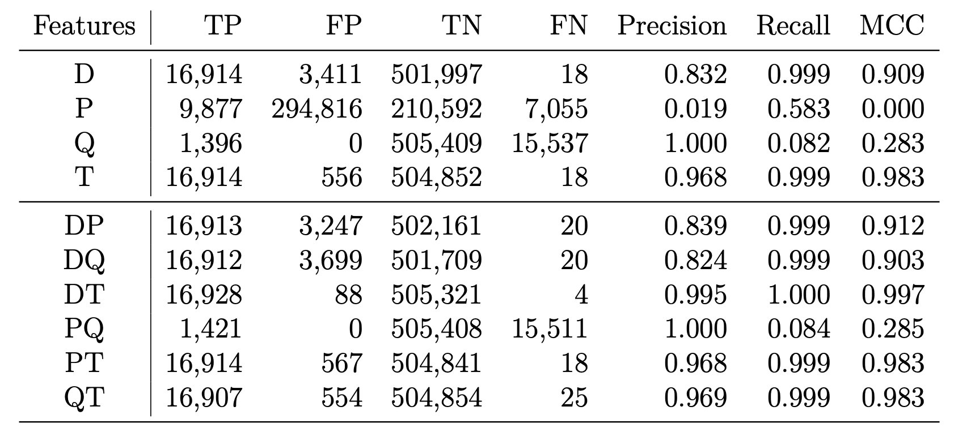
Spoofing Detection
1160 days, 49 configs
Quote size significant
Spoofing is effective
Logs recorded
via Exchange
Activity seq.
Reconstruction
Training Data
85K spoof. seq.
Selected
Notes:
Correlation absurd for external detector, but we’re examining our own agent for spoofing. Detector is not focus: if we have a detector, can we discourage harmful behavior adoption?

Slide 15
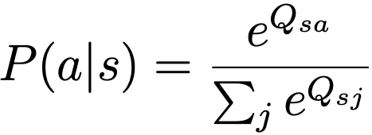
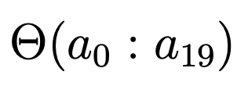
Experimental Agent
Q-Trader
Long only, no leverage
Features, Actions
Holdings, open orders
Entry / Exit advantage
Stop loss, depth orders
Controls
Exploration two ways
Reward: Exit P/L
Spoofing recognizer
Notes:
For the remaining experiments, Q-learning trader, long-only portfolio, no leverage.
Available actions: enter aggressively with a market order, passively with a limit order below the best bid, exit a position, cancel or update the price of existing orders, or to do nothing.
Spoofing recognizer will be referred to as a function Theta which takes a sequence of 20 actions and returns a real-valued spoofing activation level between zero and one.

Slide 16
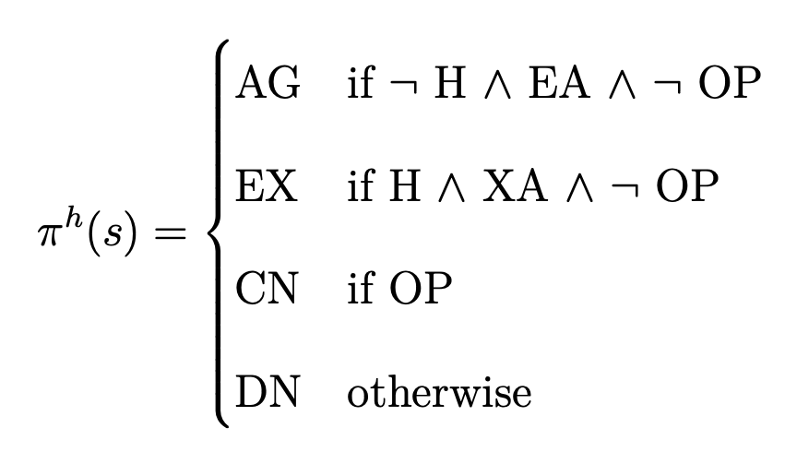
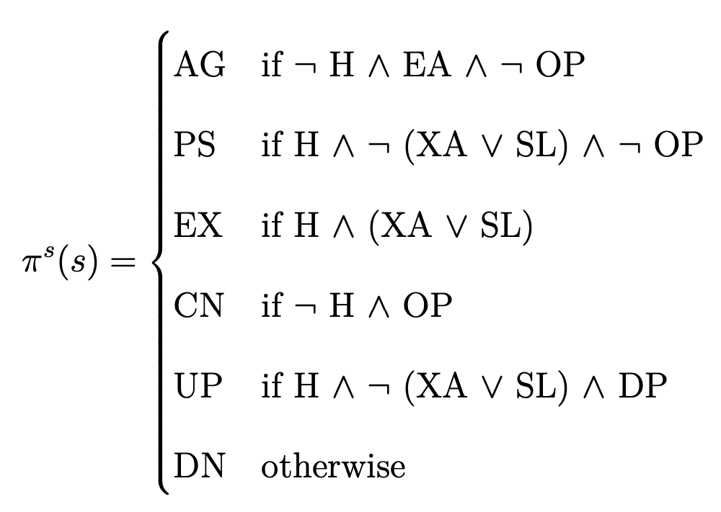
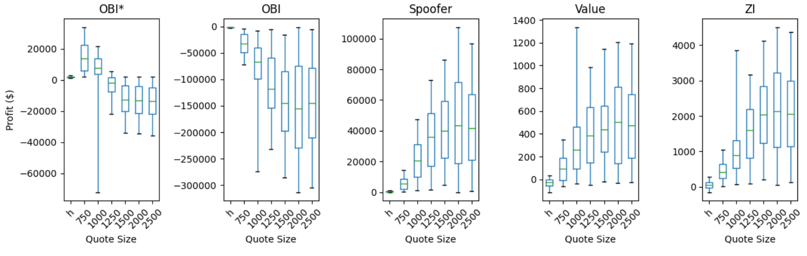
Fixed Policy
Spoofing Policy
Honest Policy
100 days
Same config.
No learning
Validate policy space
Spoofing not detected
Spoofing detected!
Notes:
First I wanted to validate that the state-action space I had designed allowed a prospective trading agent to profit without spoofing, and also to effectively spoof if it elected to do so. See: agent profitable without spoofing, but more profitable/disruptive with.

Slide 17
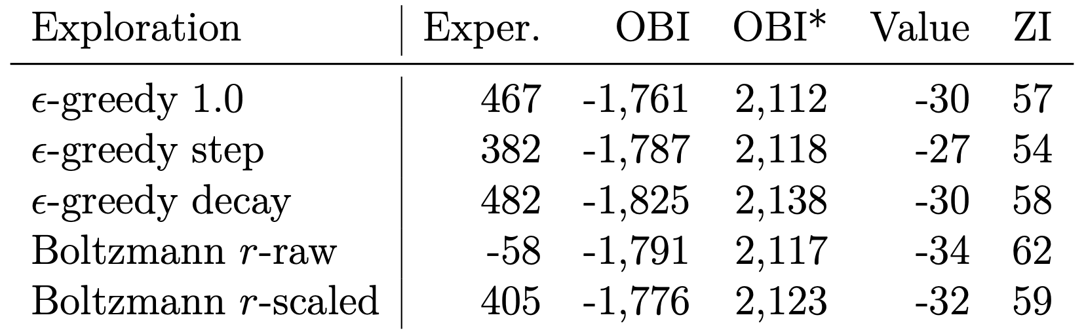
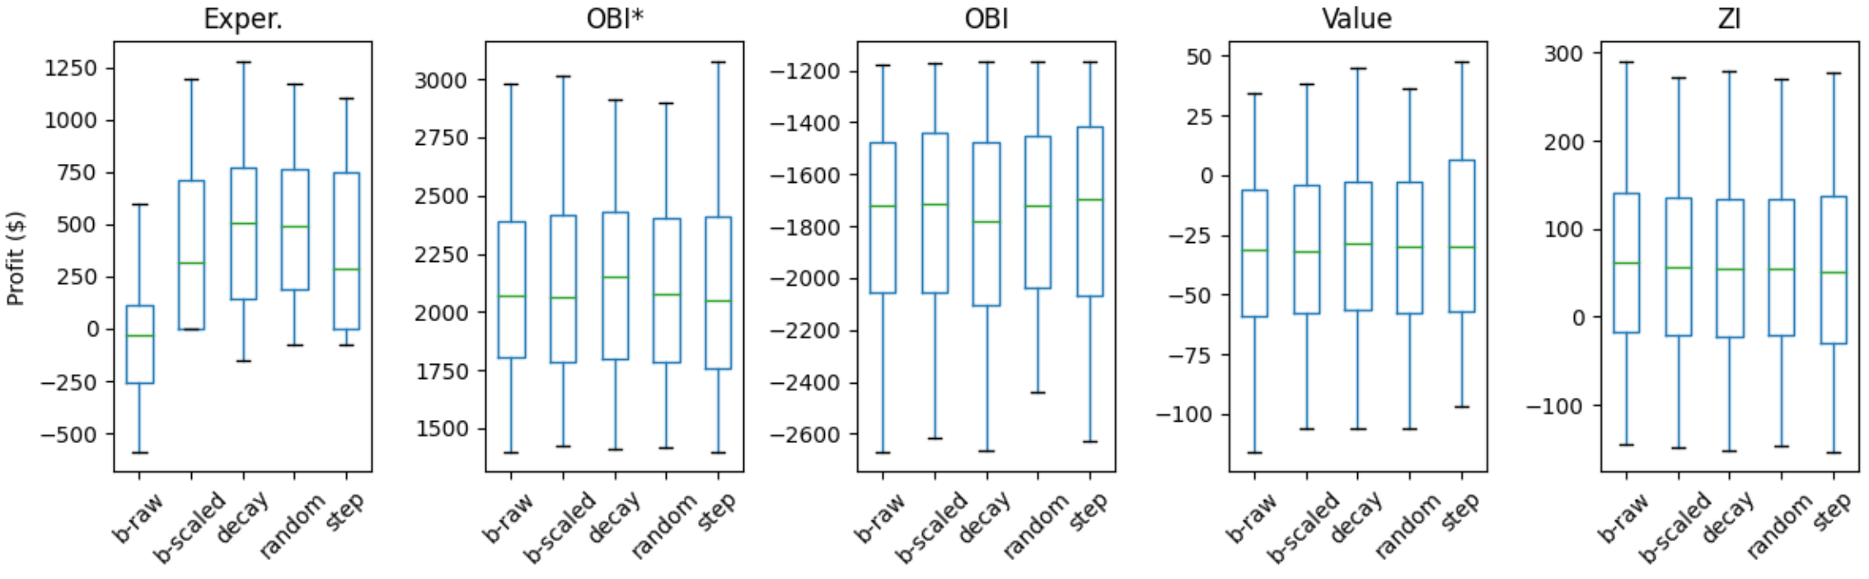
Restricted Learner
Limited action space
10 Q-traders
10 days train, 10 days test
Small, consistent profit
Spoofing not detected
Notes:
Now we start using the Q-trader. To ensure an actual learner could figure out how to profit in the market without spoofing, I removed the ability to cancel or update orders. This should render our agent unable to spoof the market. Tested combinations of e-greedy, Boltzmann, “raw” or “scaled” rewards. Boltzmann with scaled rewards had acceptable performance with the fewest downward deviations, and lends itself to action reranking: selected.

Slide 18
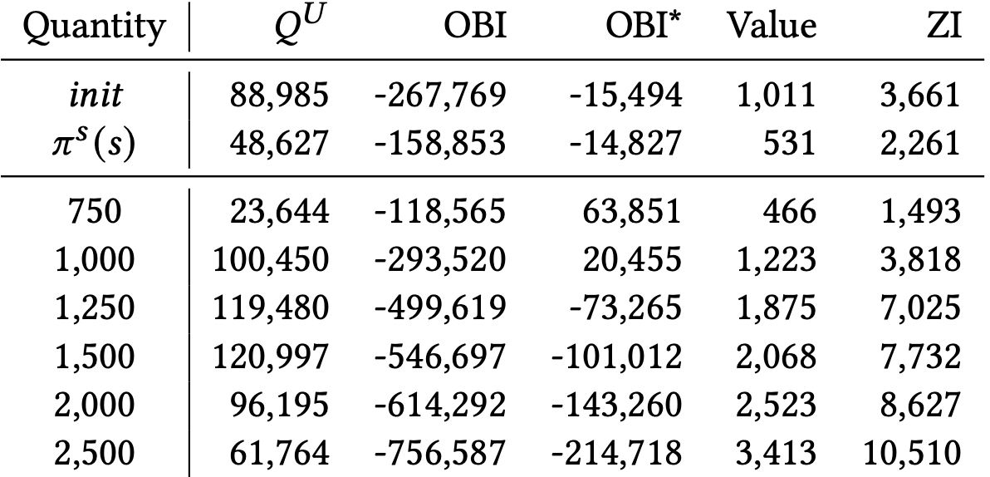
Unconstrained Learner
Previous Experiments
Honest: ad-hoc, fixed, restricted
Spoof: ad-hoc, fixed
Learner has options…
Naïve R(s)
No action restrictions
Scaled-r Boltzmann
Spoofing detected!
Notes:
The last preliminary experiment is this: is there even a problem that needs solving in the first place? Will an unconstrained autonomous trading agent, simply directed to maximize profit, learn to spoof? Yes, with awful effects for other participants, and occasionally even itself! Now let’s try to stop it!

Slide 19
Normative Approaches
Action selection
All individually normative
Exchange-visible only
Length 20 memory
Modify Q^{U} to Q^{N}
Depth 5, quantity 2500
100 market days each
Reward Shaping
Evaluate recent history
Action Reranking
Method of policy shaping
Evaluate prospective history
Notes:
Compared to the works I cite, the real challenge for me is that all of my agent’s actions are individually normative! There’s just nothing wrong with cancelling an order. This is why the action sequences are so critical.

Slide 20
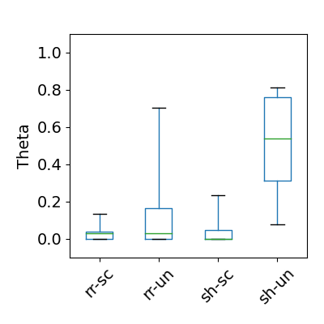
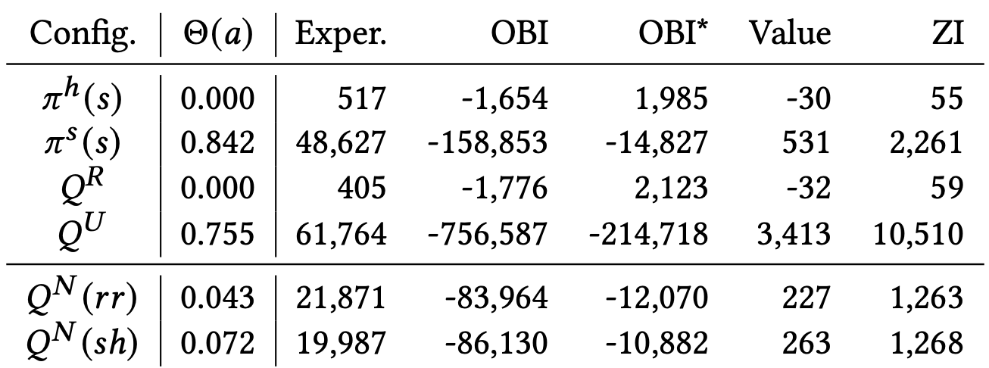
Normative Learner
Successful normative guidance!
Reranking with scaled rewards best inhibits
unwanted behavior
Notes:
So how did we do? The table compares mean Theta activation levels and returns for the reranking (rr) and shaping (sh) approaches to the earlier results, and the big box plot again shows the distribution of returns. Both methods are a tremendous improvement over the unconstrained learner in terms of returns and the volatility inflicted on other participants - these agents are better market citizens. Discuss results, note escapees with arrow.

Slide 21
Summary
No normative guidance?
Agents that can spoof probably will
Restricting action space works
Severely limits agent utility
Normative guidance can work
Theta activation reduced
0.75 or higher -> 0.05 or lower
Important
Scaled rewards
Action selection mechanism
Need for best practices!
“Escapees”
Bimodal returns and Theta
Notes:
But that was a very stylized market AND tabular agent with heavily designed features. More realistic?

Slide 22
Less Stylized Market
Based on Nasdaq TotalView
Full depth level 3 quotes
Includes pre/post market
How many agents?
0: market replay
1: backtest
2+: interactive backtest
Coroutine flow for better time sampling
Streamlined: 28K lines to < 1K
Accurate LOB reconstruction
Pre-market, cross
Disk cache + fast forward
Any time period, any date
Add liquidity to backtest?
Market maker agent
Notes:
Agents trade with history and each other. Still has full exchange, LOB, latency model, standard agents, even a DeepQ agent.

Slide 23
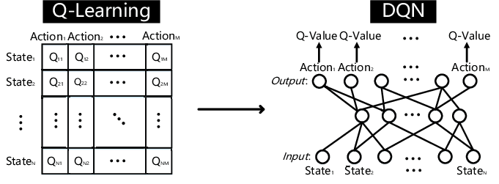
Less Stylized Agent
Q-network, not table
Add target network
Double Q
ε-greedy is f (s)
Zhang, Ji, et al. (2019). An End-to-End Automatic Cloud Database Tuning System Using Deep Reinforcement Learning.
Notes:
State space now includes continuous data: price and volume of LOB levels, shares currently held/open/etc.

Slide 24
Testing on one time period
Sep 11, 2024 from 10:21 to 10:31 AM
Symbol: SPY
Learner task is optimal execution of 4 round lots
Need to learn patience

Slide 25
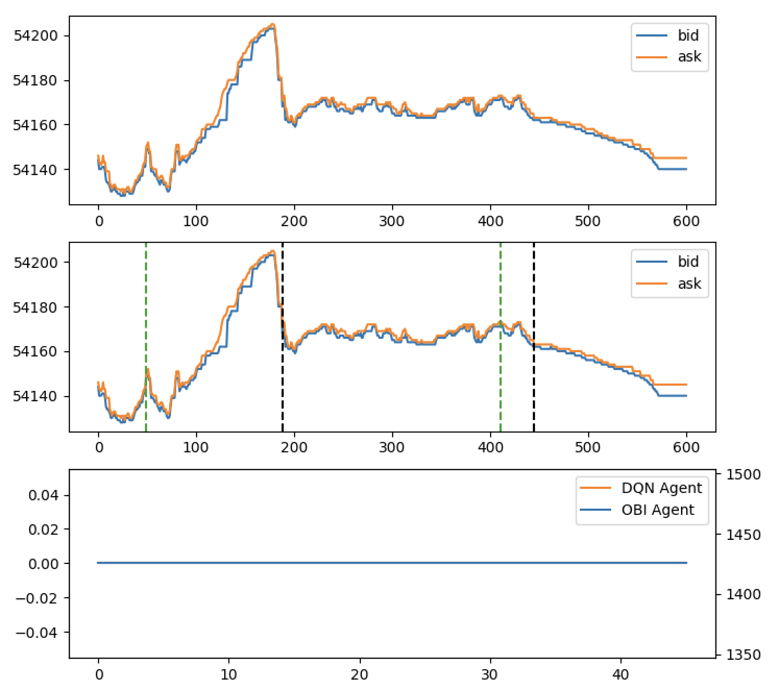
OBI alone
Notes:
Every day is the same.

Slide 26
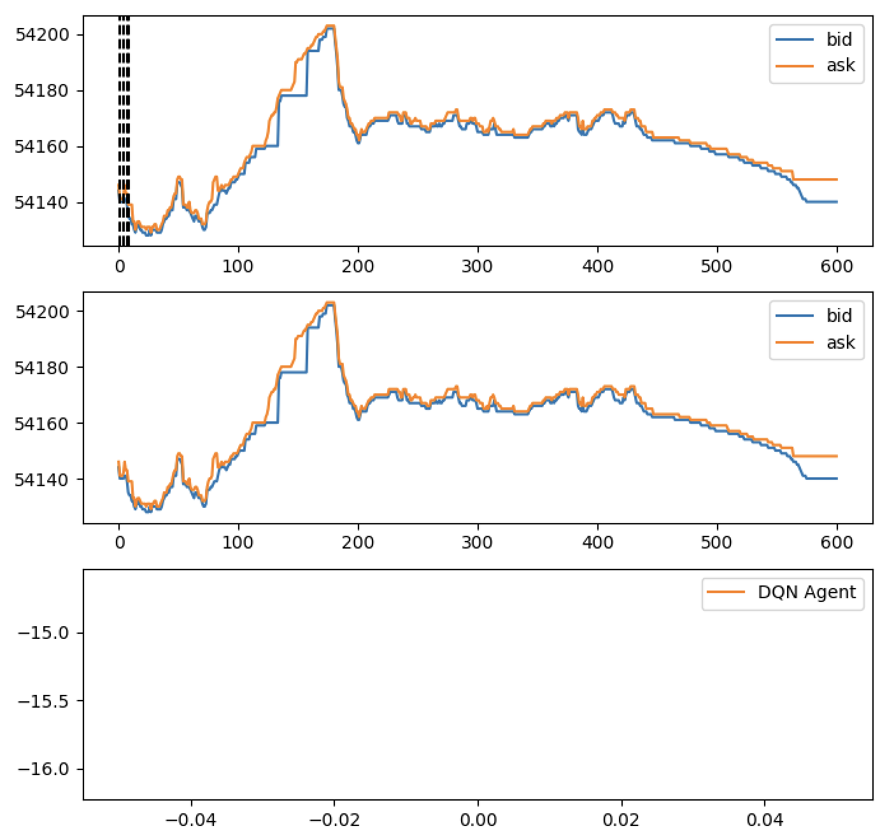
DQN-R alone
Day 1

Slide 27
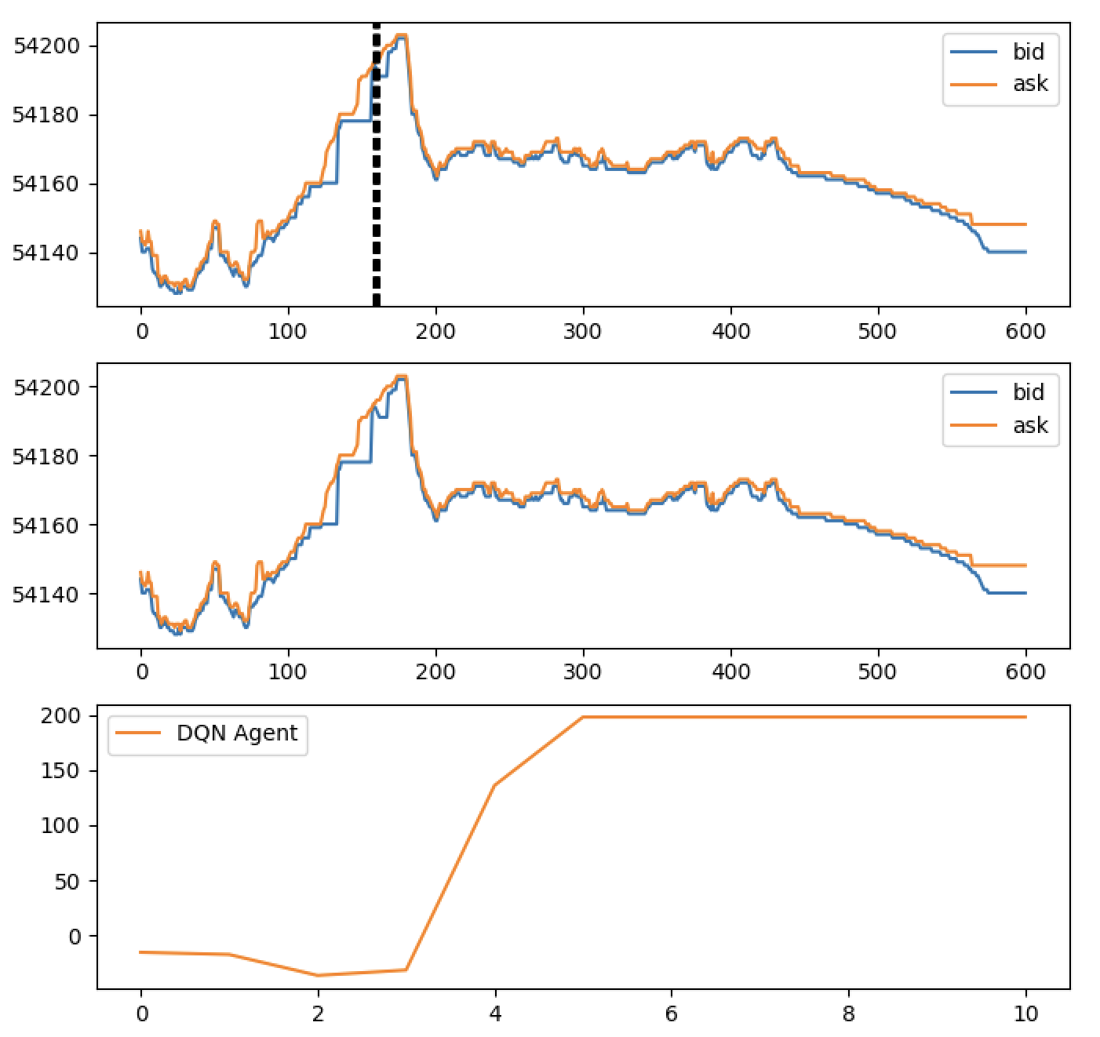
DQN-R alone
Day 10

Slide 28
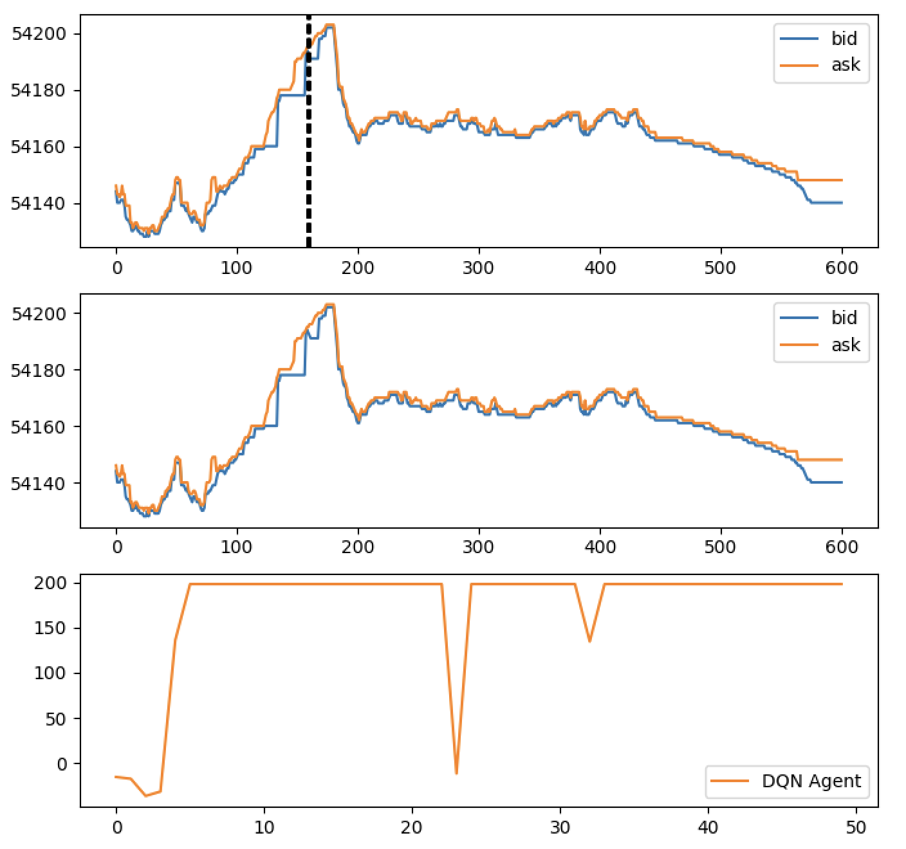
DQN-R alone
Day 50

Slide 29
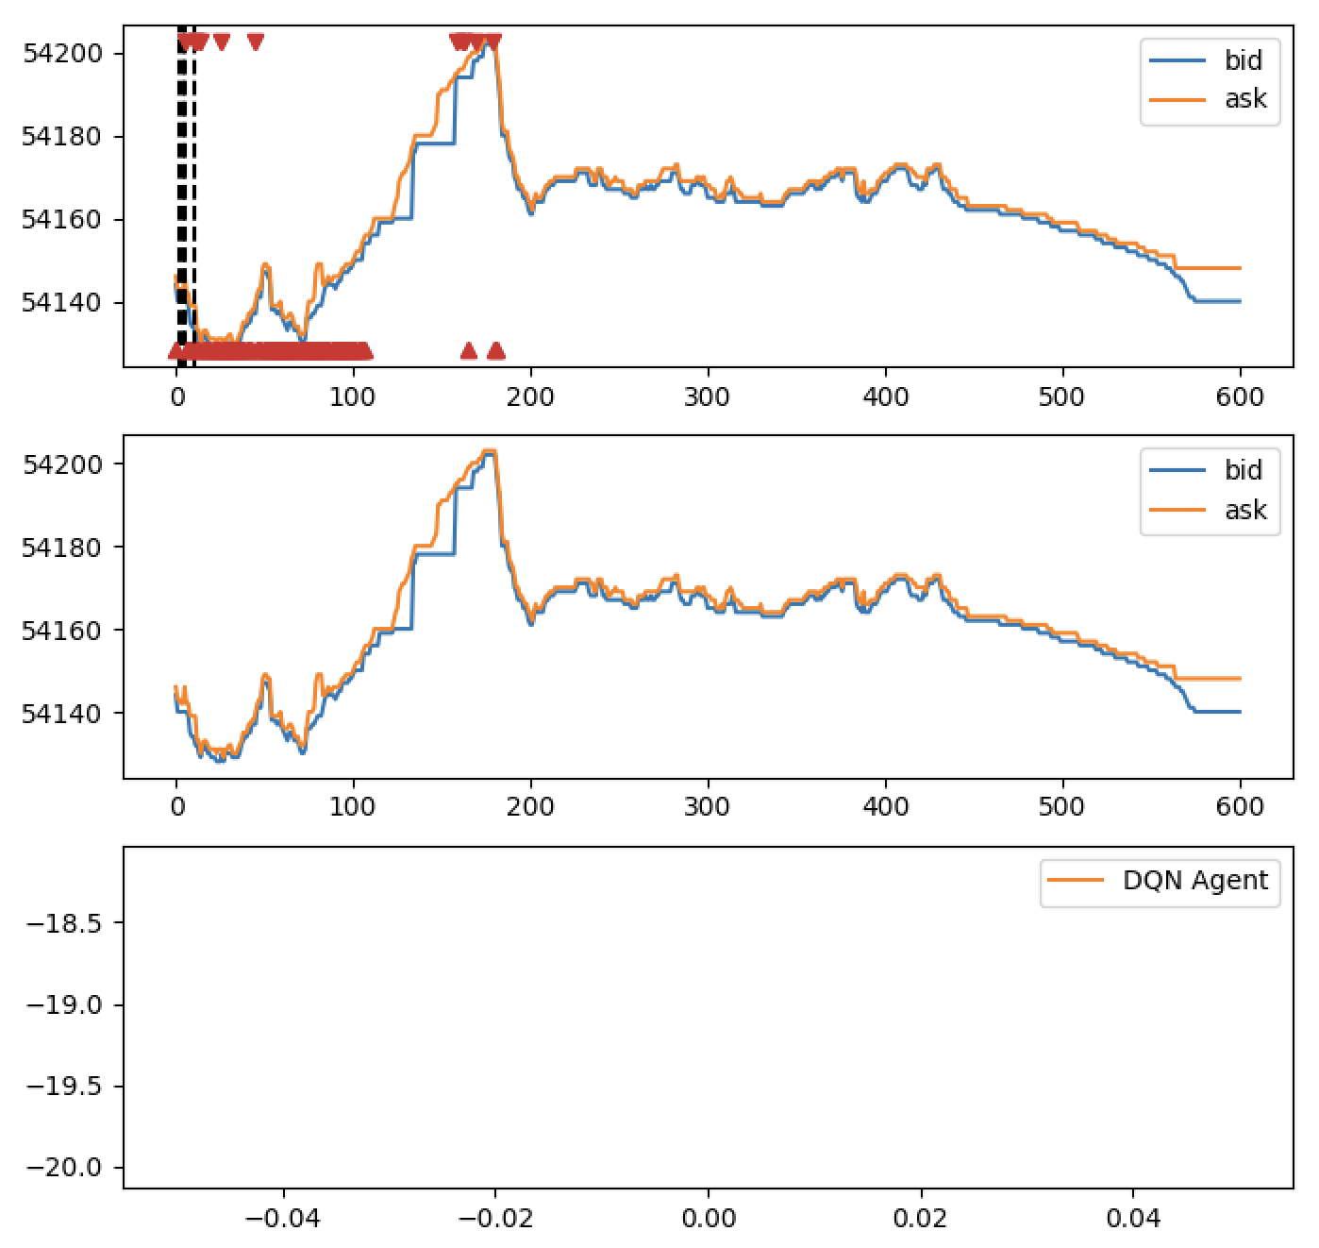
DQN-U alone
Day 1

Slide 30
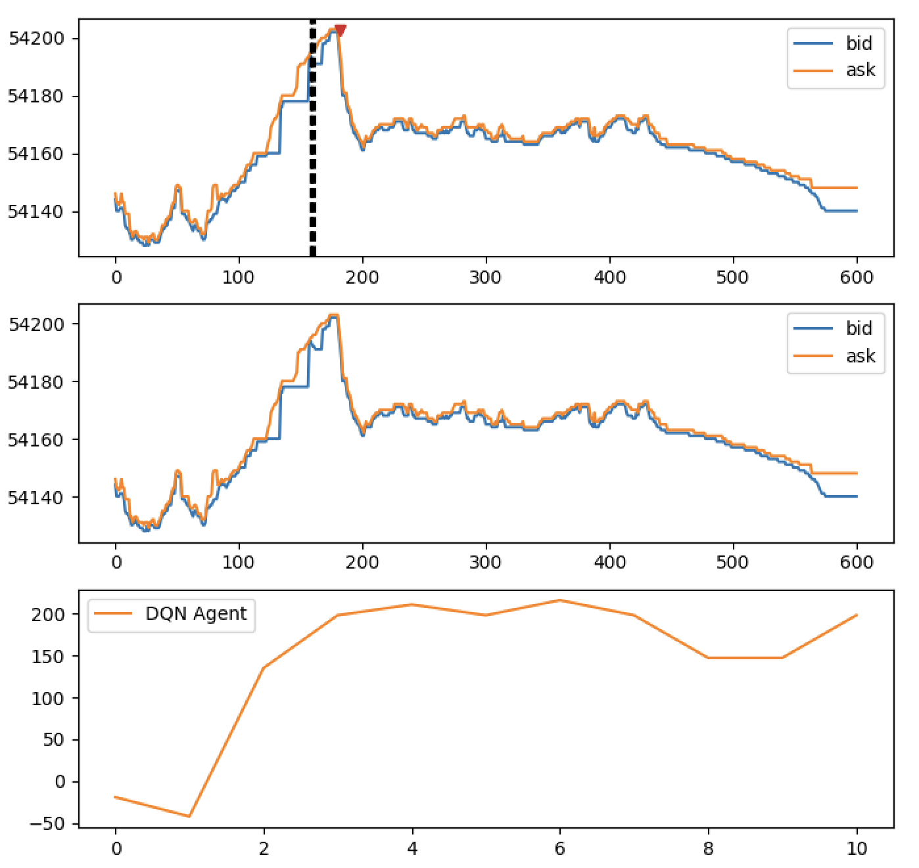
DQN-U alone
Day 10

Slide 31
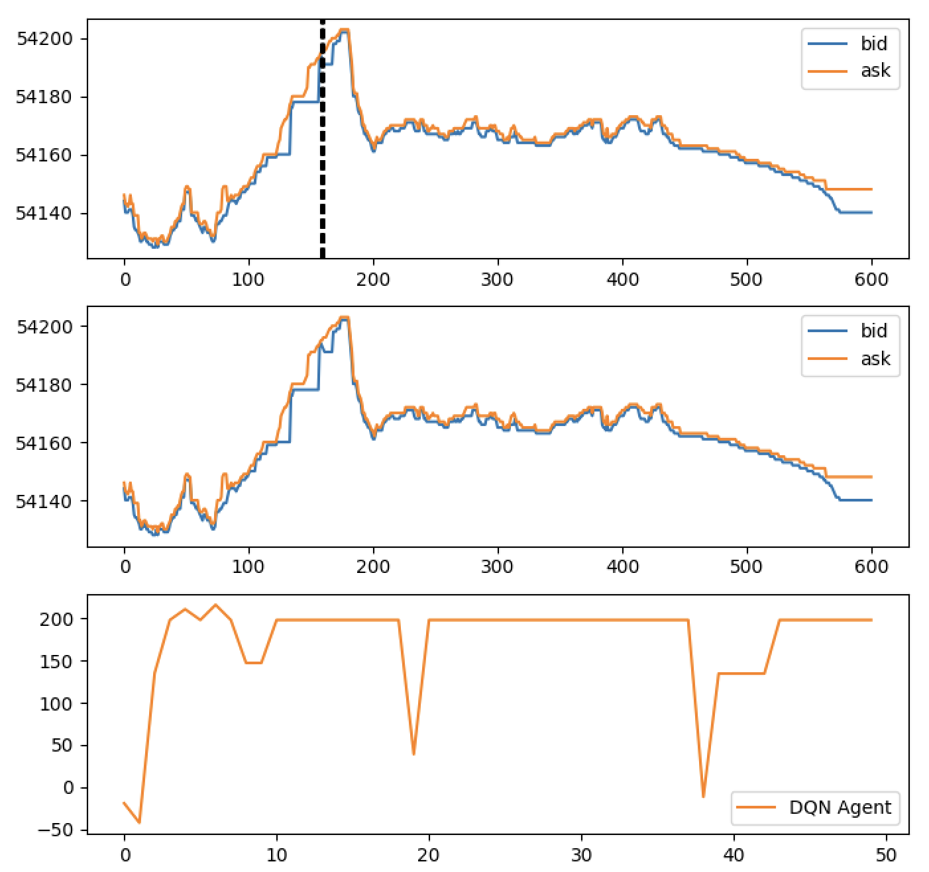
DQN-U alone
Day 50

Slide 32
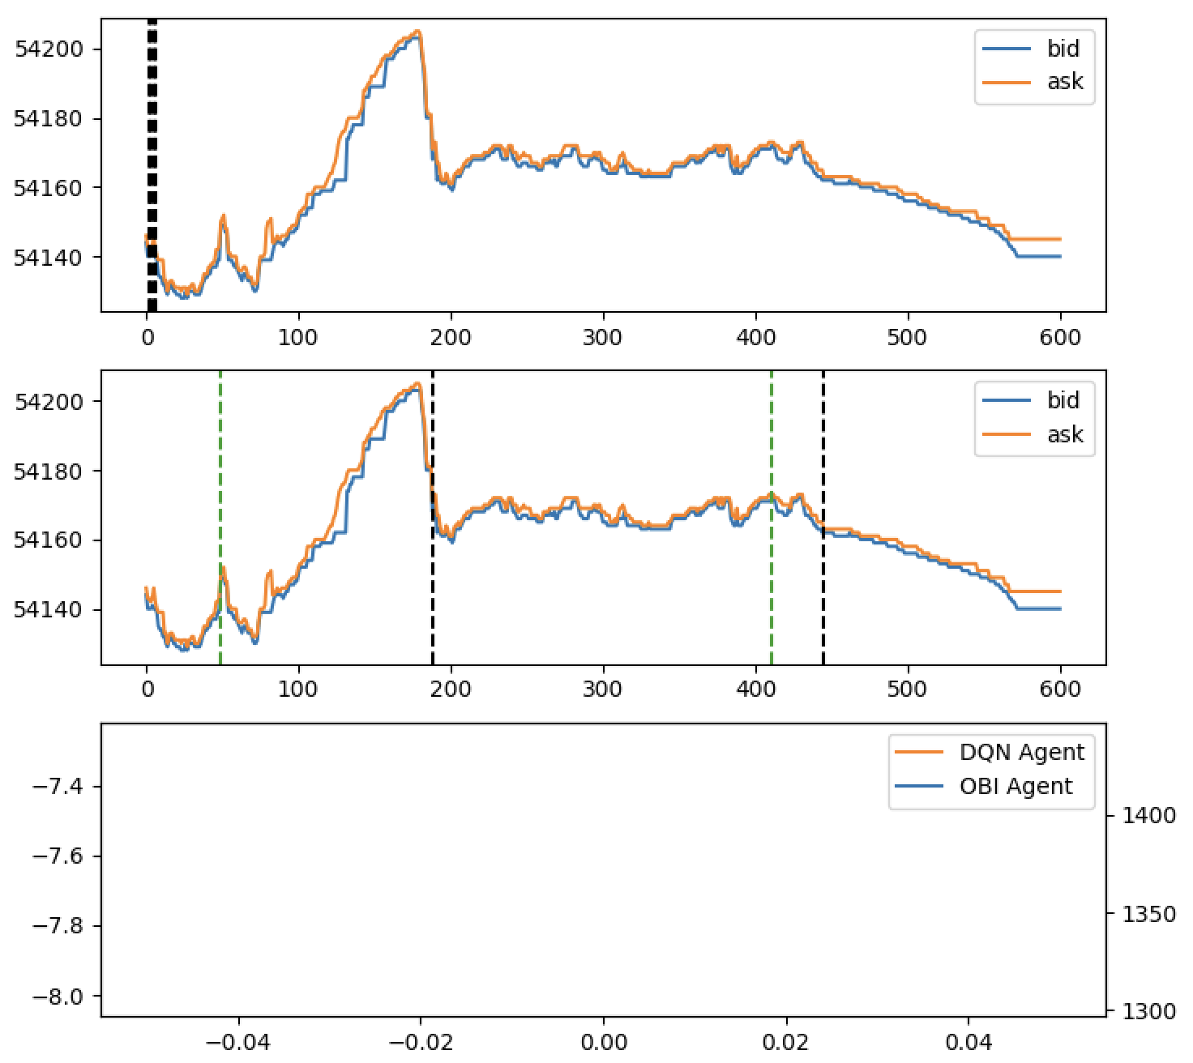
DQN-R + OBI
Day 1

Slide 33
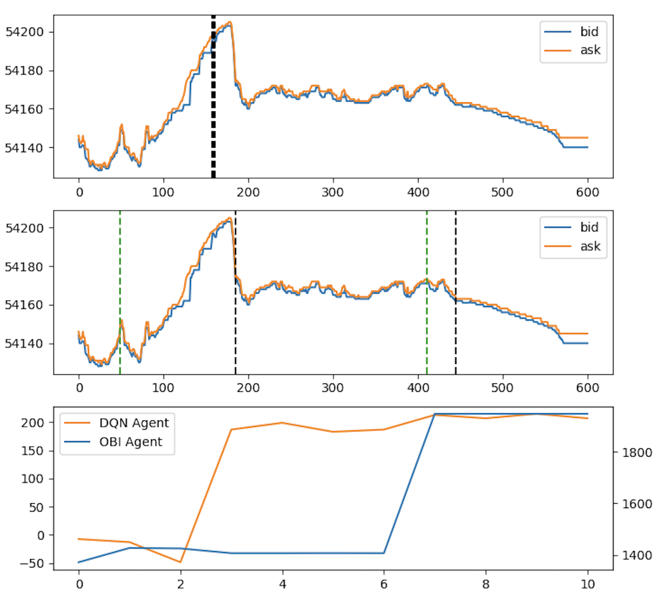
DQN-R + OBI
Day 10

Slide 34
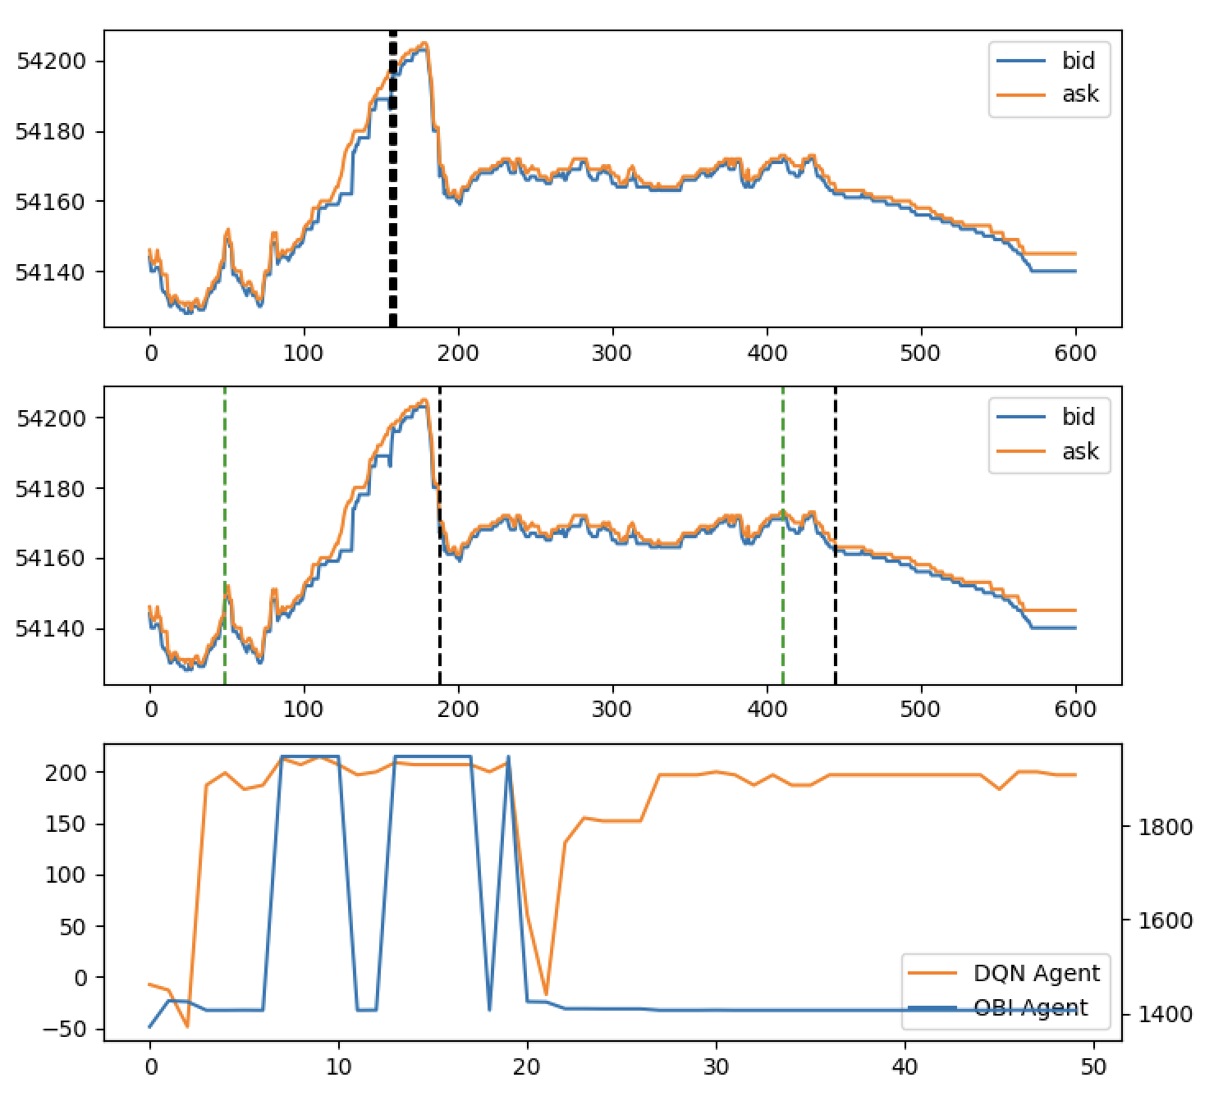
DQN-R + OBI
Day 50

Slide 35
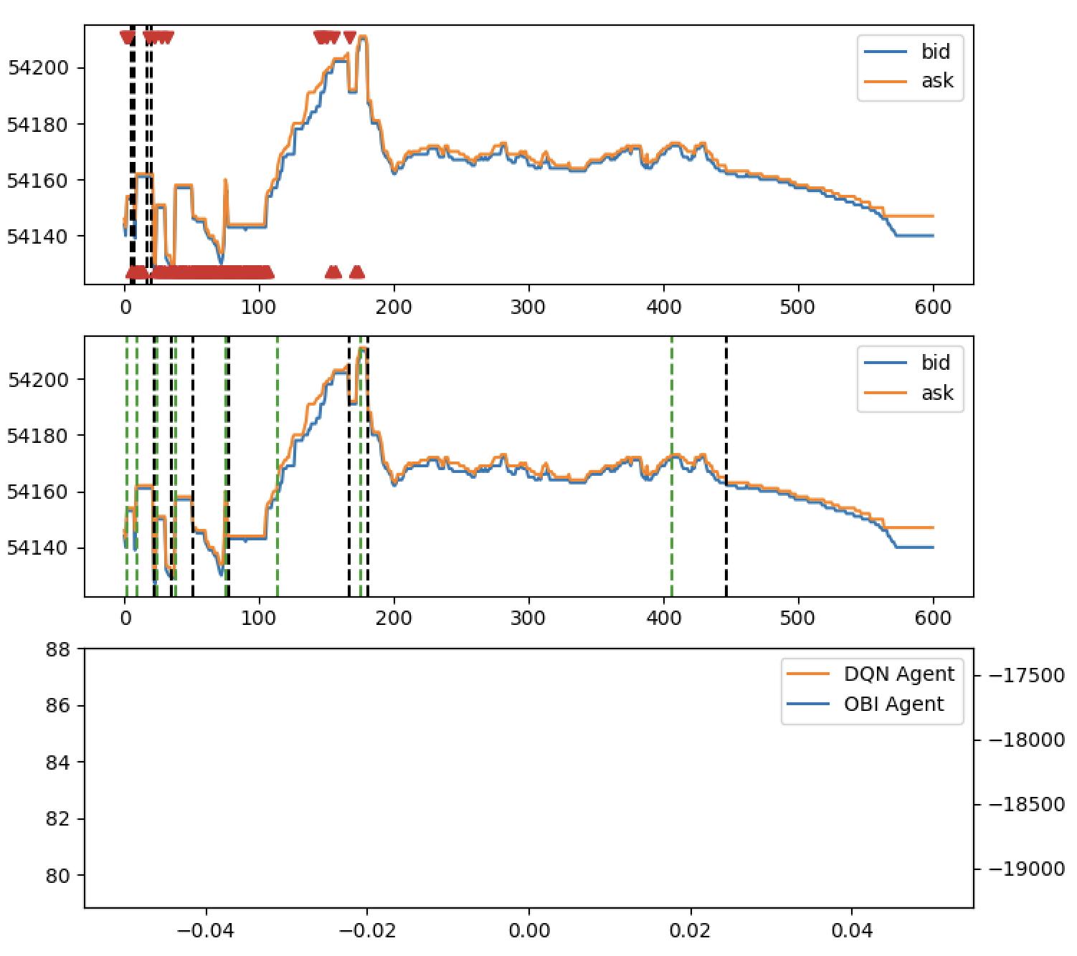
DQN-U + OBI
Day 1

Slide 36
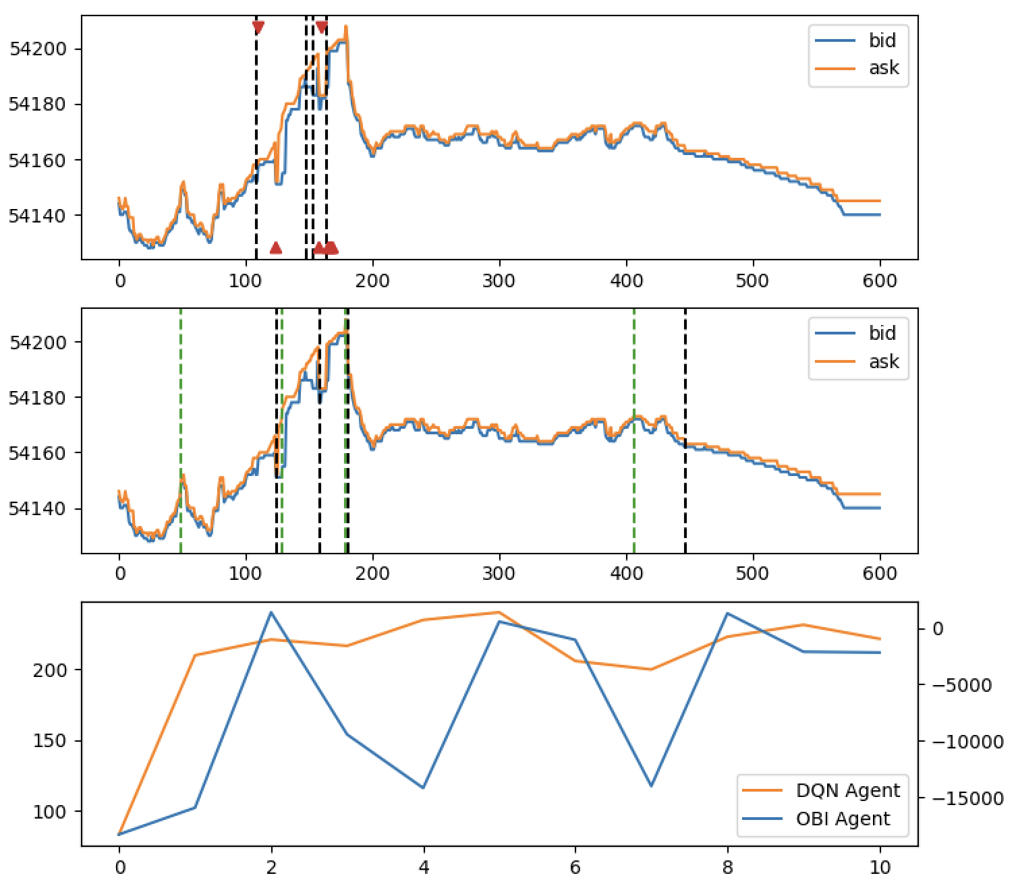
DQN-U + OBI
Day 10

Slide 37
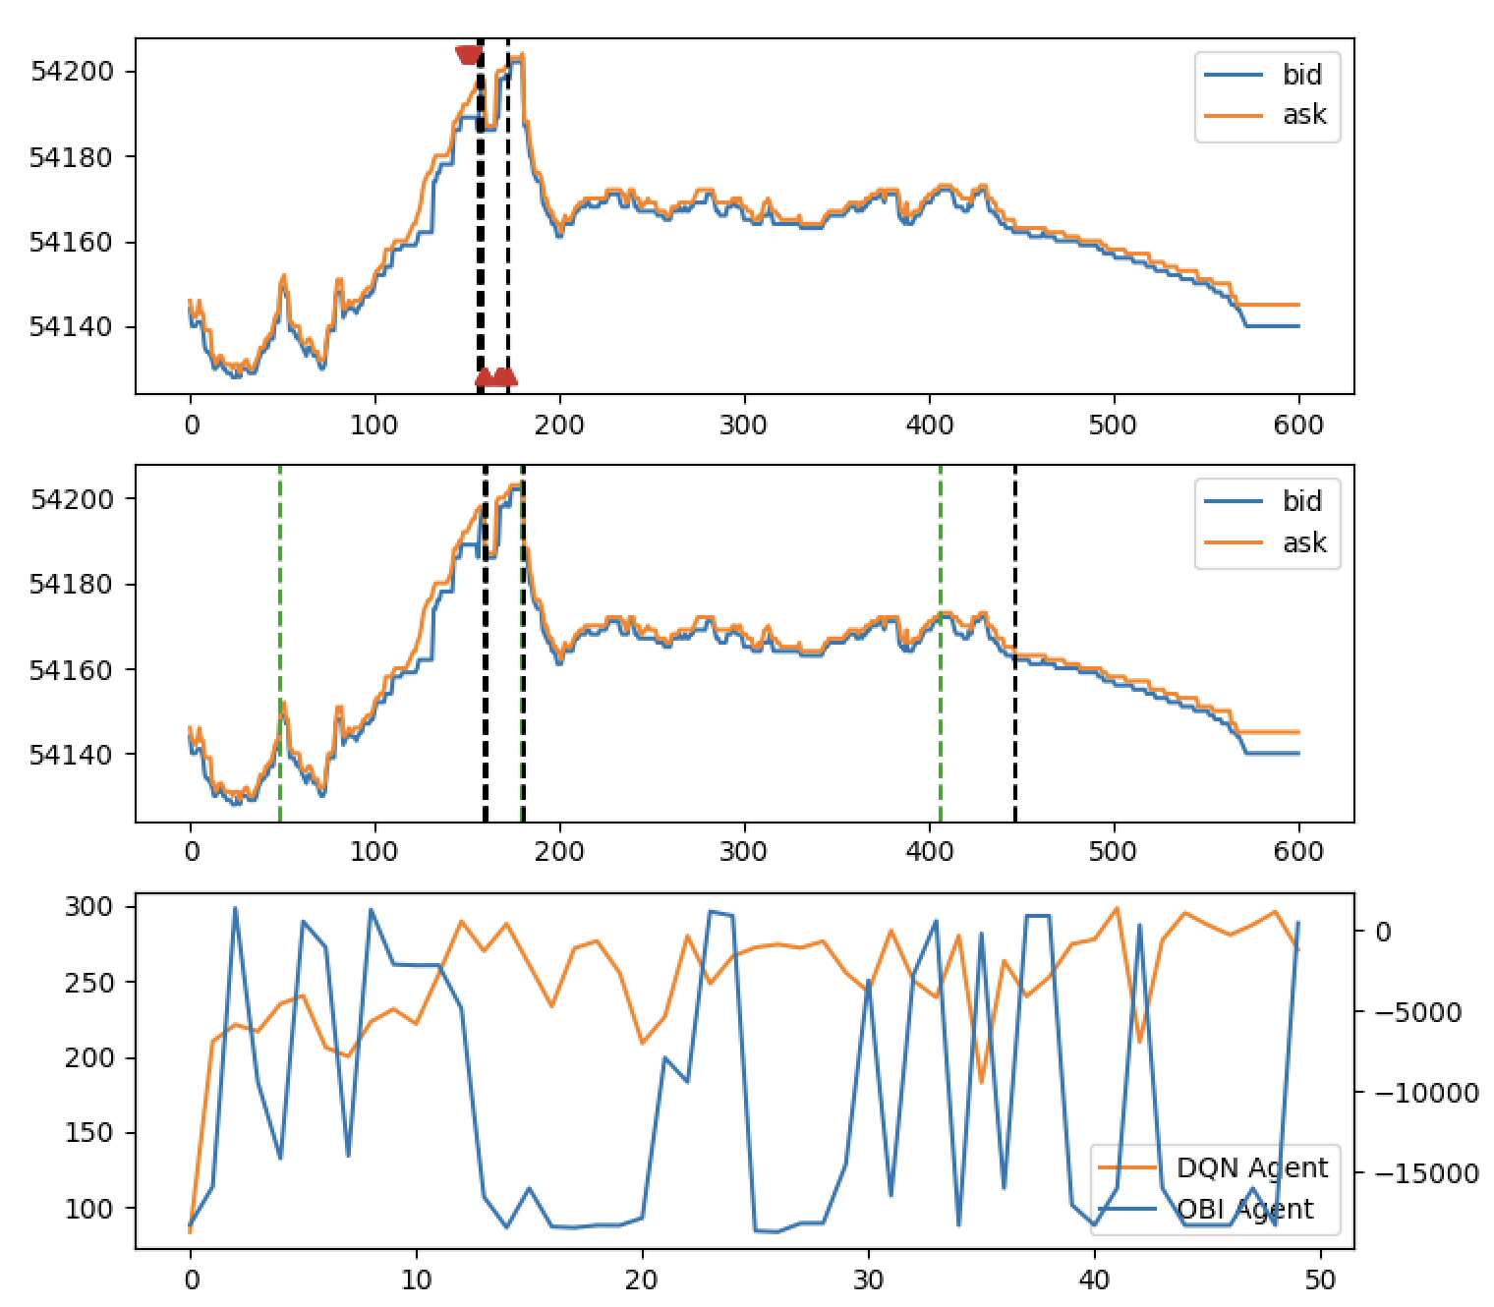
DQN-U + OBI
Day 50

Slide 38
You need interactive simulation
Autonomous AI misbehaves
Think responsibly
Constrain input information
Necessary actions only
Normative guidance helps
Allows separate policy
Env. vs normative rewards
Careful incentive design
Thank you! Questions?
Byrd, D., Hybinette, M., & Balch, T. H. (2020, June). ABIDES: Towards high-fidelity multi-agent market simulation.
In Proceedings of the 2020 ACM SIGSIM Conference on Principles of Advanced Discrete Simulation (pp. 11-22).
Byrd, D. (2022, November). Learning not to spoof. In Proceedings of the Third ACM International Conference on AI in Finance (pp. 139-147).
Notes:
It’s not only spoofing. Anywhere you introduce autonomy, you need to be careful. (summer research) Our intelligent agents are pathological and don’t understand human norms. It’s up to us to teach them how to behave.

