Slide 1


Multi-Agent Learning in the Era of Agentic Coding
Zun Li
12th Annual Bloomberg-Columbia Machine Learning in Finance Conference

Slide 2
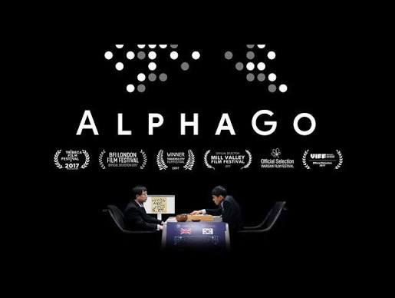


Google DeepMind was once famous for its multiagent learning research….

Slide 3
Three Eras of Multi-Agent Learning
Era I: ~1990s – Early 2010s
Era II: ~Mid 2010s – Early 2020s
Era III: ~2023 – Present
Tabular Algorithms
Heuristic & Exact Payoffs
Deep Algorithms
Neural Function Approximation
LLM Agentic Coding
Symbolic Reasoning & Tools
• Techniques: Heuristic search, lookup Q-tables, fictitious play
• Representation: Discrete, small-scale state & action spaces
• Coordination: Exact Nash & Minimax equilibrium solvers
• Applications: Automated negotiation, auctions, matrix games
• Techniques: Deep neural nets, self-play, MCTS, policy gradients
• Representation: High-dimensional inputs (pixels, large boards)
• Coordination: Centralized training / decentralized execution (CTDE)
• Scale: Large games (Go, StarCraft II, Poker)
• Techniques: Pretrained LLMs, code generation, execution loops
• Representation: Open-ended language, codebases, APIs & tools
• Coordination: Multi-agent debate, role critique, consensus
• Applications: SWE-bench, algorithmic discovery, swarms

Slide 4
Three Works of Agentic Coding in Multi-Agent Learning
PART I · SIMULATOR
PART II · POLICY/STRATEGY
PART III · ALGORITHM
Code World Models
Environment & Search
Code-Space Oracles
Interpretable Policies
Algorithmic Discovery
Meta-Level Learning
Shift: Direct LLM Moves → Code Model + MCTS
Shift: Black-Box Neural RL → Code Policies
Shift: Manual Tuning → Evolutionary Discovery
• Synthesize game rules into verifiable Python models
• Guarantee legal moves & state transitions
• Plug in general-purpose MCTS for deep planning
• Prompt LLM for best-response strategies in code
• Inherently explainable & auditable gameplay
• Solve approximate equilibria via PSRO framework
• Deploy AlphaEvolve to search CFR & PSRO spaces
• Discovered SOTA solvers (VAD-CFR, SHOR-PSRO)
• Distill minimal theoretical cores (WOP, PM)
ICLR’26: Paper: arXiv:2510.04542
AAMAS’26: Paper: arXiv:2603.10098
Submitted to NeurIPS’26: Paper: arXiv:2602.16928

Slide 5

Code World Models for General Game Playing
ICLR’26

Slide 6
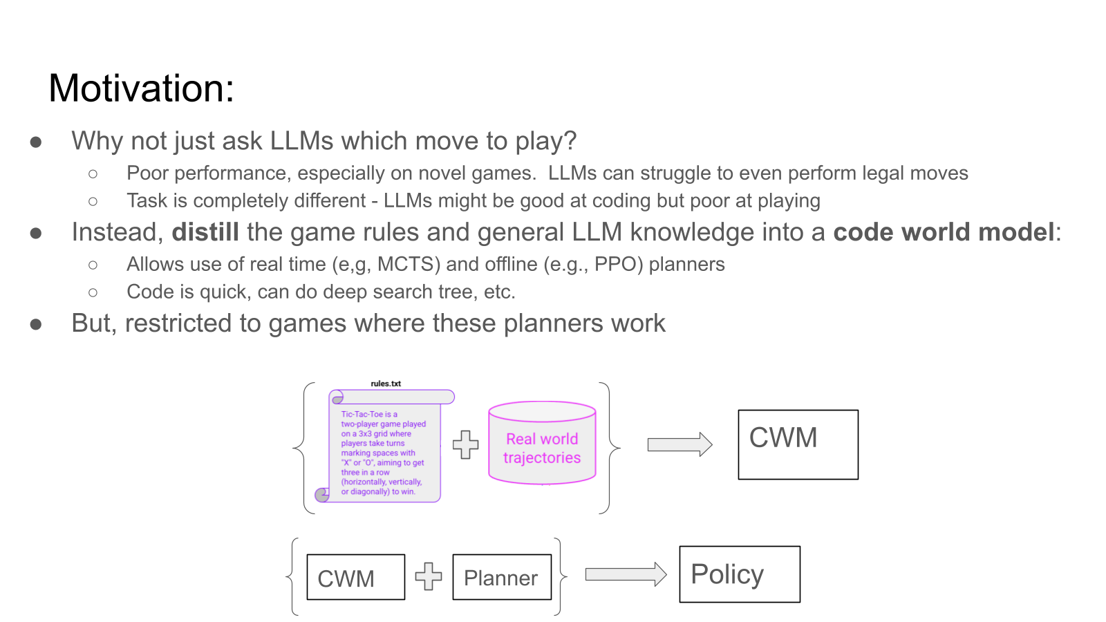

Slide 7
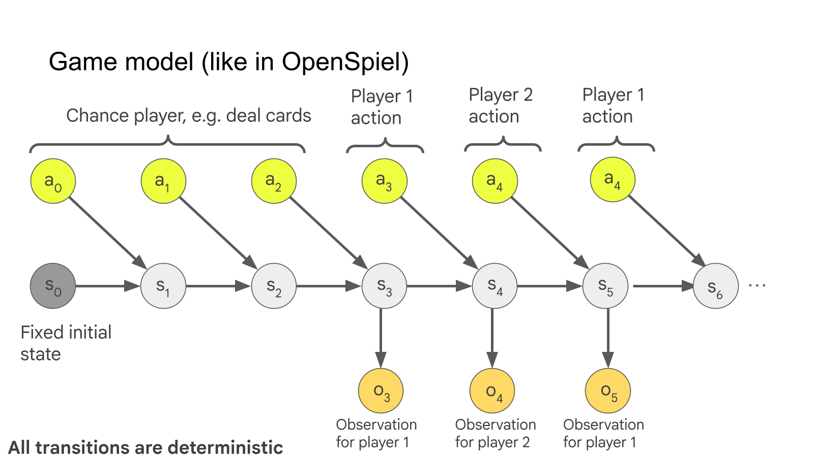

Slide 8
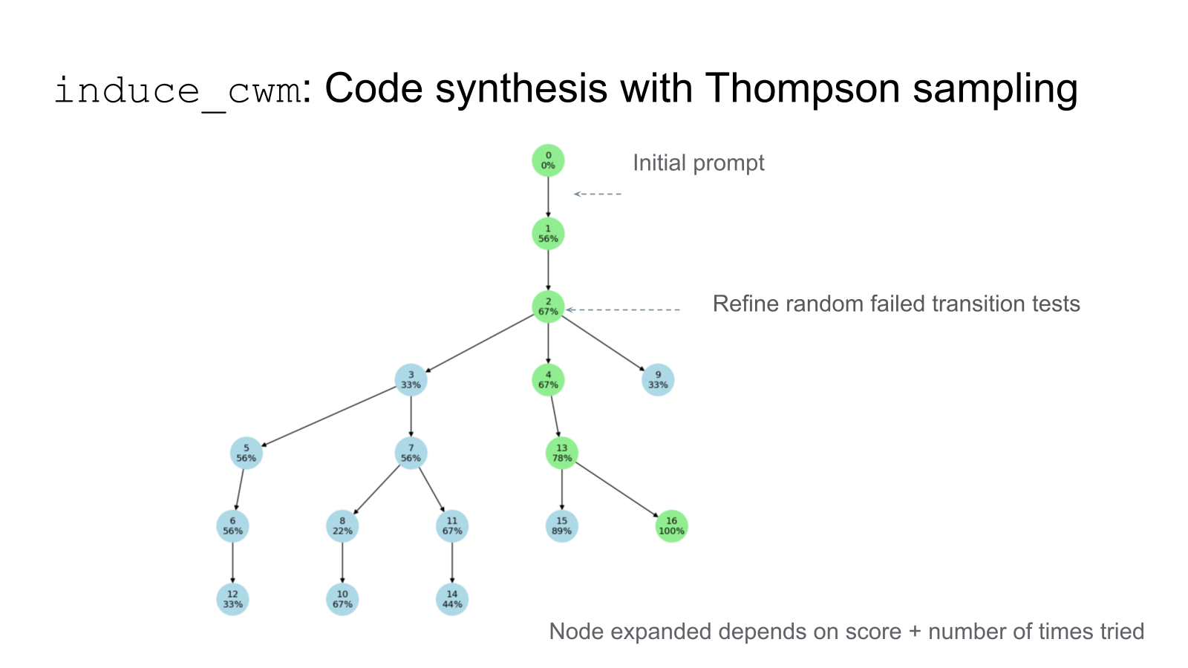

Slide 9
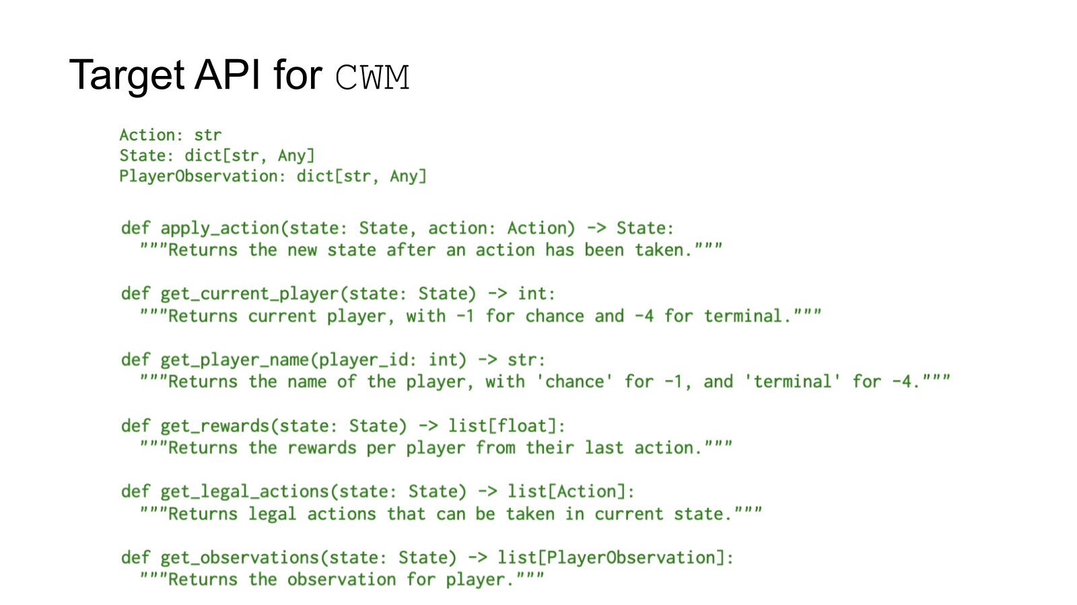

Slide 10
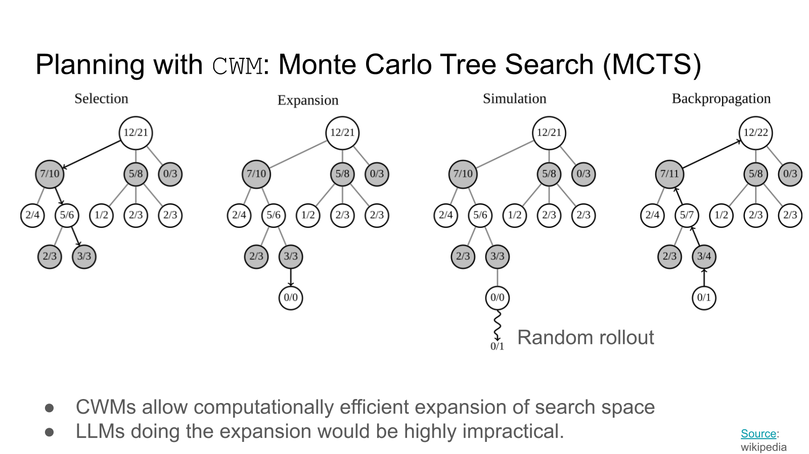

Slide 11
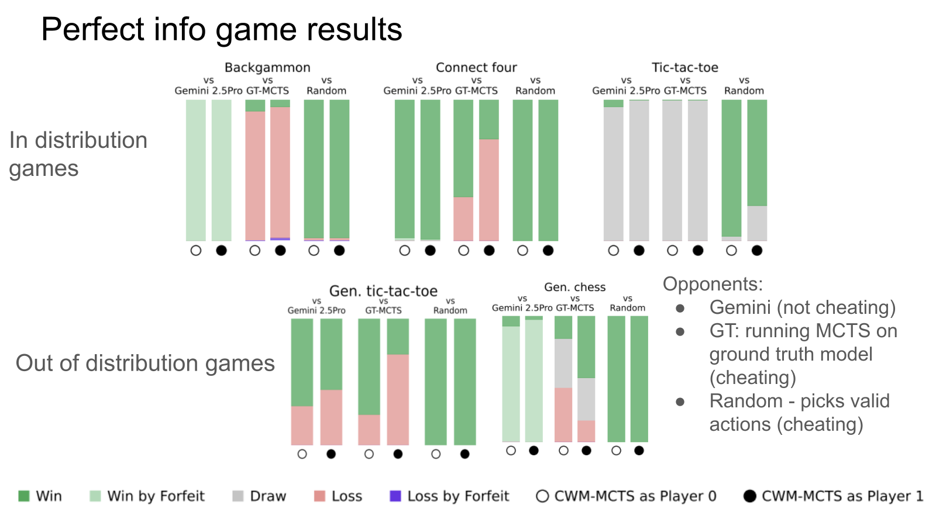

Slide 12
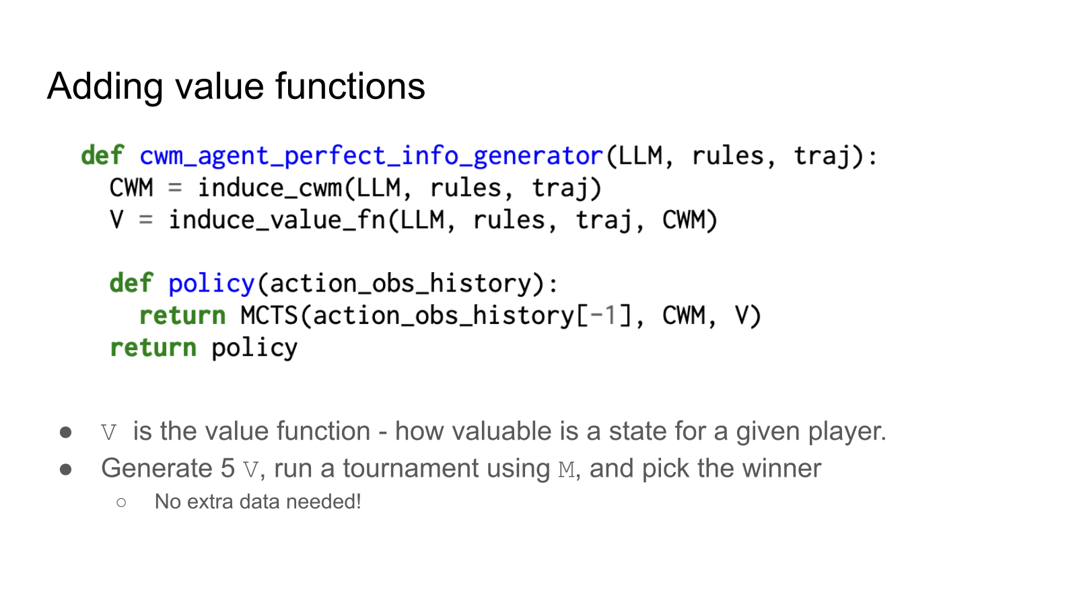

Slide 13
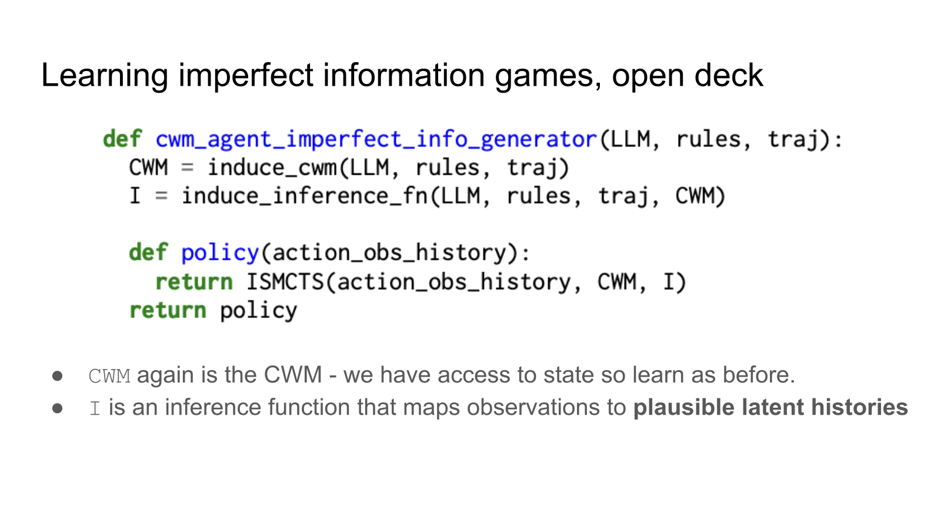

Slide 14
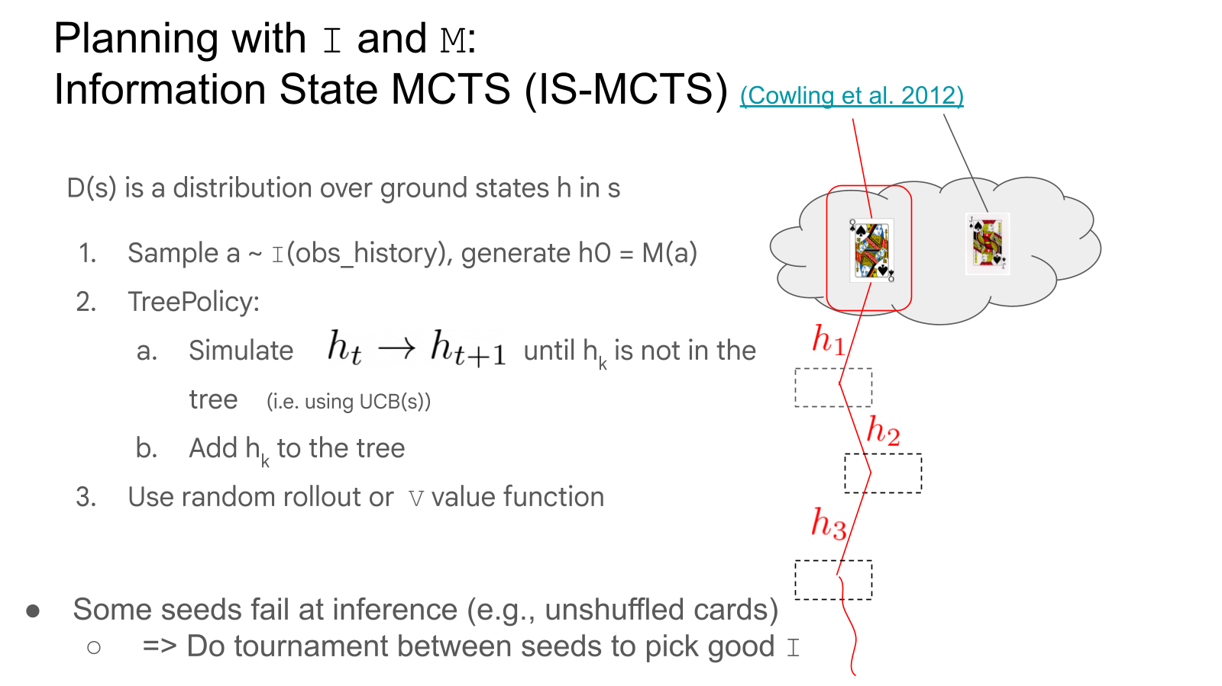

Slide 15
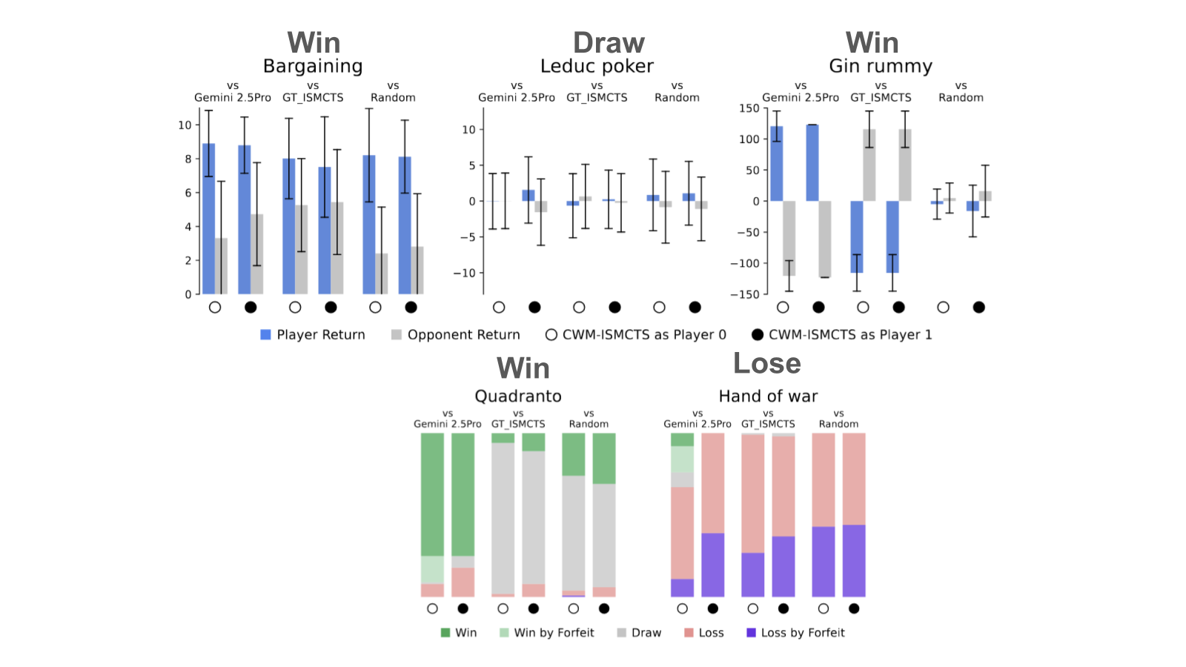

Slide 16
Code Space Response Oracles
Daniel Hennes, Zun Li, John Schultz, Marc Lanctot
AAMAS’26

Slide 17
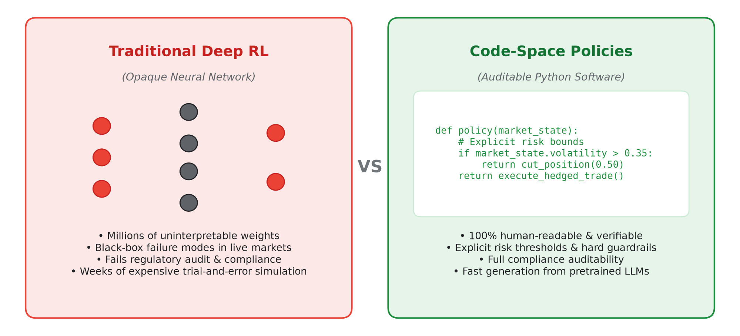
The Challenge: Black-Box AI in Strategic Decisions

Slide 18
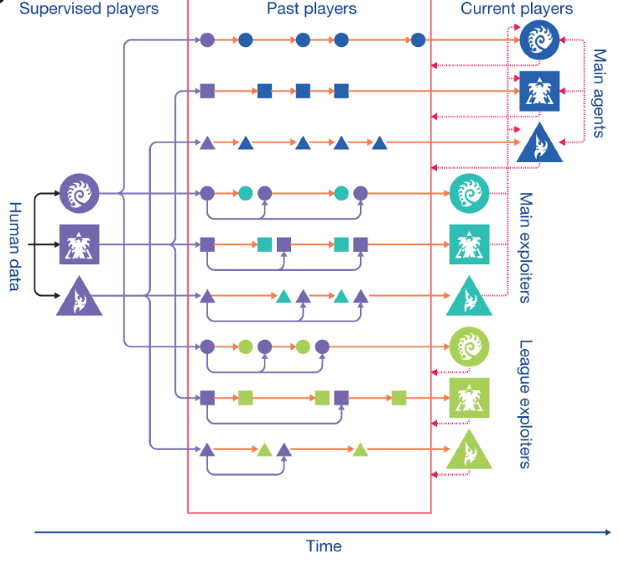
The Intuition: AlphaStar-Style League Training
• How DeepMind solved StarCraft II (AlphaStar):
• Population-Based League Training:
- Agents do not train against fixed bots
- Instead, they play against an evolving pool of competitors
- "Exploiter" agents actively find and punish weaknesses in past strategies
• The Arms Race:
- Mitigates strategic cycling (rock-paper-scissors traps)
- Gradually drives the entire population toward game-theoretic mastery
• The Catch: Traditional AlphaStar relied on massive neural networks trained with millions of game steps.

Slide 19
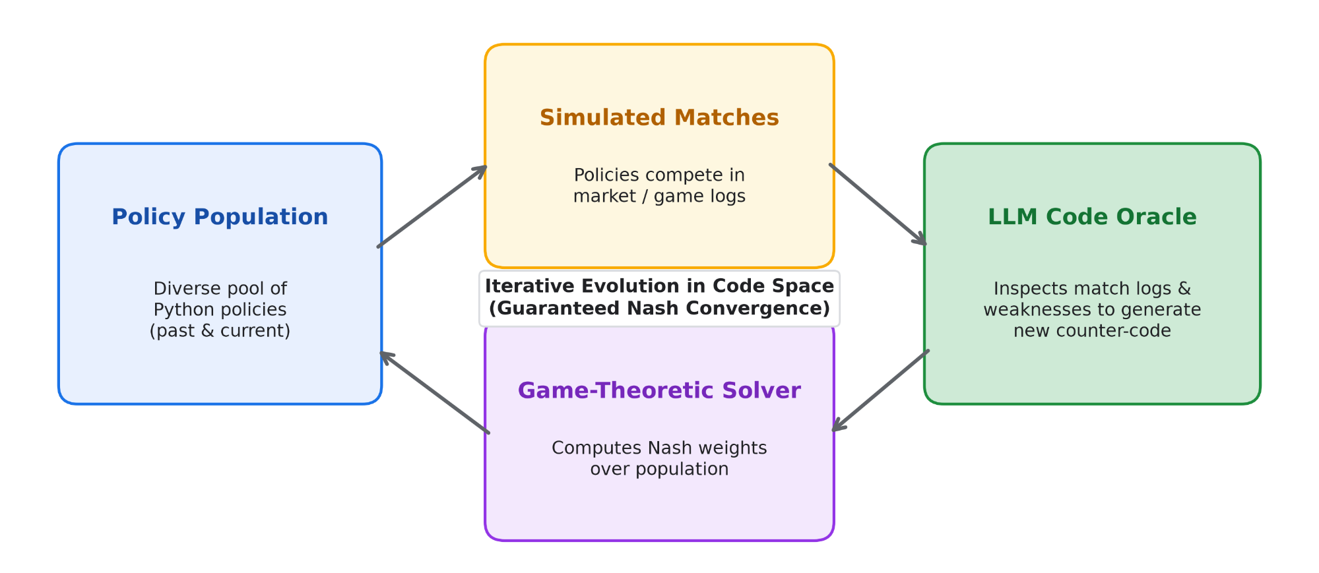
Our Idea: League Training via Code Generation

Slide 20
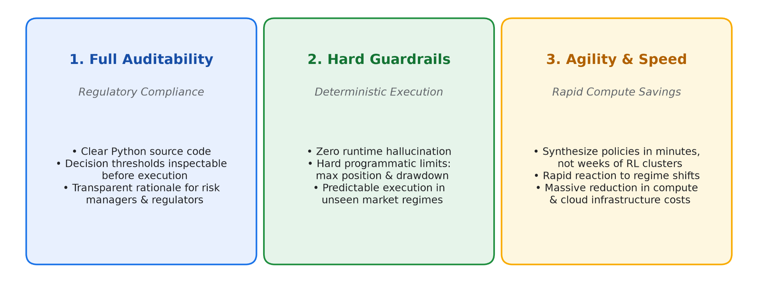
Why Code Policies Matter for Finance & High Stakes

Slide 21
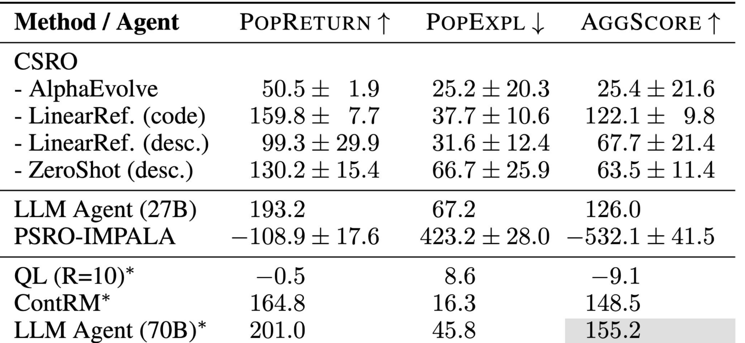
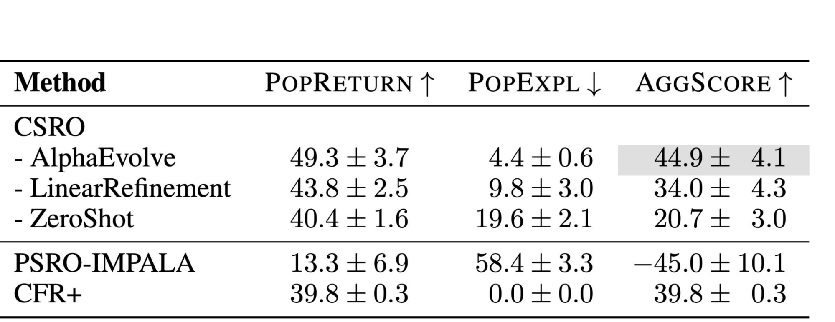
Empirical Proof: Transparent Code Outperforms Deep RL
• Validated across competitive multi-agent benchmarks (Repeated Rock Paper Scissors & Poker):
- Transparent code policies consistently outperform Deep RL baselines (such as IMPALA)
- Avoids the catastrophic overfitting that often plagues neural networks against diverse opponents
• Takeaway: We do not have to sacrifice transparency to achieve state-of-the-art strategic AI.
Benchmark 1: Repeated Games (Pattern Exploitation)
Benchmark 2: Imperfect Information Poker (Bluffing & Risk)

Slide 22
Discovering Multiagent Learning Algorithms with Large Language Models
Zun Li, John Schultz, Marc Lanctot, Daniel Hennes
AAMAS’26 SE workshop best paper; submitted to NeurIPS’26

Slide 23
Anatomy of a Game-Theoretic Algorithm: Regret Matching
RPS Round t: Your strategy σᵗ = (50% R, 50% P, 0% S) vs. Opponent σ₋ᵢᵗ = 100% Paper ⇒ Expected Payoff u(σᵗ, σ₋ᵢᵗ) = -0.5
MODULE 1 · Regret Accumulator
rᵗ(a) = u(a, σ₋ᵢᵗ) − u(σᵗ, σ₋ᵢᵗ)
Rᵀ(a) = Rᵀ⁻¹(a) + rᵗ(a)
Rock: rᵗ = -0.5 ⇒ Rᵀ = -0.5
Paper: rᵗ = +0.5 ⇒ Rᵀ = +1.5
Scissors: rᵗ = +1.5 ⇒ Rᵀ = +3.5

Slide 24
Anatomy of a Game-Theoretic Algorithm: Regret Matching
RPS Round t: Your strategy σᵗ = (50% R, 50% P, 0% S) vs. Opponent σ₋ᵢᵗ = 100% Paper ⇒ Expected Payoff u(σᵗ, σ₋ᵢᵗ) = -0.5
MODULE 1 · Regret Accumulator
MODULE 2 · Policy from Regret
rᵗ(a) = u(a, σ₋ᵢᵗ) − u(σᵗ, σ₋ᵢᵗ)
Clip negative regrets & normalize:
Rᵀ(a) = Rᵀ⁻¹(a) + rᵗ(a)
σᵀ⁺¹(a) = max(Rᵀ(a), 0) / Σ max(Rᵀ, 0)
Rock: rᵗ = -0.5 ⇒ Rᵀ = -0.5
Rock: σᵀ⁺¹(R) = 0% (clipped ≤ 0)
➔
Paper: rᵗ = +0.5 ⇒ Rᵀ = +1.5
Paper: σᵀ⁺¹(P) = 30% (1.5 / 5.0)
Scissors: rᵗ = +1.5 ⇒ Rᵀ = +3.5
Scissors: σᵀ⁺¹(S) = 70% (3.5 / 5.0)

Slide 25
Anatomy of a Game-Theoretic Algorithm: Regret Matching
RPS Round t: Your strategy σᵗ = (50% R, 50% P, 0% S) vs. Opponent σ₋ᵢᵗ = 100% Paper ⇒ Expected Payoff u(σᵗ, σ₋ᵢᵗ) = -0.5
MODULE 1 · Regret Accumulator
MODULE 2 · Policy from Regret
MODULE 3 · Policy Accumulator
rᵗ(a) = u(a, σ₋ᵢᵗ) − u(σᵗ, σ₋ᵢᵗ)
Clip negative regrets & normalize:
Time-average over rounds t = 1..T:
Rᵀ(a) = Rᵀ⁻¹(a) + rᵗ(a)
σᵀ⁺¹(a) = max(Rᵀ(a), 0) / Σ max(Rᵀ, 0)
σ̄ᵀ(a) = (1/T) Σ σᵗ(a) ⟶ Nash
Rock: rᵗ = -0.5 ⇒ Rᵀ = -0.5
Rock: σᵀ⁺¹(R) = 0% (clipped ≤ 0)
Time-Average Strategy
➔
➔
σ̄ᵀ → (1/3 Rock, 1/3 Paper, 1/3 Scissors)
Paper: rᵗ = +0.5 ⇒ Rᵀ = +1.5
Paper: σᵀ⁺¹(P) = 30% (1.5 / 5.0)
Zero-sum regret O(1/√T)
⇒ Provably converges to Exact Nash
Scissors: rᵗ = +1.5 ⇒ Rᵀ = +3.5
Scissors: σᵀ⁺¹(S) = 70% (3.5 / 5.0)
↻ Repeat loop every round t

Slide 26
25 Years of Human Discovery: Evolving the 3 CFR Modules
2000
Regret Matching
Hart & Mas-Colell
Baseline 3-Module Loop
Rᵀ = Rᵀ⁻¹ + rᵀ
σᵀ⁺¹ ∝ [Rᵀ]₊ , σ̄ᵀ = (1/T) Σ σᵗ
• Normal-form repeated games
• Proved convergence to coarse
correlated & Nash equilibria
at rate O(1/√T)

Slide 27
25 Years of Human Discovery: Evolving the 3 CFR Modules
2000
2007
Regret Matching
Vanilla CFR
Hart & Mas-Colell
Zinkevich, Bowling et al.
Baseline 3-Module Loop
Extended to Game Trees
Rᵀ = Rᵀ⁻¹ + rᵀ
Rᵀ(I,a) = Rᵀ⁻¹(I,a) + r_cfᵀ(I,a)
σᵀ⁺¹ ∝ [Rᵀ]₊ , σ̄ᵀ = (1/T) Σ σᵗ
Tree Regret ≤ Σ_I Rᵀ(I)
• Normal-form repeated games
• Proved convergence to coarse
correlated & Nash equilibria
at rate O(1/√T)
• Decomposed sequential
imperfect-info game trees
into local info-set regrets I
• Enabled Poker-scale AI

Slide 28
25 Years of Human Discovery: Evolving the 3 CFR Modules
2000
2007
2014–2019
Regret Matching
Vanilla CFR
CFR+ & DCFR
Hart & Mas-Colell
Zinkevich, Bowling et al.
Tammelin; Brown & Sandholm
Baseline 3-Module Loop
Extended to Game Trees
Rewrote Modules 1 & 3
Rᵀ = Rᵀ⁻¹ + rᵀ
Rᵀ(I,a) = Rᵀ⁻¹(I,a) + r_cfᵀ(I,a)
Mod 1: Rᵀ = [ d(t) Rᵀ⁻¹ + rᵀ ]₊
σᵀ⁺¹ ∝ [Rᵀ]₊ , σ̄ᵀ = (1/T) Σ σᵗ
Tree Regret ≤ Σ_I Rᵀ(I)
Mod 3: σ̄ᵀ ∝ Σ t^γ σᵗ
• Normal-form repeated games
• Proved convergence to coarse
correlated & Nash equilibria
at rate O(1/√T)
• Decomposed sequential
imperfect-info game trees
into local info-set regrets I
• Enabled Poker-scale AI
• Clip & discount early regrets
• Weight late policies by t^γ
★ Powered DeepStack,
Libratus & Pluribus
(Science 2017, 2019)

Slide 29
25 Years of Human Discovery: Evolving the 3 CFR Modules
2000
2007
2014–2019
2021
Regret Matching
Vanilla CFR
CFR+ & DCFR
Predictive CFR+
Hart & Mas-Colell
Zinkevich, Bowling et al.
Tammelin; Brown & Sandholm
Farina, Kroer & Sandholm
Baseline 3-Module Loop
Extended to Game Trees
Rewrote Modules 1 & 3
Rewrote Module 2
Rᵀ = Rᵀ⁻¹ + rᵀ
Rᵀ(I,a) = Rᵀ⁻¹(I,a) + r_cfᵀ(I,a)
Mod 1: Rᵀ = [ d(t) Rᵀ⁻¹ + rᵀ ]₊
Mod 2: R̃ᵀ⁺¹ = Rᵀ + r̂ᵀ⁺¹
σᵀ⁺¹ ∝ [Rᵀ]₊ , σ̄ᵀ = (1/T) Σ σᵗ
Tree Regret ≤ Σ_I Rᵀ(I)
Mod 3: σ̄ᵀ ∝ Σ t^γ σᵗ
σᵀ⁺¹(a) ∝ [ R̃ᵀ⁺¹(a) ]₊
• Normal-form repeated games
• Proved convergence to coarse
correlated & Nash equilibria
at rate O(1/√T)
• Decomposed sequential
imperfect-info game trees
into local info-set regrets I
• Enabled Poker-scale AI
• Clip & discount early regrets
• Weight late policies by t^γ
★ Powered DeepStack,
Libratus & Pluribus
(Science 2017, 2019)
• Connected CFR to Online
Mirror Descent (OMD)
• Optimistic future regret
prediction accelerates
convergence beyond O(1/√T)
Pattern of Human Discovery: Each breakthrough manually modified the math of Module 1 (Discounting), Module 2 (Prediction), or Module 3 (Averaging).

Slide 30
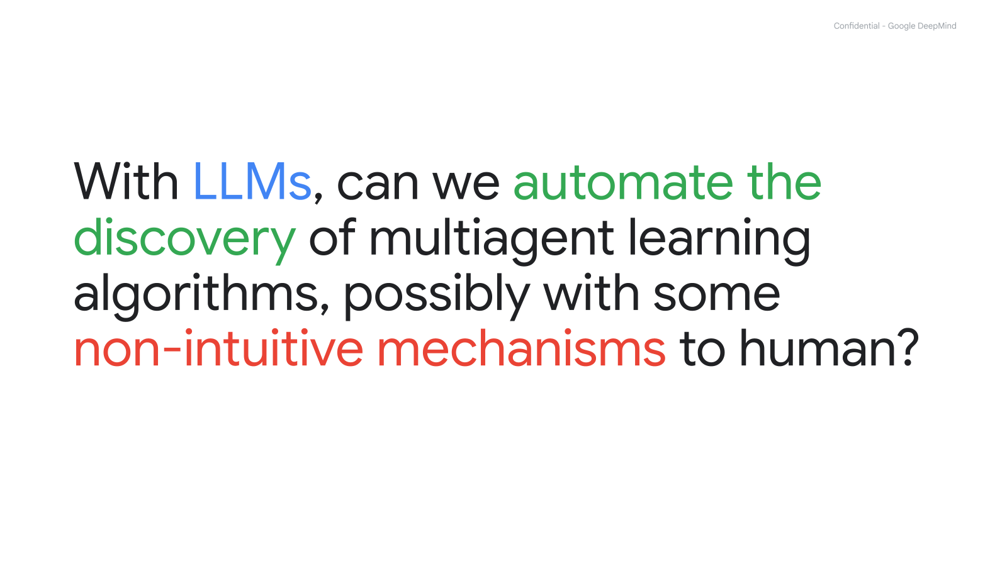

Slide 31
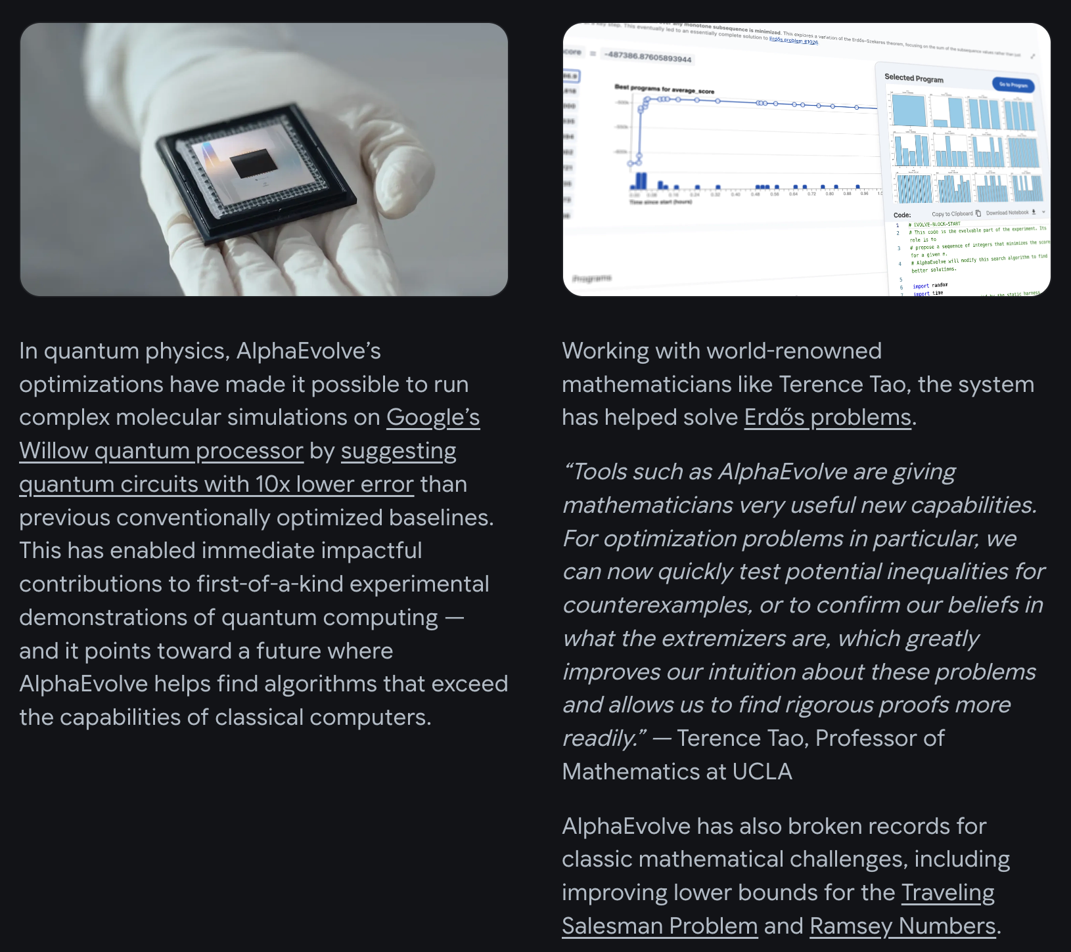

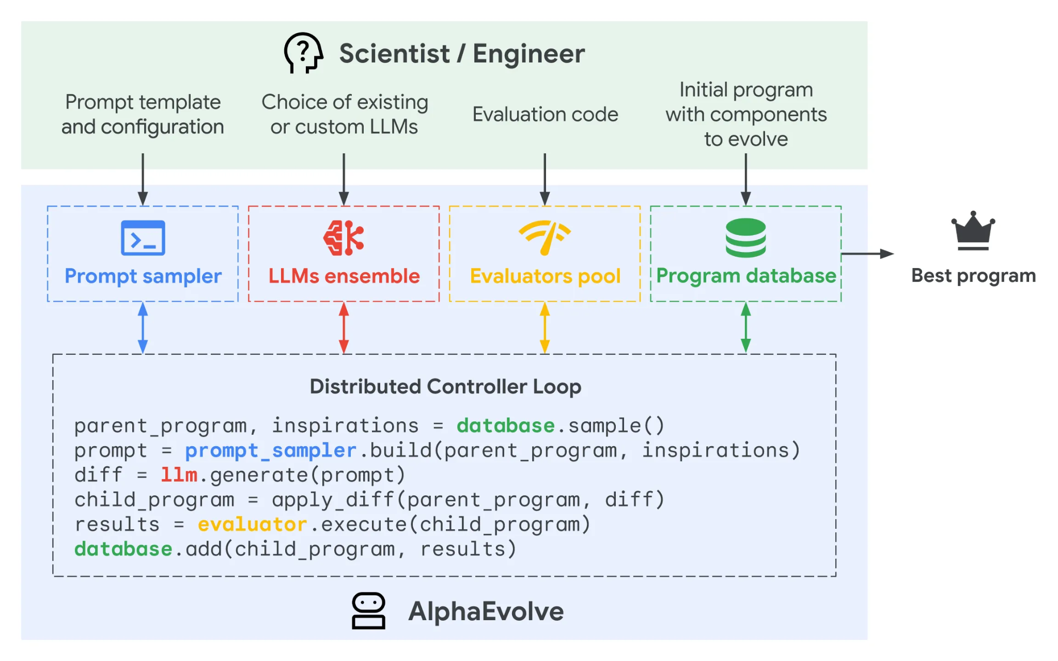
AlphaEvolve (https://deepmind.google/blog/alphaevolve-impact/)

Slide 32
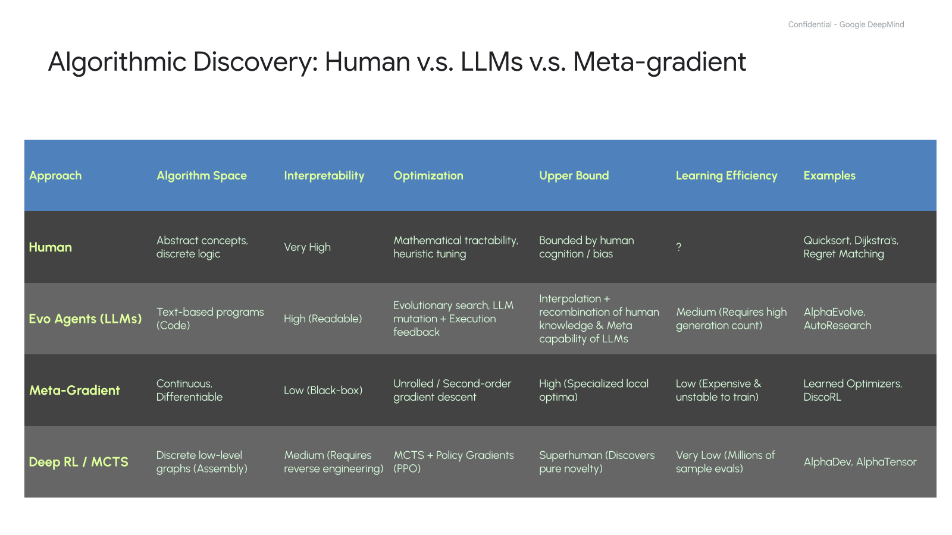

Slide 33
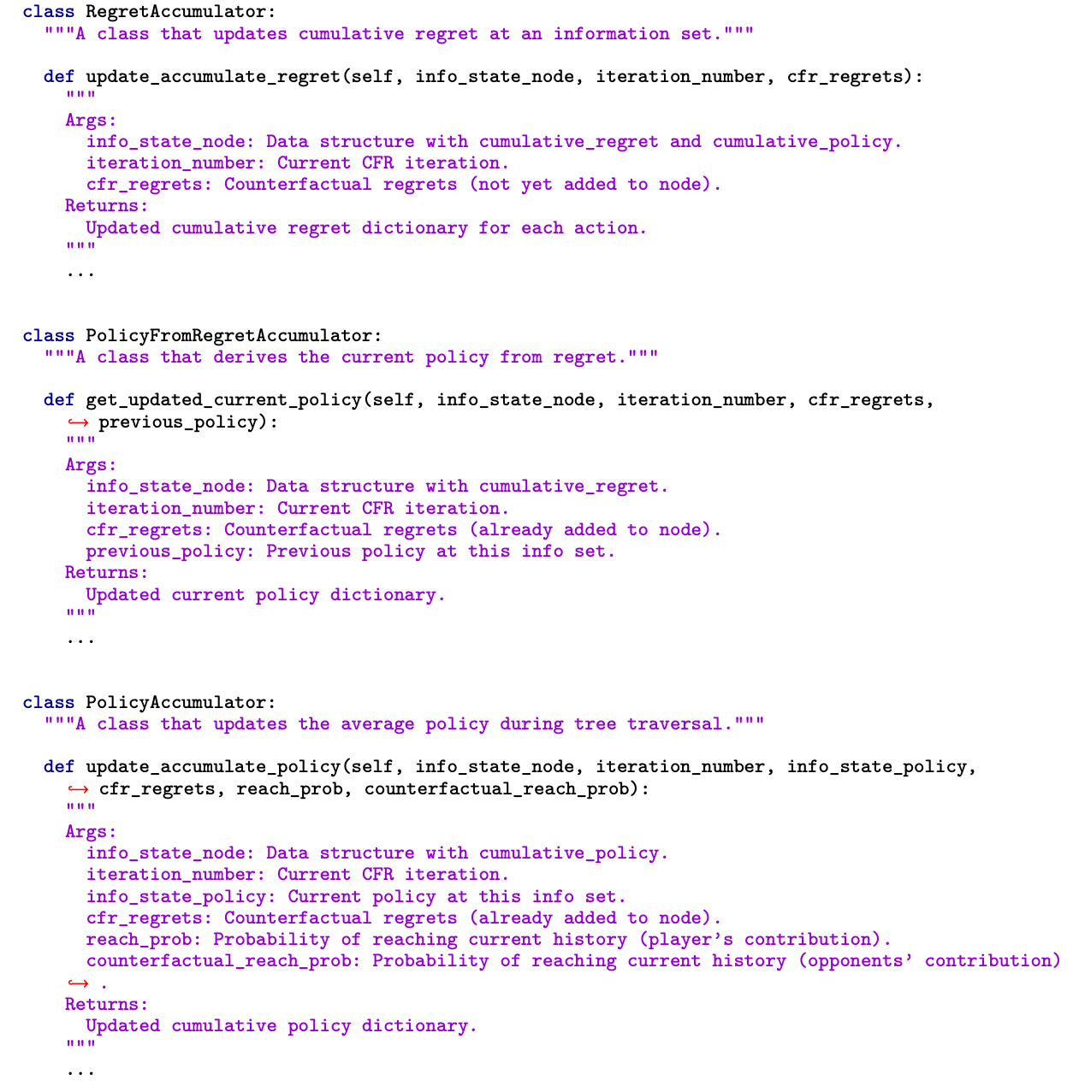
Automating Multi-Agent Learning via LLMs: Counterfactual Regret Minimization
Exposing core mechanisms to the coding agent
Using negative exploitability on training games as fitness metrics to guide evolutionary search

Slide 34
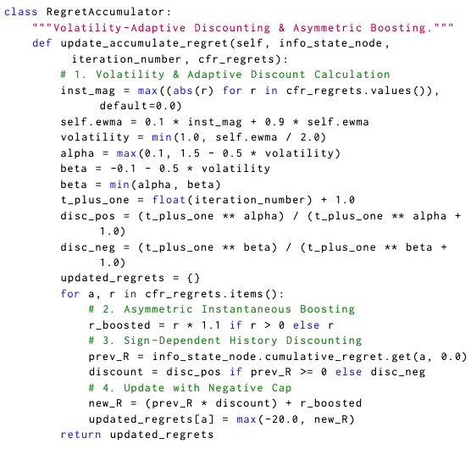
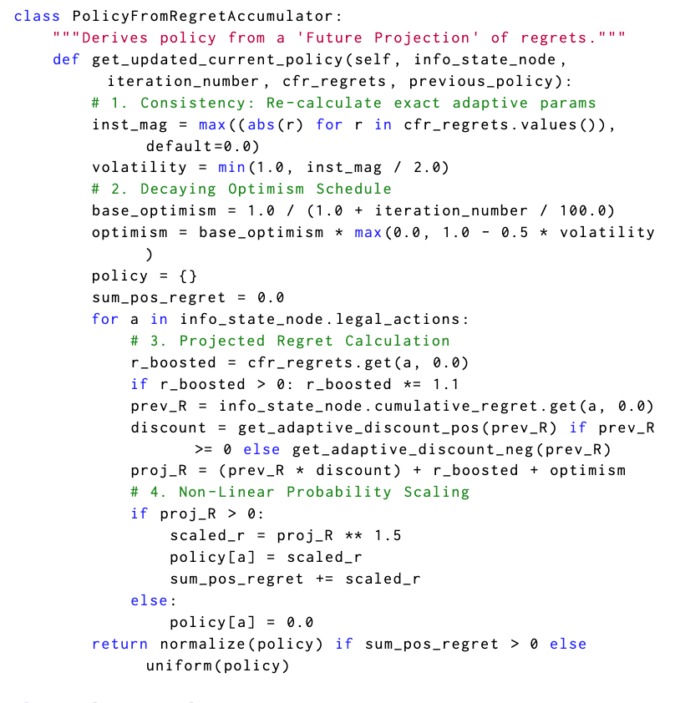
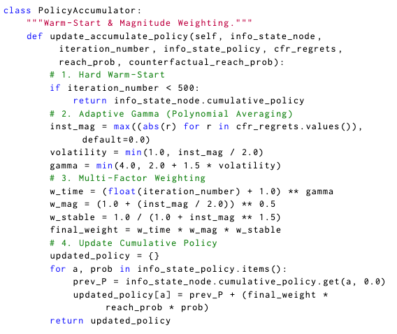
Raw Discovery: Volatility-Adaptive Discounted (VAD-) CFR

Slide 35
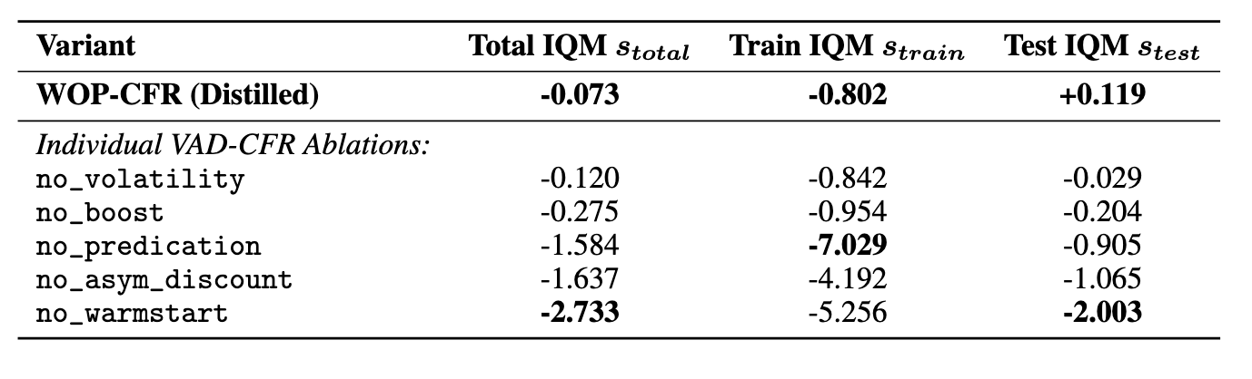
But… does every line of code matter?
Ablation metric: log-improvement score: log(Exploitability(VAD-CFR))-log(Exploitability(Variant))
Using interquartile mean (IQM) to aggregate over training games / test games

Slide 36
Distillation: Warm-Started Optimistic Predictive (WOP-) CFR
From 100+ lines of raw LLM code (VAD-CFR) to 3 clean mathematical modifications of the classic CFR modules:
MODULE 1 · Extreme Discounting
Rewrote RegretAccumulator
Rᵢᵗ(I,a) = d(t) · Rᵢᵗ⁻¹(I,a) + rᵢᵗ(I,a)
If R ≥ 0: d₊(t) = t¹·⁵ / (t¹·⁵ + 1)
If R < 0: d₋(t) = t⁻⁰·¹ / (t⁻⁰·¹ + 1)
• Human DCFR discounts negative
regrets mildy (t⁰·⁵ → 1 as t → ∞)
• LLM discovered extreme decay
(t⁻⁰·¹ ≈ 0.33): rapidly forgets bad
actions while locking in winners

Slide 37
Distillation: Warm-Started Optimistic Predictive (WOP-) CFR
From 100+ lines of raw LLM code (VAD-CFR) to 3 clean mathematical modifications of the classic CFR modules:
MODULE 1 · Extreme Discounting
MODULE 2 · Nonlinear Optimism
Rewrote RegretAccumulator
Rewrote PolicyFromRegret
Rᵢᵗ(I,a) = d(t) · Rᵢᵗ⁻¹(I,a) + rᵢᵗ(I,a)
σᵢᵗ⁺¹(I,a) ∝ max( 0 , R̃ᵢᵗ(I,a) )¹·⁵
If R ≥ 0: d₊(t) = t¹·⁵ / (t¹·⁵ + 1)
where Decaying Optimism is:
R̃ᵢᵗ = d(t)·Rᵢᵗ + [ 1 / (1 + t/100) ] · rᵢᵗ
If R < 0: d₋(t) = t⁻⁰·¹ / (t⁻⁰·¹ + 1)
➔
• Human DCFR discounts negative
regrets mildy (t⁰·⁵ → 1 as t → ∞)
• LLM discovered extreme decay
(t⁻⁰·¹ ≈ 0.33): rapidly forgets bad
actions while locking in winners
• Anneals optimistic lookahead
weight 1/(1 + t/100) over time
• Raises positive regrets to power
1.5 (non-linear sharpening toward
high-regret best responses)

Slide 38
Distillation: Warm-Started Optimistic Predictive (WOP-) CFR
From 100+ lines of raw LLM code (VAD-CFR) to 3 clean mathematical modifications of the classic CFR modules:
MODULE 1 · Extreme Discounting
MODULE 2 · Nonlinear Optimism
MODULE 3 · Hard Warm-Start
Rewrote RegretAccumulator
Rewrote PolicyFromRegret
Rewrote PolicyAccumulator
Rᵢᵗ(I,a) = d(t) · Rᵢᵗ⁻¹(I,a) + rᵢᵗ(I,a)
σᵢᵗ⁺¹(I,a) ∝ max( 0 , R̃ᵢᵗ(I,a) )¹·⁵
if t < 500 : return (skip)
If R ≥ 0: d₊(t) = t¹·⁵ / (t¹·⁵ + 1)
where Decaying Optimism is:
R̃ᵢᵗ = d(t)·Rᵢᵗ + [ 1 / (1 + t/100) ] · rᵢᵗ
else (t ≥ 500) :
σ̄ᵢᵀ(I,a) ∝ Σ (t ≥ 500) t^γ · σᵢᵗ(I,a)
If R < 0: d₋(t) = t⁻⁰·¹ / (t⁻⁰·¹ + 1)
➔
➔
• Human DCFR discounts negative
regrets mildy (t⁰·⁵ → 1 as t → ∞)
• LLM discovered extreme decay
(t⁻⁰·¹ ≈ 0.33): rapidly forgets bad
actions while locking in winners
• Anneals optimistic lookahead
weight 1/(1 + t/100) over time
• Raises positive regrets to power
1.5 (non-linear sharpening toward
high-regret best responses)
• Completely discards the noisy
first 500 iterations of exploration!
★ Single largest ablation impact:
removing Hard Warm-Start drops
performance by -2.73 IQM
Why Distillation Matters: Stripping away LLM bloat into WOP-CFR improves out-of-distribution generalization (+0.119 Test IQM over VAD-CFR).

Slide 39
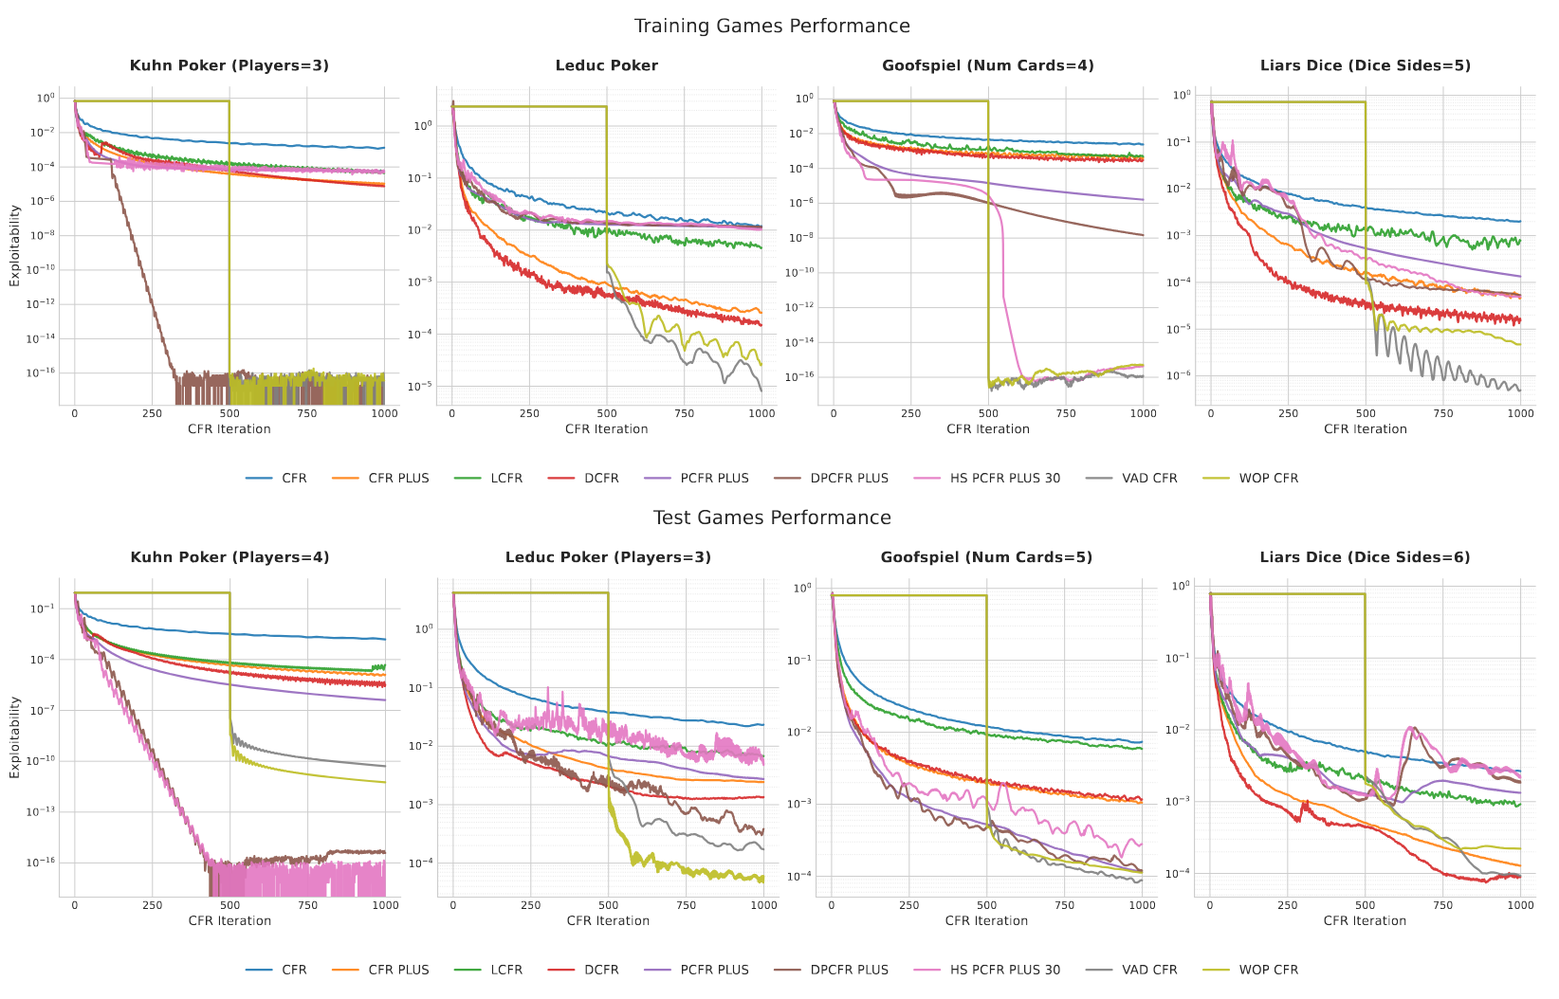
CFR Results
Consistently competitive with SToA; VAD-CFR and WOP-CFR achieves lowest exploitability in 15 and 14 of 18 games
The distilled WOP-CFR generalizes better: achieve +0.119 Log-Improvement IQM on 14 test games

Slide 40
Automating Multi-Agent Learning via LLMs: PSRO
Policy-Space Response Oracles (PSRO) iteratively expands a population of policies — generalized AlphaStar league training:
1 · Policy Pool & Payoff Matrix
2 · MetaStrategySolver [EVOLVED]
3 · Best-Response Oracle (RL)
Policy Sets: Πᵢ = { πᵢ¹, πᵢ², ..., πᵢᵏ }
σᵢ = MetaStrategySolver( M )
πᵢⁿᵉʷ = BestResponse( σ₋ᵢ )
Empirical Payoffs: Mᵢ(πᵢ, π₋ᵢ)
Probability distribution σᵢ ∈ Δ(Πᵢ)
Update pool: Πᵢ ← Πᵢ ∪ { πᵢⁿᵉʷ }
• Each player maintains a growing
population of diverse strategies Πᵢ
• Simulated head-to-head matches
evaluate payoff matrix M across
all policy pairs
➔
★ Target of LLM Evolution:
How should we weight existing
policies to guide exploration?
• Human baselines: Uniform,
Nash, AlphaRank, PRD, Regret
➔
• Computes a new policy πᵢⁿᵉʷ
that exploits opponent mix σ₋ᵢ
• Appends πᵢⁿᵉʷ to population Πᵢ
and repeats loop until Nash
convergence
Evolutionary Objective: AlphaEvolve mutates MetaStrategySolver using negative exploitability on training games as the fitness score.

Slide 41
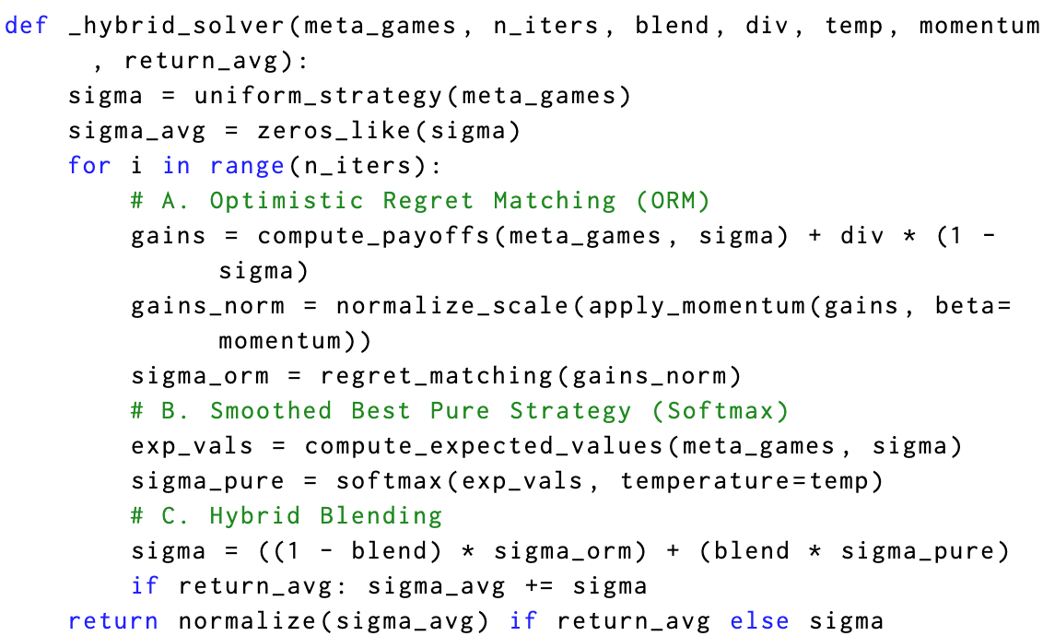
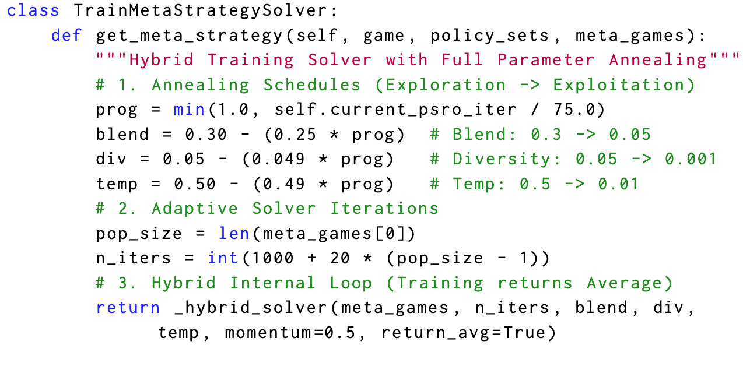
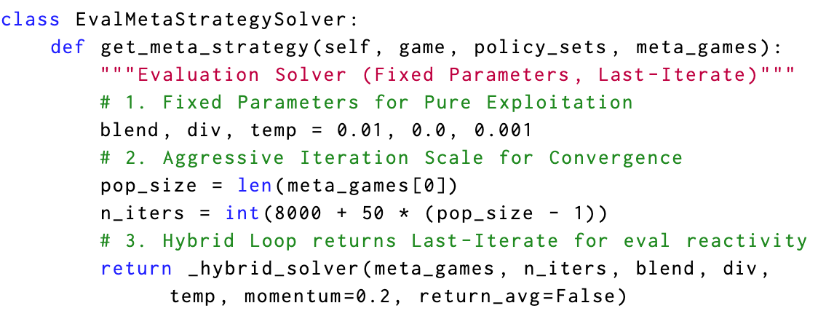
Raw Discovery: Smoothed-Hybrid Optimistic Regret (SHOR)-PSRO

Slide 42
Distillation: Projection Matching (PM)-PSRO
Ablating SHOR-PSRO's complex annealing schedules reveals a single, mathematically grounded projection mechanism:
1 · Core Mechanism: Simplex Projection Matching
Replace standard regret rᵢᵗ = uᵢᵗ − (uᵢᵗ · σᵢᵗ) 1 with:
gᵢᵗ = P_TΔ( uᵢᵗ ) = ( I − (1 / |Πᵢ|) 1 1ᵀ ) uᵢᵗ
Meta-Strategy Update: σᵢᵗ⁺¹ ∝ max( 0 , Σ gᵢᵗ )
• Why Standard Regret Struggles in PSRO:
Evaluating against current meta-strategy σᵢᵗ can
prematurely lock onto early suboptimal policies.
• Why Projection Matching Works:
Projects utility vector uᵢᵗ onto the tangent space of
the simplex — comparing every policy against the
uniform population mean (1/|Πᵢ|) Σ uᵢ(k)ᵗ !

Slide 43
Distillation: Projection Matching (PM)-PSRO
Ablating SHOR-PSRO's complex annealing schedules reveals a single, mathematically grounded projection mechanism:
1 · Core Mechanism: Simplex Projection Matching
2 · Theoretical Grounding: Evolutionary Game Theory
Replace standard regret rᵢᵗ = uᵢᵗ − (uᵢᵗ · σᵢᵗ) 1 with:
Continuous-time limit recovers Projection Dynamic:
gᵢᵗ = P_TΔ( uᵢᵗ ) = ( I − (1 / |Πᵢ|) 1 1ᵀ ) uᵢᵗ
ẋᵢ = Fᵢ(x) − (1 / n) Σ F_k(x)
Meta-Strategy Update: σᵢᵗ⁺¹ ∝ max( 0 , Σ gᵢᵗ )
[ Lahkar & Sandholm, Games and Economic Behavior 2008 ]
➔
• Why Standard Regret Struggles in PSRO:
Evaluating against current meta-strategy σᵢᵗ can
prematurely lock onto early suboptimal policies.
• Why Projection Matching Works:
Projects utility vector uᵢᵗ onto the tangent space of
the simplex — comparing every policy against the
uniform population mean (1/|Πᵢ|) Σ uᵢ(k)ᵗ !
• AI Rediscovered Game Theory:
Without being prompted with Lahkar & Sandholm (2008),
LLM evolution + human distillation converged to the
exact simplex projection dynamic!
• Empirical Superiority:
Achieves lowest exploitability in 12 of 18 games and
generalizes better to unseen test games (+0.059 IQM).
Key Insight: LLM evolution explores complex code heuristics (SHOR-PSRO); scientific distillation extracts new mathematical theory (PM-PSRO).

Slide 44
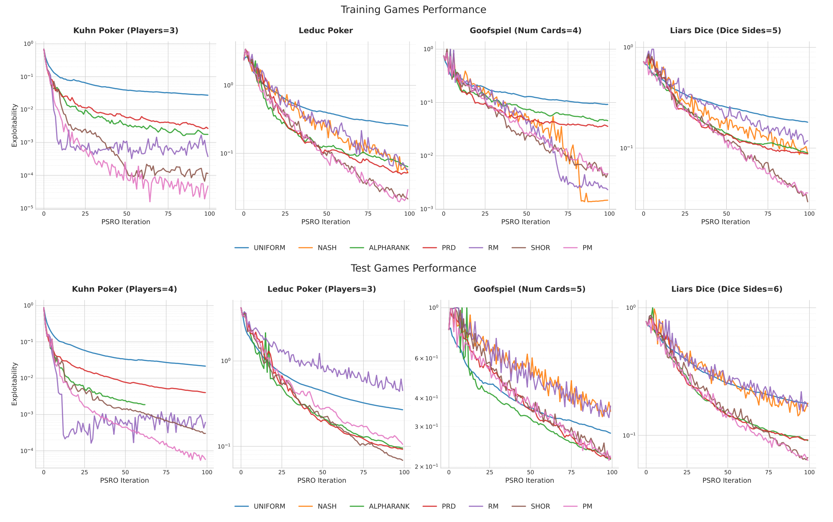
PSRO Results
Both SHOR-PSRO and PM-PSRO consistently competitive with SToA; Achieving lowest exploitability in 12 of 18 games
The distilled PM-PSRO generalizes better: achieve +0.059 Log-Improvement IQM on 14 test games

Slide 45
Conclusion: Multi-Agent Learning in the Era of Agentic Coding
Executable code bridges the gap between LLM reasoning and rigorous game-theoretic guarantees across all three levels:
PART I · Code as World Simulator
PART II · Code as Strategic Policy
PART III · Code as Algorithm Designer
Code World Models (ICLR '26)
Code-Space Oracles (AAMAS '26)
Discovering MARL Algos (arXiv '26)
• Synthesizes natural language rules
into fast, verifiable Python simulators
• Enables exact tree search (MCTS)
without LLM inference latency
• Eliminates hallucinated states in
complex strategic planning
• Replaces black-box Deep RL nets
with LLM-generated Python policies
in AlphaStar-style league training
• 100% human-auditable logic with
hard risk & compliance guardrails
• Outperforms Deep RL baselines
• Evolves new SToA equilibrium
solvers: VAD-CFR & SHOR-PSRO
• Scientific distillation uncovers
pure mathematical principles:
WOP-CFR & PM-PSRO
• Rediscovers & extends game theory
Core Takeaway: Raw LLM Evolution (Exploration) + Mathematical Distillation (Verification) = Auditable SToA Game Theory
• Why Code Space Wins for High-Stakes & Financial AI: Unlike neural weights, code policies & code algorithms can be inspected, ablated,
mathematically proven, and bounded by hard risk limits before deployment.
• Future Directions: Scaling agentic code discovery to deep reinforcement learning and cooperative general-sum multi-agent markets.

