Slide 1
Thematic Sentiment from Bloomberg News Topic Codes
8th Annual Machine Learning in Finance Workshop
September 23, 2022
Ivailo Dimov
Quant Researcher & Data Scientist
Quantitative Research Team, Bloomberg’s CTO Office

Slide 2
Introduction

Slide 3
A News Story
From the EDF Story-level News Analytics File:
Tagged with a Ticker that identifies a security as being a subject of the story
Classified into positive (+1) , neutral(0), and negative (-1) Sentiment categories
Sentiment confidence (0-100) is also generated indicating confidence of the classification
Tagged with a collection of Topic Codes

Slide 4
What is Bloomberg’s Story-level News Sentiment?
Supervised machine learning engine trained to “reliably reproduce a human’s emotional reaction to textual information” that is used to generate sentiment scores
Human annotators have classified stories in the training set as having positive, negative, or neutral sentiment with regards to a given security, if a long-only trader would buy, sell, or hold the security after reading it
Bloomberg Daily Aggregate (DAGG) Sentiment
A 24-hour confidence-weighted average of story-level sentiment of all stories associated with a given ticker
Published 10 minutes before the market opens
Available to Bloomberg clients for both News and Twitter
See [Cui & Etal 2016] for more details

Slide 5
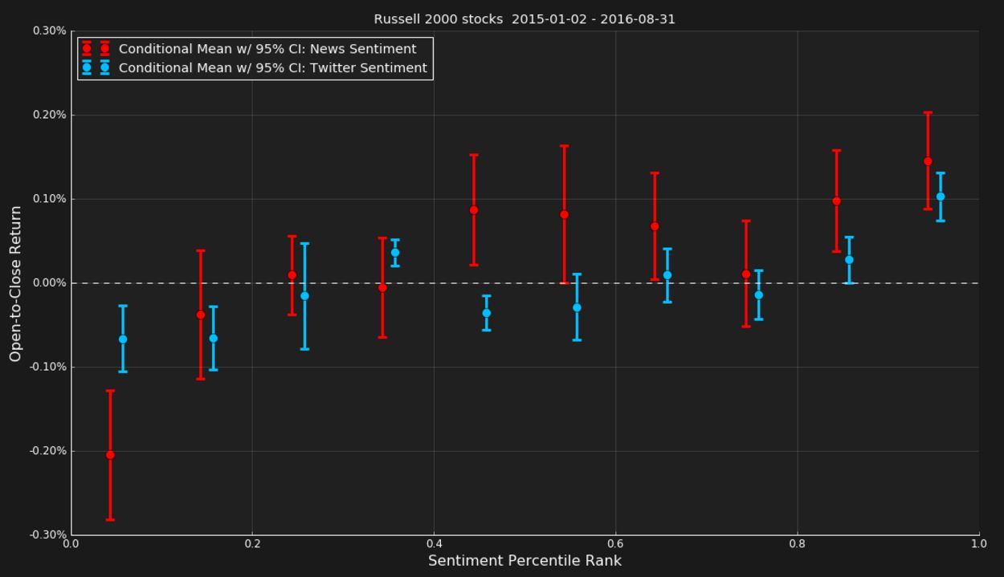
Conditioning on Sentiment as an Alpha Signal
Stocks with high / low Bloomberg DAGG Sentiment pre-market open tend to produce significant positive / negative open-to-close returns
Both Twitter and News sentiment
Signal is especially pronounced for small cap stocks

Slide 6
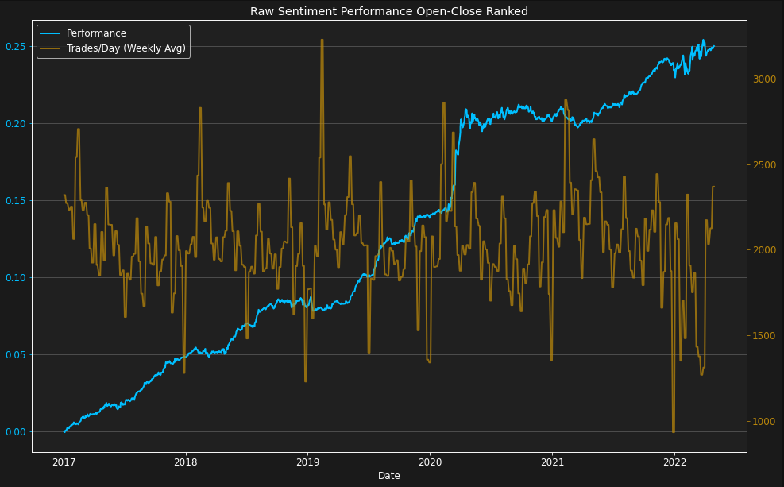
Conditioning on Sentiment as an Alpha Signal
Stocks with high / low Bloomberg DAGG Sentiment pre-market open tend to produce significant positive / negative open-to-close returns
Signal is especially pronounced for small cap stocks
But, for the Russell 2000, this is a very high turnover strategy!

Slide 7
News Themes from Topic Codes

Slide 8
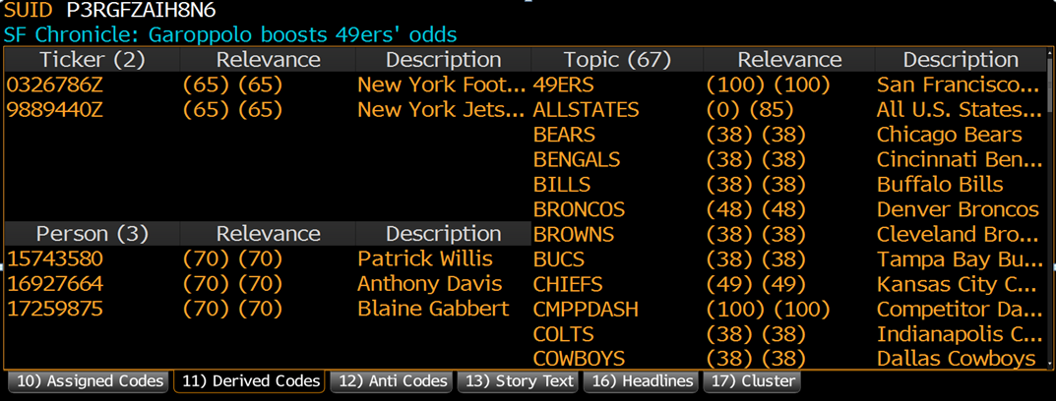
What About Topic Codes?
There are thousands of topic codes
This story is tagged with 67 of them
Conditioning on topics might be a good way to reduce turnover on any sentiment strategy
Topic codes also naturally provide thematic classification of news flow

Slide 9
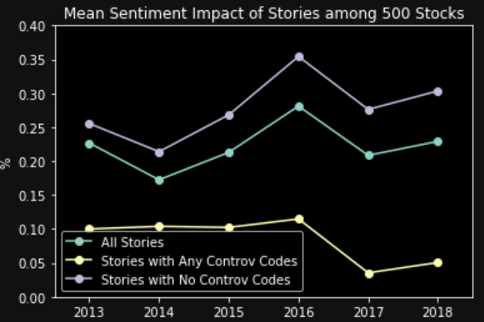
Topic Codes And Sentiment Impact
Sentiment Impact: the contemporaneous covariance between stock returns and sentiment
Stories carrying certain “controversial” topic codes* pertaining to legal and environmental, social, and governance disputes are less impactful than those not carrying them
What about other clusters??
See [Lam 2018]
* e.g., ESGCONTROV, LAW, ESGRES, LITIGATE, LAWPRAC, LAWSUITS, IP, PATENT, CLASS, CALVPOSS

Slide 10
How Do We Cluster Topic Codes by Co-Occurrence?
Latent Semantic Analysis / PCA on the doc-term matrix
Step 1: Map each story to a M-dimensional vector (TF-IDF transformation used
Step 2: Do PCA / truncated SVD on the column-demeaned doc-term matrix

Slide 11
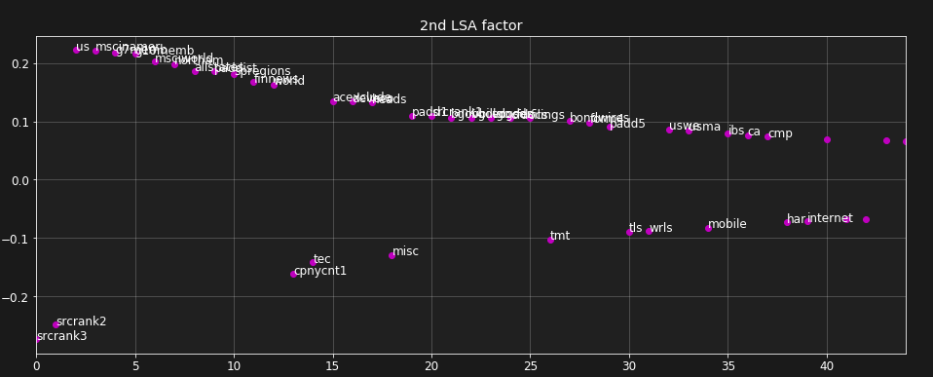
Failure of PCA/LSA: Picks Up Lots of Noise
A typical PCA factor involves a mish-mash of topic categories
Topic codes sorted by absolute weight in the factor
Normally, each factor composition would represent the topic code content of a “typical” story representing the factor. However, too many codes in each PCA factor:
Makes it hard to interpret each factor
Can’t easily decide which of these topic codes are significant and which are not

Slide 12
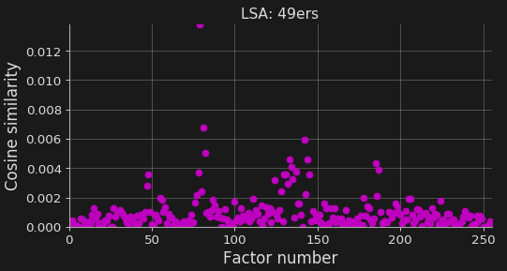
Failure of PCA/LSA: Hard To Explain Even a Single Topic Code
Ex.: A 2019 story tagged with just 49ERS code is explained by 30 PCA factors!

Slide 13
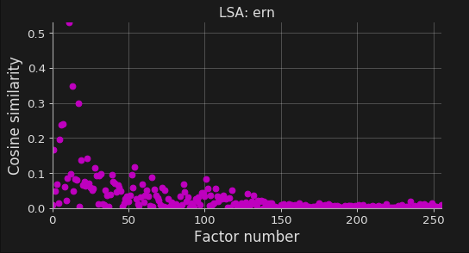
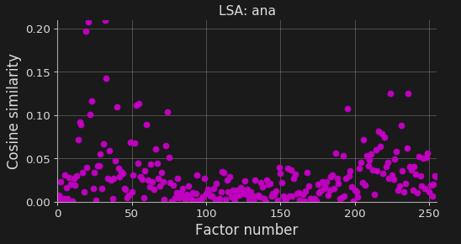
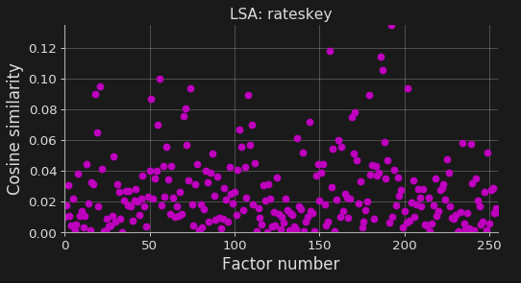
… No Matter Which Topic Code You Pick
Earnings’ news
Analyst news
Key Rates news

Slide 14
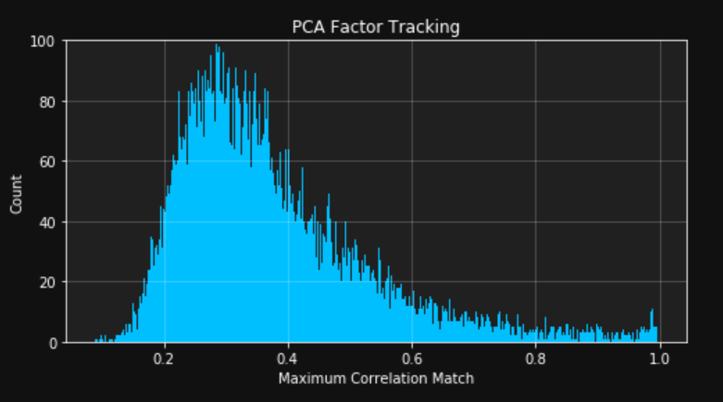
Failure of PCA/LSA: Lack of Stability to Roll-Retraining
For a randomly chosen factor, how strong is the correlation to next month’s tracked factor?
Experiment
Train the model on 12 months of 50K/month randomly chosen stories
Roll-retrain the model by dropping the first month of data and adding a month of new data
For randomly chosen factor in the initial training, find the maximal overlap with factors of the roll-retrained model
PCA Factors are less than 40% stable from one retraining period to the next!

Slide 15
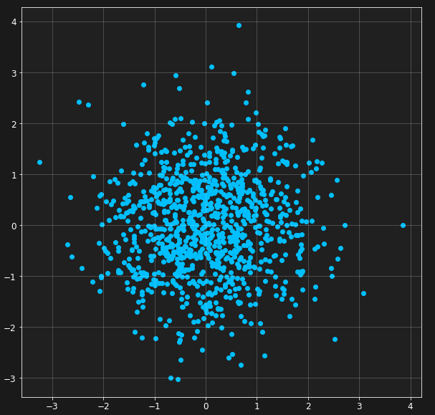
This is a Known Problem of PCA
PCA fails if data looks like this

Slide 16
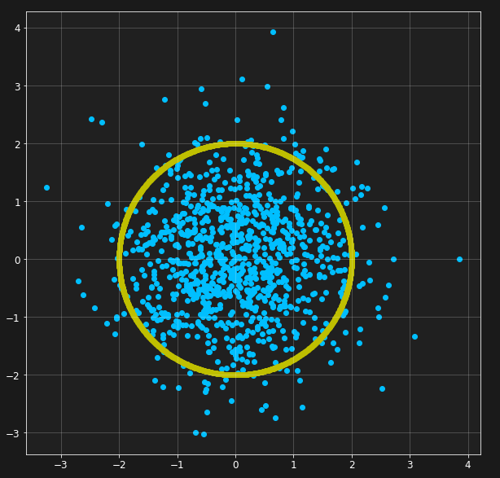
This is a Known Problem of PCA
PCA fails if data looks like this
Because it tries to fit data to an ellipse

Slide 17
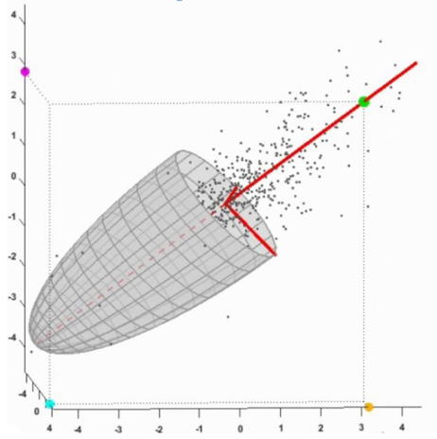
This is a Known Problem of PCA
PCA fails if data looks like this
Because it tries to fit data to an ellipse
Whose principal axes are the principal components
Image from http://bit.ly/2tK4zGJ
And the answer is not unique

Slide 18
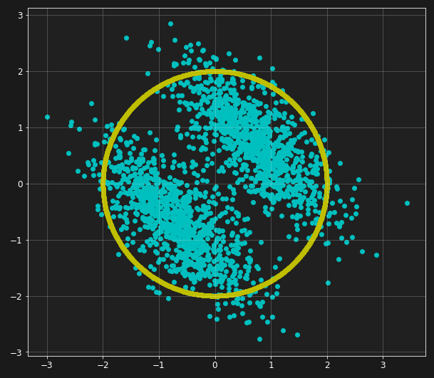
But, if Data is Non-Gaussian, There is Hope
PCA still won’t produce a unique answer
But some directions are more special than others
Amounts to finding the optimal directions in which the signal looks most localized / independent

Slide 19
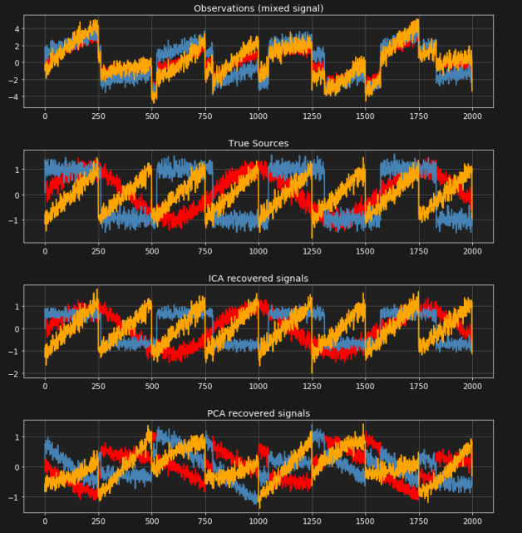
But, if Data is Non-Gaussian, There is Hope
PCA still won’t produce a unique answer
But some directions are more special than others
Amounts to finding the optimal directions in which the signal looks most localized / independent
In essence, this is the Independent Component Analysis (ICA) method

Slide 20
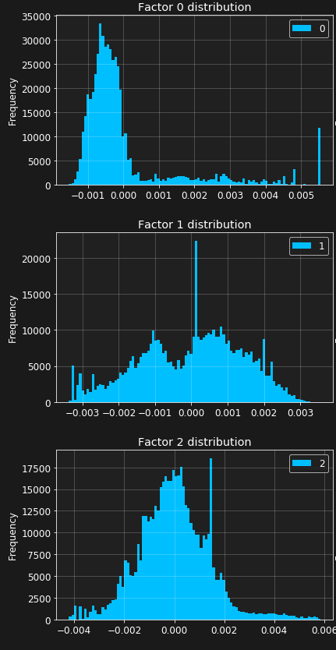
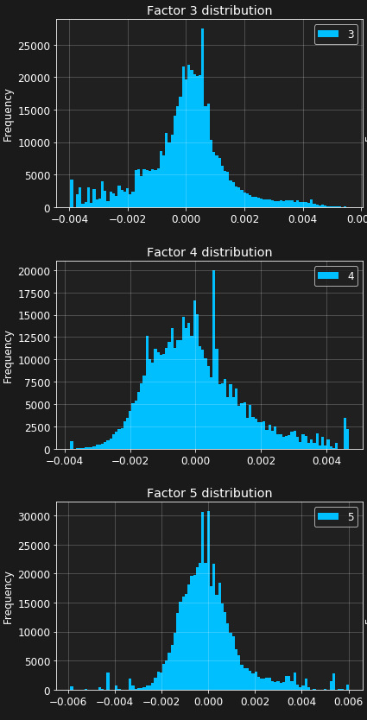
A Fun Fact About Term-Document Data
Term-doc PCA factors are usually very non-Gaussian!
Why don’t we find the “special” directions?
Essentially, we are finding the most independent / parsimonious linear factors that fit the data

Slide 21
Principally-Independent Component Analysis, or p-ICA
Amounts to rotating the top-few PCA/SVD factors in the most non-Gaussian direction
… more on the math in the appendix. See also [Dimov 2018]

Slide 22
p-ICA Produces Encouraging Results
A 49ers story is closest to just one statistical factor

Slide 23
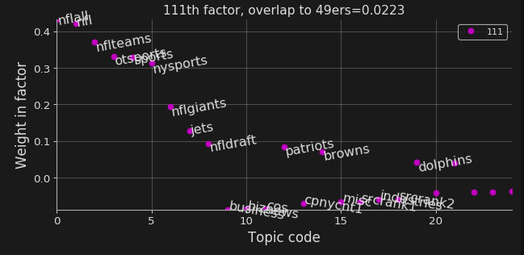
The 49ers Factor is an NFL Sports vs. Corp/Biz News Factor
Note, the 49ers topic code is not even in the top-20 codes of this NFL factor!
Yet, the NFL factor is correctly identified as the main explanatory factor of a story tagged with 49ers

Slide 24
Similarly, For Other Topics…
Earnings news
Analyst news
Key Rates news

Slide 25
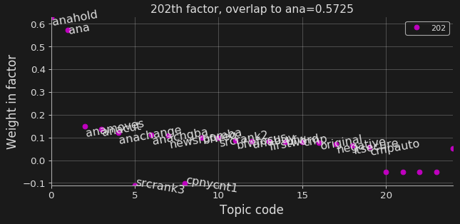
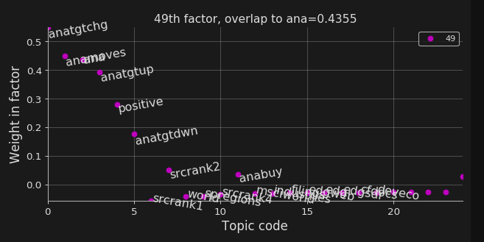
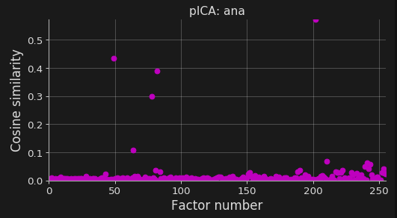
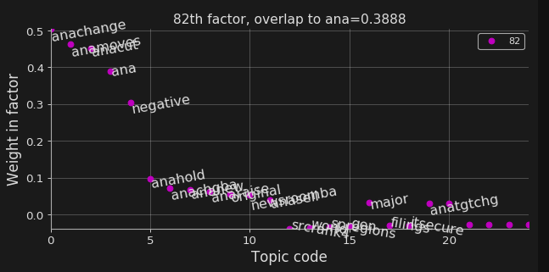
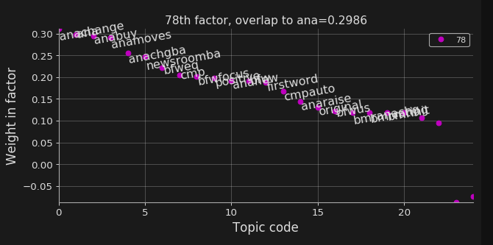
These Were the Top p-ICA ANA Factors from 2019
Analyst hold news
Analyst target change news
Factor’s proximity to ANA topic code
Analyst rating change news
Bloomberg automated / First Word analyst change news

Slide 26
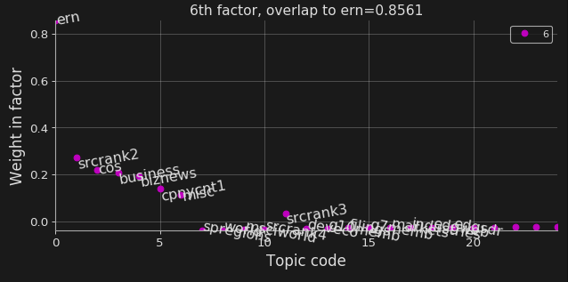
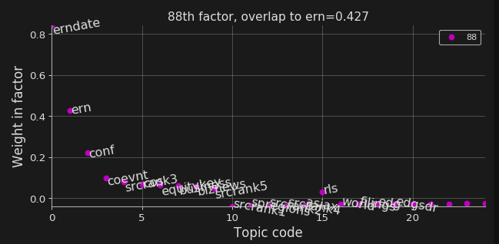
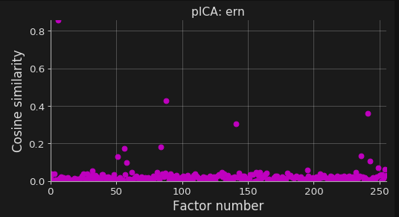
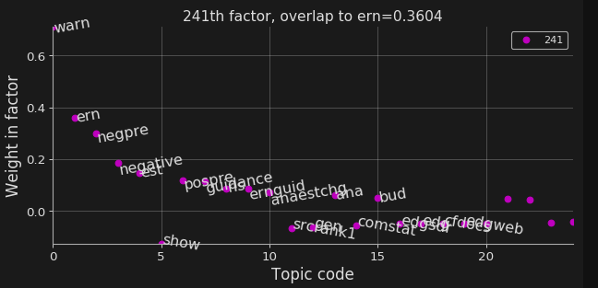
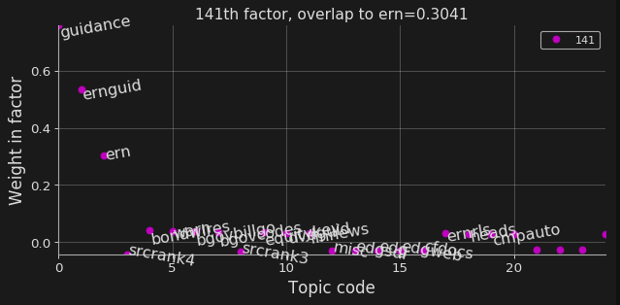
These Were the Top p-ICA ERN Factors from 2019
Generic earnings news
News around earnings announcements
Factor’s proximity to ANA topic code
Negative earnings guidance news
General earnings guidance news

Slide 27
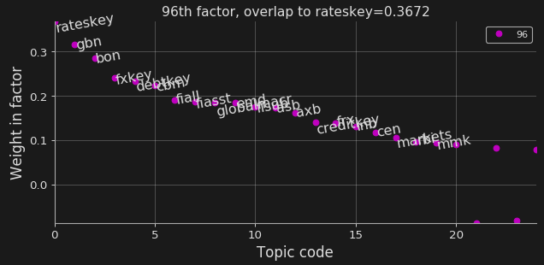
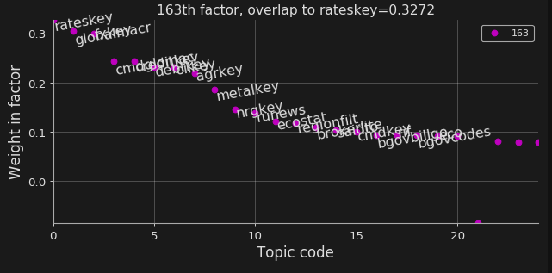
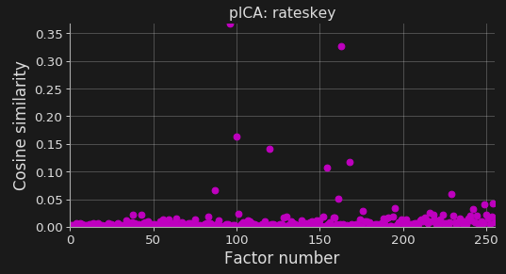
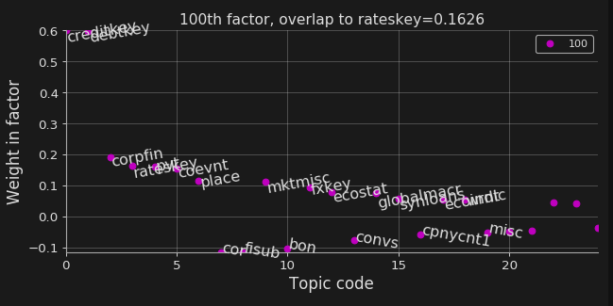
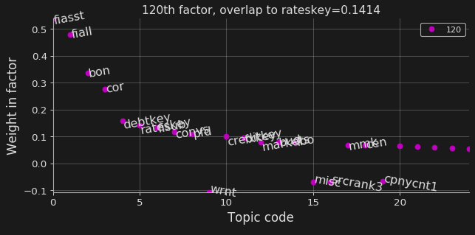
These Were the Top p-ICA RATESKEY Factors from 2019
Government bonds / fx news
Commodities / rates news
Factor’s proximity to RATESKEY topic code
Credit news
Other fixed income / corp bond news

Slide 28
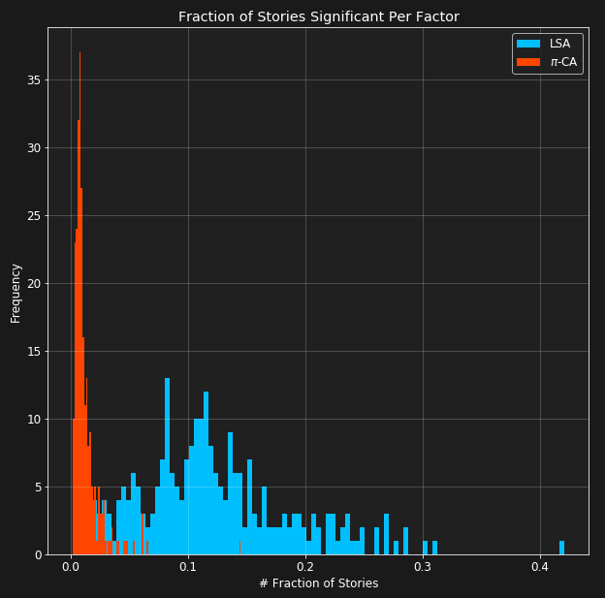
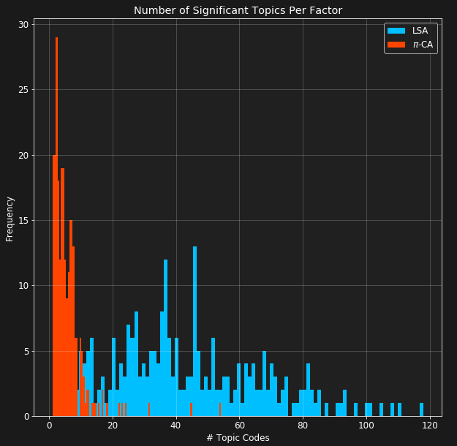
P-ICA Factors are Sparse…
An Order of Magnitude Sparser than PCA / LSA Factors
Pick any measure of significance
Each p-ICA factor:
Significant for a very small fraction of all stories
Contains very few significant topic codes
We see an order of magnitude improvement on factor sparsity!
Average factor participation:
LSA: 12% of all stories
𝞹-CA: 1.2% of all stories
Average # topic codes / factor:
LSA: 44 topic codes
𝞹-CA: 6 topic codes

Slide 29
Backtesting p-ICA News Themes (Ang & Dimov, 2020)

Slide 30
Trading on p-ICA Factors
“I want to trade the Bloomberg First Word sentiment factor”
COMPUTE stock sentiment score of stocks using ‘BFW news’
TRAIN the p-ICA model on the first of every month using 1 year of data
COMPUTE factor loadings of each story using topic codes
CONSTRUCT stock portfolio using sentiment score
Before market open, COLLECT news stories from past 24 hours
FILTER stories. Use only stories with a high loading on the BFW factor

Slide 31
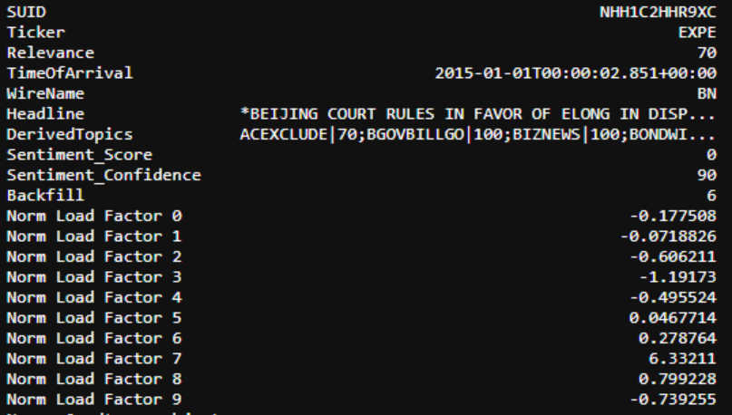
Backtesting Preliminaries
Story Data:
p-ICA uses the tagged topic codes to produce factor loadings
From the factor loading, filter for stories with large loading on a factor, say Bloomberg First Word
Use the sentiment scores to create a factor sentiment for each ticker. Trade the sentiment score
$$\left(X−\overline{X}\right)=USV^{T}$$

Slide 32
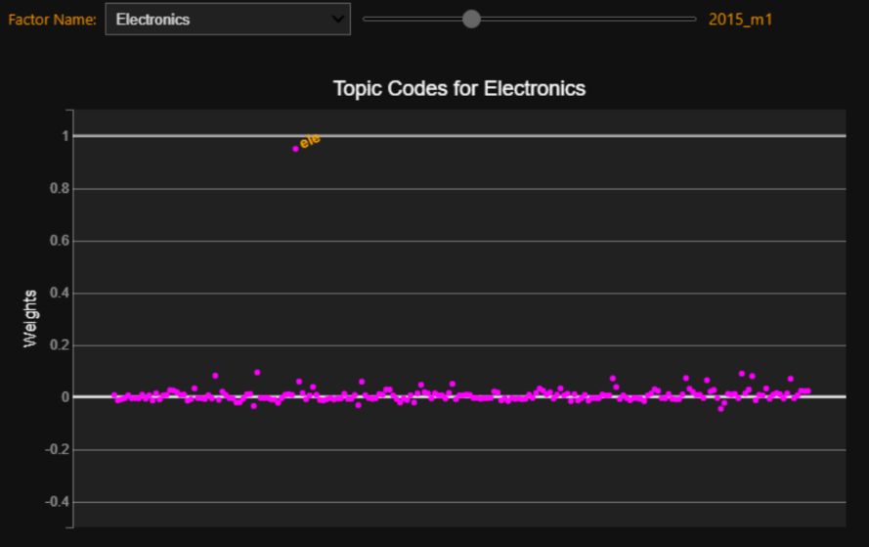
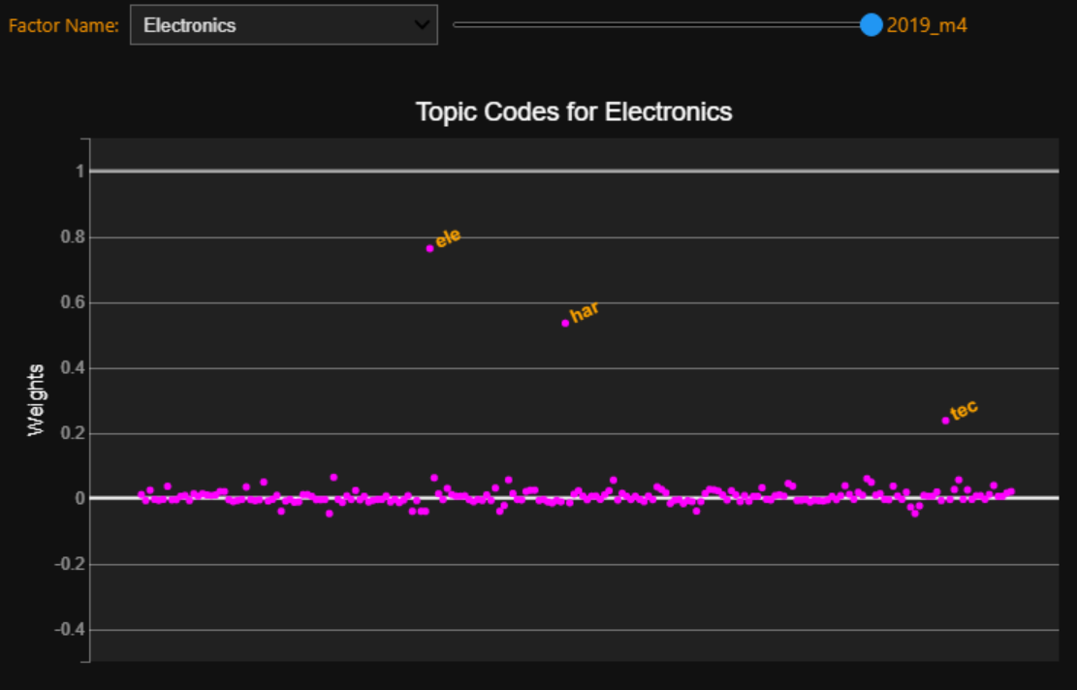
The Importance of a Dynamic Model
Goal: Identify profitable factors
Solution: Build a model starting from 2017 and track each factor’s performance
Not so fast! You need to retrain the model every month!
The news cycle is constantly evolving
For example: from 4,962 topic codes in Jan 2015 → 1,075 of these no longer exist after 4 years
Factor loadings also evolve over time

Slide 33
Rolling Model with Tracking
12 month training data
1 month deployment
Max Correlation Matching
2015_m1
2015_m2
…
…
…
2015_m2
2015_m4
2015_m1
2015_m3
Each month’s p-ICA factors are different (with a large overlap) to the following month’s. So, how do we track the ‘BFW’ factor across time?
Match it to the factor with the highest correlation

Slide 34
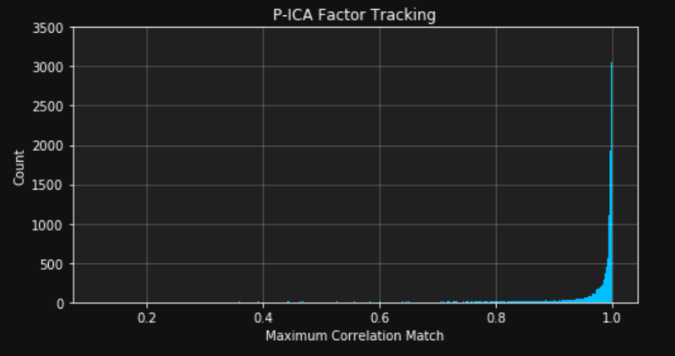
p-ICA Factors Are Extremely Stable
For a randomly chosen factor, how strong is the correlation to next month’s tracked factor?
Regular LSA PCA factors have poor matching
p-ICA factors have strong matching
91.77% of p-ICA matches have a matching correlation of >0.85
Only a small proportion (0.21%) of factors have multiple strong matches (>0.85)

Slide 35
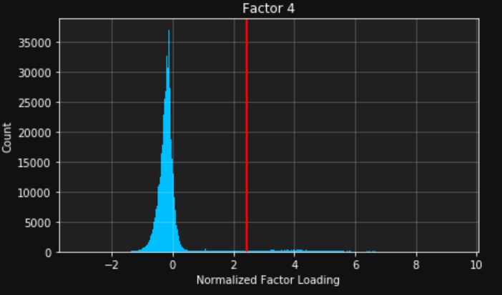
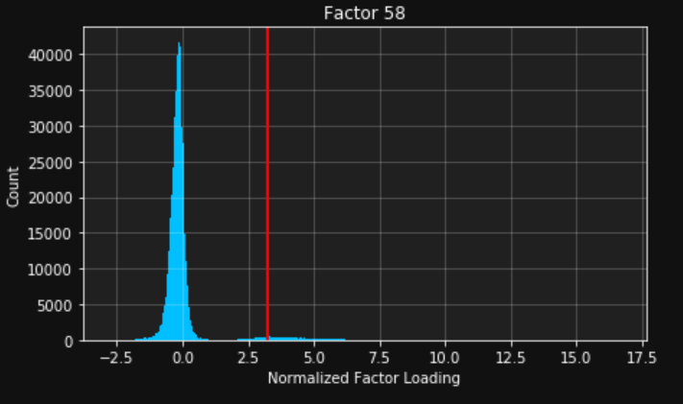
Compute Factor Loadings and Filter
Apply trained TF-IDF transformation to today’s stories to get TF-IDF matrix $X$
Compute normalized loadings by projection onto trained factors $V$. $\left(X−\overline{X}\right)=USV^{T}$ $U=\left(X−\overline{X}\right)V{\left(V^{T}V\right)}^{−1}S^{−1}$
Identify significant factor loadings by looking at outliers in the factor loading distribution. We find that a kurtosis / ICA-based significance measure works well and produces consistent results:
${n_{signif. = }\left(\sum_{j=1}^{N}{{e_{kj}}^{4}}\right)}^{−1}$
$\sum_{j=1}^{N}{e_{kj}=0}$
$\sum_{j=1}^{N}{{e_{kj}}^{2}=1}$

Slide 36
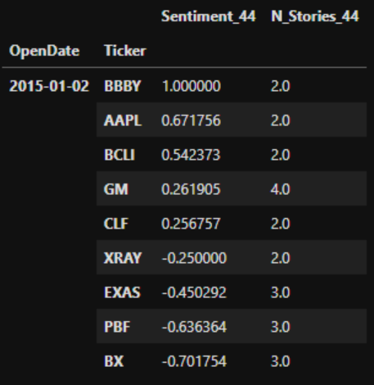
Compute Factor Sentiment and Trade
4. Compute each stock’s sentiment score using only factor-relevant news
5. Construct portfolio using BFW sentiment
Long top $1/3$ and short bottom $1/3$ equal weighted
Use demeaned and rescaled scores directly
…
$$Sentiment=\frac{\sum_{i=1}^{N}{{Score}_{i}×{Confidence}_{i}}}{\sum_{i=1}^{N}{{Confidence}_{i}}}$$
$= 0.2037$

Slide 37
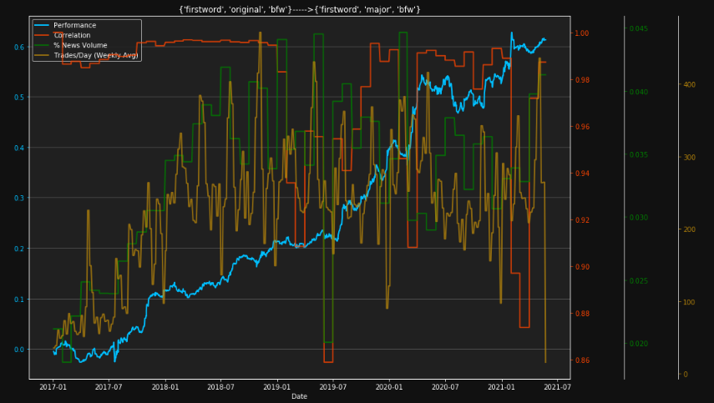
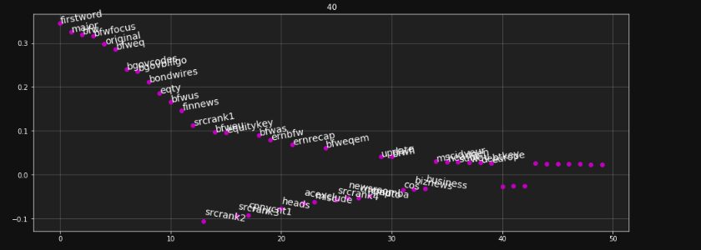
Different Market Reaction to Depending on Sentiment Theme
Some Sentiment Themes Exhibited Underreaction
Example: Bloomberg First Word news theme HML 1/3 strategy [Ang & Dimov, 2022]

Slide 38
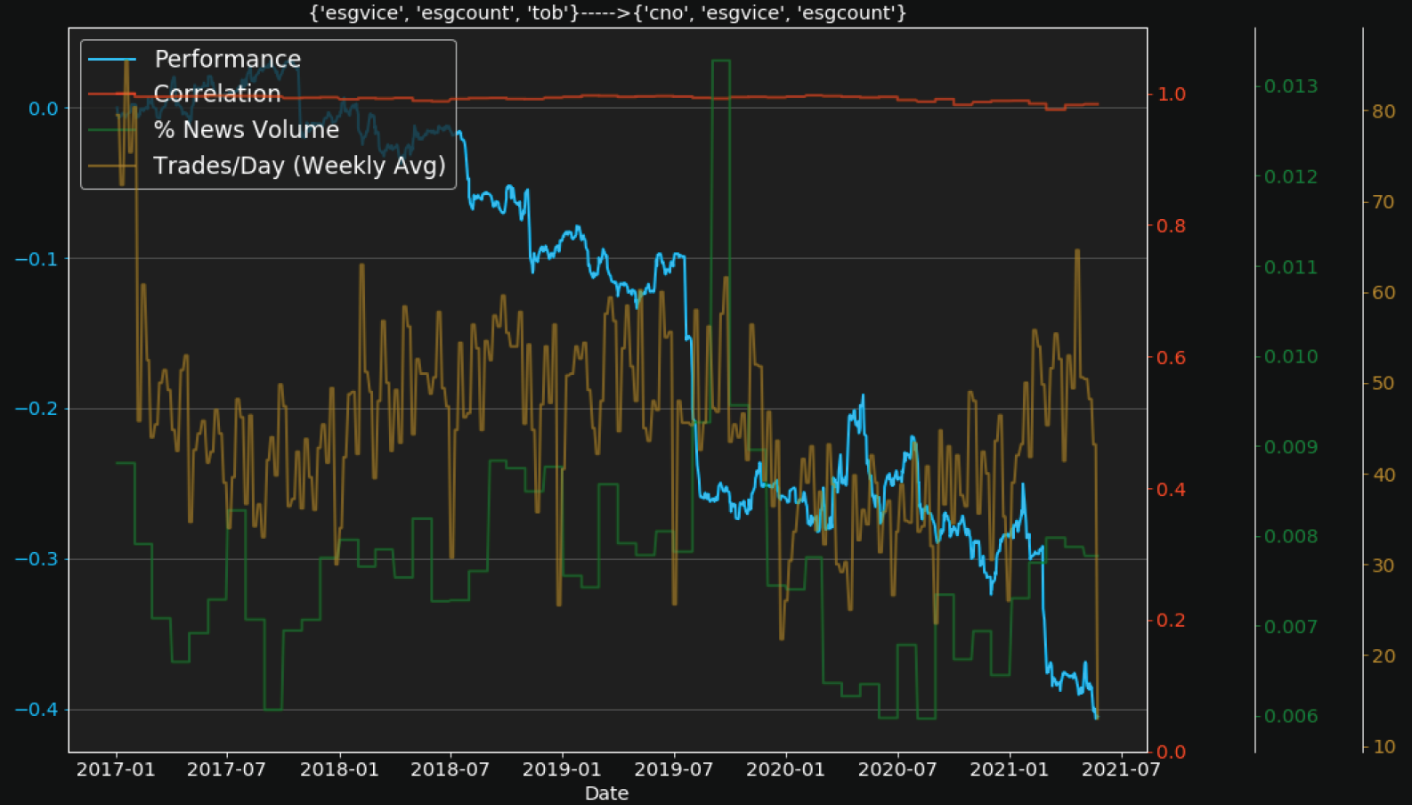
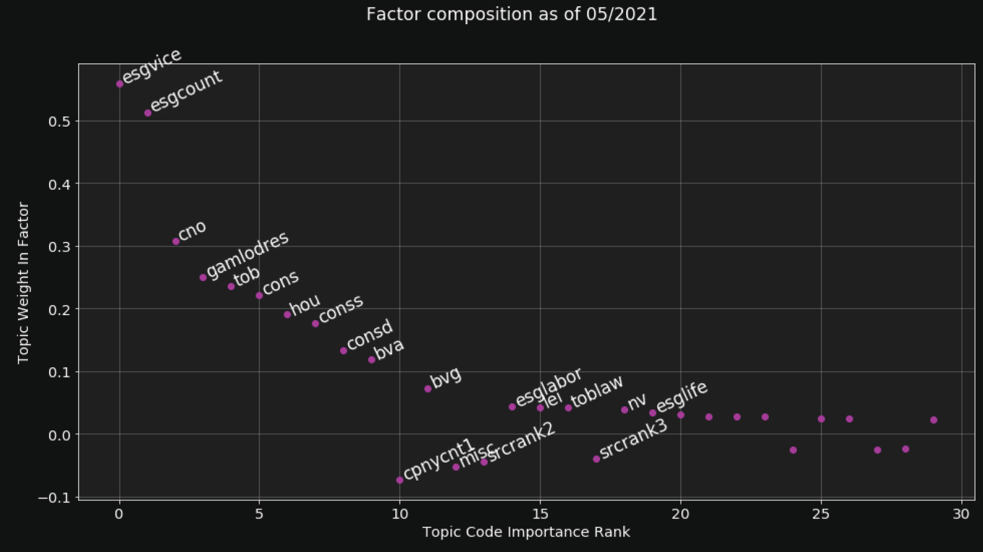
Different Market Reaction to Depending on Sentiment Theme
Other Sentiment Themes Exhibited Overreaction
Example: ESG Vice / Tobacco news theme HML 1/3 strategy [Dimov & Soni, 2022]

Slide 39
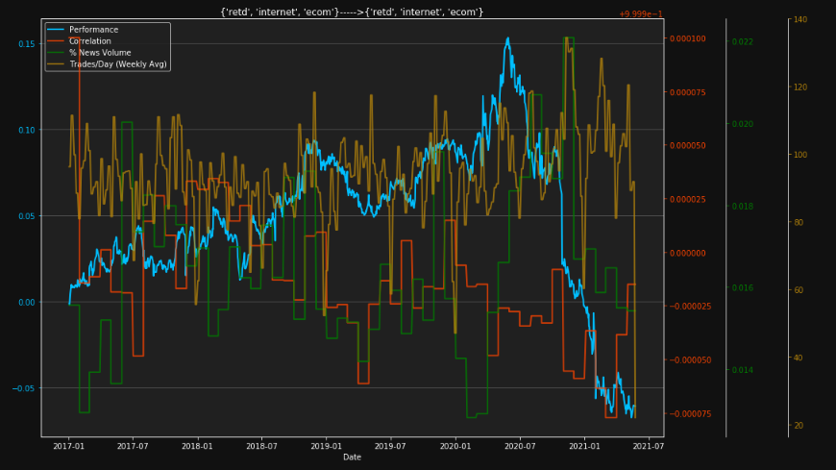
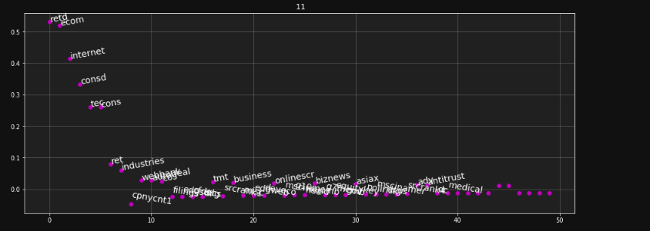
Different Market Reaction to Depending on Sentiment Theme
Some Sentiment Themes Exhibited Regime Shifts
Example: Retail / Discretionary HML 1/3 strategy [Dimov & Soni, 2022]

Slide 40
p-ICA Inspired Factors
Conditioning on Factor Loadings is Not as Intuitive
What about conditioning on stories which contain any of a given set of topic codes obtained from the model trained on 2017 data? For example, a Bloomberg First Word theme would consist of stories containing any of the topic codes: BFW, FIRSTWORD, MAJOR, ORIGINAL, BFWEQ, or BFWFOCUS Similarly, one could extract Credit, Loans, Analyst Ratings, Analyst Target Change, Headlines, etc., themes

Slide 41
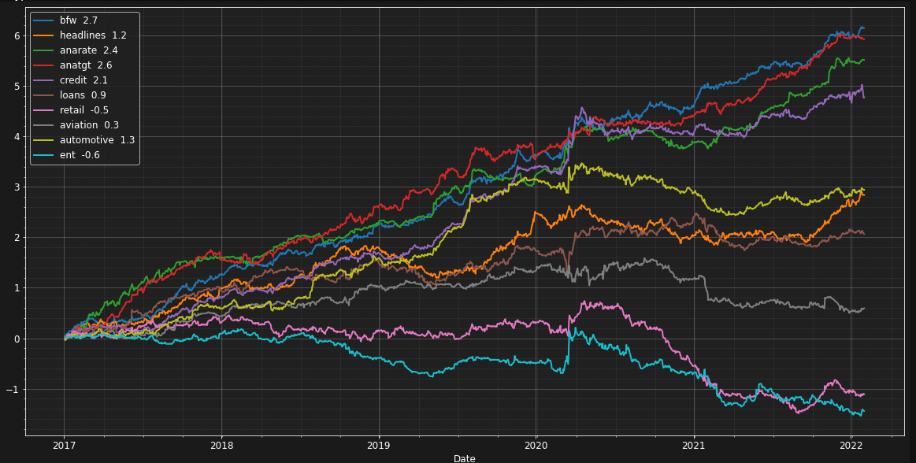
p-ICA Inspired Factors Also Found to Exhibit Over/Underreaction and Regime Shifts

Slide 42
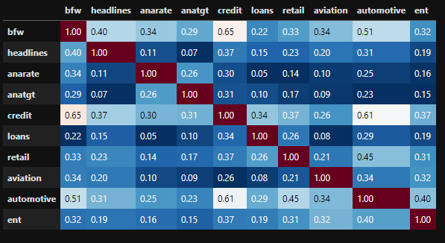
The Factor P&Ls are Diversified
Likely Due to Factor Co-occurrence Minimization via ICA

Slide 43
As a Result, Meta Factor Strategies Can Be Even Better
Top and Second Metafactor P&Ls

Slide 44
Links to Optimization

Slide 45
Modelling as a Single Optimization
A loss function perspective
$X=USV^{T}+E$, $V^{T}V=U^{T}U$ =$I_{K}, tr\left(U^{T}E\right)=tr\left(EV^{T}\right)=0$
p-ICA algorithm [Dimov 2018]:
1. Truncated SVD: 2. Followed by an ICA step: 3. And an exact step to find $S_{I}, V_{I}$ $U,S,V=\underset{\begin{aligned}P, P^{T}P=I_{K} \\ Q, Q^{T}Q=I_{K} \\ R\end{aligned}}{argmin}{{|X−PRQ^{T}|}_{F}}$ $U_{I} =U{A_{I}}^{T}$, $A_{I}=\underset{A, A^{T}A=I_{K}}{argmax}{|kurt\left(U{A_{I}}^{T}\right)|}$
Steps 1-2 can be seen as the $λ→0$limit of the following optimization:
$U,S,V,A_{I}=\underset{\begin{aligned}P, Q, R,A \\ P^{T}P=Q^{T}Q=A^{T}A=I_{K}\end{aligned}}{argmin}{{|X−PRQ^{T}|}_{F}}−λ|kurt\left(P{A_{I}}^{T}\right)|$

Slide 46
Comparison to Other Methods
Can also be rewritten as:
$X=USV^{T}+E$, $V^{T}V=U^{T}U$ =$I_{K}, tr\left(U^{T}E\right)=tr\left(EV^{T}\right)=0$
$$U_{I},S_{I}V_{I}=\underset{\begin{aligned}P_{I},R_{I},Q_{I} \\ {P_{I}}^{T}P_{I}=diag({Q_{I}}^{T}Q_{I})=I_{K}\end{aligned}}{argmin}{{|X−P_{I}R_{I}{Q_{I}}^{T}|}_{F}}−λ|kurt\left(P_{I}\right)|$$
Interpretation: standard SVD quadratic optimization + neural net regularization with non-linear activation function
This is similar to, but somewhat different than, autoencoders. Instead of seeking the optimal non-linear PCA approximation, we are “twisting” the SVD to fit our data’s tails
However, note that this loss does not have a probabilistic interpretation because the regularizer term is negative
The orthogonality constraint on $P_{I}$prevents the kurtosis term from blowing up

Slide 47
For Further Details
[Cui & Etal 2016] “Embedded Value in Bloomberg News & Social Sentiment Data,” Xin Cui, Daniel Lam, Arun Verma. Bloomberg white paper, 2016.
[Cui & Huang 2017] “Long-term Performance of U.S. Equity Long/Short Strategy,” Xin Cui, Lei Huang. Bloomberg, 2017.
[Lam 2018] “Sentiment Impact on Stock Prices of News with Selected Topic Codes: Part One,” Daniel Lam. Bloomberg white paper, 2018.
[Dimov 2018] “Sentiment Impact on Stock Prices of News with Selected Topic Codes,” Ivailo Dimov. Bloomberg white paper, 2018.
[Ang & Dimov 2020] “Backtesting the p-ICA Topic Code Factor Model” Michael Ang, Ivailo Dimov. (unpublished)
[Dimov & Soni 2022] “Trading ESG news using topic codes factors,” Ivailo Dimov, Jaydeep Soni. Bloomberg white paper, 2018

Slide 48
Thank You!
https://www.bloomberg.com/careers
Contact me with questions:
Ivailo Dimov (idimov1@bloomberg.net)

